Slide 1
SURFACE MINE DEVELOPMENT
Younus Ahmed Khan, PhD
Professor, Dept. of Geology and Mining
University of Rajshahi

Slide 2
Surface Mine Development
The subject of surface mine development is large. This section
covers the fundamental concepts involved in both the open
pit mining of thick or steeply dipping deposits as well as the
strip mining of thin, shallow, and relatively flat-lying seams or
beds.
Design involves the marrying of geometries, ore and waste
characteristics, equipment, and economics so that the desired
result is achieved. Generally, there are many possible
combinations from which to choose. For example, extraction
over a short time period requires one strategy while quite
another is applied for longer times. Variations in supply and
demand require some flexibility of operation.

Slide 3
Open Pit Planning and Design
An open pit mine is an excavation or cut made at the surface of the
ground for the purpose of extracting ore and which is open to the
surface for the duration of the mine’s life.
To expose and mine the ore, it is generally necessary to excavate and
relocate large quantities of waste rock.
The main objective in any commercial mining operation is the
exploitation of the mineral deposit at the lowest possible cost with a
view of maximizing profits.
The selection of physical design parameters and the scheduling of the ore and waste extraction program are complex engineering decisions of enormous economic significance. The planning of an open pit mine is, therefore, basically an exercise in economics, constrained by certain geologic and mining engineering aspects.

Slide 4
Advantages of surface mining
It is generally conceded that surface mining is more advantageous than underground mining in terms of recovery, grade control, economy, flexibility of operation, safety, and the working environment. There are, however, many deposits that are too small, irregular, and/or deeply buried to be extracted economically by surface mining methods.

Slide 5
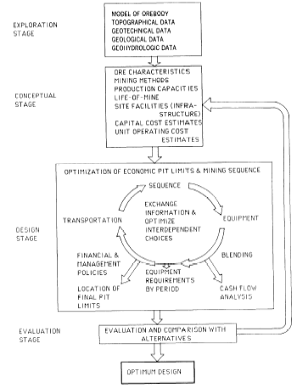
Design Process diagram
Open pit design is conducted in several stages. They consist, technically, of devising a scheme or set of alternative schemes, followed by an evaluation and selection of the optimum scheme, as illustrated in Fig.

Slide 6
Advantages of Surface Mine
It is generally conceded that surface mining is more advantageous than underground mining in terms of recovery, grade control, economy, flexibility of operation, safety, and the working environment. There are, however, many deposits that are too small, irregular, and/or deeply buried to be extracted economically by surface mining methods.

Slide 7
Open Pit Terminology
A bench may be defined as a ledge that forms a single level of operation above which mineral or waste materials are mined back to a bench face. The mineral or waste is removed in successive layers, each of which is a bench. Several benches may be in operation simultaneously in different parts of, and at different elevations in the open pit mine.
The bench height is the vertical distance between the highest point of the bench, or the bench crest, and the toe of the bench.

Slide 8
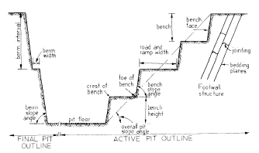
Section through an open pit mine

Slide 9
The bench slope is the angle, measured in degrees, between the horizontal and an imaginary line joining the bench toe and crest.
Pit limits are the vertical and lateral extent to which the open pit mining may be economically conducted. The cost of removing overburden or waste material vs. the minable value of the ore is usually the prime factor controlling the limits of the pit. Other factors that can influence pit limits are existing surface infrastructures, such as townships, rivers, etc.

Slide 10
A berm is a horizontal shelf or ledge within the ultimate pit wall slope. The berm interval, berm slope angle, and berm width are governed by the geotechnical configuration of the slope. In order to enhance the stability of a slope within the pit—and for safety reasons—berms may be left.
The overall pit slope angle is the angle at which the wall of an open pit stands, as measured between the horizontal and an imaginary line joining the top bench crest with the bottom bench toe.

Slide 11
For the duration of open pit mining, a haul road must be maintained into the pit.
A spiral system is an arrangement whereby the haul road is arranged spirally along the perimeter walls of the pit so that the gradient of the road is more or less uniform from the top to the bottom of the pit.
A zigzag or switchback system is an arrangement in which the road surmounts the steep grade of a pit wall by zigzagging, generally on the footwall side of the pit.
The choice of spiral or zigzag is dependent upon the shape and size of the ore body, truck economics, and pit slope stability.

Slide 12
The angle of repose or angle of rest is the maximum slope at which a heap of loose material will stand without sliding.
The suboutcrop depth represents the depth of waste that has to be removed before any ore is exposed. This waste is often referred to as preproduction stripping.

Slide 13
Exploration Input for Open pit Planning
Exploration supplies data vital to mine development:
The extent and value of a mineral deposit,
Decisions regarding pit size and layout, production rate, and the mineral processing flow-sheet are critically dependent on exploration data input
A successful exploration program culminates in drilling and sampling information, useful in
1. establishing mine operation parameters,
2. geotechnical design
3. geohydrologic conditions, and
4. mineral processing or metallurgical extraction.

Slide 14
Geotechnical Investigations.
Requirements for effective geotechnical drilling are briefly as follows:
1. Boreholes must be cored from as close as possible (or practicable) to surface through the overburden to at least 35 ft (10 m) into the footwall. If there is any suspicion of permeable zones at greater depth, the boreholes should be extended.
2. Cores should preferably be at least 2 3/8 in. (60 mm) in diameter and drilled with triple-tube core barrels to ensure minimal core disturbances.
3. In many cases, it may be desirable to drill inclined rather than vertical holes for the purposes of:
a. Orientating the core, either from the bedding traces or by the use of a core orientation.
b. Intersecting steeply dipping joints, which are common in flat-lying sediments and which are poorly sampled by vertical holes.

Slide 15
A basic program of materials testing is required to determine
significant material properties and to confirm visual estimates
during core logging. The relevant testing for open pit mines
includes
1. Slaking and classification tests on weathered or suspected
weak materials that could influence dump and pit stability.
2. Shear strength tests on soft or weak layers, particularly
in the floor, and on overburden materials showing strong
Slaking behavior, for use in analysis of pit stability.
3. Compressive strength, point load strength, and drillability
tests to provide information for estimation of overburden and
ore excavation characteristics

Slide 16
Geohydrologic Conditions
The presence of groundwater in the rock mass surrounding an open pit has a detrimental effect on mining operations for the following reasons:
1. Water pressure reduces the stability of pit slopes by reducing the shear strength of potential failure surfaces. Water pressure in tension cracks, or similar near-vertical fissures, reduces stability by increasing the forces tending to induce sliding. 2. High moisture content results in an increased unit weight of the rock and hence gives rise to increased transport costs. Changes in moisture content of some rocks, particularly shales, can cause accelerated weathering with a resultant decrease in stability.
3. Freezing of groundwater during winter can cause wedging in water-filled fissures due to temperature-dependent volume changes in the ice. Freezing of surface water on slopes can block drainage paths, resulting in a buildup of water pressure in the slope with a consequent decrease in stability.
4. Erosion of both surface soils and fissure infilling occurs as a result of the velocity of flow of groundwater. This erosion can give rise to a reduction in stability and also to silting up of drainage systems.
5. Discharge of groundwater into an open pit gives rise to increased operating costs because the water must be pumped out, and also because of the difficulties of operating heavy equipment on very wet ground. Blasting problems and blasting costs are increased by wet blastholes.
6. Liquefaction of overburden soils or waste dumps can prevail where water pressure within the material rises to the point where the uplift forces exceed the mass of the soil. This can occur if drainage channels are blocked or if the soil structure undergoes a sudden volume change, as can happen under earthquake conditions.

Slide 17
There are two possible approaches to obtaining data on water pressure distribution within a rock mass:
Deduction of the overall groundwater flow pattern from consideration of the permeability of the rock mass and sources of groundwater.
2. Direct measurement of water levels in boreholes or wells or of water pressure by means of piezometers installed in boreholes.

Slide 18
Bench Plan Preparation and Presentation
A key point in the design and operation of a modern mining operation is the construction of what is called an ore body model or block model. This model is a representation of reality constructed from predicted information. The blocks involved are merely subsets of the overall model that allows manipulation of the contained information on a local scale. In general, block models enable mine planners to effectively select the most promising means of extracting the ore both physically and economically.
The uses of a block model can be quite diversified, but one must realize that a single model that satisfies all curiosities and forms of expertise is difficult to construct.

Slide 19
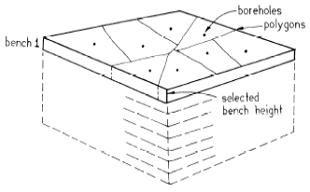

Slide 20
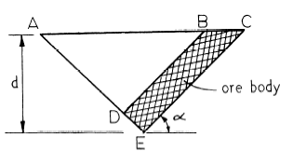
Stripping Ratio Considerations
The parameter known as the stripping ratio is almost universally used and represents the amount of uneconomic material that must be removed to uncover one unit of ore.

Slide 21
The ratio of the total volume of waste to the ore volume is defined as the overall stripping ratio:

Slide 22
While a volume relationship, calculated in cubic yards/cubic yards (cubic meters/cubic meter), it is more commonly expressed as tons/ tons (tonnes/tonne). Note that in mining certain mineral commodities, however, stripping ratio is expressed in units of cubic yards/ton (cubic meters/tonne).
To obtain pit limits is to utilize the cutoff stripping ratio:
First, the pit slope is determined from geotechnical and other considerations and the stripping ratio then calculated. The cutoff stripping ratio is the one for which the costs of mining the ore and waste are matched by the revenue from that block of ore. Factors used to determine costs should include the added costs of mining as the pit deepens and the interest charges on the prestripping of waste.

Slide 23
It is necessary to update the long-term plan of the mining project at regular intervals. Having determined the final pit limits and overall stripping ratio, the mining plan can be executed in a number of ways, as illustrated in the following.
1. Declining Stripping ratio method
2. Increasing Stripping ratio method
3. Constant Stripping ratio Method

Slide 24
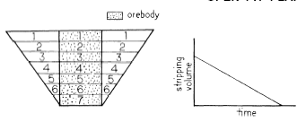
Declining Stripping Ratio Method.
This method (Fig.) requires that each bench of ore be mined in sequence, and all the waste on the particular bench is removed to the pit limit. The advantages of this method are the operating working space available, the accessibility of the ore on the subsequent bench, all equipment working on the same level, no contamination from waste blasting above the ore, and equipment requirements are a minimum towards the end of the mine’s life.
The primary disadvantage of this method is that the overall operating costs are a maximum during the initial years of operation when maximum repayment of capital.

Slide 25
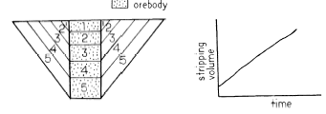
Increasing Stripping Ratio Method.
In this method, stripping is performed as needed to uncover the ore (Fig. 13.1.1.6). The working slopes of the waste faces are essentially maintained parallel to the overall pit slope angle. This method allows for maximum profit in the initial years of operation and greatly reduces the investment risk in waste removal for ore to be mined at a future date. This method is very popular where the mining economics or cutoff stripping ratio is likely to change on very short notice.
The disadvantage of this method is the impracticality of operating a large number of stacked, narrow benches simultaneously to meet production needs.

Slide 26
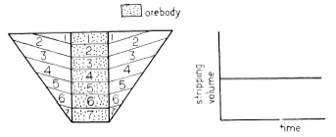
Constant Stripping Ratio Method.
This method (Fig.) attempts to remove the waste at a rate approximated by the overall stripping ratio. The working slope of the waste faces starts very shallow, but increases as mining depth increases until the working slope equals the overall pit slope.
This method, from an advantage and disadvantage point of view, is a compromise that removes the extreme conditions of the former two stripping methods outlined. Equipment fleet size and labor requirements throughout the project life are relatively constant.

Slide 27
Ideal Stipping
In actual practice, the best stripping sequence for a large ore body is one in which the rate is low during the initial stages and towards the end of the project’s life. The advantages can be summarized as follows:
1. A good profit can be generated initially to increase cash flow.
2. The labor and equipment fleet can be increased to maximum capacity over a period of time.
3. The labor and equipment requirements decrease gradually toward the end of the mine’s life.
4. Distinct mining and stripping areas can be operated simultaneously, allowing for flexibility in planning.

Slide 28
Mine Plan Frequency
Mine plans vary in frequency from short- to long-range. The most common are (1) daily, (2) weekly, (3) monthly, (4) yearly, and (5) life-of-mine.
The prime difference among these plans is the degree of detail. The shorter the time span covered by the plan, the greater the degree of accuracy and confidence that the actual performance will meet the forecast. For example, the daily mine plan details the production schedule on a shift basis for 24 hours, while long-range plans can be used to establish financial forecasts with regards to purchase of new equipment, changes in the work force, variations in operating costs due to increased haul distances, and dewatering requirements. Changes in the ore type may dictate the long-term blending criteria and possible changes in revenue from the sale of ore.

Slide 29
OPEN PIT FEASIBILITY STUDY
After a mineral deposit has been discovered and evaluated sufficiently to be considered an ore deposit, the problem then becomes how to mine and process that ore body in a way that maximizes the net present value (NPV) within a practical operating format.
Mine planning is dependent upon the interaction of contributing factors that lead to maximizing the NPV

Slide 30
Assume that the exploration data are acceptable and provide at least the following categories of information and guidelines:
(1) detailed drillhole data;
(2) mineral and waste inventory;
(3)geologic, hydrologic, and geotechnical criteria;
(4) topographic layout, including property boundaries;
(5) metallurgical flowsheet, recovery, and design criteria;
(6) access, water and power information;
(7) environmental baseline data; and
(8) financial criteria (minimum rate of return, payback period, etc.).

Slide 31
Open Pit Feasibility
Ore Reserve Analysis
Production Scheduling
Equipments and Facilities
Ore Reserves Re-analyses
Financial Evaluations

