Slide 1
Class No- 03
The First Travel Agents
Historic Transportation
Accommodations
Job Forecasts
Job Requirements
Career Possibilities
Career Paths in Tourism
Internships
Other Sources of Career Information

Slide 2
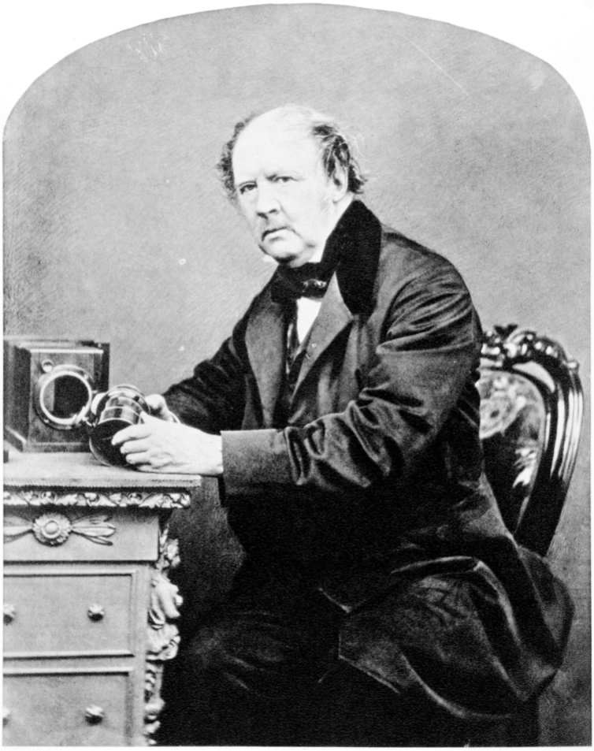
The First Travel Agents
In 1822, Robert Smart of Bristol, England, announced himself as the first steamship agent. He began booking passengers on steamers to various Bristol Channel ports and to Dublin, Ireland.

Slide 3
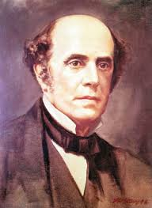
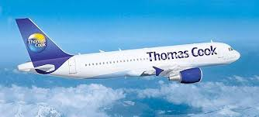
The First Travel Agents……
In 1841, Thomas Cook began running a special excursion train from Leicester to Loughborough (in England), a trip of 12 miles. On July 5 of that year, Cook’s train carried 570 passengers at a round-trip price of 1 shilling per passenger. This is believed to be the first publicly advertised excursion train.

Slide 4
The First Travel Agents……
Thomas Bennett (1814–1898), an Englishman who served as secretary to the British consul general in Oslo, Norway. In this position, Bennett frequently arranged individual scenic tours in Norway for visiting British notables.
Finally, in 1850, he set up a business as a ‘‘trip organizer’’ and provided individual tourists with itineraries, carriages, provisions, and a ‘‘traveling kit.’’ He routinely made advance arrangements for horses and hotel rooms for his clients.

Slide 5
Historic Transportation
Stagecoach Travel
Water Travel
Rail Travel
Automobile and Motor-coach Travel
Air Travel

Slide 6
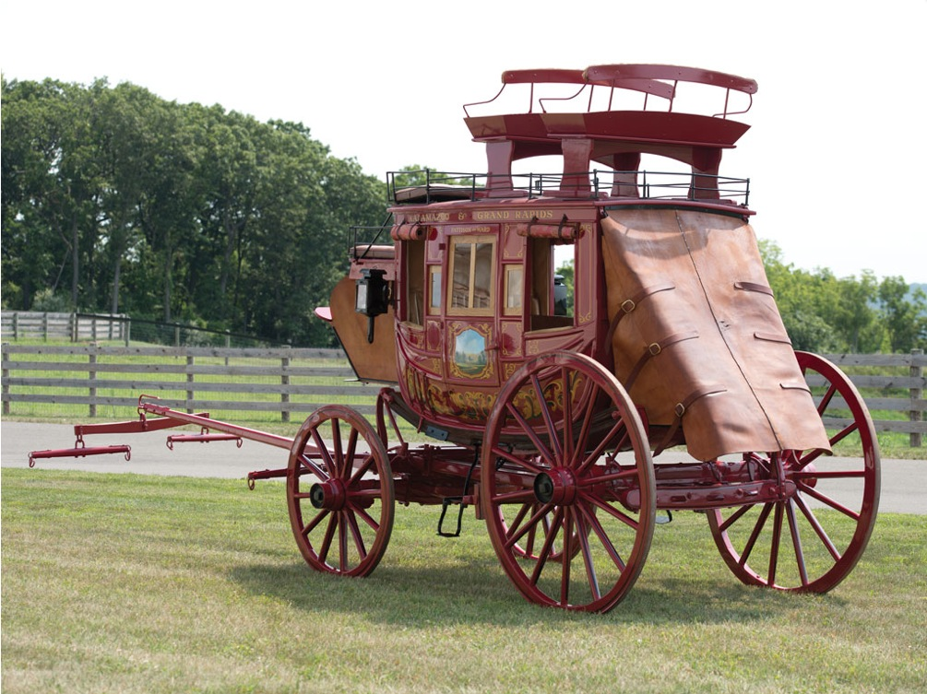
Stagecoach Travel
Stagecoaches were invented in Hungary in the fifteenth century and provided regular service there on prescribed routes. By the nineteenth century, stagecoach travel had become quite popular, especially in Great Britain.
The development of the famous English tavern was brought about by the need for overnight lodging by stagecoach passengers.

Slide 7
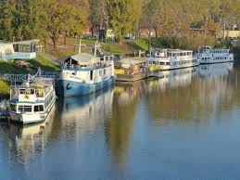
Water Travel
Market boats picked up passengers as well as goods on ship canals in England as early as 1772. The Duke of Bridgewater began such water travel service between Manchester and London Bridge (near Warrington). Each boat had a coffee room from which refreshments were sold by the captain’s wife.

Slide 8
Rail Travel
Railways were first built in England in 1825 and carried passengers beginning in 1830.

Slide 9
Automobile and Motor-coach Travel
Automobiles entered the travel scene in the United States when Henry Ford introduced his famous Model T in 1908. The relatively cheap ‘‘tin lizzie’’ revolutionized travel in the country, creating a demand for better roads. By 1920, a road network became available, leading to the automobile’s current dominance of the travel industry.

Slide 10
Air Travel
Nearly 16 years after the airplane’s first flight at Kitty Hawk, North Carolina, in 1903, regularly scheduled air service began in Germany. This was a Berlin–Leipzig–Weimar route, and the carrier later became known as Deutsche Lufthansa.

Slide 11
Accommodations
The earliest guest rooms were parts of private dwellings, and travellers were hosted almost like members of the family. In the Middle East and in the Orient, caravansaries and inns date back to antiquity. In more modern times, first the stagecoach and then railroads, steamships, the automobile, motorcoach, and airplane expanded the need for adequate accommodations.

Slide 12
Job Opportunities
According to the WTTC, by 2020, employment forecasts are that 303.0 million people around the globe will have jobs created by tourism, accounting for 9.2 percent of total employment, or 1 in every 10.9 jobs.

Slide 13
Career Possibilities
Tourism Technology
Airlines
Bus Companies
Cruise Companies
Railroads
Rental Car Companies
Hotel, Motels, and Resorts
Travel Agencies
Tour Companies
Food Service
Tourism Education
Research
Translator
Tourism Education
Tourism Research
Travel Communications
Recreation and Leisure
Attractions
Tourist Offices and Information Centers
Convention and Visitor Bureaus
Meeting Planners
Travel communication
Recreation and leisure
Attraction
Guide

Slide 14
Global Distributions Systems and Online Companies
There are currently three large global distributions systems (GDS) companies and a number of smaller ones.
GDSs are computer reservation systems that sell tickets for multiple airlines, book hotels, reserve rental cars, and conduct other transactions related to travel.

Slide 15
Top 10 Things Tourism Employees Like about Their Jobs
Variety
Dealing with people.
Working with other tourism employees
Opportunities.
Advancement potential
Developing global skills
Easy to get started
Training opportunities
Tips
Creativity

Slide 16
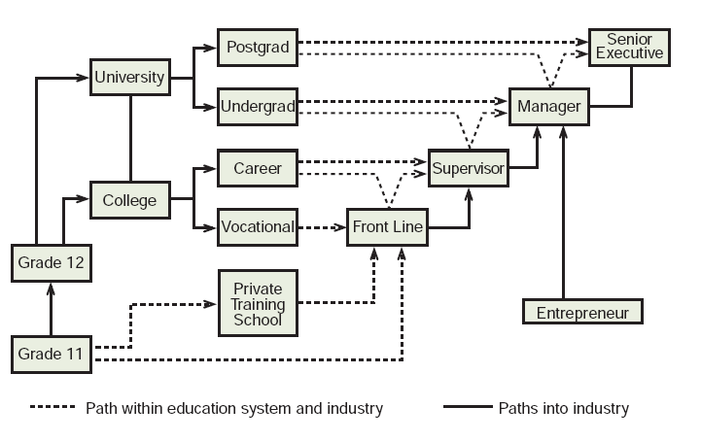
Career Path in Education

Slide 17
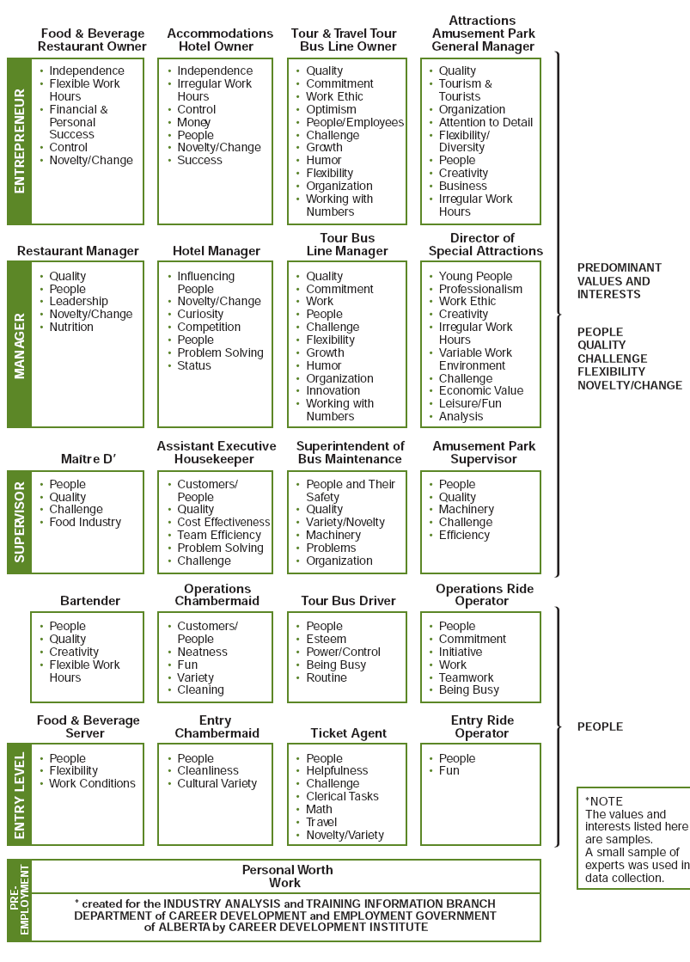

Slide 18
INTERNSHIPS
One of the best ways to get the job you want is to have internship (cooperative education) experience. Internship opportunities abound in the tourism area. Most internship programs are designed to provide students the opportunity to accomplish five things:
1. Acquire valuable, hands-on experience to supplement their academic learning.
2. Learn potential practical skills.
3. Develop professionalism.
4. Interact with segments of the local business community and develop an appreciation for the daily operation and long-term strategic direction of a corporate or small business environment.
5. Develop a further understanding of their chosen field.

Slide 19
OTHER SOURCES OF CAREER INFORMATION
The Internet. A Google search of tourism careers will produce about 28.5 million hits.
Eberts, Marjorie, Linda Brothers, and Ann Gisler. Careers in Travel, Tourism, and Hospitality. New York: McGraw-Hill, 2005.
Rubin, Karen. Inside Secrets to Finding a Career in Travel. Indianapolis, IN: JIST Works, 2001.

Slide 20

THE END

