Slide 1
Principles of Marketing
5th slide

Slide 2
Today’s Content
1. Marketing mix (7 P’s)
2. Micro Environment
3. Macro Environment

Slide 3
Marketing Mix

Slide 4
People
All people, who are directly or indirectly influence the perceived value of the product or service, including knowledge workers, employees, management and consumers.

Slide 6
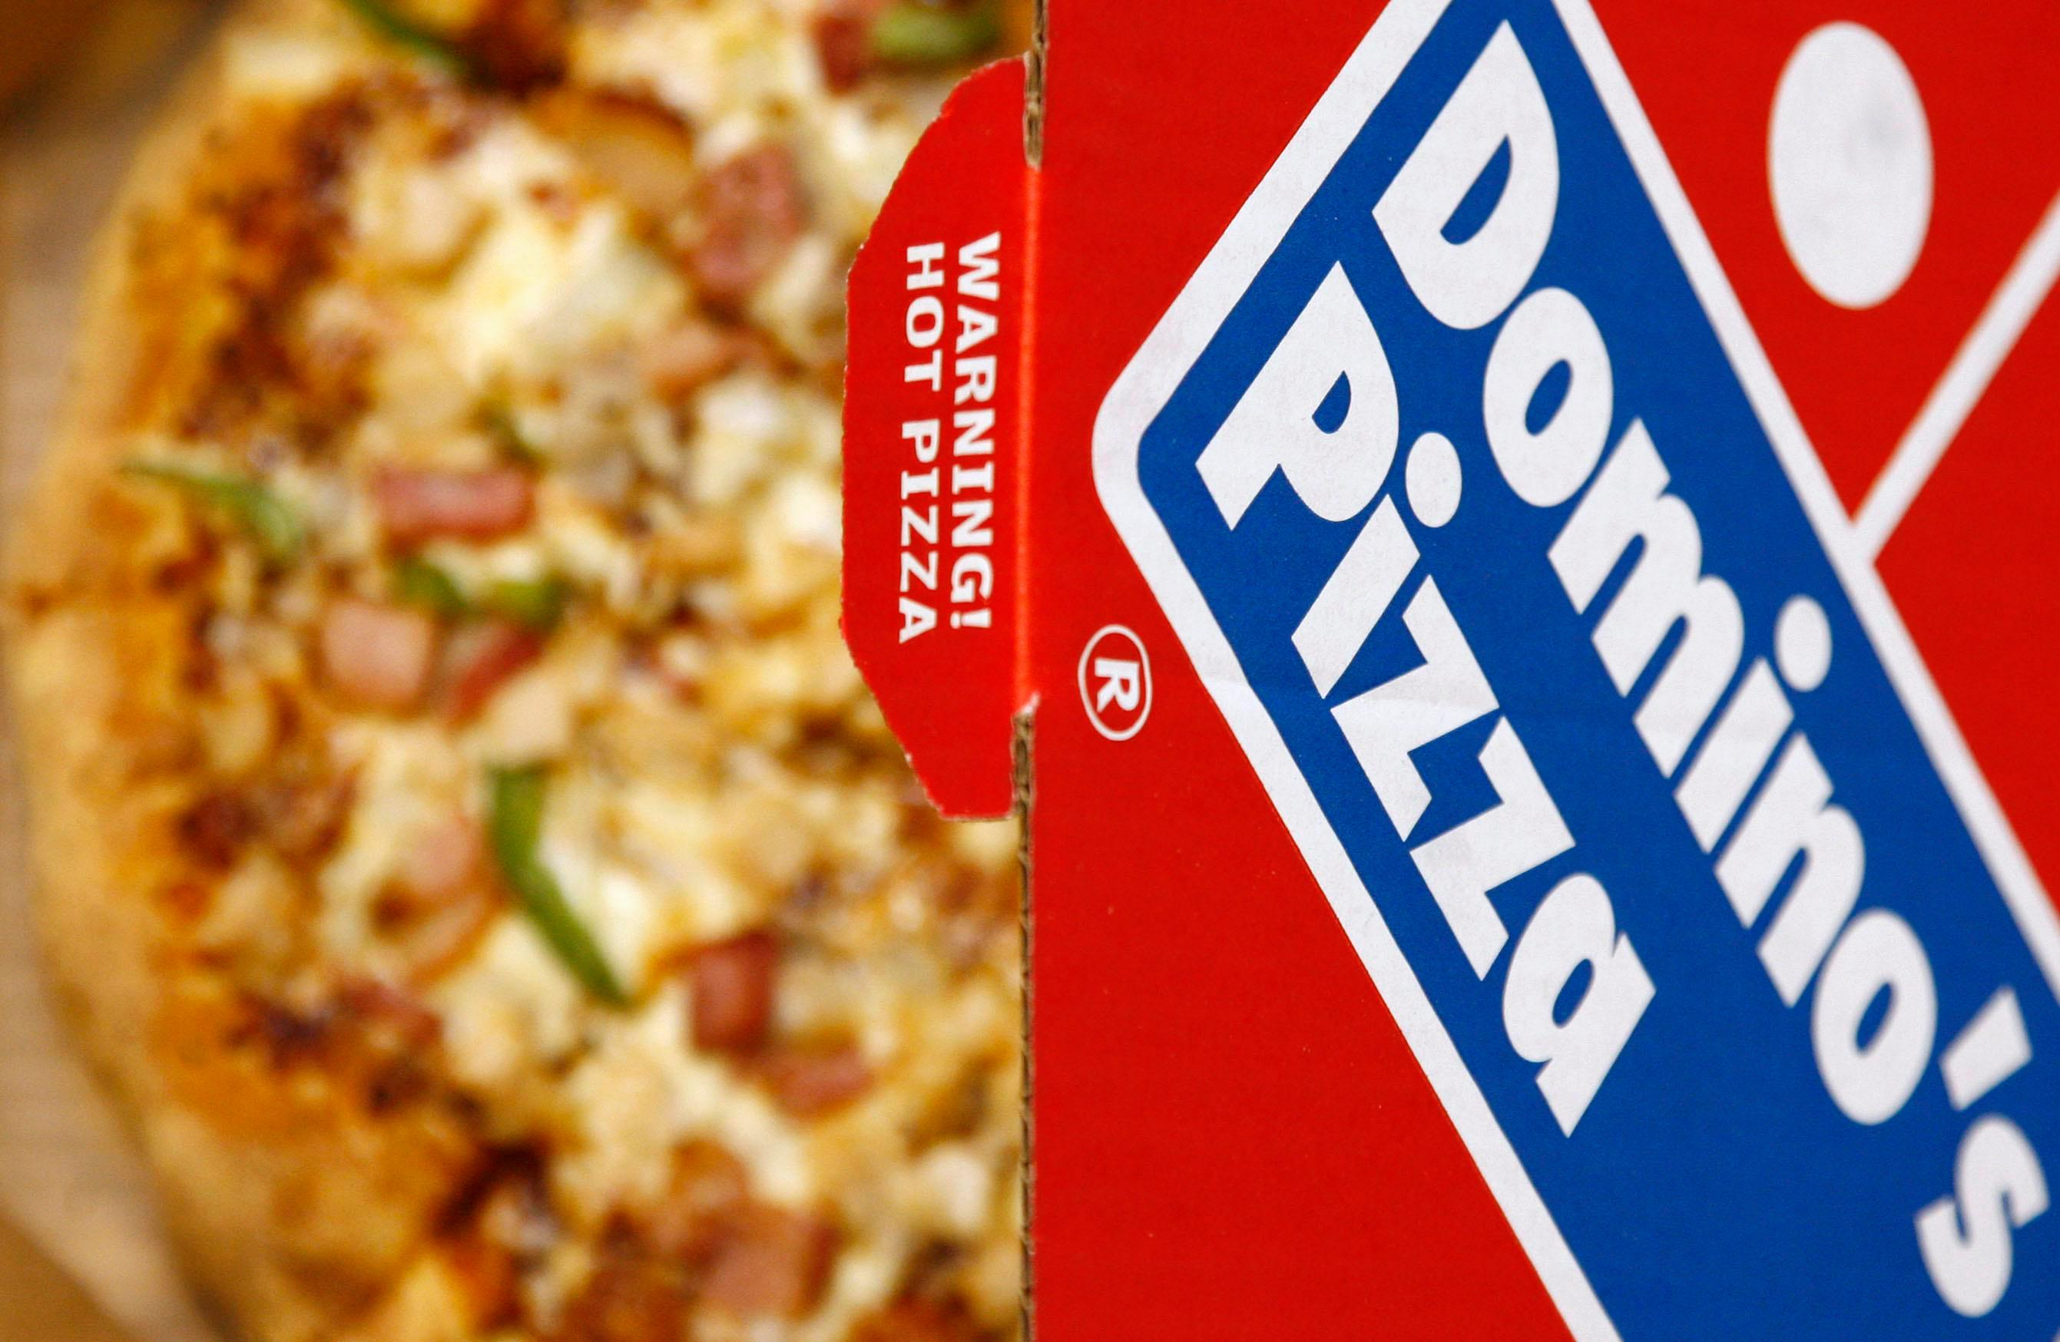
Process
Procedures, mechanisms and flow of activities helps the marketer to satisfy the consumer in a better way.

Slide 7
Physical Evidence
It deals with the direct sensory experience of a product or service that allows a customer to measure whether he or she has received value.

Slide 8
Marketing Environment
Marketing Environment is the combination of external and internal factors and forces which affect the company’s ability to establish a relationship and serve its customers.
The marketing environment of a business consists of an internal and an external environment. The internal environment is company-specific and includes owners, workers, machines, materials etc. The external environment is further divided into two components: micro & macro.

Slide 9
Marketing Environment
The micro or the task environment is also specific to the business but external. It consists of factors engaged in producing, distributing, and promoting the offering. The macro or the broad environment includes larger societal forces which affect society as a whole. The broad environment is made up of six components: demographic, economic, physical, technological, political-legal, and social-cultural environment.

Slide 10
Micro Environment

Slide 11
Macro Environment

Slide 12
End of Session

