Slide 1
Soil Permeability, Seepage and flow nets
Younus Ahmed Khan
Dept. of Geology and Mining
University of Rajshahi

Slide 2
Soil Permeability
The loss of head of h units is effected as the water flows from a point to another point (L). The loss of head per unit length of flow (i) may be expressed as,
i=h/L
where i is called the hydraulic gradient.
Darcy’s Law:
the quantity of water q per sec flowing through a cross-sectional area of soil under hydraulic gradient i can be expressed by the formula,
q=kiA

Slide 3
Velocity of flow,
v=q/A=ki
k is the hydraulic conductivity/coefficient of permeability with unit of velocity

Slide 4
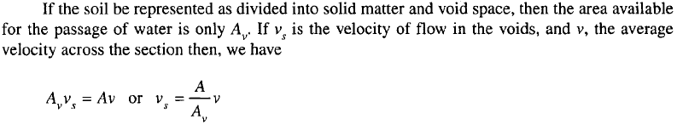

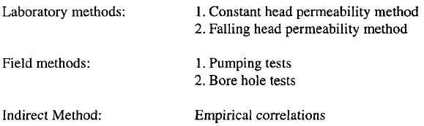
Methods of determination of hydraulic conductivity

Slide 5
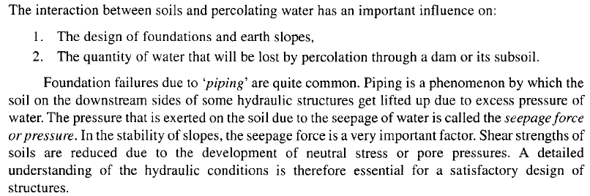
Seepage
Flow nets:

Slide 6
Flow nets:
A flow net for an isotropic medium is network of flow lines and equipotential lines intersecting at right angles to each other.
A flow net for an isometric medium is a network of flow lines and equipotential lines intersecting at right angles to each other.
The path which a particle of water follows in its course of seepage through a saturated soil mass is called a flow line.
Equipotential lines are lines that intersect the flow lines at right angles. At all points along an equipotential line, the water would rise in piezometric tubes to the same elevation known as the piezometric head .

Slide 7
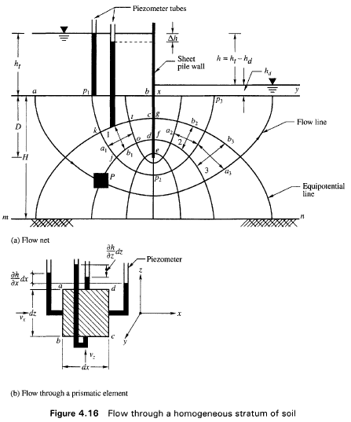

Slide 8
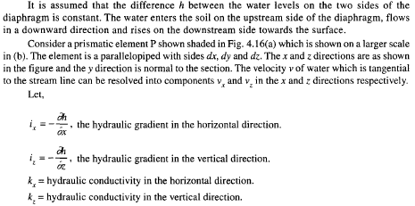
Laplace Equation

Slide 9
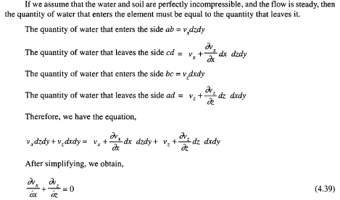
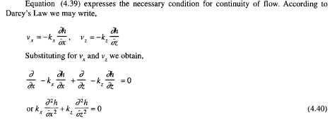

Slide 10
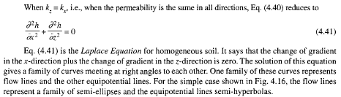
For anisotropic soil:

Slide 11
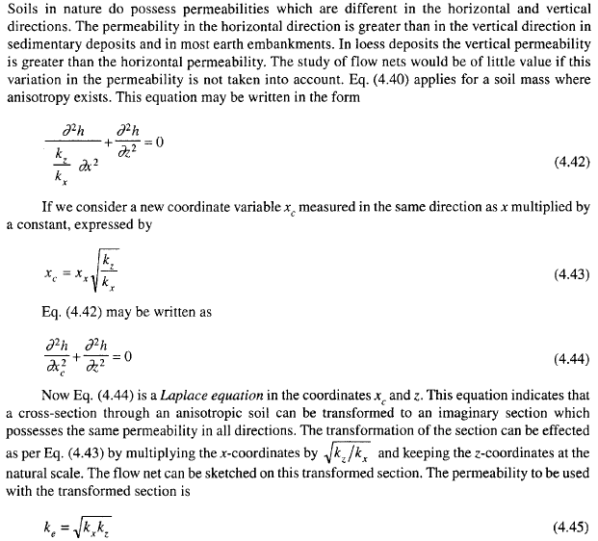
Laplace equation for anisotropic soil

Slide 12
Flow net construction
Properties of flow net:
1. Flow and equipotential lines are smooth curves.
2. Flow lines and equipotential lines meet at right angles to each other
3. No two flow lines cross each other.
4. No two flow or equipotential lines start from the same point
Boundary conditions:
* In practical water flow in earth dam is three dimensional, but due to complicated nature of computation, it is assumed that the flow is two dimensional.

Slide 13
Flow is in steady state.
According to the figure, the boundary conditions are:
1 . Line ab is a boundary equipotential line along which the head is h₁
2. The line along the sheet pile wall is a flow boundary
3. The line xy is a boundary equipotential line along which the head is equal to h_{d}
4. The line m n is a flow boundary (at depth H below bed level).
Construction:
All blocks are approx. square. Width to length ratio (a/b) remain approx. same for all square
Area between two flow lines is called flow channel.

Slide 14
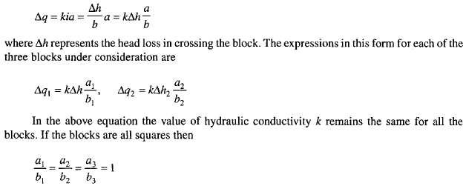

Darcy's law for the discharge through any block such as 1 per unit length of the section may be written as,

Slide 15
This proves that the same quantity flows through each block and there is the same head drop in crossing each block if all the blocks are squares or possess the same ratio alb. Flow nets are constructed by keeping the ratio alb the same in all figures. Square flow nets are generally used in practice as this is easier to construct.
Different methods of flow net construction:
1. Analytical: rigorous method based on Laplace equation, but complex in nature
2. Electrical analog : Extensively used in important design, but seepage flow and pressure assumptions are not always possible.
3. Scaled model method : Based on fluid flow model, usefull for some cases. But needs much time to develop model.
4. Graphical method: Widely used. Easily applicable, originally used by Forchheimer (1930). Later developed by Casagrande (1937). The main drawback of this method is that a good deal of practice and aptitude are essential to produce a satisfactory flow net. In spite of these drawbacks, the graphical method is quite popular among engineers

Slide 16
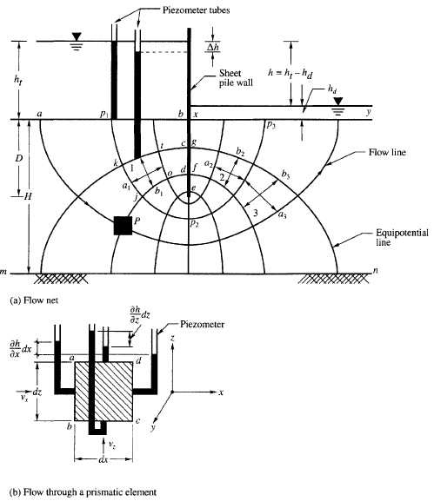

Slide 17
Taylor (1948) proposed a procedure known as the procedure by explicit trials. Some of the salient features of this procedure are given below:
1. As a first step in the explicit trial method, one trial flow line or one trial equipotential line is sketched adjacent to a boundary flow line or boundary equipotential.
2. After choosing the first trial line (say it is a flow line), the flow path between the line and the boundary flow line is divided into a number of squares by drawing equipotential lines.
These equipotential lines are extended to meet the bottom flow line at right angles keeping
in view that the lines drawn should be smooth without any abrupt transitions.
3. The remaining flow lines are next drawn, adhering rigorously to square figures.
4. If the first trial is chosen property, the net drawn satisfies all the necessary conditions. Otherwise, the last drawn flow line will cross the bottom boundary flow line, indicating that the trial line chosen is incorrect and needs modification.
5. In such a case, a second trial line should be chosen and the procedure repeated

Slide 18
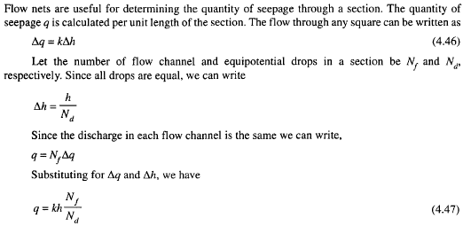
Determination seepage quantity

Slide 19
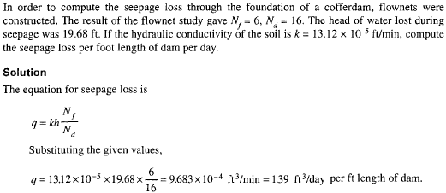
Example Problem:

Slide 20
Determination of seepage force/pressure
with all the sides equal to a. Let hl be the piezometric head acting on the face kt and h2 on face jo.
This force exerts a drag on the element known as the seepage pressure. It has the dimension of unit weight, and at any point its line of action is tangent to the flow line. The seepage pressure is
a very important factor in the stability analysis of earth slopes.

Slide 21
If the line of action of the seepage force acts in the vertical direction upward as on an element adjacent to point ;c in Fig. 4.16(a), the force that is acting downward to keep the element stable is the buoyant unit weight of the element.
When these two forces balance, the soil will just be at the point of being lifted up, and there will be effectively no grain-to-grain pressures.
The gradient at which this occurs can be computed from the balance of forces given by Eqs.
The soil will be in quick condition at this gradient, which is therefore called ic, the critical hydraulic gradient

Slide 23
Determination of uplift pressure
Water that seeps below masonry dams or weirs founded on permeable soils exerts pressures on the bases of structures. These pressures are called uplift pressures. Uplift pressures reduce the effective weight of the structure and thereby cause instability.

Slide 24
Areas of action……

Slide 25
Areas of action….

Slide 27
Disaster Risk Management and its components
Disaster risk management (DRM) is part of disaster
management, focusing on the before (risk analysis,
prevention,preparedness) of the extreme natural event,
and relating to the during and after of the disaster only
through risk analysis.
DRM is an instrument for reducing the risk of disaster primarily by reducing vulnerability, based on social agreements resulting from risk analysis.
DRM must considers basis for resisting the future effects of any extreme events.

Slide 28
Sample Question and Answer
The following slides are example questions using the layouts in the Quiz Show template. View them in slide show to see the answer animations.

Slide 29
The Sun is a star.

Slide 30
What is the name of our galaxy?
The Milky Way

Slide 31
How many planets in the solar system have rings?
Four planets.
Jupiter, Saturn, Uranus, and Neptune all have rings.

Slide 32
What is inertia?
Measurement of electrical resistance
A ratio between mass and velocity
Resistance to motion or change
The speed at which an object falls
All of the above

Slide 33
Match the device to what it measures:
Stop Watch
Distance
Scale
Temperature
Thermometer
Elapsed Time
Speedometer
Weight
Odometer
Rate of Travel

