Slide 1
Parasitology
Dr. Md Fazlul Haque
Associate Professor
Dept. of Zoology
Rajshahi University

Slide 4
What is Parasitology?
Parasitology is the branch of Science which mainly deals about all the Parasites and its infectious diseases.
What is parasite?
A parasite is a living organism, which takes its nourishment and other needs from a host; the host is an organism which supports the parasite. Thus, parasites get benefits at the expense of the host.
Parasite, from the Latin parasitus,(the Greek parasitos), “one who eats at the table of another”
Traditionally parasite referred primarily to organisms visible to the naked eye, such as helminths. But, now Parasite includes microscopic organisms such as protozoa, viruses, and bacteria.

Slide 5
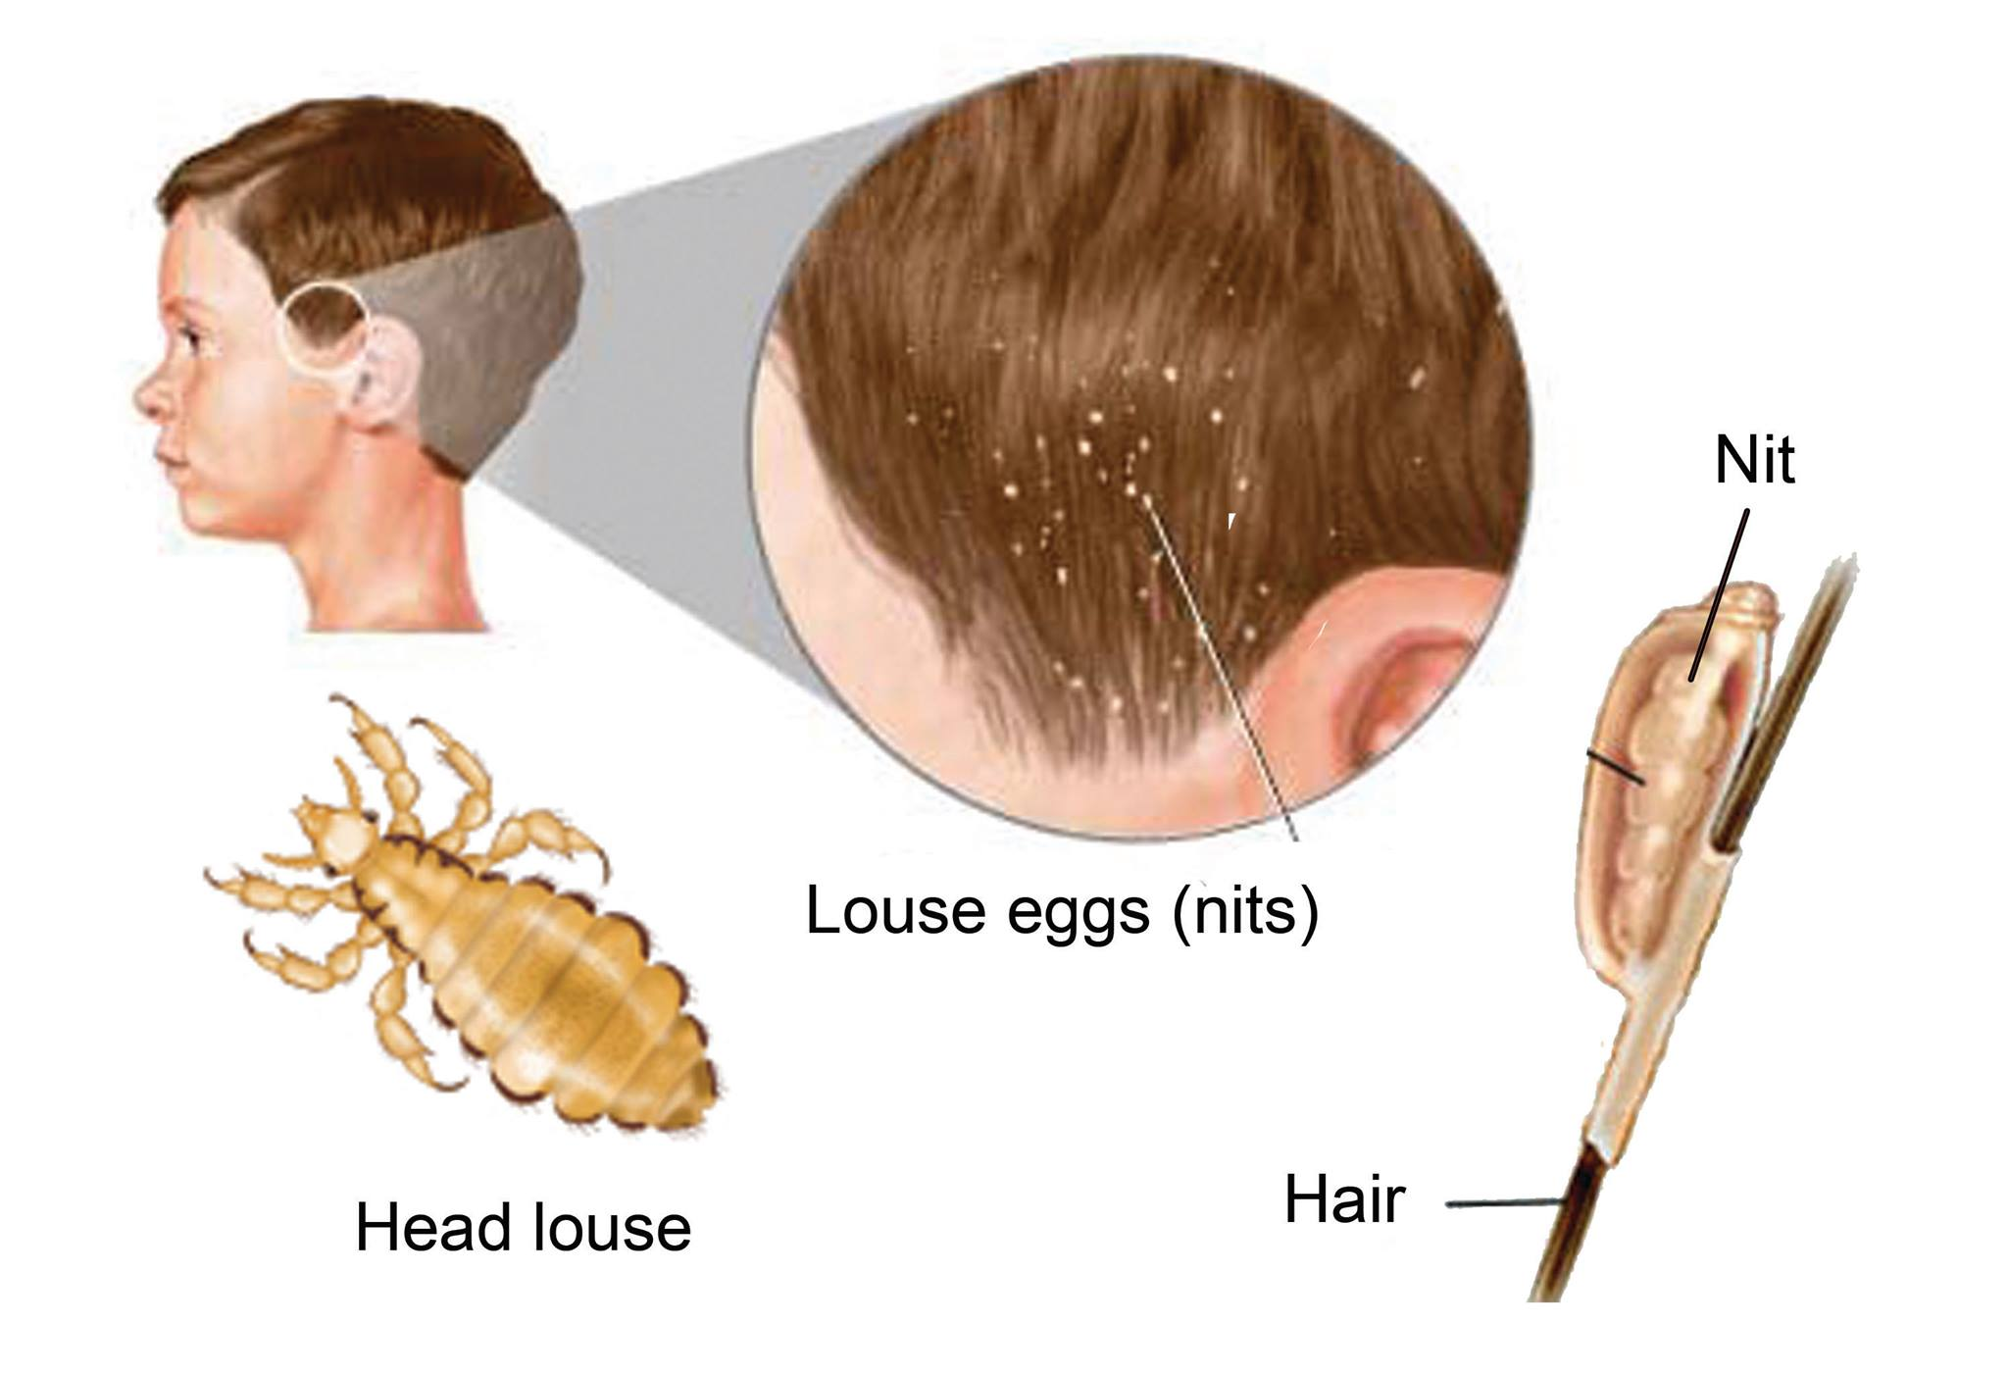
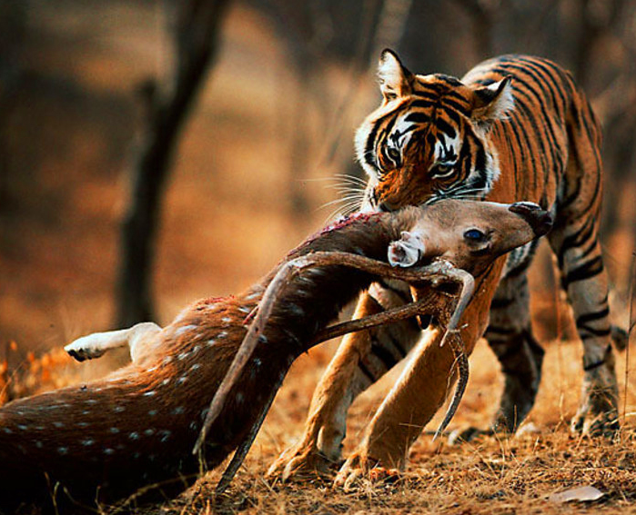
How is a parasite differ from a predator?
Unlike predators, parasites typically do not kill their host, are generally much smaller than their host, and will often live in or on their host for an extended period. Parasites show a high degree of specialization, and reproduce at a faster rate than their hosts.
Parasites usually take resources from one host, whereas predators eat many prey.

Slide 6
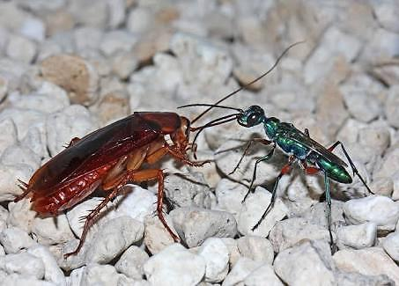
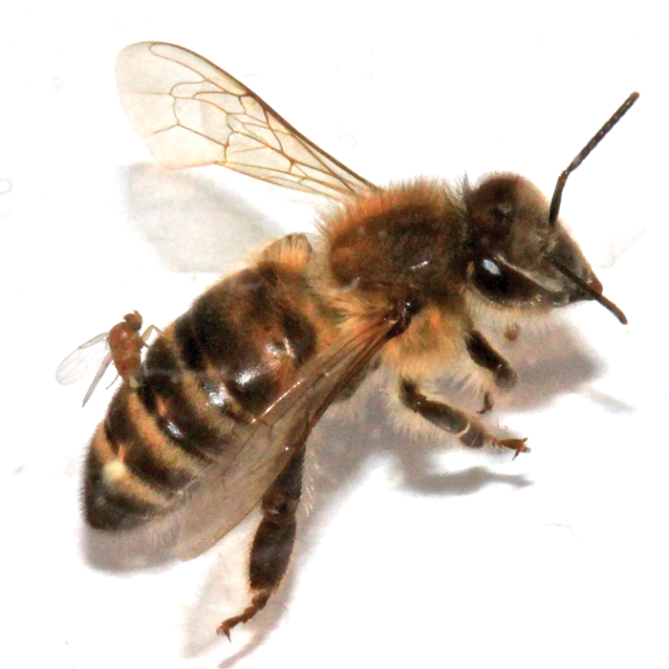
parasitoid
Cockroach hypnotized by Jewel/ Emerald Wasp for leading them in her nest where she will lay eggs in the tissue of Cockroach
Female Apocephalus borealis ovipositing eggs into the abdomen of a worker honey bee

Slide 7
How is a parasite differ from a parasitoid?
A parasitoid is an organism that spends a significant portion of its life history attached to or within a single host organism, and ultimately kills the host.
Only larval form of an organism can be a parasitoid, but their adult forms are always non-parasitoidic.
Thus in a typical parasitic relationship, the parasite and host live side by side without lethal damage to the host.
Typically, the parasite takes enough nutrients to thrive without preventing the host from reproducing. In a parasitoid relationship, the host is killed, normally before it can produce offspring.

Slide 8
Is parasite a member of Symbiosis?
Symbiosis means “living together of both members of two different species.
Any organism that spends a portion or all its life intimately associated with another living organism of a different species is known as a symbiont (or symbiote), and the relationship is designated as symbiosis.
The term symbiosis is used in its original sense (living together) without any reference to “benefit” or “damage” to the symbionts.
There are at least three categories of symbiosis whose are commonly recognized:
1. Parasitism (+ / -)
2. Mutualism (+ / +)
3. Commensalisms (+ / )

Slide 9
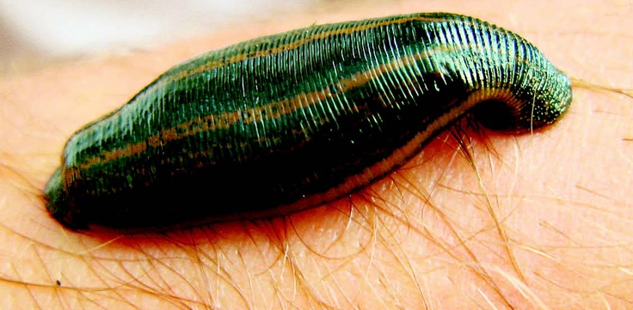
Parasitism?
Parasitism is a type of symbiotic relationship between two organisms: a parasite, usually the smaller of the two, and a host, upon which the parasite is physiologically dependent.
The relationship may be permanent, as in the case of tapeworms found in the vertebrate intestine, or temporary, as with female mosquitoes, some leeches, and ticks, which feed intermittently on host blood.
In other words, it is a symbiotic relationship in which one animal (the host) is to be injured by the activities of the other animal (the parasite) to be benefited.

Slide 10
Commensalism?
Commensalism was derived from Latin for “eating at same table”, denotes an association which is beneficial to one partner and at least not disadvantageous to the other.
The two partners can survive independently.
Humans harbor several species of commensal protozoans, that colonize in the intestinal tract such as Entamoeba dispar, Entamoeba hartmanni, Endolimax nana
Mutualism?
Mutualism is an association in which the mutualist and the host depend on each other physiologically.
It is seen where such associations are beneficial to both organisms(partners).
At least 20% of insect species, as well as many mites, spiders, crustaceans, and nematodes, are mutually infected with bacteria of genus Wolbachia.

Slide 11
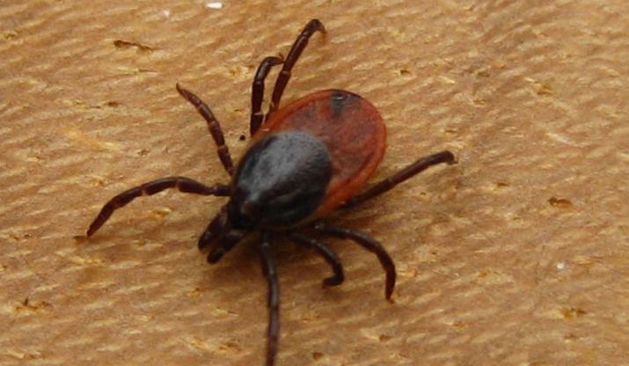
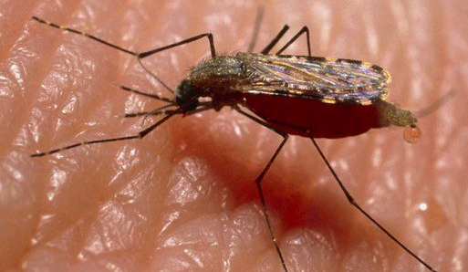
Types of parasites
Depending on size:
1. Macroparasites: parasites which are visible to the naked eye, such as helminthes, tick, mosquitos etc.
2. Microparasites:
Parasite which are
typically smaller or
microscopic in
size, such as protozoa,
viruses, and bacteria.

Slide 12
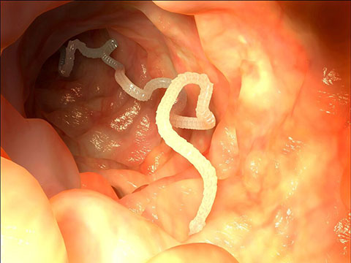
Types of parasites
Depending on living place on host:
1. Ectoparasite – The parasitic organism that lives on the outer surface of its host, e.g. lice, ticks, mites etc.
2. Endoparasite – The parasites that live inside the body of their host, e.g. Entamoeba histolytica, Taenia solium.
Endoparasites can exist in one of two forms:
Intercellular parasites: The parasites that are inhabiting spaces in the host’s body
Intracellular parasites The parasites that are inhabiting in cells in the host’s body.

Slide 13
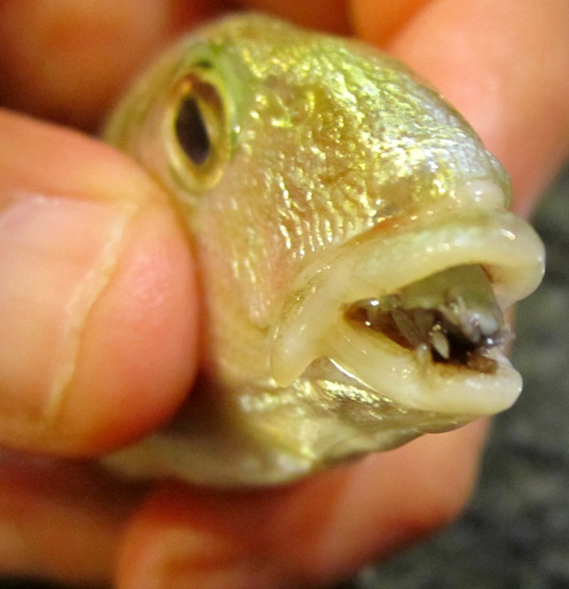
Types of parasites
3. Mesoparasite- The parasites living in an intermediate position, being half-ectoparasites and half-endoparasites.
eg. Cymothoa exigua, or the tongue-eating louse, is a parasitic crustacean
This parasite enters fish through the gills, and then attaches itself to the fish's tongue.

Slide 14
Types of parasites
Based on their interactions with their hosts and on their life cycles:
Obligate Parasite - This parasite is completely dependent on the host during a segment or all of its life cycle. Eg. Plasmodium sp.
Facultative parasite: An organism that exhibits both parasitic and non-parasitic modes of living and hence does not absolutely depend on the parasitic way of life, but is capable of adapting to it if placed on a host. Eg. Naegleria fowleri.
Temporary (intermittent) parasites – A parasite that is parasitic for limited periods for either feeding or reproduction. Eg. Mosquitos
Permanent parasite: A parasite that lives on its host until maturity or spends its entire life on its host. Eg. fluke

Slide 15
Types of parasites
Accidental parasite – when a parasite attacks an unnatural host and survives. e.g. Hymenolepis diminuta (rat tapeworm) is a cestode of rodents infrequently seen in humans.
Erratic parasite - is one that wanders in to an organ in which it is not usually found. e.g. Entamoeba histolytica in the liver or lung of humans.
Epiparasite: An epiparasite is one that feeds on another parasite. This relationship is also sometimes referred to as hyperparasitism, exemplified by a protozoan (the hyperparasite) living in the digestive tract of a flea living on a dog.

Slide 16
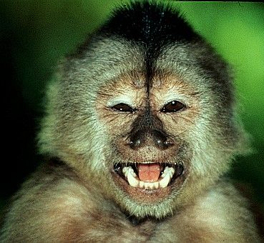
Types of parasites
Social parasites: They take advantage of interactions between members of social organisms such as ants or termites.
An example of social parasite is Phengaris arion, a butterfly whose larvae employ mimicry to parasitize certain species of ants.
Another example of social parasitism is parasitic nursing, where some individuals take milk from unrelated females.
In wedge-capped capuchins, higher ranking females sometimes take milk from low ranking females without any reciprocation. The females benefit at the expense of the low ranking females.

Slide 17
Types of parasites
Brood Parasite: Brood parasites are organisms that rely on others (the host) to raise their young. An example is the brood parasitism practiced by cuckoos and cowbirds, which do not build nests of their own and leave their eggs in nests of other species.
Klepto parasite: Klepto parasite is an animal who takes prey or other food from another that has caught, collected, or otherwise prepared the food, including stored food

Slide 18
Types of parasites
Adelpho-parasite: An adelpho-parasite is a parasite in which the host species is closely related to the parasite, often being a member of the same family or genus.
Eg. Citrus blackfly parasitoid, Encarsia perplexa.
Depending on number of host required for completion of life cycle:
Monogenic parasites: Monogenic parasites complete the whole life cycle in one host.
Eg. Entamoeba histolytica.
Digenic parasite: A digenic parasite needs, in addition to a primary host, also a secondary host to complete the entire life cycle.
Eg. Plasmodium vivax (malaria parasite).

