Slide 1
Parasitology
Dr. Md Fazlul Haque
Associate Professor
Dept. of Zoology
Rajshahi University

Slide 2
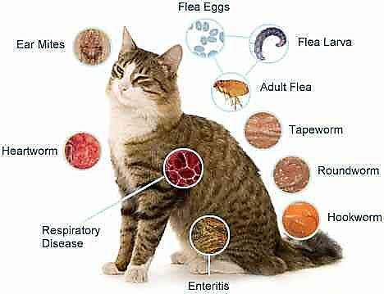
Host
What is host?
Host is defined as an organism which-
harbours the parasite and provides the nourishment and shelter.
are relatively larger in size and longer in lifetime in comparison to their parasites.
are not directly killed by parasites.
What is carrier?
Carrier is an individual (not all member of species/group) who harbours -
parasite without any clinical symptoms of disease, and
can acts as an important source of infection to other individuals in epidemiology

Slide 3
Types of Host
Hosts are classified according to their role in the life cycle of the parasite into following types:
Definitive host
The host that harbours the adult or sexually mature stages of the parasite is called definitive host
or the host in whom sexual reproduction occurs is called definitive host
e.g. man is definitive host for Schistosoma haematobium (Blood fluke),
e.g. female Anopheles mosquito is definitive host for Plasmodium species (malaria parasites).

Slide 4
Types of Host
Intermediate host
The host that harbours larval or sexually immature stages of the parasite is called intermediate host
or the host in whom asexual reproduction occurs is called intermediate host
e.g. Man is intermediate host of malaria parasites.
e.g. Two intermediate hosts termed 1st and 2nd intermediate host may be needed for completion of a parasite's life cycle, e.g. Pirenella conica snail is the 1st intermediate host, while Tilapia fish is the 2nd intermediate host for Heterophyes heterophyes (small parasitic fluke).

Slide 5
Types of Host
Reservoir host
The host (species/group) that makes the parasite available for the transmission to another host and is usually not affected by the infection (no clinical symptom).
It differs from a carrier which is an individual (not all member of species/group) who harbours parasite without clinical symptoms.
e.g. sheep are Reservoir host for Fasciola hepatica.

Slide 6
Types of Host
Paratenic or transport host
The host in whom the parasite does not undergo any development but remains alive and infective to another host is called Paratenic or transport host .
Paratenic hosts fill the gap between the hosts.
For example, dogs and pigs may carry hookworm (Ancylostoma duodenale) eggs from one place to another, but the eggs do not hatch or pass through any development in these animals.
It differs from Vector which is an animal (usually arthropods) that transmits parasites from one host to another, e.g. female sand fly transmits Leishmania parasites.

Slide 7
Types of Host
Typical or Natural host
A host that is naturally infected with certain species of parasite is called typical or natural host.
e.g. Rodents are natural host for Hymenolepis diminuta (rat tapeworm)
Accidental host
A host that is under normal circumstances not infected with the parasite is called accidental host
Human is an accidental host for Hymenolepis diminuta (rat tapeworm)

Slide 8
Host as an environment of parasite
Environment:
The environment is the sum total of physical and biotic condition influencing the response of the organisms (S. C. Kendeigh, 1974)
The physical and biological conditions of host have both
positive (good) impact on life of parasite.
negative (bad) impact on life of parasite.

Slide 9
Host as an environment of parasite
Positive impact:
Provide ready-made nourishment (degree of impact depend on availability of nutrients)
Provide ready-made shelter
Help in reproduction
Protect from predator and mechanical injuries
Protect from adverse effect of physical factors such as temperature, Ph, humidity, water activity, osmotic pressure
Negative impact:
Elimination or suppression by host immunity (Innate immunity and adaptive immunity)
Elimination or suppression because of competition for nutrient and space

Slide 10
Host parasite relationship
Once the infecting organism is introduced into the body of the host, it reacts in different ways and this could result in:
Carrier state
A perfect host parasite relationship where tissue destruction by a parasite is balanced with the host’s tissue repair.
At this point the parasite and the host live harmoniously, i.e. they are at equilibrium.
Disease state
This is due to an imperfect host parasite relationship where the parasite dominates over the host .
It can result either from lower resistance of the host or a higher pathogenicity of the parasite.
Parasite destruction
It occurs when the host dominates over the parasites.
It can result either from higher resistance of the host or a lower pathogenicity of the parasite.

Slide 11
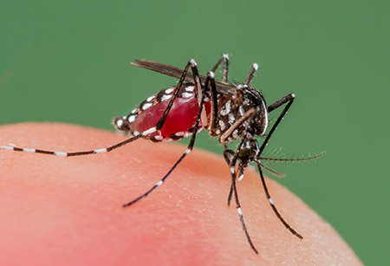
Host specificity
Host specificity can be defined as natural adaptability of a particular parasite to certain species or group of host.
Parasites can be very particular about which host species they will use.

Slide 12
Host specificity
Depending on host specificity parasites can be classified into following types:
Oioxenous parasite: A parasite that is specific for a single host species is called Oioxenous parasite. Example- HIV for human; Eimeria tenella (Intracellular protozoa) which infects only chickens.
Stenoxenous parasite: A parasite that parasitizes closely-related hosts is called Stenoxenous parasite. Example- Trichinellosis (trichinosis) is caused by nematodes (roundworms) of the genus Trichinella in many carnivorous and omnivorous mammals.
Euryxenous parasite: A parasite that parasitizes unrelated hosts is called euryxenous parasite. Example- Toxoplasma gondi for Birds and Mammals.

Slide 13
Host specificity
Host-specificity is determined by a complex of factors, some obvious and others still obscure.
Depending on requirements, host-specificity can be following types.
Ecological specificity: The first requirement is that the prospective host shares its environment with the parasite; e.g. parasites of dolphins might not have much probability to infect humans who do not live near the sea (although modern food transport networks have changed this!).
Ethological specificity: Second requirement is that host behavior must expose it to the parasite; e.g. people who eat pork may acquire parasites intended for pig such as pork tape worm Taenia solium.
Physiological specificity: The final requirement is that once the parasite comes into contact with the host, it must recognize appropriate cues and feel comfortable within its new surroundings. Obviously, this last determinant of host-specificity is the one we understand least.

Slide 14
Physiological specificity is determined by several steps:
Parasites interact with host secretions and surfaces and membranes. During this interaction, parasites must recognize and respond to molecular configurations (receptors/ligands) of host.
Parasites must need to detect delicate variations in metabolites in host which allows them to follow road-maps for selection of safe and suitable places for them in host
Parasites need to make critical changes in behaviour and development according to changes in host physiology/behaviour.
Parasites must be satisfied with their diet available in host (host intestinal contents, blood and/or tissues).
Clearly, all these combinations are unique for each host species, and vary even among individuals within a species.

