Slide 1
Transmission, hyper-infestation and diseases Dr. Md Fazlul Haque Associate Professor Dept. of Zoology Rajshahi University

Slide 2
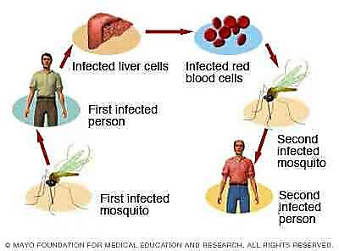
Transmission of parasites
Transmission involves the following stages
Escape from the host or reservoir of infection/infestation
Transport to the new host.
Entry to the new host.
Transmission of infection from one host to another, cause by a certain form of the parasite is known as the infective stage. eg. Sporozoites

Slide 3
Types of transmission of parasites
Depending on source or reservoir of infection, transmission of parasites is categorized into 2 types:
1. Anthroponosis (Pl. Anthroponoses)
Direct transmission Indirect transmission
2. Zoonosis (pl. Zoonoses)
Direct transmission Indirect transmission
Human
Human
Vector
Vector
Human
Human
Animals
Animals
Vector
Vector
Animals
Animals
Human
Human

Slide 4
Anthroponosis (Pl. Anthroponoses)
In case of most parasitic diseases of human, human act as the source of infection.
The condition in which the infection is transmitted from one infected man to another man is called anthroponoses.
It causes Anthroponotic disease. e.g., Leishmaniasis Recidivans, a form of cutaneous leishmaniasis
Sandfly

Slide 5
Zoonosis (pl. Zoonoses)
In case of many parasitic diseases of human, other animals act as the source of infection.
The condition where infection is transmitted from other animals (usually vertebrates) to humans and vice-versa is called zoonoses.
It causes Zoonotic disease. e.g., Zoonotic cutaneous leishmaniasis
Sandfly

Slide 6
Types of transmission of parasites
Depending on mode of transmission, transmission of parasites is categorized into following types:
1. Direct transmission:
This implies the transitional transmission of infective materials from one host to another.
The ectoparasitic arthropods such as lice, mites and the protozoa and virus may be transmitted by direct contact.
2. Transmission through living agents:
Transmission of parasites from one host to another through living organisms.
3. Transmission through non-living agents:
Transmission of parasites from one host to another through non-living agents.

Slide 7
Direct transmission
Parasites can be directly transmitted in following ways:
Touch:
Parasite can be transmitted from one person to another person by touching such as hand shaking.
For example, a cold can be caught by shaking the hand of a person who has a cold and who has just used their hand to wipe their dripping nose.

Slide 8
Direct transmission
Kiss:
A cold or the flu can be caught from the saliva of an infected person when one kisses them.

Slide 9
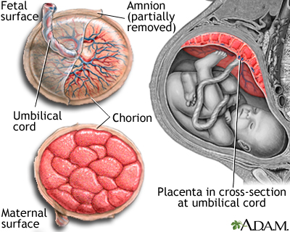
Direct transmission
Transplacental/ Intra-uterine transmission:
In this case the infective phase enters the young through fetal circulation,
e.g. Ancylostoma caninum (Hook worm) in dog.
Puppies become infected with Ancylostoma caninum while in the bitch as fetus.

Slide 10
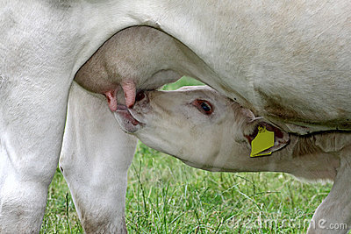
Direct transmission
Transmammary transmission:
Infective phase enters the young through milk of infected mother.
e.g. Toxocara vitulorum infection in buffalo calves.

Slide 11
Direct transmission
Sexual contact
Parasites are directly transmitted from infected host to new host during sexual contact.
HIV, Hepatitis B, Trichomonas etc. is transmitted by sexual contact.
Frequently, Entamoeba also is transmitted by sexual contact among homosexuals.

Slide 12
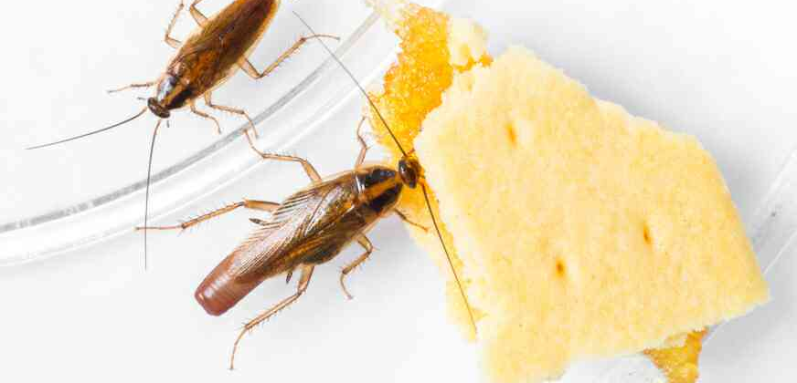
Transmission through living agents:
Transmission of parasites from one host to another through living organisms. Two types:
1. Mechanical transmission:
Mechanical transmission means that the disease agent does not replicate or develop in/on the vector (eg. flies);
Disease agent is simply transported by the vector from one animal to another.
eg. Entamoeba histolytica transmission by cockroach.

Slide 13
2. Biological transmission
Biological transmission occurs when the vector uptakes the agent, usually through a blood meal from an infected animal, replicates and/or develops it, and then regurgitates the pathogen onto or injects it into a susceptible animal.
Fleas, ticks, and mosquitoes are common biological vectors of disease.

Slide 14
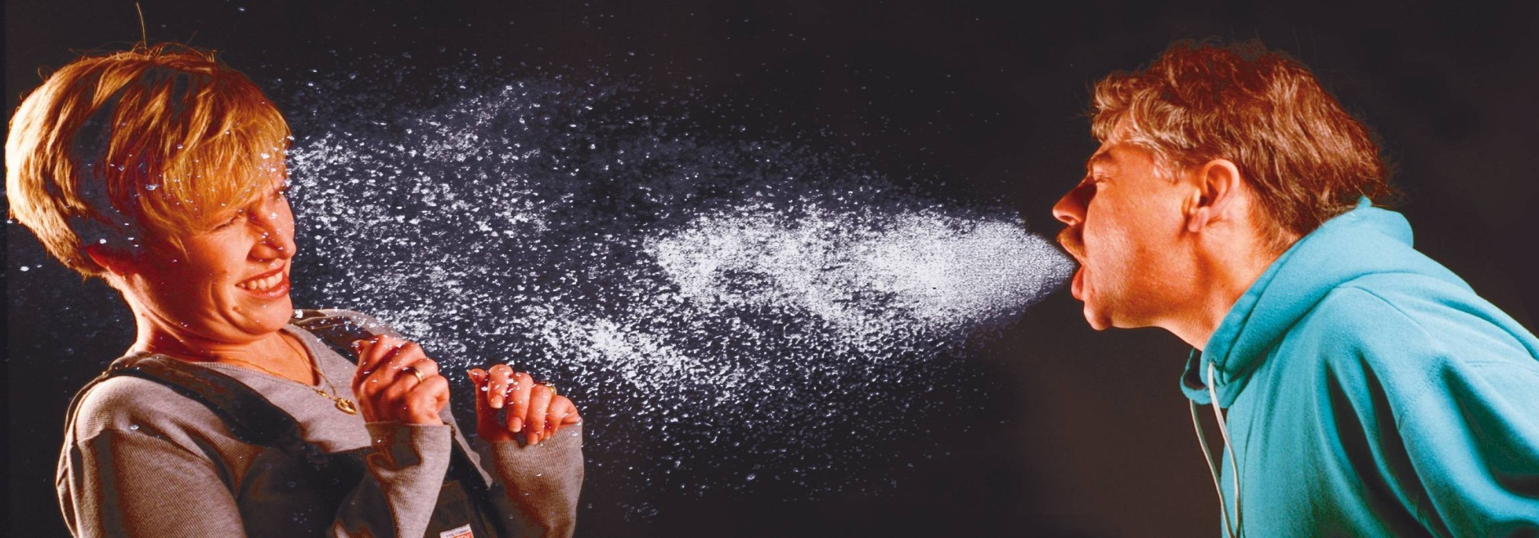
Transmission through non-living agents
Parasites can be transmitted through following non-living agents:
Air:
Measles, mumps and tuberculosis can be spread by coughing or sneezing.
A cough or a sneeze can release millions of microbes into the air in droplets of mucus or saliva which can then infect somebody else if they breathe in the infected particles.

Slide 15
Transmission through non-living agents
Food:
Microbes need nutrients for growth and they like to consume the same foods as humans.
They can get into our food at any point along the food chain.
For example, Larval stage of Taenia solium can be transmitted through raw or undercooked meat harbouring the infective stage of the parasite (e.g., pork containing the larval stage of Taenia solium).

Slide 16
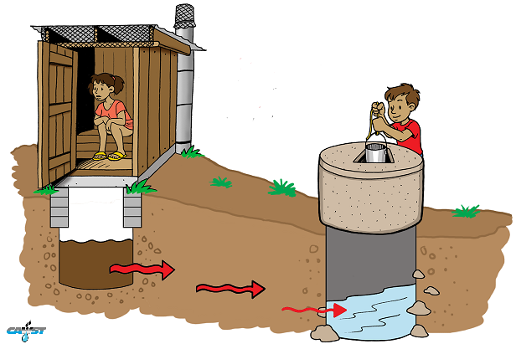
Transmission through non-living agents
Water:
Some diseases are caused by drinking water that is contaminated by human or animal faeces, which may contain disease-causing microbes.
Typhoid and cholera are example of water-borne diseases

Slide 17
Transmission through non-living agents
Fomites:
This is a non-living object which are used in daily life such as bedding, towels, toys and hooked wire that can carry disease-causing organisms.
The fungus Trichophyton that causes athlete’s foot can be spread indirectly through towels and changing room floors.

Slide 18
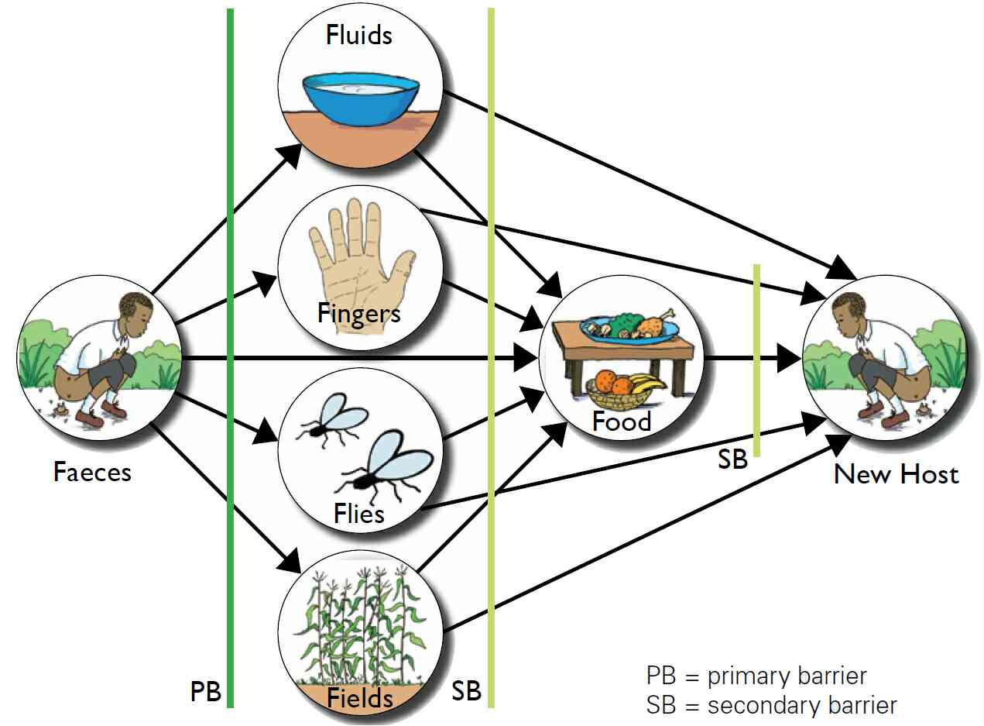
Route of transmission of parasites
Oral route (faecal-oral)
The infection is transmitted orally by ingestion of food, water or vegetables contaminated by the faeces that contain the infective stages of the parasite.
This mode of transmission is referred to as faecal-oral route (e.g., cysts of Entamoeba histolytica).

Slide 19
Route of transmission of parasites
Nasal route:
Measles, mumps and tuberculosis can be spread by coughing or sneezing.
A cough or a sneeze can release millions of microbes into the air in droplets of mucus or saliva which can then infect somebody else if they breathe in the infected particles.

Slide 20
Route of transmission of parasites
Urogenital route:
HIV, Hepatitis B, Trichomonas etc. is transmitted through urogenital route (through urogenital organ) during sexual intercourse.
Anal route:
Entamoeba also is transmitted through anal route (through anus) during sexual contact among homosexuals.

Slide 21
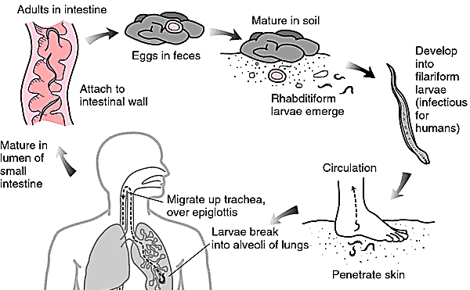
Route of transmission of parasites
Skin and mucous membrane route:
This route is used by parasite by penetration of the intact skin.
For example, the intact skin is penetrated by filariform-larvae of hookworm on coming in contact with faecally polluted soil.

Slide 22
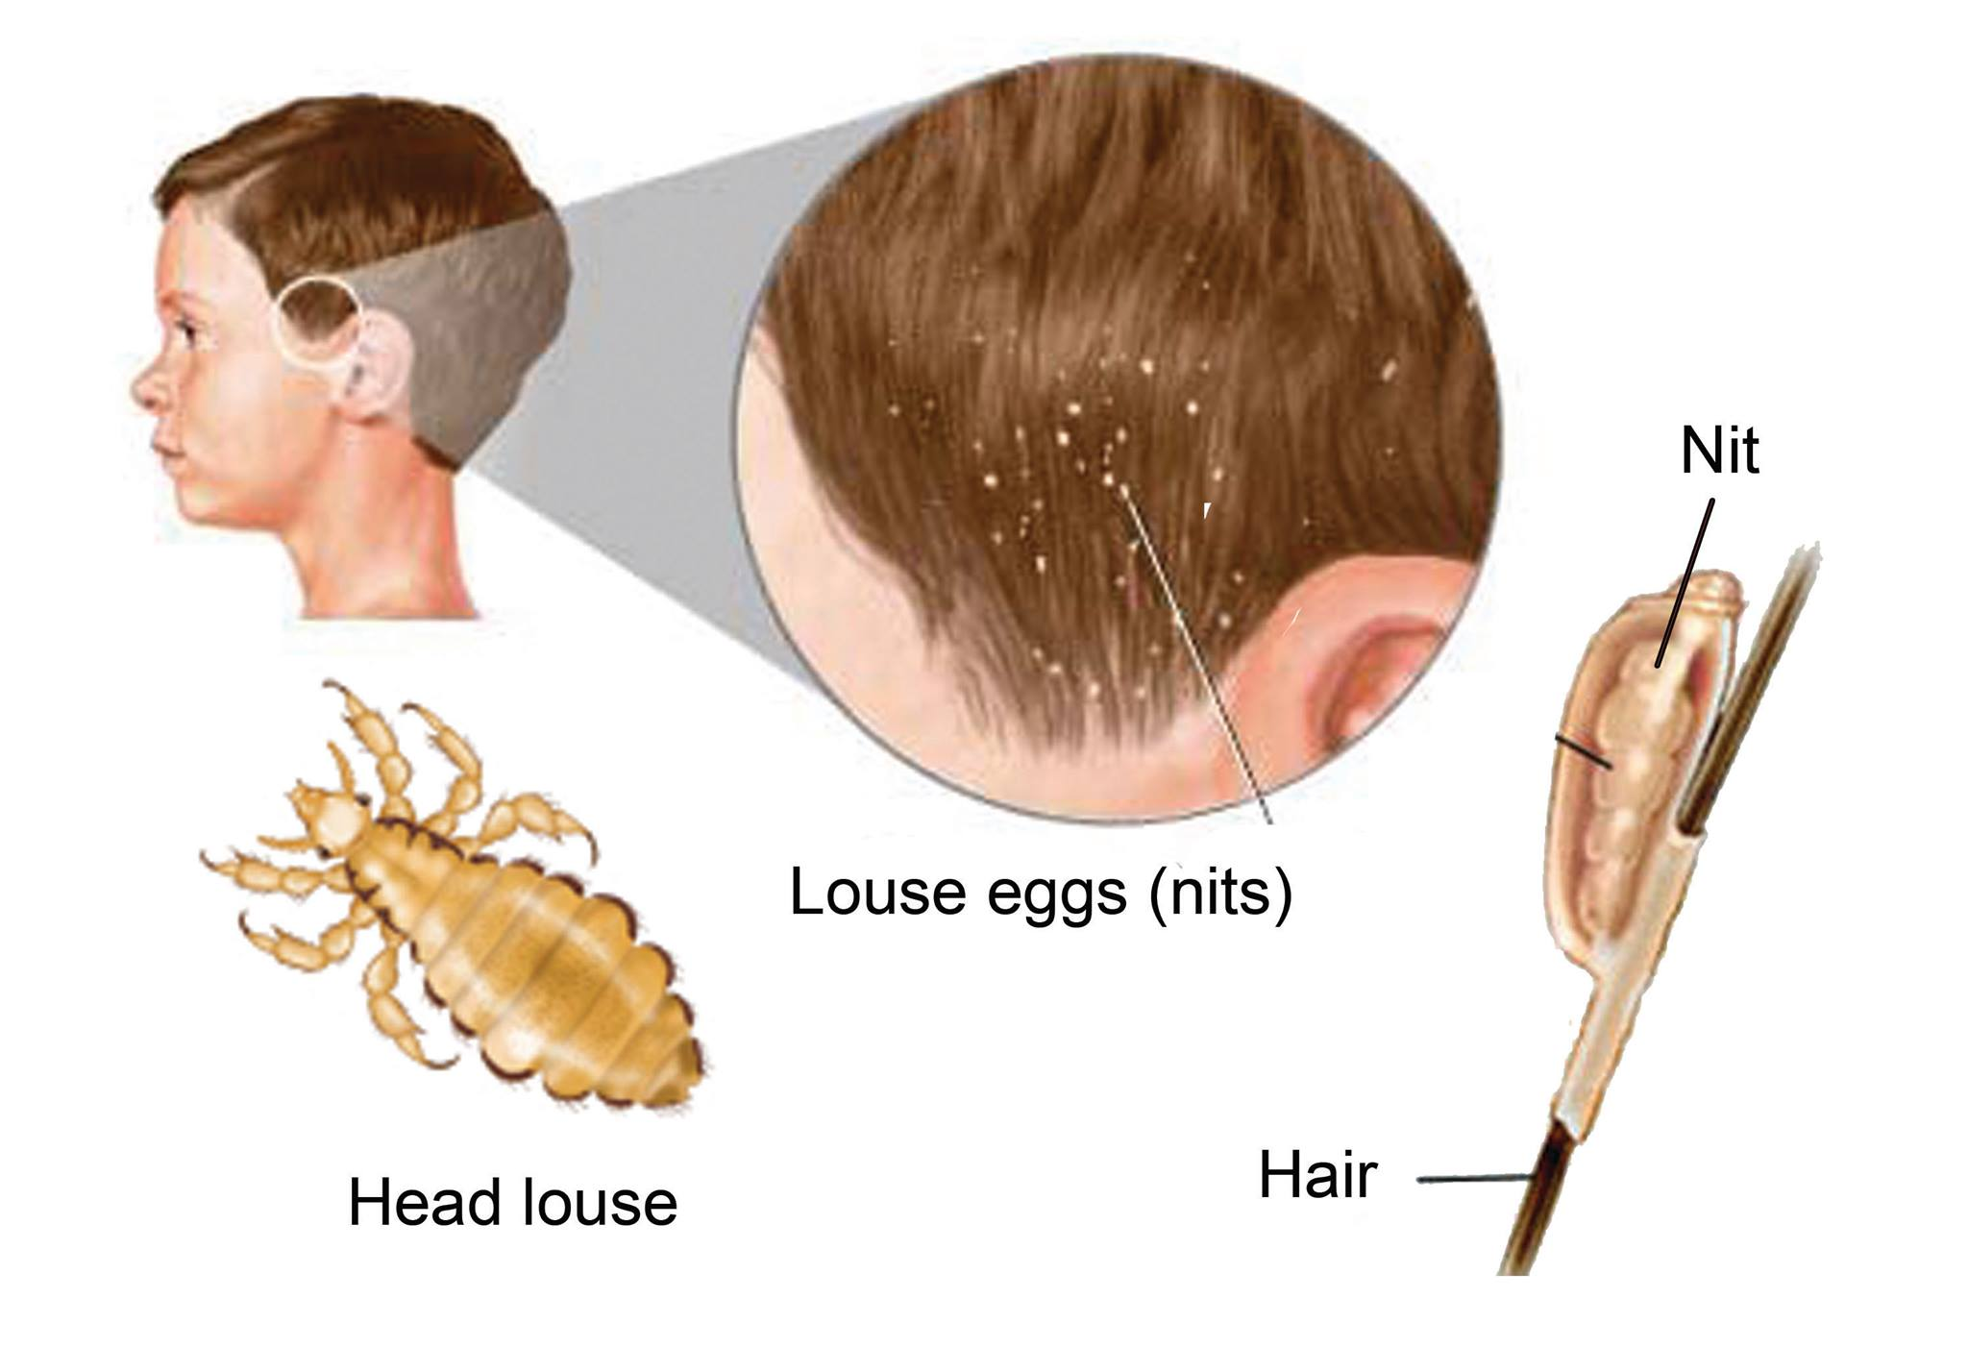
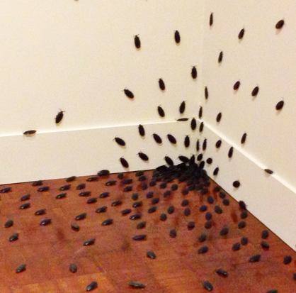
Infestation
Infestation refers to the invasion by larger and complex parasites than microbes
The term infestation is also used to describe invasion of living places by pests

Slide 23
Infestation
In infestation parasites usually live and reproduce on external surface of host body.

Slide 24
Infestation
Infestation can happen both in living organisms and non-living objects.

Slide 25
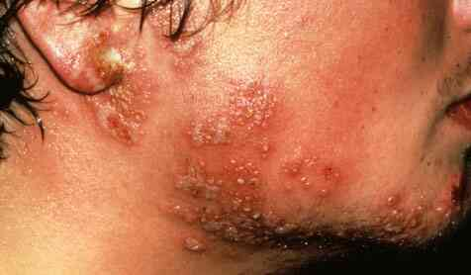
Infection
Infection refers to the invasion by microorganisms like viruses, protozoa and bacteria.
In infection parasites usually enter the internal body tissues and then multiply to disrupt the normal functionality of the cell.
Infection can happen only in living organisms.

Slide 26
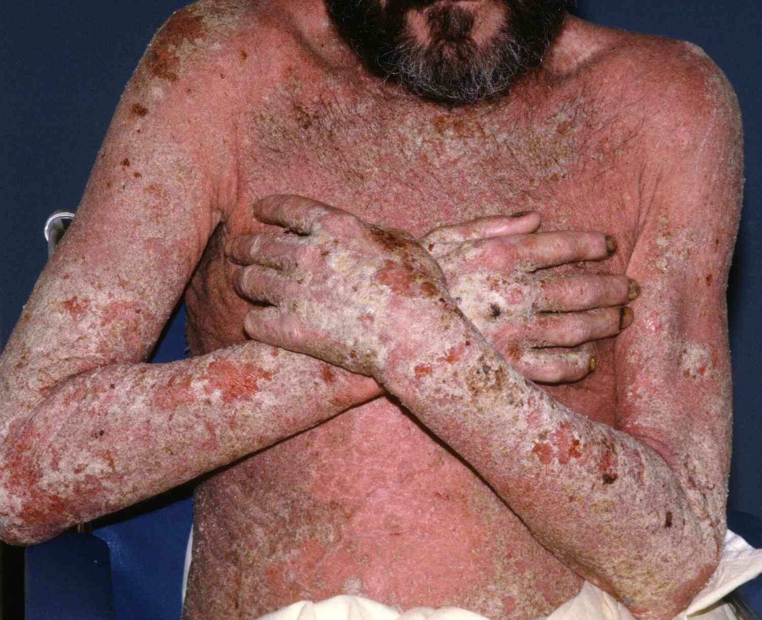
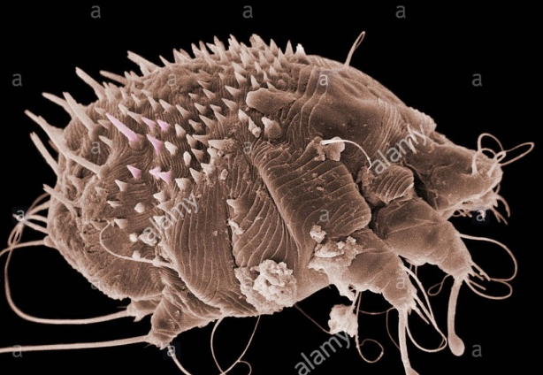
Hyperinfestation
Hyperinfestation refers to invasion by thousands or millions of larger and complex parasites resulting in severe form of diseases. eg. Crusted scabies.
Sarcoptes scabiei

Slide 27
Hyperinfestation
Crusted scabies is a more severe form of scabies with a hyperinfestation of lots of scabies mites.
Sarcoptes scabiei

Slide 28
Hyperinfestation
It can be very extensive and can, if severe, lead to serious secondary bacterial skin infections.
Crusted scabies mainly occurs in people who have a poor immune system (immunocompromised).
Sarcoptes scabiei

Slide 29
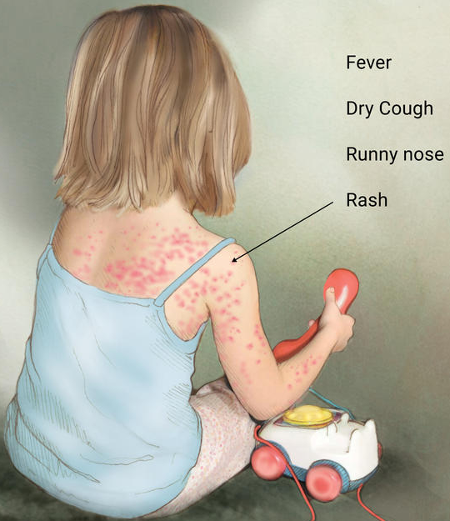
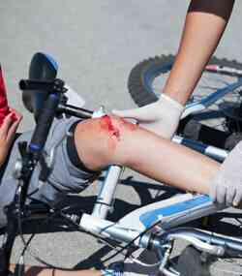
Disease
a disorder of structure or function in an organism,
especially one that produces specific signs or symptoms or
that affects a specific location and
is not simply a direct result of physical injury.
Measles

Slide 30
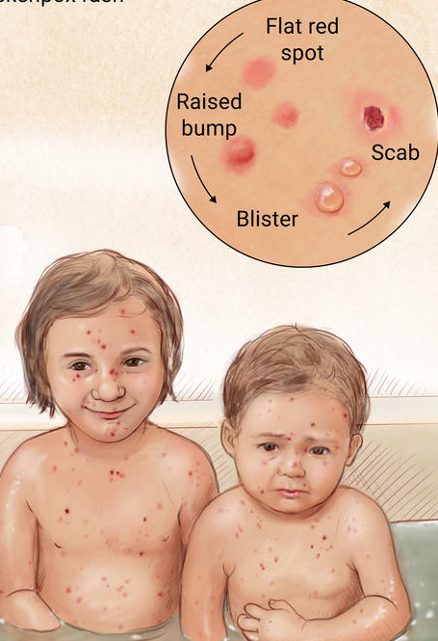
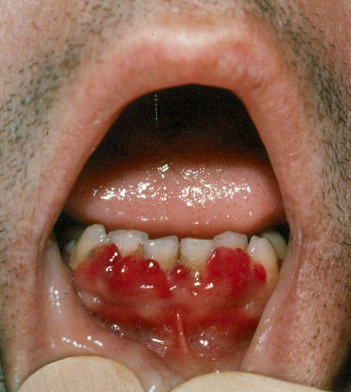
Parasitic disease
A parasitic disease is a disease caused by a parasite.
The parasitic disease usually are designate by generic names of the parasites ending with -iasis or –osis.
e.g., Schistosoma infection is called as schistosomiasis
Measles
Chickenpox
Scurvy

Slide 31
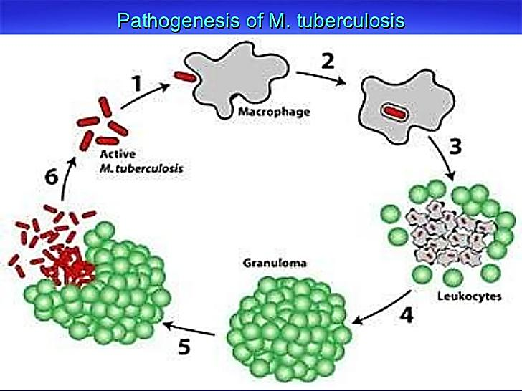
Pathogenesis
Pathogenesis is the manner of development of a disease, or
the biological mechanisms that lead to the diseased state.
Pathogenesis of the parasitic diseases is a dynamic process and depends on the complex interaction of a variety of host and parasitic factors.
Pathogenesis of TB

