Slide 1
Oxygen Requirements for Parasites
Dr. Md Fazlul Haque
Associate Professor
Dept. of Zoology
Rajshahi University

Slide 2
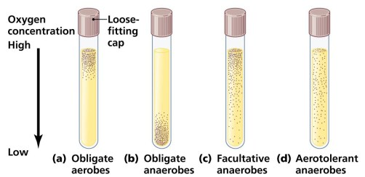
The oxygen requirement of parasites (mainly bacteria) reflects the mechanism used by those particular parasites to satisfy their energy needs in host.

Slide 3
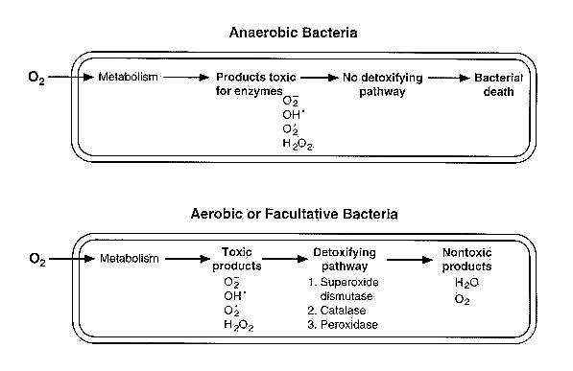
Why oxygen is toxic to some bacteria and how bacteria detoxify toxic oxygen metabolites?

Slide 4
Types of microorganisms
On the basis of oxygen requirements, parasites can be divided into following different categories:
Obligate aerobes
Facultative aerobes or anaerobes
Obligate anaerobes
Aerotolerant anaerobes:
Capnophiles:
Microaerophiles:

Slide 5
Types of microorganisms
Obligate aerobes: They have absolute requirement for oxygen in order to grow. Grow in ambient air, which contains around 21% oxygen and small amount of (around 0.03%) of carbondioxide. e.g. Bacillus cereus. Psuedomonas aeruginosa, Mycobacterium tuberculosis.
Facultative aerobes or anaerobes: They are capable of growth under both aerobic and anaerobic conditions. E.g. Bacteria: Enterobacteriaceae group, Staphylococcus aureus.
Obligate anaerobes: These parasites can grow only in absence of Oxygen and for which Oxygen is toxic. E.g. Clostridium perfringens, Clostridium botulinum;

Slide 6
Types of microorganisms
Aerotolerant anaerobes: They are anaerobic parasites that are not killed by exposure to oxygen. They can only tolerate oxygen but do not grow in it, they can only grow and ferment in anaerobic conditions. Example- Streptococcus.
Capnophiles: Capnophilic parasites require increased concentration of carbondioxide (5% to 10%). The examples of capnophilic bacteria includes: Haemophilus influenzae, Neisseria gonorrhoeae etc.
Microaerophiles: Microaerophiles are those groups of parasites that can grow under reduced oxygen (5% to 10%) and increased carbondioxide (8% to 10%). Higher oxygen tensions may be inhibitory to them. Examples of Microaerophiles are: Campylobacter jejuni, Helicobacter pylori etc.

Slide 7
Oxygen requirement of Protozoa
Aerobes:
Grow in ambient air, which contains around 21% oxygen and small amount of (around 0.03%) of carbondioxide.
However, some aerobic protozoa avoid oxygen tensions above a certain level.
E.g. Plasmodium (Malarial parasite).
Anaerobes:
Usually can not grow in the presence of oxygen.
E.g. Entamoeba histolytica, Trichomonas vaginalis, Giardia
Facultative anaerobes:
They are capable of growh under both aerobic and anaerobic conditions. e.g. Amoeba

Slide 8
Oxygen requirement of Helminthes
Parasitic helminths may be divided into three random groups based upon their metabolic oxygen requirements.
Some helminthes, e.g. adult intestinal parasites such as the nematode Ascaris lumbricoides and cestodes (tapeworms) H. nana. and Taenia crassiceps, require no oxygen in their energy yielding pathways and appear to survive equally well in vitro either anaerobically or aerobically.
Some helminthes are obligate aerobes, e.g. the adult stages of the filarial worm, Litomosoides carinii, which resides in the pleural cavity of some rodents, the nematode of the rat intestine, Nippostrongylus brasilensis, and larval stages of Ascaris.
The third group of parasites is primarily larval stages that require an aerobic metabolism for motility but not for survival. E.g. microfilariae of L. carinii, Brugia pahangi, and Dipetalonema viteae

