Slide 1
Metabolism of Carbohydrate, Lipid and Protein
Dr. Md Fazlul Haque

Slide 2
Metabolism
The sum of the physical and chemical processes in an organism by which its material substance is-
- produced,
- maintained, and
- destroyed,
and by which energy is made available.
Metabolism is usually divided into two types:
- Anabolism
- Catabolism

Slide 3
Anabolism
Constructive or biosynthetic metabolism.
The synthesis of complex molecules in living organisms from simpler ones together with the storage of energy.

Slide 4
Catabolism
Destructive or Energy-yielding metabolism.
The breakdown of complex molecules in living organisms to form simpler ones, together with the release of energy.

Slide 5
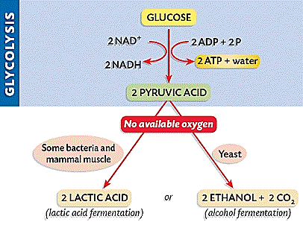
Alanine
Isoleucine
Tyrosine
Notes:
An electron transport chain (ETC) is a series of compounds that transfer electrons from electron donors to electron acceptors via redox reactions, and couples this electron transfer with the transfer of protons (H⁺ ions) across a membrane.
An oxidation-reduction (redox) reaction is a type of chemical reaction that involves a transfer of electrons between two species.
Oxidation is the loss of electrons.
Pepsin---Protein to polypeptide
Trypsin--- Polypeptide to peptide
Erepsin -----Peptide to aminoacid

Slide 6
Glycolysis is the metabolic pathway that converts glucose C₆H₁₂O₆, into pyruvate, CH₃COCOO⁻ + H⁺.
Glycolysis
Notes:
nicotinamide adenine dinucleotide

Slide 7
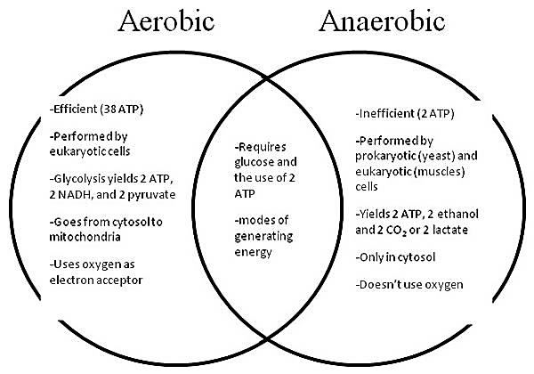
Krebs cycle

Slide 8
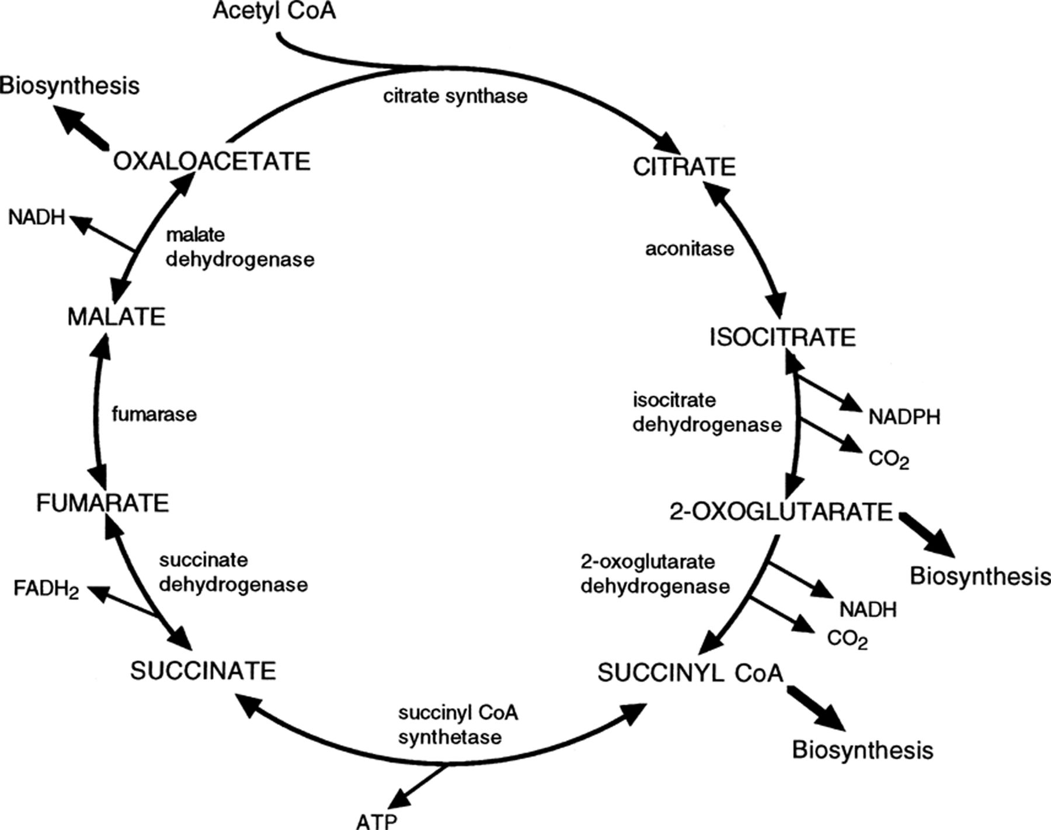
Krebs Cycle
Notes:
Nicotinamide adenine dinucleotide phosphate, abbreviated NADP⁺ or, in older notation, TPN (triphosphopyridine nucleotide), is a cofactor used in anabolic reactions, such as lipid and nucleic acid synthesis, which require NADPH as a reducing agent. NADPH is the reduced form of NADP⁺.
Nicotinamide adenine dinucleotide exists in two forms, an oxidized and reduced form abbreviated as NAD⁺ and NADH respectively

Slide 9
electron transport chain (ETC)
ETC is a series of compounds that transfer electrons from electron donors to electron acceptors via redox reactions, and couples this electron transfer with the transfer of protons (H⁺) across a membrane
Complex I, II, III and IV
Coenzyme ubiquinone (Q)
Coenzyme Cytochrome-c (Cyt c)
(FADH2)
Notes:
An electron transport chain (ETC) is a series of compounds that transfer electrons from electron donors to electron acceptors via redox reactions, and couples this electron transfer with the transfer of protons (H⁺ ions) across a membrane.
Most eukaryotic cells have mitochondria, which produce ATP from products of the citric acid cycle, fatty acid oxidation, and amino acid oxidation. At the mitochondrial inner membrane, electrons from NADH and succinate (FADH2) pass through the electron transport chain to oxygen, which is reduced to water. The electron transport chain comprises an enzymatic series of electron donors and acceptors. These are called complex I, II, III and IV. Each complex contains some coenzymes such as ubiquinone (Q). Each electron donor passes electrons to a more electronegative acceptor, which in turn donates these electrons to another acceptor, a process that continues down the series until electrons are passed to oxygen, the most electronegative and terminal electron acceptor in the chain. Passage of electrons between donor and acceptor releases energy, which is used to generate a proton (H⁺) gradient across the mitochondrial membrane by actively “pumping” protons into the intermembrane space resulting in existence of higher number of proton (H⁺) in that space, producing a thermodynamic state that has the potential to do work. When the proton (H⁺) returns from the intermembrane space into the inner space of mitochondria ADP is phosphorylated to ATP by ATP synthase. The entire process is called oxidative phosphorylation, since ADP is phosphorylated to ATP using the energy of hydrogen oxidation in many steps.

Slide 10
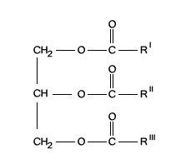
The Catabolism of Lipid

Slide 11
beta-oxidation
beta-oxidation is the catabolic process by which fatty acid molecules are broken down in the mitochondria
-to generate acetyl-CoA, which enters the citric acid cycle, and
-to generate NADH and FADH2, which are co-enzymes used in the electron transport chain.
It is named as such because the beta carbon of the fatty acid undergoes oxidation to a carbonyl group.

Slide 12
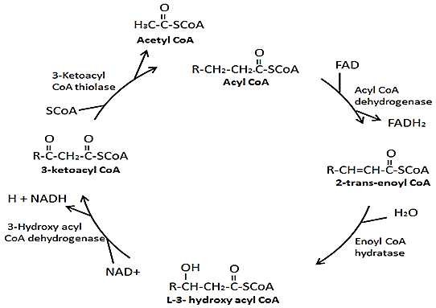
Beta oxidation
Fatty acid
Fatty acyl-CoA
synthase (FACS)
Cleavage
Dehydrogenation
Dehydrogenation
Hydration
Notes:
Once inside the cell, a CoA group is added to the fatty acid by fatty acyl-CoA synthase (FACS), forming long-chain acyl-CoA.
Oxidation is the loss of electrons or an increase in oxidation state by a molecule, atom, or ion. Reduction is the gain of electrons or a decrease in oxidation state by a molecule, atom, or ion.

Slide 13
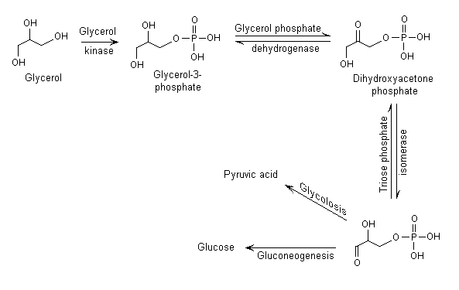
Catabolism of glycerol in humans
Glyceraldehyde 3-phosphate

Slide 14
The Catabolism of Protein

Slide 15
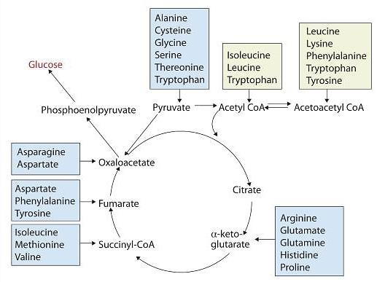
Fates of the Carbon Skeletons of Amino Acids
Notes:
Any amino acid can be converted into an intermediate of the citric acid cycle. Once the amino group is removed, usually by transamination, the α-keto acid that remains is catabolized by a pathway unique to that acid and consisting of one or more reactions. For example, phenylalanine undergoes a series of six reactions before it splits into fumarate and acetoacetate. Fumarate is an intermediate in the citric acid cycle, while acetoacetate must be converted to acetoacetyl-coenzyme A (CoA) and then to acetyl-CoA before it enters the citric acid cycle.
Those amino acids that can form any of the intermediates of carbohydrate metabolism can subsequently be converted to glucose via a metabolic pathway known as gluconeogenesis. These amino acids are called glucogenic amino acids. Amino acids that are converted to acetoacetyl-CoA or acetyl-CoA, which can be used for the synthesis of ketone bodies but not glucose, are called ketogenic amino acids. Some amino acids fall into both categories. Leucine and lysine are the only amino acids that are exclusively ketogenic. Figure 20.7.2
summarizes the ultimate fates of the carbon skeletons of the 20 amino acids.

Slide 16
Transamination
Notes:
Transamination is an exchange of functional groups between any amino acid (except lysine, proline, and threonine) and an α-keto acid. The amino group is usually transferred to the keto carbon atom of pyruvate, oxaloacetate, or α-ketoglutarate, converting the α-keto acid to alanine, aspartate, or glutamate, respectively. Transamination reactions are catalyzed by specific transaminases (also called aminotransferases), which require pyridoxal phosphate as a coenzyme. Alanine and aspartate then undergo a second transamination reaction, transferring their amino groups to α-ketoglutarate and forming glutamate (2nd stage).
Two Transamination Reactions. In both reactions, the final acceptor of the amino group is α-ketoglutarate, and the final product is glutamate.

Slide 17
Transamination
Notes:
Two Transamination Reactions. In both reactions, the final acceptor of the amino group is α-ketoglutarate, and the final product is glutamate.

Slide 18
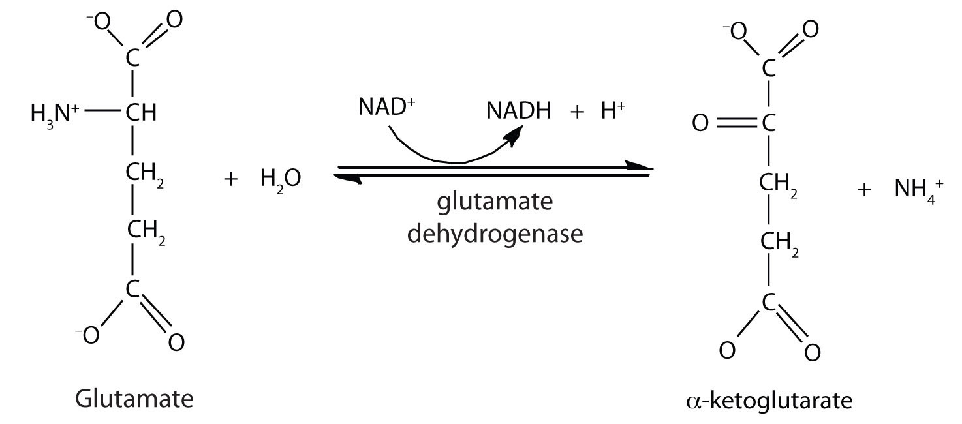
Oxidative Deamination
Notes:
In the breakdown of amino acids for energy, the final acceptor of the α-amino group is α-ketoglutarate, forming glutamate. Glutamate can then undergo oxidative deamination, in which it loses its amino group as an ammonium (NH₄⁺) ion and is oxidized back to α-ketoglutarate (ready to accept another amino group):
This reaction occurs primarily in liver mitochondria. Most of the NH₄⁺ ion formed by oxidative deamination of glutamate is converted to urea and excreted in the urine in a series of reactions known as the urea cycle.
The synthesis of glutamate occurs in animal cells by reversing the reaction catalyzed by glutamate dehydrogenase. For this reaction nicotinamide adenine dinucleotide phosphate (NADPH) acts as the reducing agent. The synthesis of glutamate is significant because it is one of the few reactions in animals that can incorporate inorganic nitrogen (NH₄⁺) into an α-keto acid to form an amino acid. The amino group can then be passed on through transamination reactions, to produce other amino acids from the appropriate α-keto acids.

