Slide 1
Nucleic acid Distribution and Disturbance in host Nucleic Acid Metabolism by parasites
Dr. Md Fazlul Haque
Assistant Professor
Dept. of Zoology
Rajshahi University

Slide 2
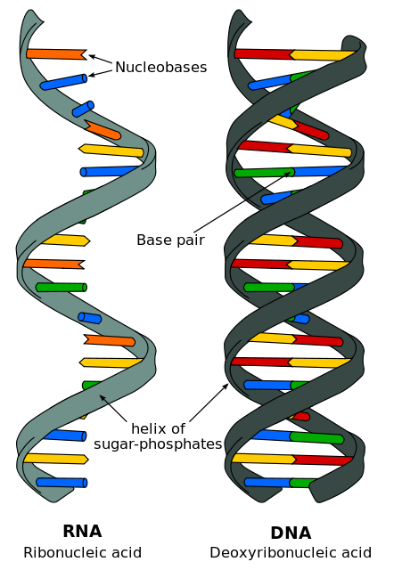
Nucleic acids
Nucleic acids-
are biopolymers, or large biomolecules,
are essential for all known forms of life.
are made from monomers known as nucleotides.
include two natural types: DNA (deoxyribonucleic acid), double stranded molecules
RNA (ribonucleic acid),
single stranded molecules

Slide 3
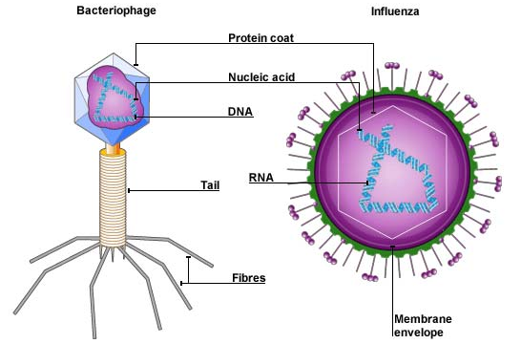
Distribution of Nucleic acid
Distribution of nucleic acid refer to the distribution of DNA and RNA in living cells.
In virus
DNA or RNA is wrapped in a protective coat of protein called the capsid.

Slide 4
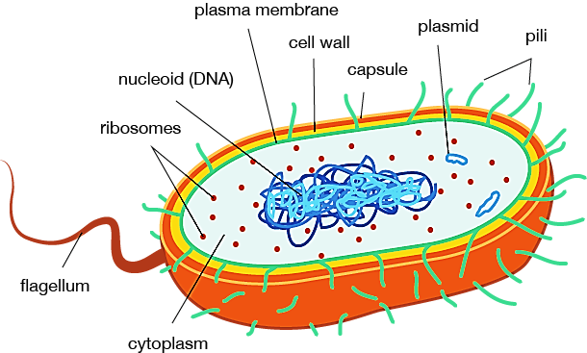
Distribution of Nucleic acid
In prokaryotic cells
DNA (bacterial chromosome) is located in the cytoplasm in a region called the nucleoid.
Plasmid (extrachromosomal DNA) can be found in any location of the cytoplasm except nucleoid region
RNA (mRNA, rRNA and tRNA) is distributed in the cytoplasm including nucleoid region.

Slide 5
Distribution of Nucleic acid
In Eukaryotic cells
Chromosomal DNA is located in the nucleus.
Plasmid (extrachromosomal DNA) can be found rarely in any location of the cytoplasm and nucleus.
Mitochondrial DNA (mtDNA or mDNA) is located in mitochondria
Chloroplasts DNA (cpDNA) is located in chloroplasts.
RNA (mRNA, rRNA and tRNA) is distributed in both nucleus and cytoplasm.

Slide 6
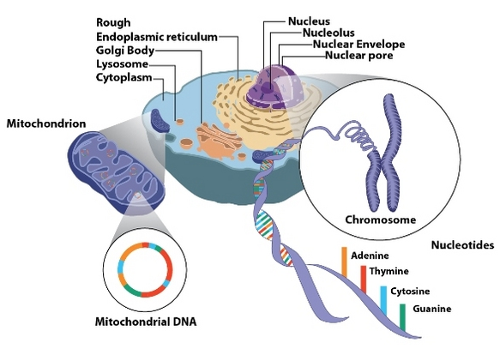

Slide 7
Disturbance in host Nucleic Acid Metabolism by parasites
Parasitic Infection
Parasitic Infection
Normal amount of nucleic acid
in healthy cells
Decrease of enzymes for nucleic acid anabolism
Increase of enzymes for nucleic acid anabolism
Decrease of nucleic acid anabolism
Increase of nucleic acid anabolism
Decrease of nucleic acid content in infected cell than normal.
Increase of nucleic acid content in infected cell than normal

Slide 8
Disturbance in host Nucleic Acid Metabolism by parasites
Parasitic Infection
Parasitic Infection
Normal amount of nucleic acid
in healthy cells
Decrease of enzymes for nucleic acid catabolism
Increase of enzymes for nucleic acid catabolism
Decrease of nucleic acid catabolism
Increase of nucleic acid catabolism
Increase of nucleic acid content in infected cells than normal
Decrease of nucleic acid content in infected cells than normal

Slide 9
Disturbance in host Nucleic Acid Metabolism by parasites
Following types of disturbances in host nucleic acid metabolism have been reported by different studies:
Decrease of DNA content of erythrocytes during infections with Plasmodium gallinaceum
Decrease of DNA content because of increase of nucleic acid catabolism during the Plasmodium berghei infection in rats.
Increase of level of certain enzymes involved in nucleic acid catabolism (nucleases, deaminases, nucleoside phosphorylase, xanthine oxidase) in some organs of rat during the P. berghei infection.

Slide 10
Disturbance in host Nucleic Acid Metabolism by parasites
Decrease of DNA content of tissue culture cells infected with Trichomonas vaginalis
Decrease of level of certain enzymes (adenosine triphosphatase and 5-nucleotidase) involved in DNA anabolism in tissue culture cells infected with T. vaginalis
Decrease of nucleic acid (DNA and RNA) contents in host tissue infected with some helminthes such as Schistosoma japonicum, Clonorchis sinensis, Paragonimus westermani, and larvae of Ascaris lumbricoides

Slide 11
Disturbance in host Nucleic Acid Metabolism by parasites
Depletion of inosine monophosphate (Purine nucleotides are derivative of inosine monophosphate) in the liver of chicken infected with Eimeria necatrix
Decrease of RNA synthesis in the intestinal cells of honey bees infected with Nosema apis
Increase of RNA content in diaphragms of mice infected with Trichinella spiralis

