Slide 1
Osmoregulation and Moulting
Dr. Md Fazlul Haque
Assistant Professor
Dept. of Zoology
Rajshahi University

Slide 2
Osmoregulation
Osmoregulation is the active regulation of the osmotic pressure of an organism's body fluids to maintain the homeostasis of the organism's water content.
Osmoregulation maintains the fluid balance and the concentration of electrolytes (salts in solution) to prevent the fluids from becoming too diluted or too concentrated.
Homeostasis is the property of a system in which variables are regulated so that internal conditions remain stable and relatively constant.

Slide 3
Two major types of Animals depending on osmoregulation
Osmoconformers match their body osmotic concentration to their environment actively or passively. Most marine invertebrates are osmoconformers.
Osmoregulators tightly regulate their body osmotic concentration, which always stays constant. Osmoregulators actively control salt concentrations despite the salt concentrations in the environment. An example is freshwater fish.

Slide 4
Osmoregulatory structure in parasites
Transporter on plasma membrane (Bacteria)
Contractile vacuoles (Protista)
Skin and Flame cell (Helminthes)
Mulpighian tubes (Insect)

Slide 5
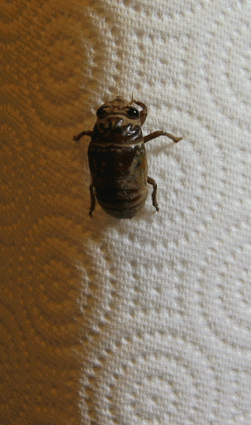
moulting or molting
Moulting or molting, also known as shedding, or in many invertebrates, ecdysis,
Molting is the manner in which an animal routinely replace a part of its body (often, but not always, an outer layer or covering), either at specific times of the year, or at specific points in its life cycle.
Moulting can involve shedding the epidermis (skin), pelage (hair, feathers, fur, wool), or other external layer.
In some groups, other body parts may be shed, for example, wings in some insects or the entire exoskeleton in arthropods.

