Slide 1
Basic concept on Immunity
Immunity is the state of protection against foreign organisms or substances (antigens) or other unwanted biological invasion.
Vertebrates have two types of immunity,
Innate Immunity
Adaptive or Acquired Immunity
Innate immunity refers to nonspecific defense mechanisms that come into play immediately or within hours of an antigen's appearance in the body. These mechanisms include physical barriers such as skin, chemicals in the blood, and immune system cells that attack foreign cells in the body.
Adaptive immunity refers to antigen-specific immune response. The antigen first must be processed and recognized. Once an antigen has been recognized, the adaptive immune system creates an army of immune cells specifically designed to attack that antigen.

Slide 2
Basic concept on Immunity
Humoral immunity is an aspect of immunity that is mediated by macromolecules (as opposed to cells) found in extracellular fluids such as secreted antibodies, complement proteins, and certain antimicrobial peptides.
Cell mediated immunity is an aspect of immunity that does not involve antibodies, but rather involves the activation of phagocytes, antigen-specific cytotoxic T-lymphocytes, and helper T-lymphocyte to release of various cytokines in response to an antigen.
Active immunity is an aspect of immunity that results from the production of antibodies by the immune system in response to the presence of an antigen.
Passive Immunity is an aspect of immunity in which short-term immune response is activated in an individual because of the introduction of antibodies from another person or animal.

Slide 3
trained immunity
Memory was classically considered an exclusive hallmark of adaptive immunity.
But, this dogma was challenged by recent reports that innate immune cells such as macrophages and Natural Killer cells (NK cells) can retain ‘memory’ of earlier stimulation, enabling them to respond strongly to a secondary stimulus, even though it is different from earlier stimulus.
This memory characteristic of the innate immune system is referred as trained immunity.
There are only few evidences of enhanced protection against infections by induction of trained immunity with regulatory agents such as BCG vaccine and β-Glucan.

Slide 4
Differences between Innate and adaptive immunity
Differences | Innate immunity | Adaptive immunity
Components | Physical barriers such as skin Chemical barriers Phagocytic cells, e.g., leukocytes Natural killer cells ( NK cells) Plasma proteins (Complement) | B cells and plasma cells that produce antibody helper T cells, suppressor T cells and cytotoxic T cells
Activity type | Cells of innate immunity are active all the time and are ready to combat as soon as a foreign body enters the human system. These cells are active since birth. | Cells of adaptive immunity are normally in silent mode and become active only when the antigen is identified. The cells of adaptive immunity develops over time.

Slide 5
Differences between Innate and adaptive immunity
Differences | Innate immunity | Adaptive immunity
Response | The response comes immediately, hence also referred to as immediate immunity. | The response appears after a week or two, also called as delayed response type immunity.
Potency | Although the response is immediate but the effectiveness and potency is limited and low. | The potency and effectiveness levels are extremely high because the combat cells are highly specialized and powerful.
Inheritance | Innate type of immunity is generally inherited from parents and passed to offspring. | Adaptive immunity is not passed from the parents to offspring, hence it cannot be inherited, and called acquired immunity.
Type | Primitive type in origin, present in bacteria to human | Developed type in origin, present only in higher organism, vertebrates

Slide 6
Differences between Innate and adaptive immunity
Differences | Innate immunity | Adaptive immunity
Specificity | It can recognize all types of pathogens (viruses, bacteria, fungal organisms), but cannot make fine distinction | The cells of adaptive immunity are highly specific to antigen.
Memory | No memory A same response is produced every time pathogen invades. | Memory present Memory cell “remember” specific pathogen on first exposure; Upon re-exposure to that pathogen, these cells mount a much faster and more potent second response.
Diversity of response | The diversity among response produced is very low. | Diversity is very high.

Slide 7
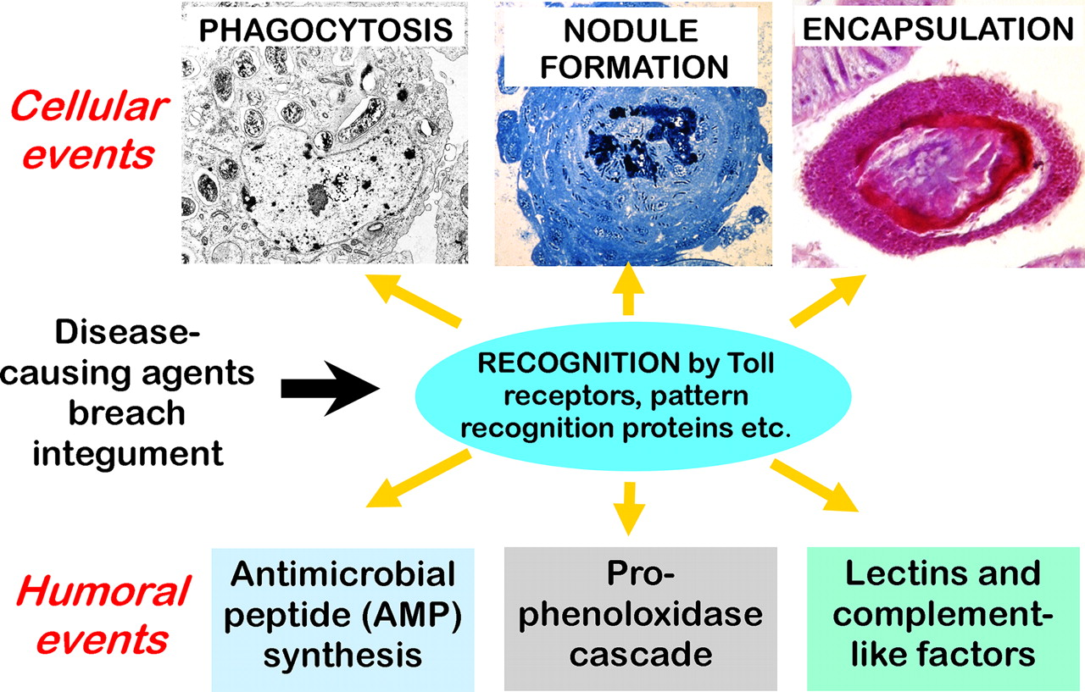
Immunity of invertebrate (parasites)
Notes:
Schematic of the defense strategies of arthropods to parasites and pathogens. Such organisms are recognized by a variety of pattern recognition molecules either free in the plasma or associated with various cell types. The cellular events consist of phagocytosis by specialist “professional” phagocytes while nodule formation removes large numbers of microorganisms from the hemocoel such that they become walled off by a sheath of cells. Encapsulation occurs when larger invaders or damaged self-tissues are recognized and become surrounded by a multilayer of hemocytes. Bacteria and fungi are also killed by AMPs or by intermediates of the prophenoloxidase cascade. Lectins and complement-like factors may act as recognition molecules and aid in the elimination of invading organisms.

Slide 8
Cellular Immunity
Phagocytosis: The core cellular defense function in invertebrates is phagocytosis, a process with two goals, defense from external invaders (by ingestion and elimination of intruding agents), and tissue homeostasis and remodeling (by clearing damaged cells).
Nodule formation: Nodule formation removes large numbers of microorganisms from the hemocoel such that they become walled off by a sheath of cells.
Encapsulation: Encapsulation is a cell-mediated immune defense mechanism of invertebrates, which aims at clearing multicellular parasites, too large to be phagocytosed, from tissues and haemolymph. The haemocytes involved in this process adhere to each other and onto the surface of foreign particles through adhesion molecules, forming multilayer cellular sheaths. Haemocytes also release cytotoxic factors for killing the invaders.

Slide 9
Humoral Immunity
Prophenoloxidase (PO): The PO precursor proPO is constitutively synthesized by a subset of haemocytes, the granular cells, and released and activated in response to microbial compounds or endogenous factors produced upon tissue damage. Active PO leads to melanization of microorganisms or damaged tissues. Melanin acts as a physical shield that prevents or delays parasite growth.
Antimicrobial Peptides: Antimicrobial peptides/proteins are of particular importance for invertebrate defense, as they are toxic for bacteria, yeasts, filamentous fungi, protozoa, and enveloped viruses, thereby preventing infections. Despite a large structural diversity, AMPs have in common the ability to permeabilizing microbial membranes, leading to cell death.
Complements: The complement system is one of the major defensive tools of all metazoans. The complement system enhances the ability of phagocytic cells to clear microbes and damaged cells from an organism.

Slide 10
The main invertebrate haemocytes involved in immune response.
Pro-haemocyte: Immature cell identified as pro-haemocyte or lymphocyte-like cell. The undifferentiated pro-haemocyte is small, with a big nucleus containing a large amount of heterochromatin and a prominent nucleolus.
Amoeboid phagocytes: These are motile vacuolated cells. Depending on the species, amoeboid phagocytes are involved in phagocytosis, migration, wound repair, non-self-recognition, transplant reaction, cytotoxicity, encapsulation, endocytosis, and enzymatic digestion of engulfed material.

Slide 11
The main invertebrate haemocytes involved in immune response.
Granular cells: These are mature cells which are able to synthesize a number of cytotoxic and defense factors and store them in granules. Degranulation occurs upon challenge with stressors.
Hyaline cells: These are vacuolated or non-vacuolated cells. They are mainly involved in phagocytosis.

Slide 12
The main invertebrate haemocytes involved in immune response.
Oenocytoid cell: These cells are large cells with a low nuclear-cytoplasmic ratio, which show phenoloxidase activity in the cytoplasm. This suggests that oenocytoid cells could play a role in the melanization process.
Spherule or morula cell: These haemocytes are berry-shaped cells, sometimes pigmented, with highly refractive cytoplasmic inclusions. They are actively involved in encapsulation and synthesize, transport and release various defensive factors during infections, including antimicrobial proteins, cytotoxic factors, and opsonins.

Slide 13
The main invertebrate haemocytes involved in immune response.
Lamellocyte: These flat cells with adhesive properties appear in the lymph glands and haemolymph during larval development and differentiate in response to parasite infection. They are active in neutralizing and encapsulating materials recognized as “non-self,”.

Slide 14
Mechanisms used by parasites to Evade host immunity
Immune-evasion mechanisms can be classified into two major types depending on mode of action:
Passive evasion
Active modulation and interference
Passive evasion
Parasites can passively evade the immune system in a variety of ways as mentioned below.
Hiding away from immune system
Parasites can hide away from the immune system by invading immune-privileged tissue such as the central nervous system or the eye.
Also some parasitoids place their eggs inside tissue such as the fat body that is not well patrolled by the host’s immune system.

Slide 15
Mechanisms used by parasites to Evade host immunity
Changing surface identity of parasites
Parasites can change their surface identity as the T-cells and antibodies of the vertebrate’s immune system recognize specific epitopes (the antigenic surface of a parasite).
The parasite escapes this recognition by changing its antigenic surface during the course of infection.
Often, parasites store surface variants that are successively expressed; for example, Plasmodium falciparum has approximately 60 stored variants.
Parasites can also evade by mutation of their epitopes. In HIV, for example, such mutants arise with sufficient frequency to outpace the immune system.

Slide 16
Mechanisms used by parasites to Evade host immunity
Shielding surface components of parasites
Parasites can become ‘invisible’ to the immune system. This is, for example, achieved by shielding surface components as soon as they become opsonized by the host’s immune system (e.g. in Plasmodium).
Entering dormant stage
The parasite can temporarily become inactive and so escape the immune system (dormancy).
For example, bacteria can go dormant stage with little or no metabolic activity and no cell division. They thereby avoid being blocked by components that target the cell replication step.

Slide 17
Mechanisms used by parasites to Evade host immunity
Active modulation and interference
Parasites commonly interfere with the regulatory network that orchestrates the various arms of the immune defense.
But parasites also interfere with basic functions of the host’s cells. For such interference, parasites produce or code (in the case of viruses) for molecules that are able to block or modulate general cellular functions that are crucial for host defence (e.g. cell motility).
Modulatory molecules are deployed in different ways.
For example,
During the course of coevolution with their hosts, some parasites, the viruses in particular, have captured genes from their hosts to produce molecules that disarm host immunity.

Slide 18
Mechanisms used by parasites to Evade host immunity
Continued:
These genes code for ‘natural’ host molecules that regulate the host’s immune response (host cytokines becoming virokines), or
These genes code for host molecules acting as decoy receptors (that bind a ligand, inhibiting it from binding to its normal receptor) and thus inhibiting the immune response (host receptors becoming viroreceptors)

