Slide 1
Hello Welcome to the class
Its Our 8th class

Slide 2
Today’s content
Cultural and International Tourism for Life's Enrichment
Introduction
Life-Seeing Tourism
The Romance of Pleasure Travel
Developmental and Promotional Measures
Anthropography (Geography of Humankind)

Slide 3
Introduction
The highest purpose of tourism is to become better acquainted with people in other places and countries that builds a better world for all. Travel raises levels of human experience, recognition, and achievements in many areas of learning, research, and artistic activity

Slide 4
Categories of Tourism
Travel experiences vary according to the varieties of humankind and their geographical distribution.
Valene L. Smith has identified six categories of tourism:
1. Ethnic tourism 4. Environmental tourism
2. Cultural tourism 5. Recreational tourism
3.Historical tourism 6. Business tourism.
Obviously, destinations can, and usually do, provide more than one type of tourism experience.

Slide 5
Other Tourist Appeal
Fine Arts
Music and Drama
Handicraft
Industry and Business
Agriculture
Education
Literature and language
Science
Govt.
Religion
Food and Drink
History and Prehistory

Slide 6
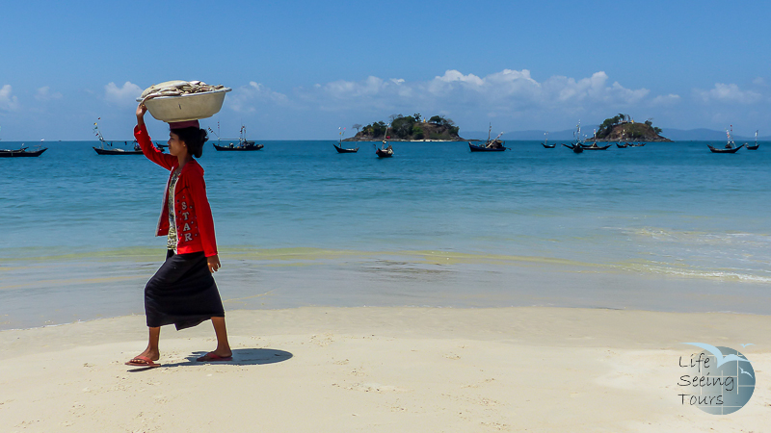
Life Seeing Tourism

Slide 7
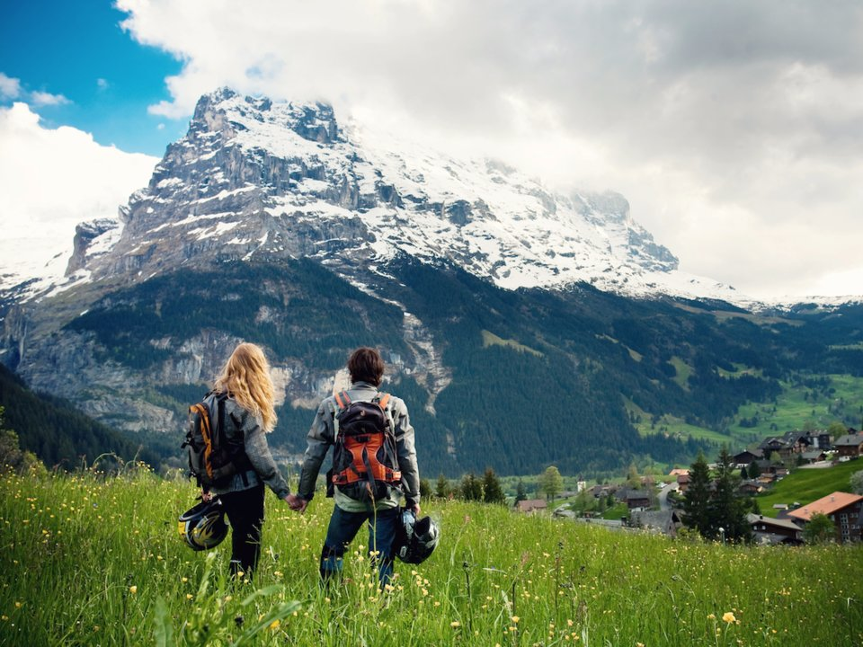
The Romance of Pleasure Travel

Slide 8
Developmental and Promotional Measures
Development of Methods and Techniques
Improvement in Educational and Cultural Content of Tourism
Concentration of Activities around Important Themes
Uses of Mass Media
Development of Out-of-Season Tourism

Slide 9
Anthropography (Geography of Humankind)
Anthropography is defined as the branch of anthropology that describes the varieties of humankind and its geographical distribution. One of the most important motivations for travel is interest in the culture of other peoples.
The Mexicans are not like the Swiss, and the Balinese are not like the Eskimos.
Our natural curiosity about our world and its peoples constitutes one of the most powerful travel motivating influences. A travel agent or other travel counsellor must be familiar with the basic differences in culture among the peoples of the world, where accessible examples of such cultures are located, and which of these cultures (or groups of cultures) would be most interesting to a particular would-be traveller.

Slide 10
End Of The Class

