Slide 2
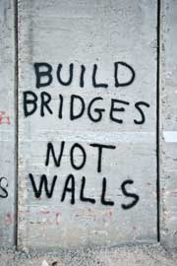
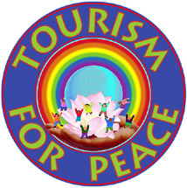
Tourism and Peace
Tourism is believed to have a positive effect on world peace. When people travel from place to place with a sincere desire to learn more about their global neighbours, knowledge and understanding grow. Then, at least a start has been made in improving world communication, which seems so important in building bridges of mutual appreciation, respect, and friendship.

Slide 3
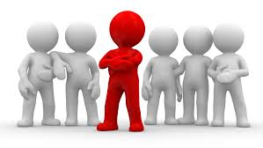
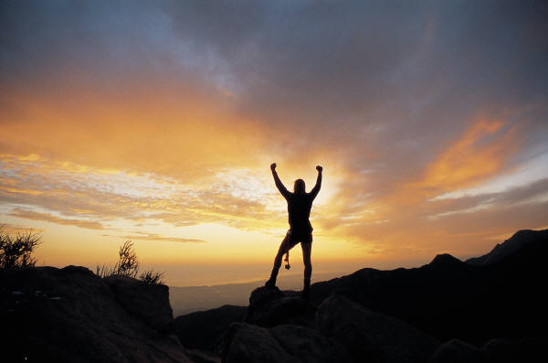
Effects on the Individual
Someone who travels, particularly to a strange location, often finds an environment that is unfamiliar, not only geographically but also personally, socially, and culturally. The effects of travel experiences are profound—on the host society as well as on the traveller, particularly because travel experiences often are among the most outstanding memories in the traveller’s life.

Slide 4
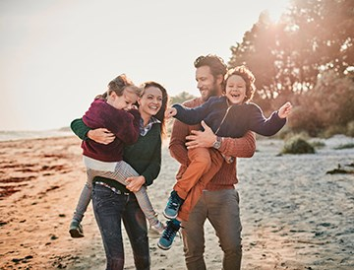
Effects on the Family
As a family is growing and the children are maturing, the trips taken as a family are highlights of any year. The excitement of preparation and anticipation and the actual travel experience are memorable occasions of family life. Family travel may also be educational. Study before taking the trip and expert travel counselling greatly add to a maximization of the trip’s benefits.

Slide 5
Effects on Society
Travel has a significant influence on national understanding and appreciation of other people. The presence of visitors in a country affects the living patterns of indigenous peoples. The way visitors conduct themselves and their personal relationships with citizens of the host country often has a profound effect on the mode of life and attitudes of local people. This greatly increases the awareness of one another’s character and qualities, building appreciation and respect in both groups.

Slide 6
Thanks
End Of The Session.

