Slide 1
Hello Everyone…….
This is our 12th class

Slide 2
Today’s content
Life Characteristics and Travel
Emergence of Group Travel Patterns
Principal Social Effects of Tourism
The International Tourist
Barriers to Travel

Slide 3
Life Characteristics and Travel
Rising standards of living, changes in the population age composition, better communication, increased social consciousness of people relating to the welfare and activities of other people throughout the world, have combined to produce an interest among nations in all other nations. These are the considerable factors for tourism. There have other factors which must be considered as a tourism manager. That’s are:

Slide 4
Travel Patterns Related to Age

Slide 5
Senior Citizen Market

Slide 6
Growing Senior Citizen Market in a Chart

Slide 7
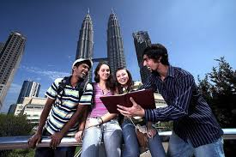
Income & Education

Slide 8
LGBT Tourism
A growing market that is getting a lot of attention is the gay and lesbian market. Lesbian, gay, bisexual, and transgender (LGBT) tourism is a highly profitable segment. It is also referred to as pink tourism. Gay tourism has moved from being almost invisible to something that is studied by academics for its social impact and counted by tourism suppliers for its considerable dollar impact.

Slide 9
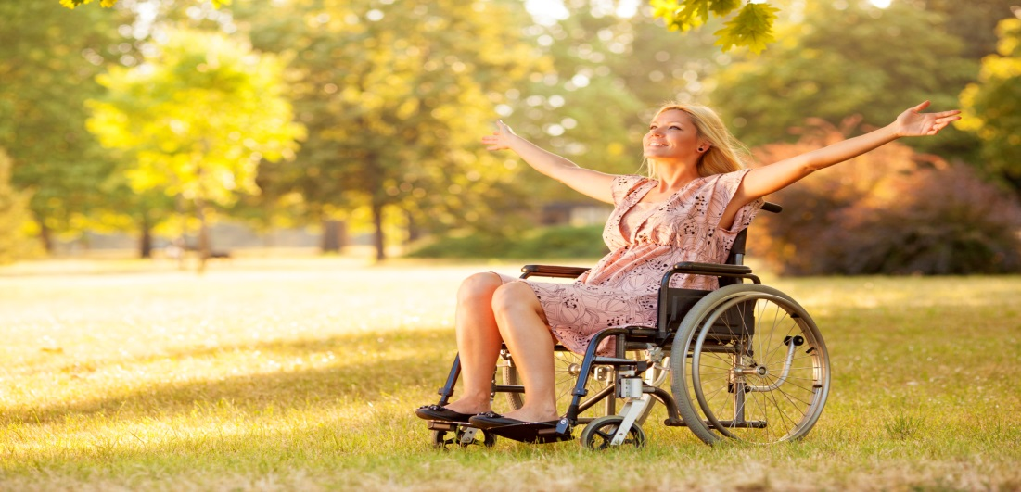
Travel for People with Disabilities

Slide 10
Emergence of Group Travel Patterns
Group travel involves a group combining both transportation and ground services into tours. Different retail travel agents and tour wholesalers, organize group tours (group inclusive tours or GITs) that they sell to travellers. Some group travel arrangements are:

Slide 11
Travel Clubs

Slide 12
Low-Priced Group Travel

Slide 13
Public Carrier Group Rates and Arrangements

Slide 14
Incentive Tours

Slide 15
Special-Interest Tours

Slide 16
Principle social Effects of Tourism
The vacation and special business trips a person takes are often among life’s most vivid memories.
For families, vacation trips taken together are among the highlights of the year’s activities.
The presence of visitors in a particular area can affect the living patterns of local people.
On a national basis, people of a particular country can have their lives changed by tourism.

Slide 17
Principle Social Effects Of Tourism
For both hosts and guests, the most satisfying relationships are formed when they can meet and interact socially at a gathering.
Tourism’s effects on crime are negligible, but tourists can become easy victims of crime. Hosts must help them avoid dangerous places and areas.
Social tourism is a form of travel wherein the cost is subsidized by the traveller’s trade union, government, public carrier, hotel, or association.

Slide 18
The International Tourist

Slide 19
The International Tourist
There are four extremes relating to the travel preferences of international tourists:
Complete relaxation to constant activity (Relaxation versus Activity)
Traveling close to one’s home environment to a totally strange Environment (Familiarity versus Novelty)
Complete dependence on group travel to traveling alone (Dependence versus Autonomy)
Order to disorder (Order versus Disorder)

Slide 20
Barriers to Travel
While travel has become a popular social phenomenon, there are a number of reasons why people do not travel extensively or do not travel at all. The reasons, products of psychological analysis, are not meant to be ultimate answers as to why people travel where they do.
For most barriers to travel fall into six broad categories:
1. Cost 4. Family stage
2.Lack of time 5. Lack of interest
3.Health limitations 6. Fear and safety

Slide 21
Cost

Slide 22
Time

Slide 23
Health Limitations

Slide 24
Family Stage

Slide 25
Lack of Interest

Slide 26
Fear And Safety
Things unknown are often feared, and in travel, much is often not familiar to the would-be traveller. Wars, unrest, and negative publicity about an area will create doubt and fear in the mind of the prospective traveller. Terrorism has reared its ugly head in the last decade and is a deterrent to travel.

Slide 27
End of The Session

