Slide 1
Good Afternoon
This is our 15th Class

Slide 2
Today’s Content
Tourism Supply

Slide 3
Supply Components

Slide 4
Supply Components
Tourism supply components are classified into four broad categories. These are:
Natural resources and environment
Built environment
Operating sectors
Spirit of hospitality and cultural resources

Slide 5
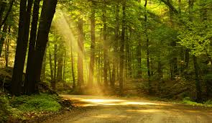
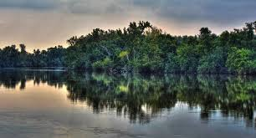
Natural Resources and Environment
This category constitutes the fundamental measure of supply the natural resources that any area has available for the use and enjoyment of visitors. Basic elements in this category include air and climate, physiography of the region, natural beauty, and water supply for drinking, sanitation, and similar uses.

Slide 6
Built Environment

Slide 7
Built Environment Components
Built environment is an important supply components that has been created by humans. It includes:
Infrastructure and Superstructure
Auto Traveller Services
Roadside Parks

Slide 8
Roadside Restaurant

Slide 9
Operating Sectors
It is the operating sectors that deliver the tourism experience and tend to be viewed by the media, public, and visitors as the ‘‘tourism industry.’’ It is the task of the operating sectors to develop and deliver tourism services and experiences with a spirit of hospitality so they will be memorable. It Includes:
Accommodation
Transportation

Slide 10
Spirit of Hospitality and Cultural Resources
The development of hospitality resources is perhaps the most important factor in tourism. The finest physical facilities will be worthless if the tourist feels unwelcome. A favourable attitude toward the visitor can be created through programs of public information and propaganda and initial welcoming (often by local volunteers). Cultural programs such as ‘‘Meet the Danes’’ (home visitation arrangements) help greatly in this respect.

Slide 11
Activities Tourists Enjoy Most

Slide 12
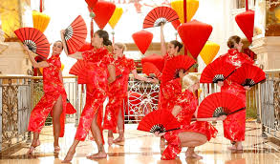
Entertainment, Recreation, and Other Activities

Slide 13
Special Events

Slide 14
Shopping

Slide 15
Museums and Art Galleries

Slide 16
Sports

Slide 17
End Of The Class
Bye For Today…… See You Soon

