Slide 1
GLYCOGEN STORAGE DISEASES
Dr Md rezaul karim
Dept. of Biochemistry & Mol. Biology
University of Rajshahi

Slide 4
There are six subtypes of this disease out of which only three will be discussed here.

Slide 9
POMPE DISEASE

Slide 11
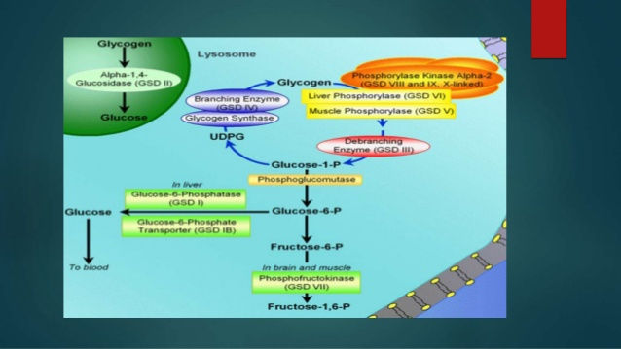

Slide 12
