Slide 1
Hello …
This is our 18th Class
Our Today’s Chapter is ‘Hospitality and Related Services.’

Slide 2
Today’s Content
The Lodging Industry
The Food Service Industry

Slide 3
The Lodging Industry (Accommodation and Food Services

Slide 4
Accommodations structure

Slide 5
The Lodging Industry
World hotel room inventory grows about 2.5% a year
Occupancy rates average about 65% overall
72% of the world’s hotel rooms are located in Europe and North America. Europe has 45% of the rooms.

Slide 6
Lodging Industry in Bangladesh

Slide 7
Resorts and Timesharing
Timeshare is a way to purchase a share, or piece, of a resort that guarantees a high-quality vacation experience at least once every year. There are different types of products—points-based, weeks-based, or a combination—that offer flexibility and a variety of options. Timeshare is also known as vacation ownership.
Put simply, there are two types of timeshare ownership—deeded and non-deeded. Most resorts today are deeded, in which the owner buys a deeded interest in real property. These are usually called “timeshare estates” under state laws. Non-deeded interests are “timeshare uses” or “timeshare licenses” but may also be called “memberships.”

Slide 8
Types of Timeshare
1. Deeded Timeshare Ownership.
2. “Right to use” vacation interval option.
Fixed or Floating Time
Fractional Ownership
Lockoff or Lockout
Points-based vacation plans
3. Exchange Timeshare.

Slide 9
Why Timeshare
Perhaps one of the greatest benefits of owning a timeshare is that you are pre-paying for your future vacations at today’s prices. You’ll no longer have to say, “I can’t afford to go on vacation this year,” as timeshare guarantees regular vacations, with all the relaxing and rejuvenating benefits of vacationing.
If you ask timeshare owners what they value most about their vacations, they will say: flexibility, affordability, variety, exchange, and comfort.

Slide 10
The Food Service Industry
Like the lodging industry ,the food service industry is a very old business. Such a service came out of the early inns and monasteries. In cities, small restaurants began serving simple dishes such as soups and breads.
With the development of stagecoaches, taverns began providing food and lodging along the early road and in small communities .Some believe that these roadside taverns were really the beginnings of the American hotel industry. As cities grew so did eating establishments. Some names of historic restaurants in the 1820s in New York City were Niblo’s Garden ,the San Souci, and Delmonico’s.

Slide 11
Food Industry in Bangladesh
Food industry is a rapidly growing sector in Bangladesh, employing a significant portion of the labor force in the country. Between 2004 and 2010, the food processing industry in Bangladesh grew at an average 7.7 percent per annum. Bangladesh Bureau of Statistics, in its 25006 Economic Census, reported that there were approximately 246 medium-sized food processing industries employing 19 percent of the industrial manufacturing workforce in Bangladesh or 8 percent of the total manufacturing labor force. The food industry employs 2.45 percent of the country's total labor force and its share in the GDP was 2.01 percent in 2010. There are also numerous small scale factories and domestic units engaged in food processing throughout the country. According to some industry analysts, the food processing sector in Bangladesh is a 4.5 billion US Dollar industry. In 2010, Bangladesh exported over $700 million worth of processed food and beverages, over 60 percent of them were shrimp and fish products.

Slide 12
Food Services Structure

Slide 13
Kinds of the food service
1)local restaurants . That include fast-food units, coffee shops, specialty restaurants, family restaurants, cafeterias, and full-service restaurants.
2)travel food service. It contains food operations in hotel and motels.
3) contract institutional food service.
4) vending

Slide 14
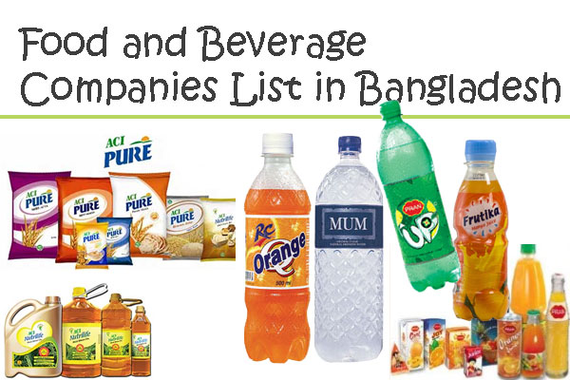
Top 10 Food & Beverage Industry in Bangladesh
1. Transcom Beverages Ltd.
2. Square Food & Beverage Ltd. (SFBL)
3. Akij Food and Beverage Ltd.
4. Partex Beverage Ltd.
5. PRAN Foods Ltd.
6. ACI Foods Ltd.
7. IFAD Multi Products Ltd.
8. Fu-Wang Foods Ltd.
9. Ispahani Foods Ltd.
10. Bombay Sweets & Co. Ltd.

Slide 15
End of Today’s Class
An extra class will be held in this week. Till then Good bye.

