Slide 1
FLAVONOID BIOSYNTHESIS

Slide 4
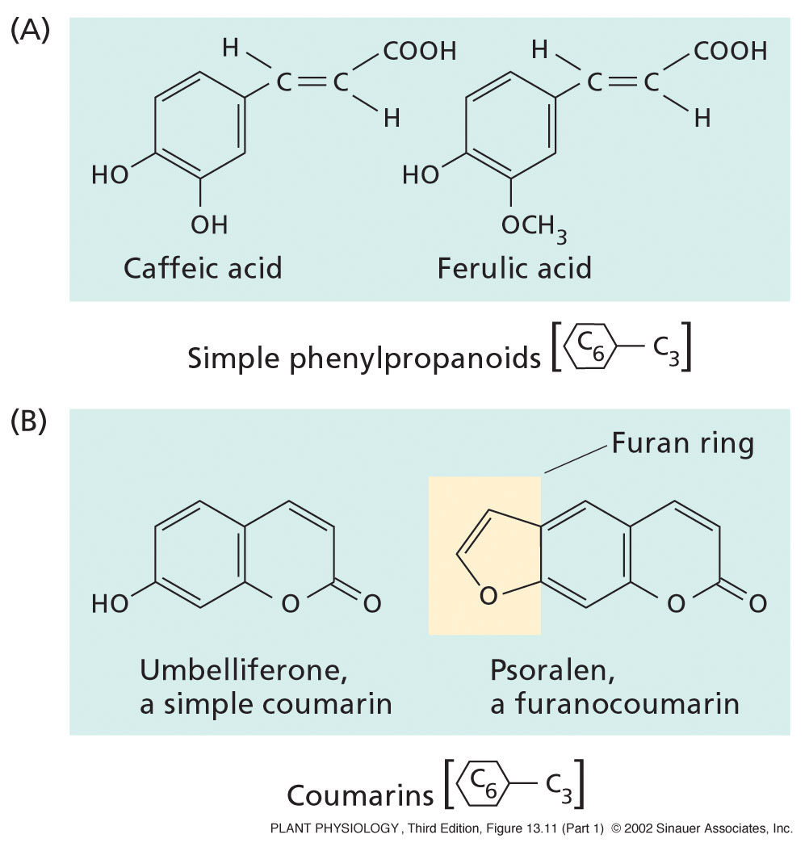
Simple phenolics
Caffeic acid
& ferulic acid
implicated in
allelopathy.
Psoralen is one
of several
phototoxic
furanocoumarins,
(UV activated)
Fig. 13.11
Notes:
PP13111.jpg

Slide 5
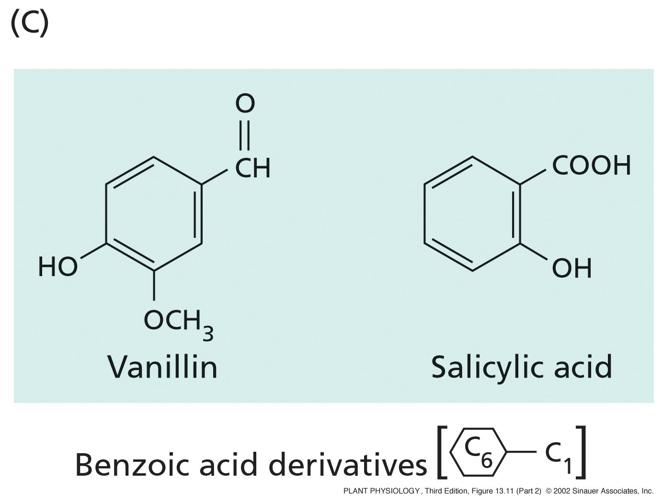
Simple phenolics
Fig. 13.11
Notes:
PP13112.jpg

Slide 6
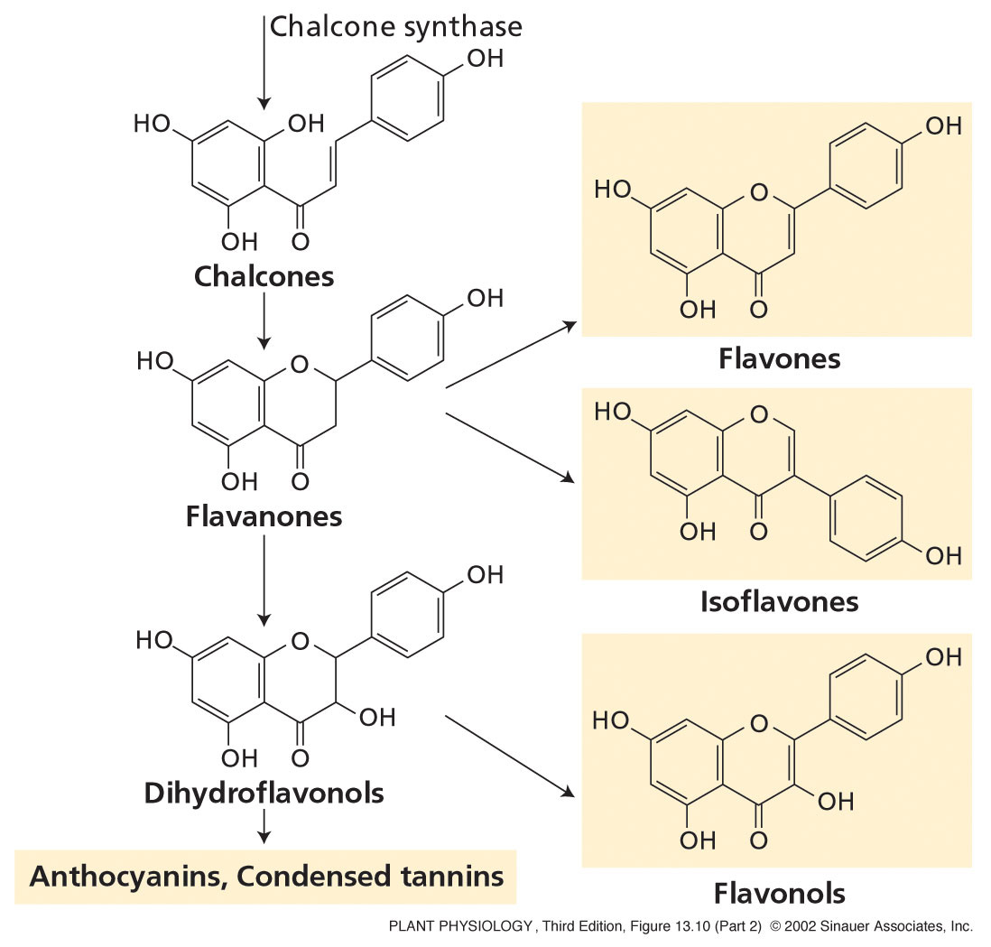
3. Flavonoids - basic structure is two aromatic
rings joined by a 3C bridge.
anthocyanins
flavones
flavonols
isoflavonoids
Fig. 13.10
Notes:
PP13102.jpg

Slide 7
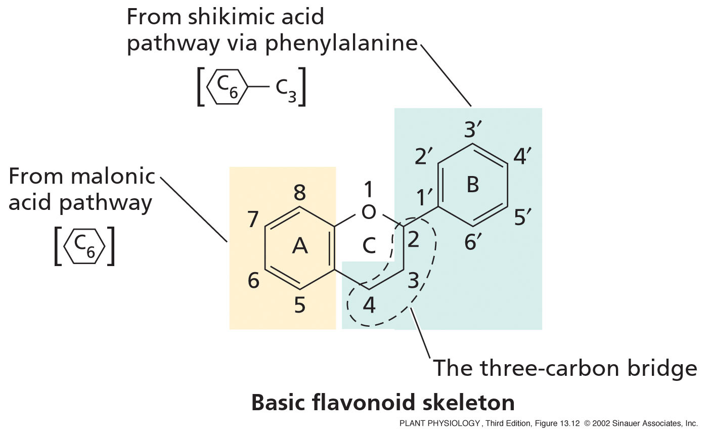

Slide 8
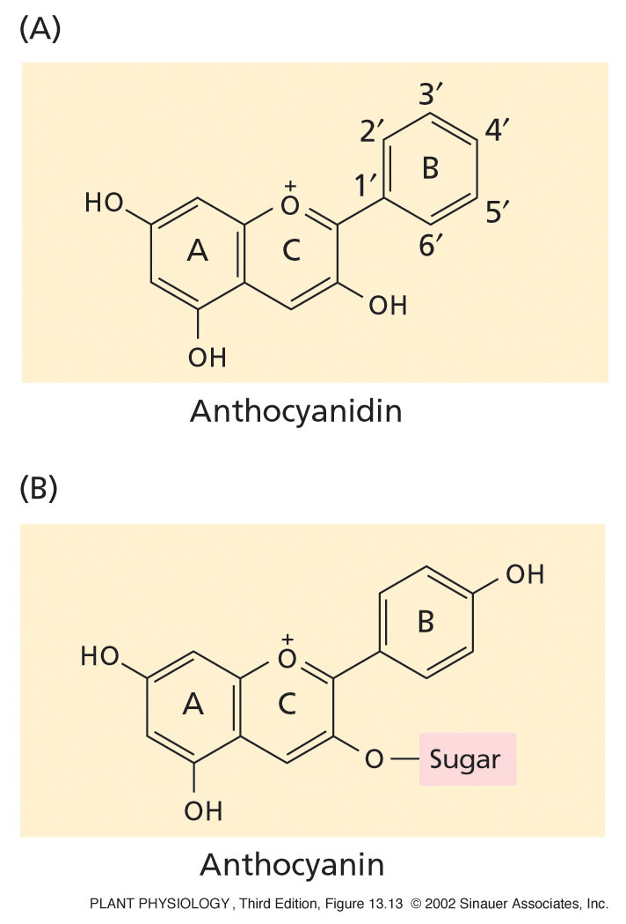
Fig. 13.13
Flavonoids
a) Anthocyanidins and
anthocyanins are pigments
that give plant tissues
red, blue, and purple
color.
Pollinator attraction
Disperser attraction
Notes:
PP13130.jpg

Slide 9
The term “tannin” is derived from the tanning process in which raw animal hides are preserved by rubbing tannins on them. The tannins help to complex the proteins and keep them from degrading.
This protein-binding property of tannins lends them their toxicity to herbivores.
tannins can bind digestion enzymes in the gut of herbivores.
tannins also form complex polymers when bound to proteins which are difficult to digest, thus decreasing the nutritional value of the plant material.

Slide 10
Tannins
Condensed
-formed by polymerization of flavonoid units
-common in woody plants
Hydrolyzable
- contain phenolic acids: gallic acid, & simple sugars
- smaller molecules than condensed tannins
- more easily hydrolyzed and degraded
Tannins reduce growth and survival of many different kinds of herbivores
Also act as antioxidants - eat your isoflavonoids Johnny!

Slide 11
Many foods contains tannins (e.g. tea, red wine) and have some healthy side effects for humans (e.g. disallowing constriction of blood vessels)
Tannins also make protein less digestible.
Animals can sense high levels of tannins in their food and opt for another food resource (e.g. mule deer, beavers).
High levels of tannins in diet can actually kill some animals.

Slide 12
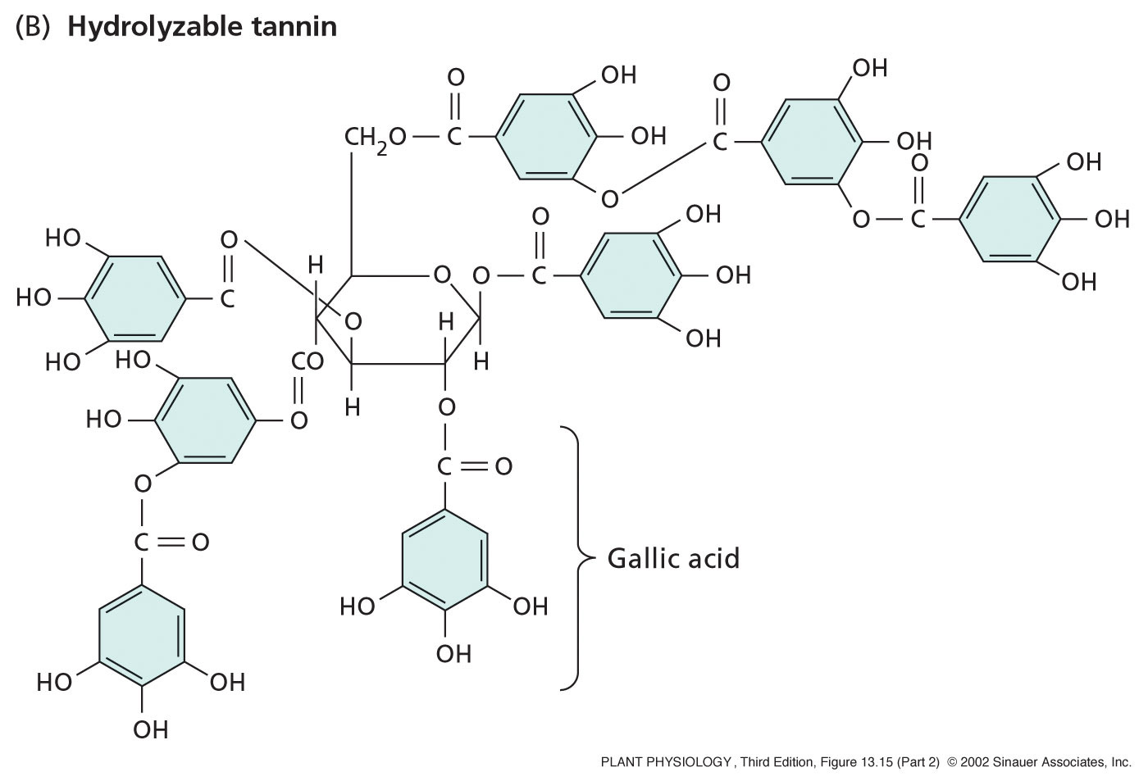
Hydrolyzable tannins are made of phenolics and sugars.
Fig. 13.15
Notes:
PP13152.jpg

Slide 13
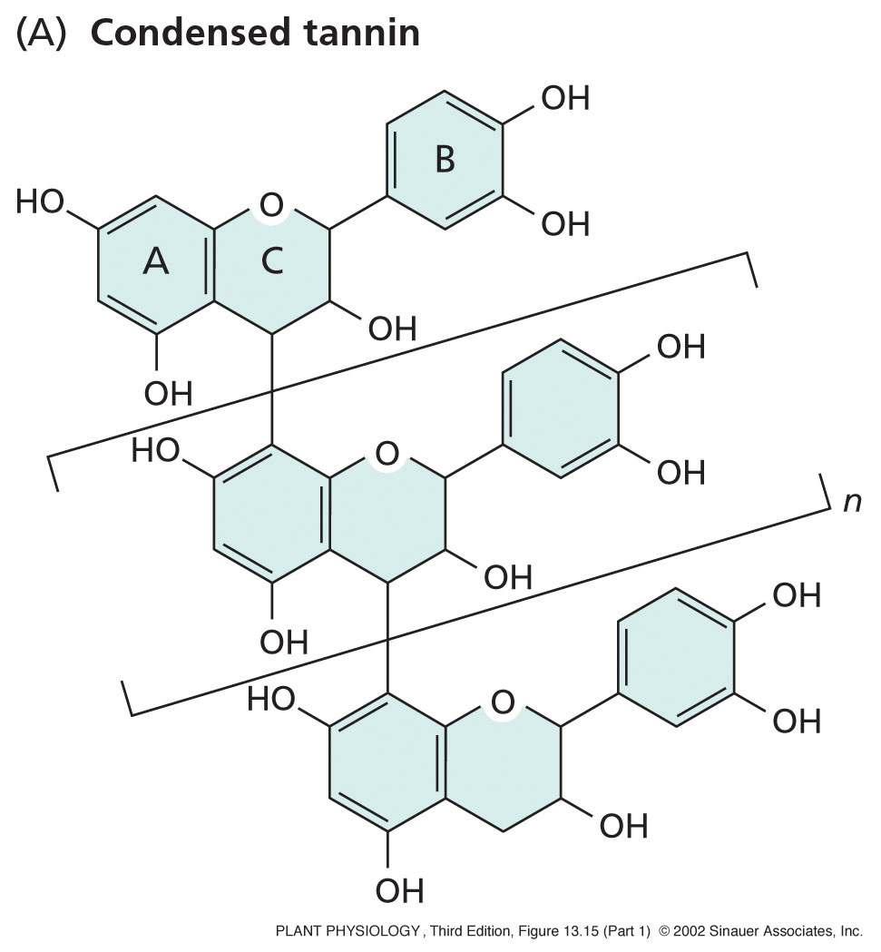
Condensed tannins are polymerized
flavonoids.
Notes:
PP13151.jpg

Slide 14
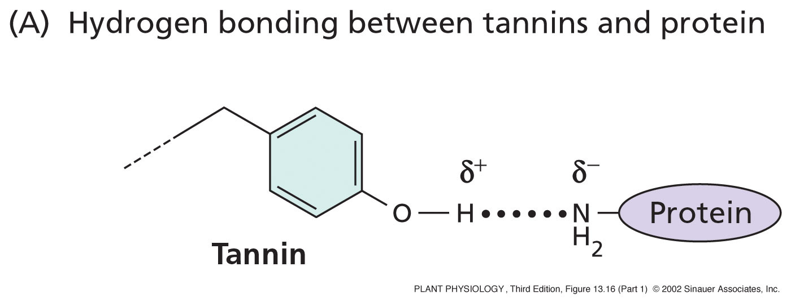
Tannins can reduce nutritional value of tissues by binding to proteins, making them less digestible.
Fig. 13.16
Care for a spot of milk in your tea?
Notes:
PP13161.jpg

Slide 15
