Slide 1
Industrial Production of vitamin B12
DR MD REZAUL KARIM
PROFESSOR
DEPARTMENT OF BIOCHEMISTRY& MOLECULAR BIOLOGY
UNIVERSITY OF RAJSHAHI

Slide 2
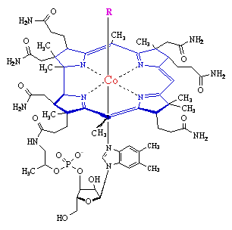
VITAMIN B12 (cobalamin)
Vitamin B12, is also called cobalamin, cyanocobalamin and hydroxycobalamin.
It is built from :
A nucleotide and
A complex tetrapyrrol ring structure (corrin ring)
A cobalt ion in the center.
A R- group
When R is cyanide (CN), vitamin B12 takes the form of cyanocobalamin.
In hydroxycobalamin, R equals the hydroxyl group (-OH).
In the coenzyme forms of vitamin B12,
R equals an adenosyl group in adenosylcobalamin.
R equals a methyl (-CH3) group in methylcobalamin.
Vitamin B12 is synthesized exclusively by microorganisms (bacteria, fungi and algae) and not by animals and is found in the liver of animals bound to protein as methylcobalamin or 5'-deoxyadenosylcobalamin.

Slide 3
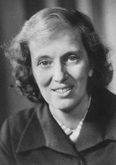
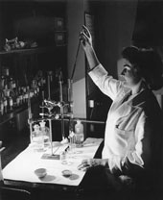
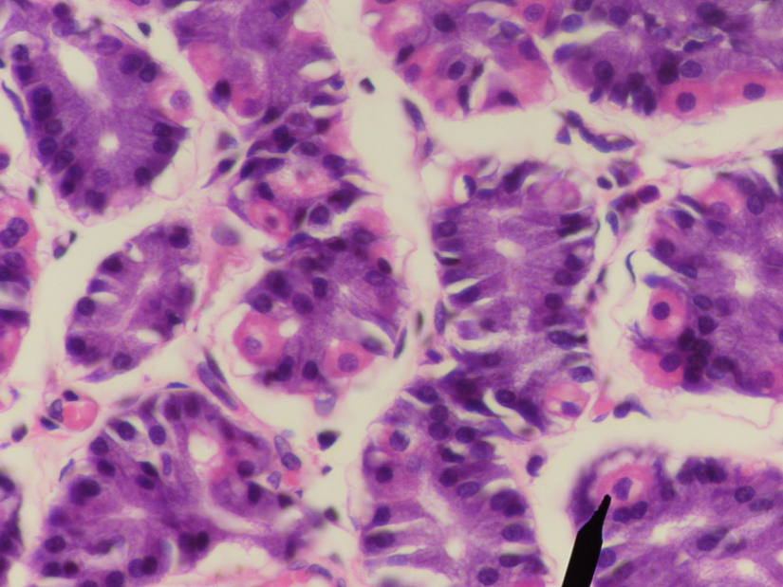
Known as the "red" vitamin because it exists as a dark red crystalline compound, Vitamin B₁₂ is unique in that it is the only vitamin to contain cobalt (Co³⁺) metal ion, which, gives it the red color.
The vitamin must be hydrolyzed from protein in order to be active.
Intrinsic factor, a protein secreted by parietal cells of the stomach, carries it to the ileum where it is absorbed.
It is transported to the liver and other tissues in the blood bound to transcobalamin II.
It is stored in the liver attached to transcobalamin I.
It is released into the cell as Hydroxocobalamin (see the next slide)
In the cytosol it is converted to ethylcobalamin.
Or it can enter mitochondria and be converted to 5’-deoxyadenosyl cobalamin.
Dorothy Crowfoot Hodgkin
(1910-1994)
Dr. Stadtman in her lab
Parietal cells of the stomach

Slide 5
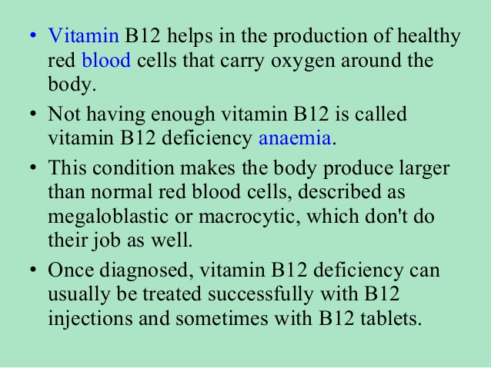

Slide 10
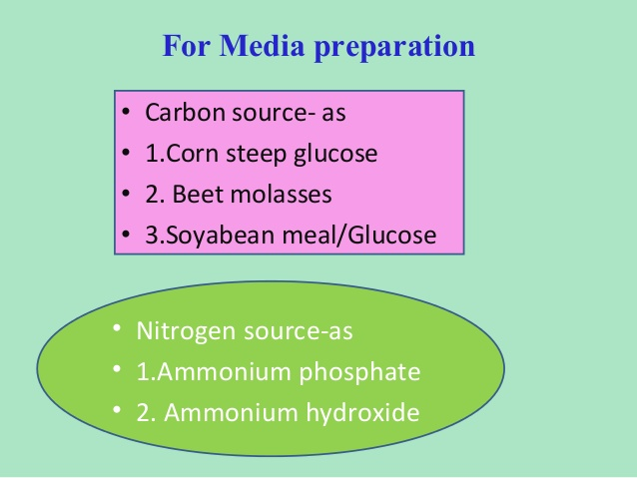

Slide 11
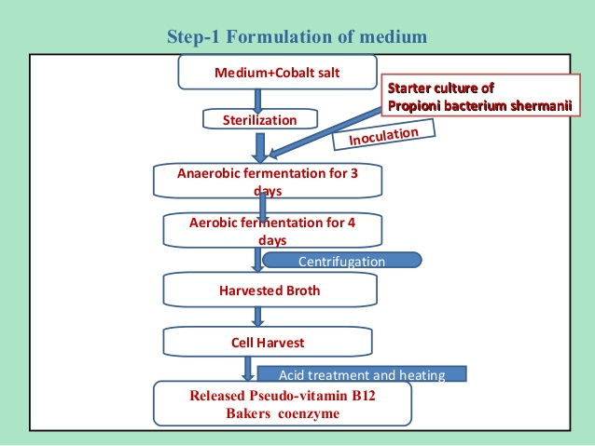

Slide 12
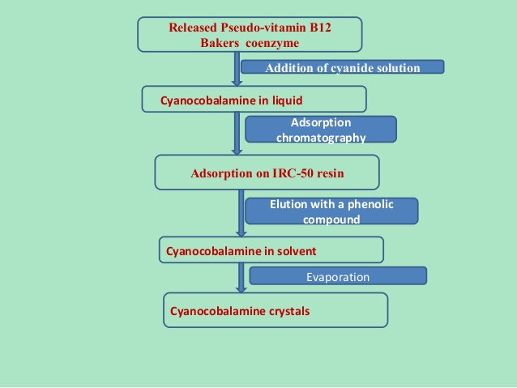

Slide 26
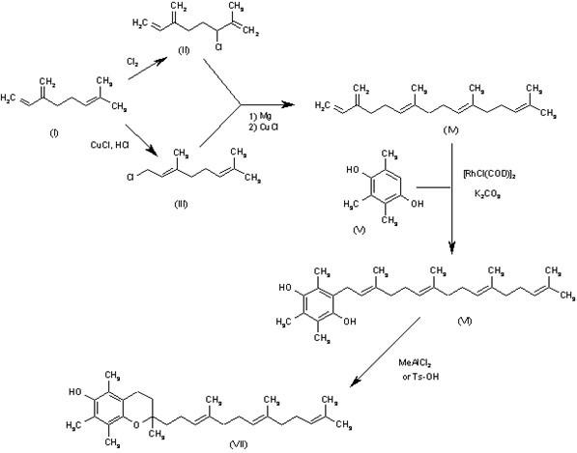
Vitamin E (CAS NO.: 59-02-9), with other names as 2(R),5,7,8-Tetramethyl-2-[4(R),8(R), 12-trimethyltridecyl]-3,4-dihydro-2H-1-benzopyran-6-ol, could be produced through the following synthetic routes.

Slide 27
The chlorination of myrcene (I) with Cl₂ in refluxing pentane gives the choromyrcene (II), and the hydrochlorination of (I) catalyzed by CuCl yields a mixture of geranyl/neryl chloride (III). The reductive coupling of (II) and (III) by means of Mg and CuCl affords beta-springene (IV), which is condensed with 2,3,6-trimethylhydroquinone (V) by means of cyclooctadienyl rhodium chloride dimer [RhCl(COD)]₂ and K₂CO₃ in refluxing toluene to provide the adduct (VI). The cyclization of (VI) by means of MeAlCl₂of Ts-OH in refluxing hexane furnishes the tocotrienol (VII), which is finally hydrogenated with H₂ over Pd/C in ethanol to give the target (rac)-vitamin E.

