Slide 1
Rational of a plant cell culture for secondary metabolite production
DR MD REZAUL KARIM
PROFESSOR
DEPARTMENT OF BIOCHEMISTRY& MOLECULAR BIOLOGY
UNIVERSITY OF RAJSHAHI

Slide 2
The principal advantage of recent technologies is that it may provide continuous, reliable source of plant pharmaceuticals and could be used for the large-scale culture of plant cells from which these metabolite can be extracted.
Plant cell and tissue cultures hold great promise for controlled production of myriad of useful secondary metabolites on demand.
However, most often trials with plant cell cultures fail to produce the desired products.
In such cases, strategies to improve the production of secondary metabolites must be considered.
One of the main problems encountered is the lack of basic knowledge of the biosynthetic routes and mechanisms responsible for the production of plant metabolites.
Where the productivity of the desired metabolites is limited by the lack of particular precursors, biotransformation using an exogenous supply of biosynthetic precursors, genetic manipulation, and metabolic engineering may improve the accumulation of compounds.

Slide 3
Not all cell types produce the desired metabolite
Within a specific cultivar of Catharanthus roseus, 62% of the clones produced the desired metabolite
whereas in another only 0.3% produced the metabolite
Culture conditions must be optimized
e.g. concentrations of sugar, hormones, and vitamins, light and temperature.

Slide 4
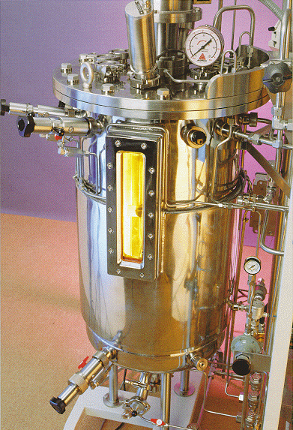
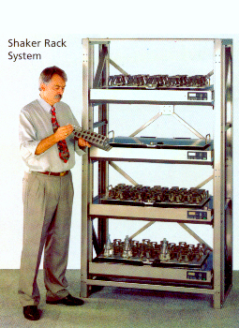
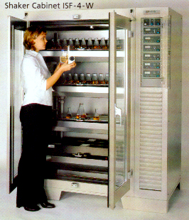
Cell can be grown on shakers or in fomenters

Slide 5
Metabolite production is frequently higher in cell cultures
Berberine production from Coptis japonica is about 5% of dry weight after 5 years of root growth, which equals 0.17 mg/g per week.
Whereas in selected cell lines it can be 13.2% of the dry weight in cell culture after 3 weeks, which is about 44 mg/g/week or about 250 times higher

Slide 6
Metabolites can be produced in root cultures
Many secondary metabolites are produced in roots. Scientists have developed a form of root culture using Agrobacterium rhizogenes, the cause of hairy root disease. (Show Fig 14.3)
Cells transformed with some of the bacteria’s DNA, causes the cells to be more sensitive to the hormones they produce. The cells form into roots. These roots grow very fast and produce the secondary metabolites that ordinary roots produce.

Slide 7
Root cultures are often better than cell cultures
Roots often secrete the metabolites into the surrounding medium, making it easy for collection.
Charcoal can be added to the medium, the metabolites are absorbed by the charcoal, and this stimulates even higher production of the metabolite.

Slide 8
Biochemical pathways of secondary metabolites can be quite long (sometimes up to 12 steps)
Precursors can be fed to either cell culture or roots to produce the metabolite in question.
In addition, cells can be genetically engineered to over-produce the metabolite, but this may be more difficult with pathways that have many enzymes.
Some goals are to eliminate secondary metabolites.
Cannabinoids: to make hemp plants cannabinoid-free
Caffeine: to produce caffeine-free plants

Slide 9
Elicitors, compounds triggering the formation of secondary metabolites, can be abiotic or biotic.
Natural elicitors include polysaccharides such as pectin and chitosan, which are also used in the immobilization and permeabilization of plant cells.
Immobilization with suitable bioreactor system provides several advantages, such as continuous process operation, but for the development of an immobilized plant cell culture process, natural or artificially induced secretion of the accumulated product into the surrounding medium is necessary.

Slide 10
In order to obtain high yields suitable for commercial exploitation, efforts have been focused on isolating the biosynthetic activities of cultured cells.
It can be achieved by:
optimizing the cultural conditions,
selecting high-producing strains and employing precursor feeding,
transformation methods,
and immobilization techniques.
Transgenic hairy root cultures have revolutionized the role of plant tissue culture in secondary metabolite production.
They are unique in their genetic and biosynthetic stability, faster in growth, and more easily maintained.
Using this methodology, a wide range of chemical compounds has been synthesized.
Advances in tissue culture, combined with improvement in genetic engineering of pharmaceuticals, nutraceuticals, and other beneficial substances.
Recent advances in the molecular biology, enzymology, and fermentation technology of plant cell cultures suggest that these systems will become a viable source of important secondary metabolites

Slide 11
Some secondary metabolites produced in cell and root culture
L-DOPA: a precursor of catecholamines, an important neurotransmitter used in the treatment of Parkinson’s disease
Shikonin: used as an anti-bacterial and anti-ulcer agent
Anthraquinone: used for dyes and medicinal purposes
Opiate alkaloids: particularly codeine and morphine for medical purposes
Berberine: an alkaloid with medicinal uses for cholera and bacterial dysenterry
Valepotriates: used as a sedative
Ginsenosides: for medicinal purposes
Rosmarinic acid: for antiviral, suppression of endotoxin shock and other medicinal purposes
Quinine: for malaria
Cardenolides or Cardioactive glycosides: for treatment of heart disease.

Slide 12
Taxol is a very good target for biotechnology
a) tissue culture of bark cells
b) fungus produces taxol
c) alternative species
d) genetic engineering
e) chemical synthesis

Slide 13
a) tissue culture of bark cells
Many cells from different bark tissues from different trees were screened.
There are at least 25 fold differences in production. It was found to be secreted into the medium thus facilitating collection.
So far 1 to 3 mg of taxol are produced per liter of cell culture. This is equivalent to about 25 g of bark.

Slide 14
b) fungus produces taxol
It was found that a fungus that colonizes yew trees also produces taxol
Fungal culture technology which is better developed than plant cell culture technology could be an important source for taxol production
c) alternative species
Some researchers found that the European Yew (Taxus baccata) produces a precursor to taxol.
This precursor can then be converted to an analog of taxol in the laboratory.
The precursor is used for chemical synthesis of taxol.

Slide 15
d) Genetic engineering
Other scientists are trying to identify and clone the genes which produce taxol.
This will enable them to scale up production in cell culture.
e) Chemical synthesis
Until 1994, chemical synthesis was formidable 3 different ways to synthesize taxol are now known.
Some take up to 13 steps
Cost per patient still expensive; about $20,000 .

Slide 16
The economics of large-scale plant cell culture favor only a few products at the present time
This is because it usually takes 10 years of research to produce a product. This requires that a product sell for at least $400 per kg to make it economically worthwhile.
Producing secondary metabolites in tissue culture may have a negative impact on the economics of the Third World countries

Slide 17
Many of these Third World countries may lose market share to superior, more efficient production of secondary metabolites in industrial countries.
Is this right? Is it fair? Are third world countries capable of competing? What should they do?

