Slide 2
Today’s Topic
1. Product and services
2. Levels of products and services
3. Product and service classification
4. Product and service decisions

Slide 3
Product
Anything that can be offered to a market for attention, acquisition, use or consumption that might satisfy a need or want is called product.
In general, a product is defined as a “thing produced by labor or effort” or the “result of an act or a process. ” The word “product” stems from the verb “produce”, from the Latin prōdūce(re) “(to) lead or bring forth. ” Since 1575, the word “product” has referred to anything produced.

Slide 5
Service
Any activity or benefit that one party can offer to another that is essentially intangible and does not result in the ownership of anything.

Slide 6
Levels of product and services

Slide 7
Levels of product and services
The concept of a Core Product originates from Philip Kotler in his 1967 book - Marketing Management: Analysis, Planning and Control. It forms the first level of the concept of Three Levels of a Product.

Slide 8
Levels of product and services

Slide 9
Product and service classification
Consumer Products: Bought by final consumers for personal consumption. Consumer products are classified as follows:
Convenience Products
Shopping Products
Specialty Products
Unsought Products

Slide 10
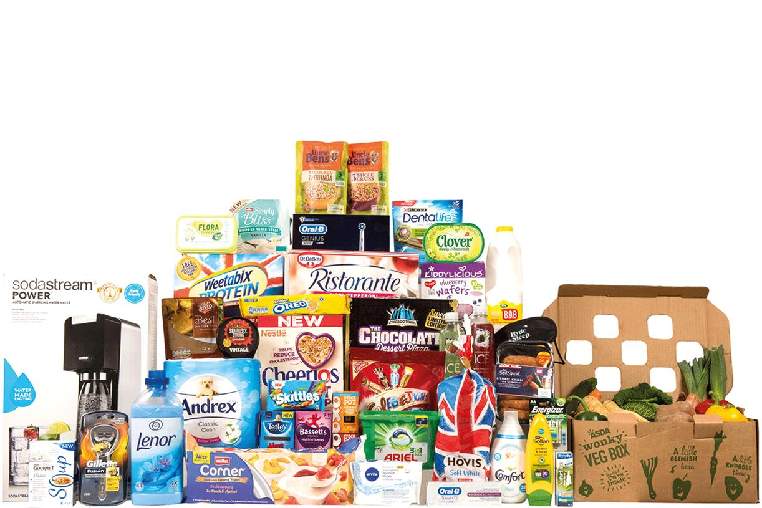
Product and service classification
1. Convenience Products: Convenience products are the products that are purchased by the consumers frequently and with minimum effort and thought. Hence, such convenience product purchases are also called as low involvement purchases.

Slide 11
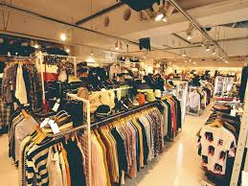
Product and service classification
2. Shopping products: Shopping products refer to items that the consumers purchase less frequently and compare with available alternatives in the market. Consumers need time, planning and efforts to take the final decision whether to buy the product or not.

Slide 12
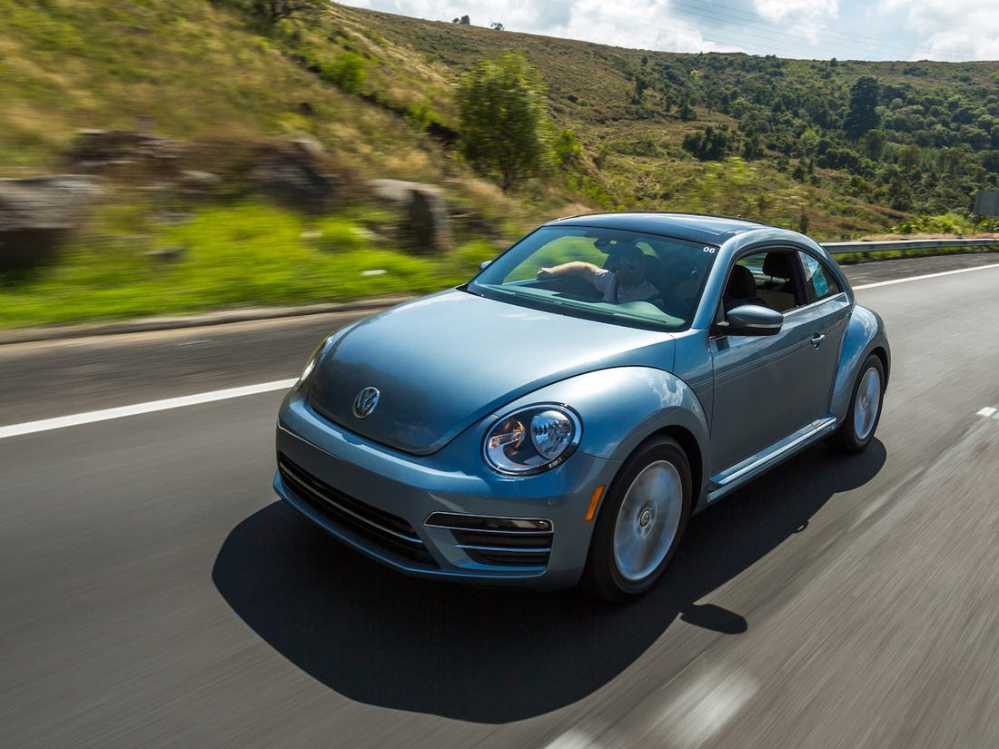
Product and service classification
3. Specialty Products : A specialty product is a product that certain consumers will actively seek to purchase because of unique characteristics or loyalty to a specific brand. Consumers who seek specialty products know what they want and will spend the time and effort to get it.

Slide 13
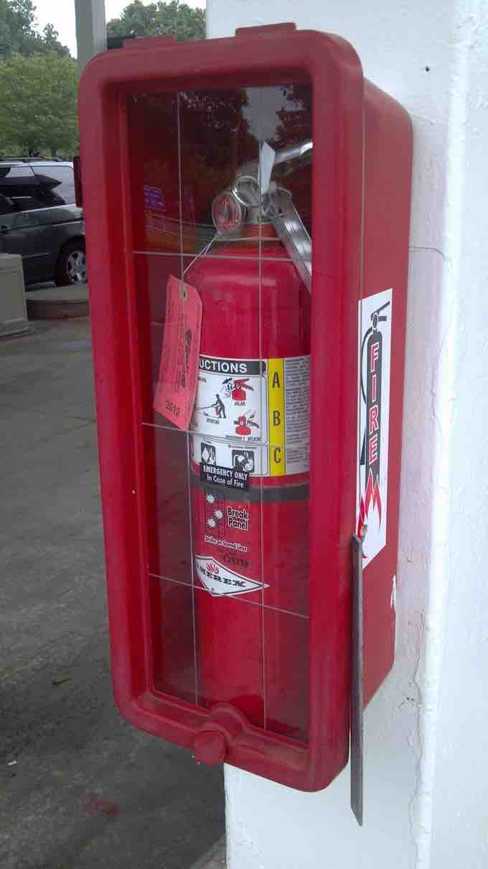
Product and service classification
4. Unsought Product: Unsought Goods are goods that the consumer does not know about or does not normally think of buying, and the purchase of which arises due to danger or the fear of danger and lack of desire. The classic examples of known but unsought goods are funeral services, encyclopedias, fire extinguishers and reference books.

Slide 14
Product and service classification
Industrial Products: are those products purchased for further processing or for use in conducting a business. Industrial products are of three types:
1. Materials and parts
2. Capital items
3. Supplies and services

Slide 15
Organizations, persons, places and ideas
Organization marketing is the marketing strategy that influences consumers to accept the goals of, receive the services of, or contribute in some way to an organization.
Person marketing is the use of efforts designed to attract the attention, interest, and preference of a target market toward a person.

Slide 16
Organizations, persons, places and ideas
Place Marketing, also referred to as Place branding refers to promotion of a particular place. It goes beyond the notion that the struggle for preference is only for the products and services. All over the world, countries, states, cities are competing for the attention in terms of business, tourism income etc
Traditional commercial marketing aims are primarily financial, though they can have positive social effects as well. In the context of public health, social marketing would promote general health, raise awareness and induce changes in behavior.

