Slide 1
Lecture-2
Information System
Analysis and Design

Slide 2
Characteristics of System
Organization (Order)
Interaction
Interdependence
Integration
Central Objective

Slide 3
Characteristics of System : Organization
Organization implies structure and order.
It is the arrangement of elements/components that helps to achieve objectives.
For example:
Hierarchical relationship starting with the president on top and leading down ward to the blue collar worker represent the organization structure
Such an arrangement portrays:
a system – subsystem relationship
defines the authority structure
specifies the formal flow of communication
formalizes the chain of command.

Slide 4
Characteristics of System : Organization

Slide 5
Organization Structure: An Example
President
Vice-President
Sales
Vice-President
Production
Vice-President
Accounting
Department Head Assembly
Department Head Painting
Workers
Workers

Slide 6
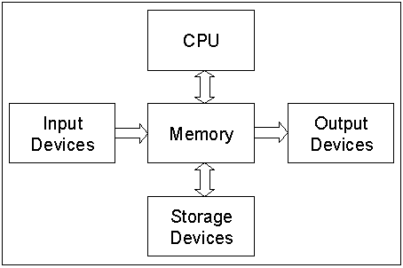
Organization Structure: An Example
Computer System:

Slide 7
Characteristics of System : Interaction
Interaction refers to the procedure in which each component interact with other components of the system.
In an organization, for example purchasing must interact with production, advertising with sales and payroll with personnel.
In computer system:
CPU I/O device

Slide 8
Characteristics of System : Interdependence
Interdependence means that parts of the organization or computer system depend on one another.
They are coordinated and linked together according to a plan.
One subsystem depends on the input of another subsystem for proper functioning:
That is, the output of one subsystem is the required input for another subsystem.
This interdependence is crucial in systems work.

Slide 9
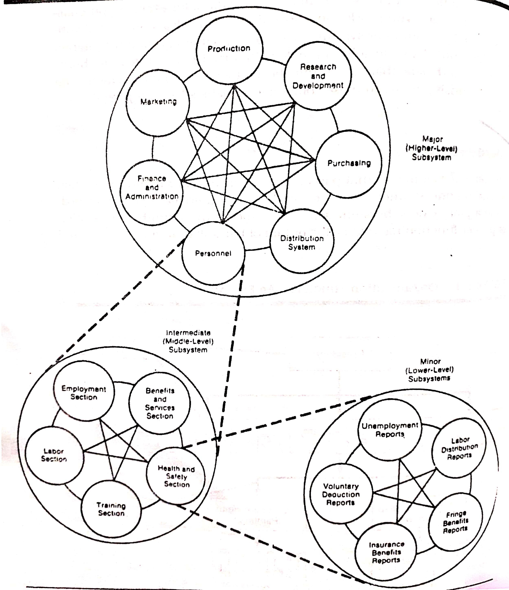
Characteristics of System : Interdependence
Each of the top inner circles represents a major subsystems of a production firm.
The personal Subsystem, may be viewed as a system that consists of sybsystems such as benefits, health, and safety.
Major Subsystems of a Production Firm

Slide 10
Characteristics of System : Interdependence
An integrated information system is designed to serve the needs of authorized users (department heads, managers, etc.) for quick access and retrieval via remote terminals.
The interdependence between the personnel subsystem and the organization’s users is obvious.

Slide 11
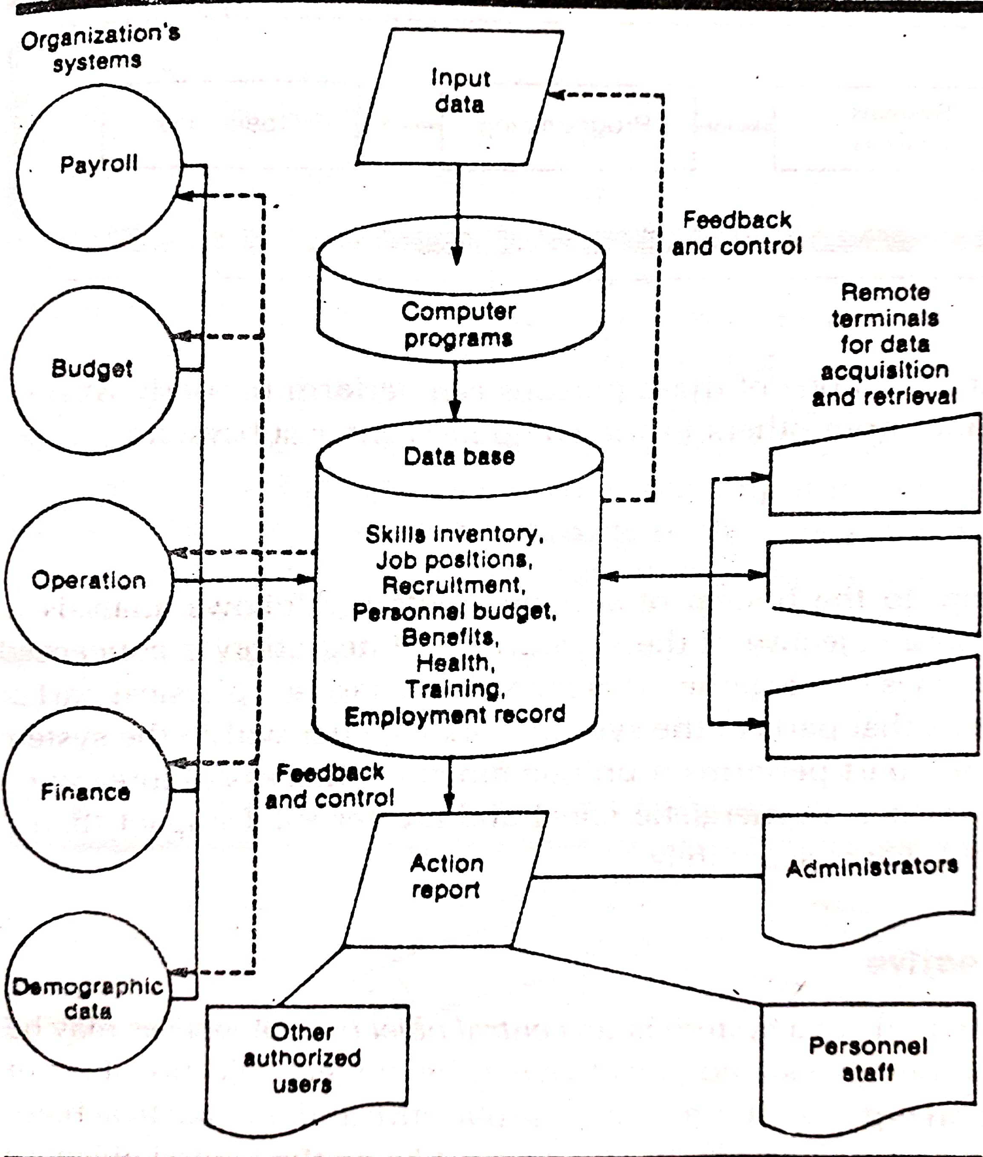
Characteristics of System : Interdependence
An integrated Information System is designed to serve the needs of authorized users (department heads, managers, etc.) for quick access and retrieval via remote terminals.
The interdependence between the personnel subsystem and the organization’s users is obvious.
A Human Resources Information System

Slide 12
Characteristics of System : Interdependence
In summary, no subsystem can function in isolation because it is dependent on the data (inputs) it receives from other subsystems to perform its required tasks.
A decision to computerize an application is initiated by the user, analyzed and designed by the analyst, programmed and tested by the programmer, and run by the computer operator.

Slide 13
Characteristics of System : Integration
Integration is concerned with how a system is tied together.
It is more than sharing a physical part or location.
It means that parts of the system work together within the system even though each part performs a unique function.

Slide 14
Characteristics of System : Central Objective
It is the last characteristics of a system.
Objective may be real or stated.
Objective is determined by higher management and user must be aware about the central objective well in advance.

