Slide 1
Lecture - 4
Elements of a System
Thursday, July 9, 2020

Slide 2
Elements of a System
In most cases, Systems analysts operate in a dynamic environment where change is a way of life.
The environment may be:
a business firm,
a business application, or
a computer system.

Slide 3
Elements of a System
To reconstruct a system, the following key elements (?) must be considered:
Outputs and inputs
Processor(s)
Control
Feedback
Environment
Boundaries and interface

Slide 4
Elements of a System: Output and Input
A major objective of a system is to produce an output that has value to its user.
It must be in line with the expectations of the intended user.
Inputs are the elements (material, human resources, and information) that enter the system for processing.
Output is the outcome of processing.

Slide 5
Elements of a System: Output and Input
A system feeds on input to produce output
Example-
A business brings in human, financial, and material resources to produce goods and services.
Determining the output is a first step in specifying the nature, amount, and regularity of the input needed to operate a system.
For example, in systems analysis,
the first concern is to determine the user’s requirements

Slide 6
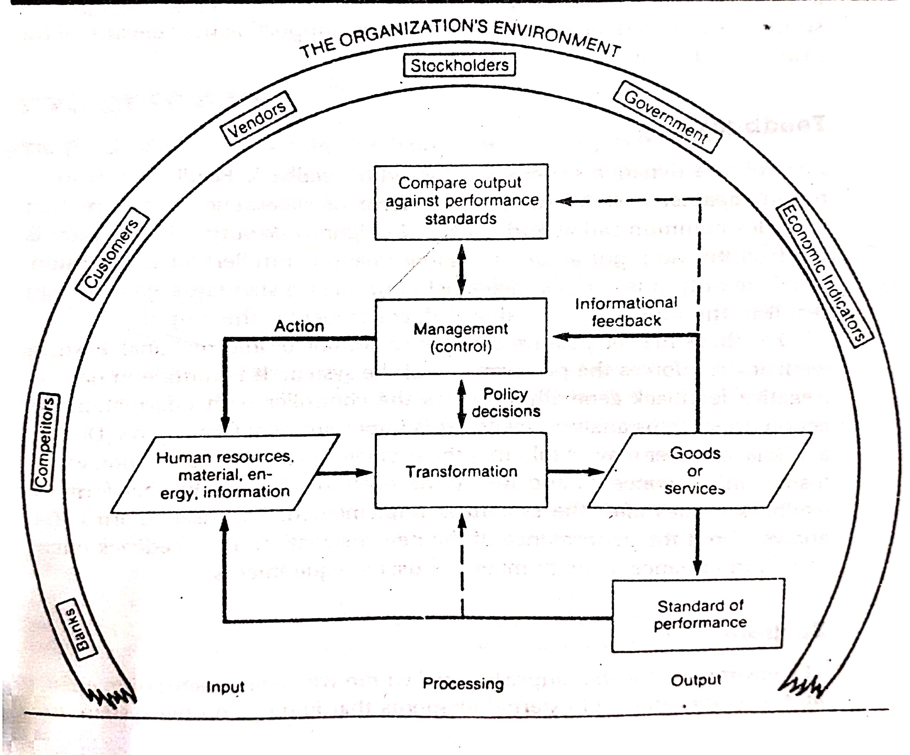
Elements of a System: Output and Input
Inputs and Outputs in a Business Operation

Slide 7
Elements of a System: Processor(s)
Processor involves the actual transformation of input into output.
It is the operational component of a system.
Processors may modify the input totally or partially, depending on the specifications of the output.
In some cases, input is also modified to enable the processor to handle the transformation.

Slide 8
Elements of a System: Control
The control element guides the system.
It is the decision-making subsystem that controls the pattern of activities governing input, processing, and output.
In an organizational context, management as a decision-making body controls the inflow, handling and outflow of activities that affect the welfare of the business.

Slide 9
Elements of a System: Control
In a computer system, the operating system and accompanying software influence the behavior of the system.
Output specifications determine what and how much input is needed to keep the system in balance.
In systems analysis, knowing the attitudes of the individual who controls the area for which a computer is being considered can make a difference between the success and failure of the installation.
Management support is required for securing control and supporting the objective of the proposed change.

Slide 10
Elements of a System: Feedback
Control in a dynamic system is achieved by feedback.
Feedback measures output against a standard in some form of cybernetic procedure that includes communication and control.
Output information is fed back to the input and / or to management (Controller) for deliberation.
After the output is compared against performance standards, changes can result in the input or processing and consequently, the output.

Slide 11
Elements of a System: Feedback
Feedback may be positive or negative, routing or informational.
Positive feedback reinforces the performance of the system. It is routine in nature.
Negative feedback generally provides the controller with information for action.
Another form of feedback comes after the system is implemented.
The user informs the analyst about the performance of the new installation. This feedback often results in enhancements to meet the user’s requirements.

Slide 12
Elements of a System: Environment
The environment is the “suprasystem” within which an organization operates.
It is the source of external elements that impinge (impose) on the system.
In fact, it often determines how a system must function.
For example, the organization’s environment, consisting of vendors, competitors, and others
May provide constraints and, consequently, influence the actual performance of the business.

Slide 13
Elements of a System: Boundaries and interface
A system should be defined by its boundaries – the limits that identify its components, processes and interrelationship when it interfaces with another system.
For example, a teller system in a commercial bank is restricted to the deposits, withdrawals and related activities of customers checking and savings accounts.
It may exclude mortgage foreclosures, trust activities, and the like.

Slide 14
Elements of a System: Boundaries and interface
Each system has boundaries that determine its sphere of influence and control.
For example, in an integrated banking – wide computer system design, a customer who has a mortgage and a checking account with the same bank may write a check through the “teller system” to pay the premium that is later processed by the “mortgage loan system.”
Recently, system design has been successful in allowing the automatic transfer of funds form a bank account to pay bills and other obligations to creditors, regardless of distance or location.
This means that in systems analysis, knowledge of the boundaries of a given system is crucial in determining the nature of its interface with other systems for successful design.

