Slide 1
Online Lecture 4 EEE4231:Control system Section: A
Dr. Md. Abdur Rahman
Contents:
Continued previous lecture
Speed control of DC machine
Thyristor control DC motor(shunt type)
Learning outcomes

Slide 2
Transfer function G(s) of DC motor

Slide 3
Continued
$v_{b}\left(t\right)=k_{b}\frac{dθ_{m}(t)}{dt}$
$$V_{b}\left(s\right)=k_{b}sθ_{m}(s)$$
Using KVL in Fig.2.35
$e_{a}\left(t\right)−i_{a}R_{a}−L_{a}\frac{di_{a}\left(t\right)}{dt}−v_{b}\left(t\right)$=0
Using Laplace transformation with zero initial condition

Slide 4
Continued
J_{m} = equivalent mechanical inertia of armature and load;
D_{m} = equivalent viscous dampling factor of armature and load.

Slide 5
Transfer function DC motor (continued)
Home work: study page 80-81 with example 2.23

Slide 6
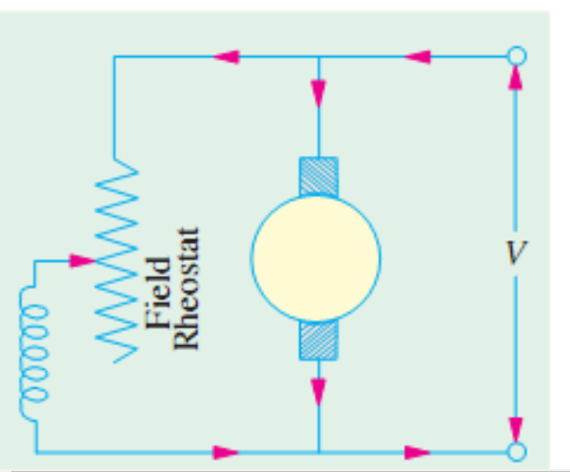
Speed control of DC motor
Speed $N_{r}$ $∝\frac{V−I_{a}R_{a}}{∅}$
Flux control
Armature current control
Voltage V control

Slide 7
Armature current control

Slide 8
Armature voltage control
Compare different techniques (home work)

Slide 9
Learning outcome
Able to deduce transfer function of DC motor
Able to draw and explain the three mechanisms of speed control of DC motor
Able to explain speed control of DC motor using solid state device

Slide 10
Next lecture
Time response analysis of control system

Slide 11
END

