Slide 1
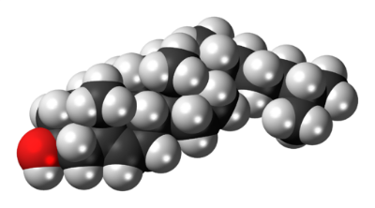
Lecture
On
Lipids
Notes:
1
1

Slide 2
CONTENTS
Introduction
Definition
Importance of Lipids
Functions
Major Lipids Of Physiological Significance
Applications
Advantages
Disadvantages
References

Slide 3
Introdcution
The word lipid is derived from a greek word “lipos” which means FAT.  These are heterogenous group of compounds  Unlike proteins,nucleic acids,polysaccharides,lipids are not polymers rather they are small molecules.  They are the chief storage form of energy,besides their role in cellular structure and other biochemical functions.

Slide 4
DEFINITION
Lipids may be regarded as organic substances relatively insoluble in water, soluble in organic solvents, actually or potentially related to fatty acids and utilized by the living cells.

Slide 5
Why lipids are important
Lipids are important to the body because;-
Important constituent of the cell membranes.
Helps in the absorption of fat soluble vitamins.
Maintains membrane fluidity.
Acts as a thermal insulator and cellular metabolic regulator.
Hormone synthesis.
Organ padding .

Slide 6
FUNCTIONS
Fat is stored in adipose tissue, where it also serves as a thermal insulator in the subcutaneous tissues.
Fatty acid derivatives serve as vitamins(A,D,E&K) or hormones.
It act as energy/food reservoir (Triacylglycerol).
Several proteins are covalently modified by fatty acids.
Structural components of biological membranes (lipoprotein, phospholipids &sphingomyelins) .

Slide 7
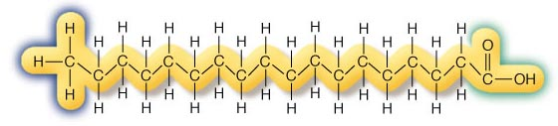
Major lipids of physiological significance;-
Fatty acids ;- basic units of fat composed of chains of carbon atoms with an acid group at one end and hydrogen atoms attached all along their length.
Present as either esterified or unesterified form in fats and oils.

Slide 8
Classification of fatty acids;-
Fatty acids
Saturated FA
Unsaturated FA

Slide 9
Saturated fatty acids;-
•
Saturated fatty contains no double bonds (having no points of unsaturation).
Saturated fats- considered as harmful. It increases total
cholesterol level and TGs level.
Hypercholestrolemic SFAs are-Myristic acid & Lauric acid.

Slide 10
Unsaturated fatty acids;-
Unsaturated fatty acid: a fatty acid with one or more points of unsaturation. Unsaturated fats are found in foods from both plant and animal sources. Unsaturated fatty acids are further divided into monounsaturated fatty acids and polyunsaturated fatty acids.

Slide 11
Divisions of unsaturated fatty acids;-
Unsaturated
Fatty acids
MUFA
PUFA
Eicosanoids

Slide 12
Monounsaturated fatty acids;-
Monounsaturated fatty acid: a fatty acid containing one point of unsaturation, found mostly in vegetable oils such as olive, canola, and peanut.
They are considered as beneficial for human health.
MUFA
Cis FA
Trans FA

Slide 13
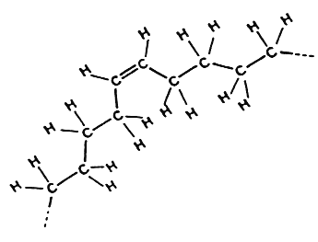
Cis- unsaturated fatty acids;-
In cis bonds, the two pieces of the carbon chain on either side of the double bond are either both “up” or both “down,” such that both are on the same side of the molecule.
Significance –
Decreases total cholesterol and TGs level.
Increases HDL level.

Slide 14
Trans unsaturated fatty acids;-
Trans fatty acids are produced by hydrogenation process.
Hydrogen atoms are on the opposite sides of the molecule.
Eg.cis-oleic acid trans-elaidic acid
PHYSIOLOGICAL EFFECTS OF
TRANS FATTY ACIDS
-
SERUM LIPIDS
-SYSTEMIC INFLAMMATION
-ENDOTHELIAL-CELL FUNCTION

Slide 15
Physiological effects of trans fatty acids continued…
SERUM LIPIDS—
>raises levels of low-density lipoprotein (LDL) cholesterol
reduces levels of high-density lipoprotein (HDL) cholesterol
>increases the ratio of total cholesterol to HDL cholesterol, a powerful predictor of the risk of CHD
>increase the blood levels of triglycerides , of Lp(a) lipoprotein, and reduce the particle size of LDL cholesterol: further raise the risk of CHD.
>trans fatty acids have markedly adverse effects on serum lipids

Slide 16
Physiological effects of trans fatty acids continued…
Systemic inflammation—
inflammation: an independent risk factor for atherosclerosis, sudden death from cardiac causes, diabetes, and heart failure
the inflammatory effects of trans fats may account in part for their effects on cardiovascular health
For example,
the difference in C-reactive protein levels ;
2.1 percent vs 0.9 percent intake: an increase in cardiovascular risk of approximately 30 percent.

Slide 17
ENDOTHELIAL-CELL FUNCTION--
Physiological effects of trans fatty acids continued…
increased levels of several markers of endothelial dysfunction:
for eg;-
soluble intercellular adhesion molecule, soluble vascular-cell adhesion molecule, and E-selectin

Slide 18
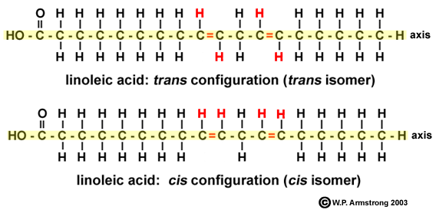
Polyunsaturated fatty acids;-
Polyunsaturated fatty acids (sometimes abbreviated PUFA) are those fatty acids where unsaturation occur more than two points, found in nuts and vegetable oils such as safflower, sunflower, and soybean, and in fatty fish.
They possess protective role on human health.considered as beneficial for consumpmtion.

Slide 19
PUFA continued;-
Increase esterification process of cholesterol & prevents its absorption.
By increasing the synthesis of eicosanoids.
Acts as an anti platelet aggregating factor, so decreases the chances of clot formation.
Decreases the synthesis of the precursor of VLDL AND TGs.
Increases clearance of LDL cholesterol.

Slide 20
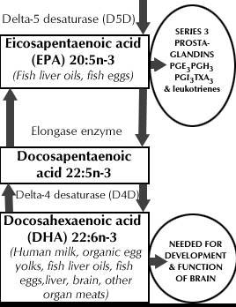
Omega-3-fatty acids-
Benefits-
>Lower PGE2s level
>Anti-inflammatory
>Lower triglyceride and cholesterol levels
>Benefits vision and >brain function
>Decrease Skin >inflammation
>Inhibit platelet adhesion >Increase insulin sensitivity

Slide 21
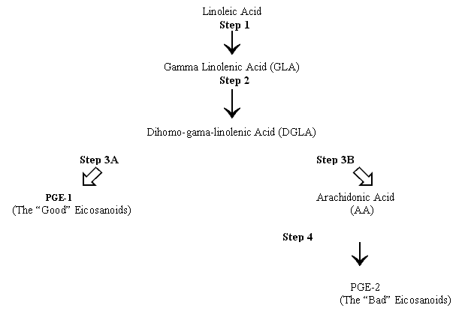
Omega-6 fatty acids-
Linoleic fatty acid
Arachidonic acid
Benefits-
Platelet aggregation, cardiovascular diseases, and inflammation.
Reduce the symptoms of eczema and psoriasis.
Clear up different types of acne.

Slide 22
Eicosanoids;-
These compounds are derived from long chain polyenoic
fatty acids (20-carbon).
Examples of eicosanoids;-
Prostaglandins.
Prostacyclines,
Thromboxanes
Leukotrienes
lipoxins
  They have roles in:
  Inflammation
  Fever
  Regulation of blood pressure
  Blood viscosity
  Male fertility
  Female conception
  Muscle cotraction
  Blood clotting
  Tissue growth
  Regulation of sleep/wake cycle
  Bronchocostriction
  Asthma.

Slide 23
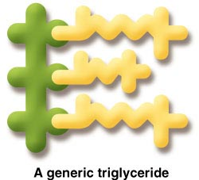
Triglycerides;-
Structure
  Glycerol + 3 fatty acids
Functions
  Energy source--9 kcals per gram
  Form of stored energy in adipose tissue.
  Insulation and protection
  Carrier of fat-soluble vitamins
  Sensory properties in food

Slide 24
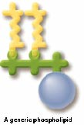
Phospholipids;- main lipid constituent of cell membrane.
Structure
  Glycerol + 2 fatty acids + phosphate group
  also considered as derivative of ‘phosphatidic acid’.
Functions
  Main lipid constituent of cell membranes
  Lipid transport as part of lipoproteins
  Emulsifiers
  Cell signalling process.
  phospholipids
  Phos.choline phos.inositol cardiolipin lysophospholipid plasmalogens sphingomy.

Slide 25
Sterols;-
Steroids are the compounds contains cyclic steroid nucleus namely cyclo pentanophenanthrene ring.
Cholesterol-
best known steroid because of its association with atherosclerosis and heart diseases.
Contains same steroid nucleus.
Exclusively present in animals
. Functions;-
--Bile acids
– Sex hormones
– Adrenal hormones
– Vitamin D
--Cardiac glycosides

Slide 26
Glycolipids;-
--widely distributed in the body
Fatty acids + sphingosine +carbohydrate
Also k/a glycosphingolipids.
Present in cell membrane and nervous tissues.
It contributes to cell surface carbohydrate
Other glycolipids are;-
Cerebrosides- simplest form of glycolipids.contains ceramides.
eg. Galactosylcerebrosides
glucosylcerebrosides
Gangliosides – predominantly found in ganglions.Complex glycolipids

Slide 27
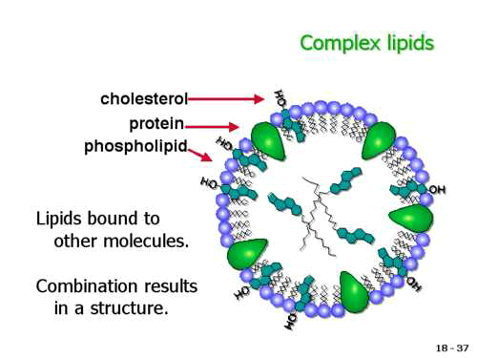
Lipoproteins;-
Lipoproteins are th macromolecular complex of lipids and proteins.
Transportation of lipids in the blood.
Structure of lipoproteins;-
Hydrophobic lipids (TG, CE) in core;
Hydrophilic lipids (UC, PL) on surface

Slide 28
Classes of lipoproteins;-
Chylomicrons,
VLDL,
LDL
HDL
> 30 nm
20–22 nm
9–15 nm
D<1.006 g/ml
D=1.019-1.063g/ml
D=1.063-1.21 g/ml
Doi H et al. Circulation 2000;102:670-676; Colome C et al. Atherosclerosis 2000;
149:295-302; Cockerill GW et al. Arterioscler Thromb Vasc Biol 1995;15:1987-1994

Slide 29
Apolipoproteins—
Apo AI (liver, small intestine)
  Structural; activator of lecithin:cholesterol acyltransferase (LCAT)
Apo AII (liver)
  Structural; inhibitor of hepatic lipase; component of ligand for HDL binding
Apo A-IV (small intestine)
  Activator of LCAT; modulator of lipoprotein lipase (LPL)
Apo A-V (liver)
  Direct functional role is unknown; regulates TG levels.

Slide 30
Apoprotein continued…
Apo B-100 (liver)
  Structural; synthesis of VLDL; ligand for LDL-receptor
Apo B-48 (small intestine)
  Structural; synthesis of chylomicrons; derived from apo B-100 mRNA following specific mRNA editing
Apo E (liver, macrophages, brain)
  Ligand for apoE receptor; mobilization of cellular cholesterol

Slide 31
Apoprotein continued…
Apo C-I (liver)
  Activator of LCAT, inhibitor of hepatic TGRL uptake
Apo C-II (liver)
  Activator of LPL, inhibitor of hepatic TGRL uptake
Apo C-III (liver)
  Inhibitor of LPL, inhibitor of hepatic TGRL uptake

Slide 32
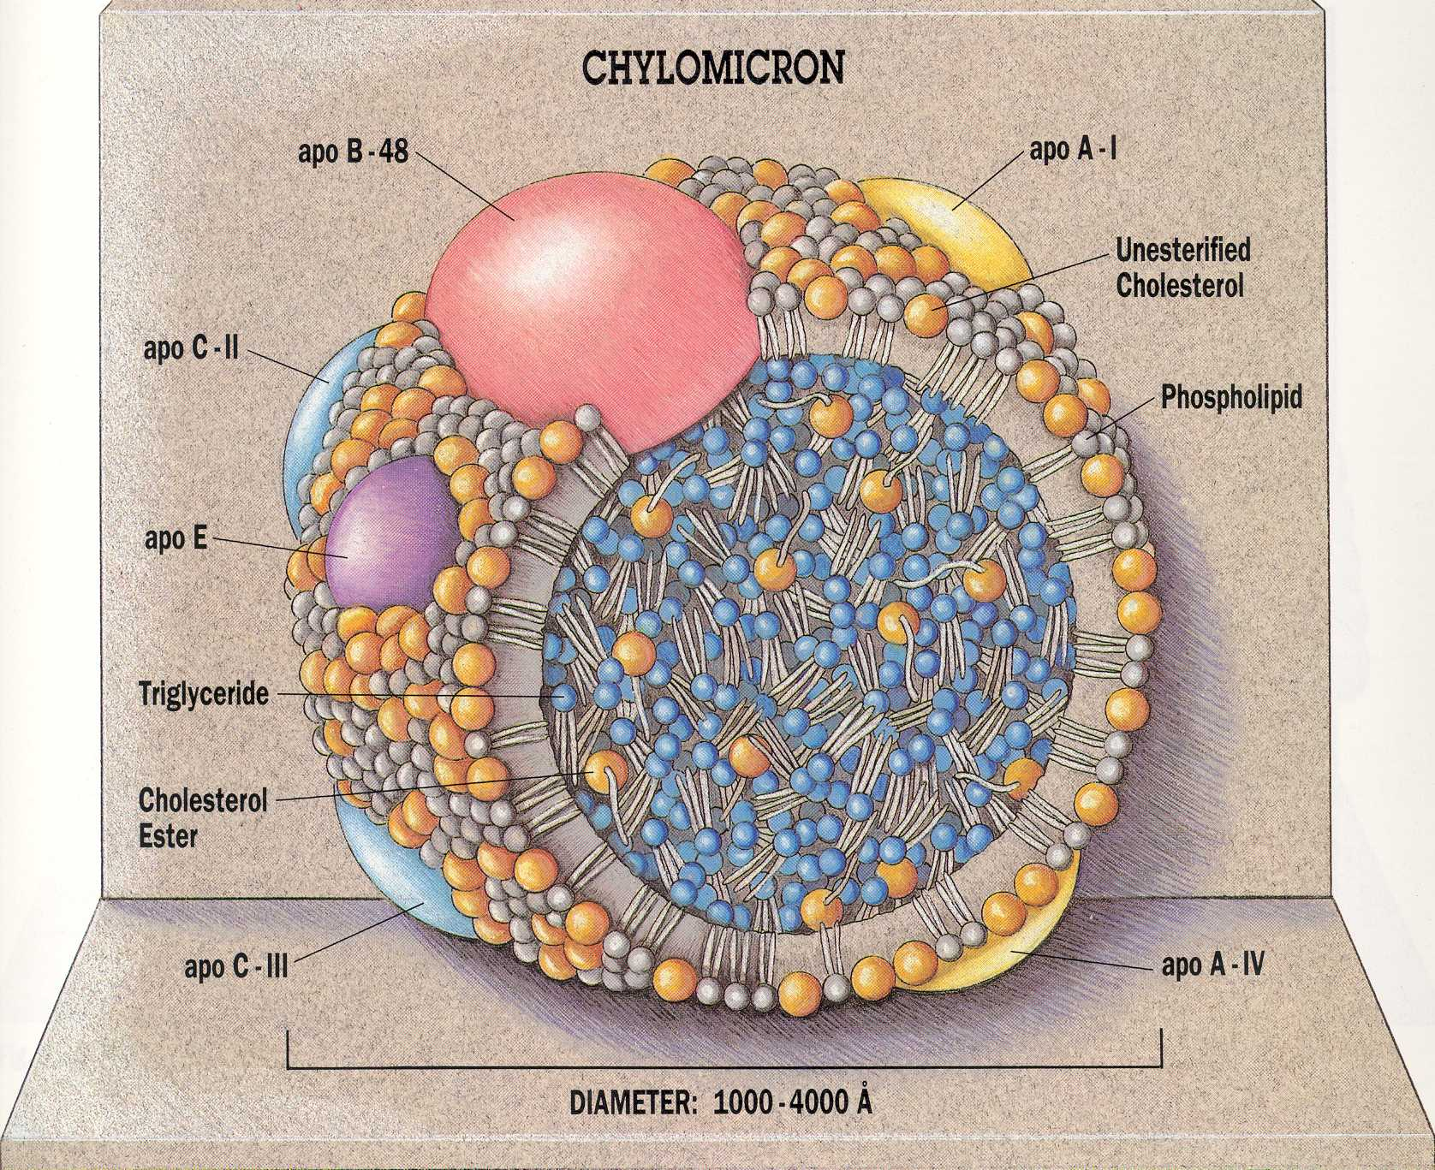
Chylomicrons;- TG rich.
Synthesized in intestine.
Transports endogenous TGs.
Hydrophobic Core
Triglyceride (93%) Cholesteryl Esters (1%)

Slide 33
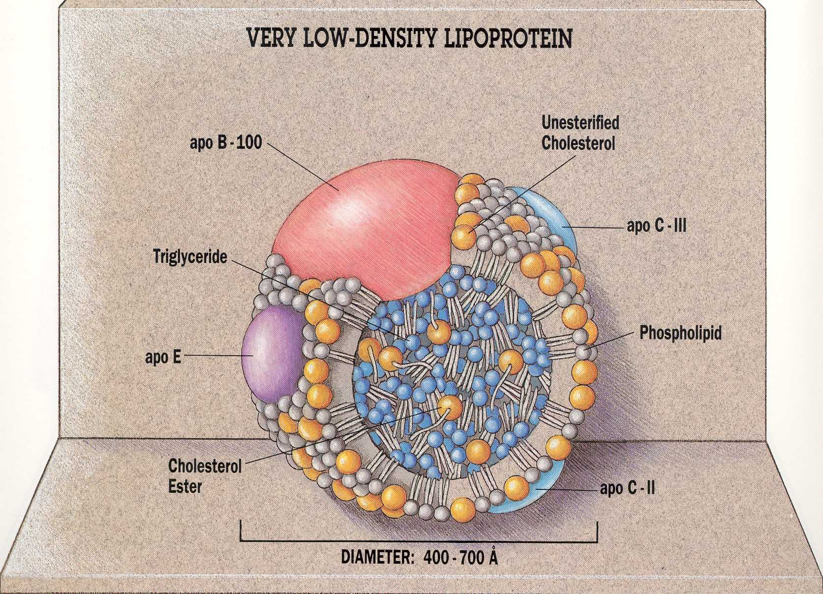
VLDL;- rich in CE and TGs-
Surface Monolayer Phospholipids (12%)
Free Cholesterol (14%)
Protein (4%)
Hydrophobic Core
Triglyceride (65%) Cholesteryl Esters (8%)

Slide 34
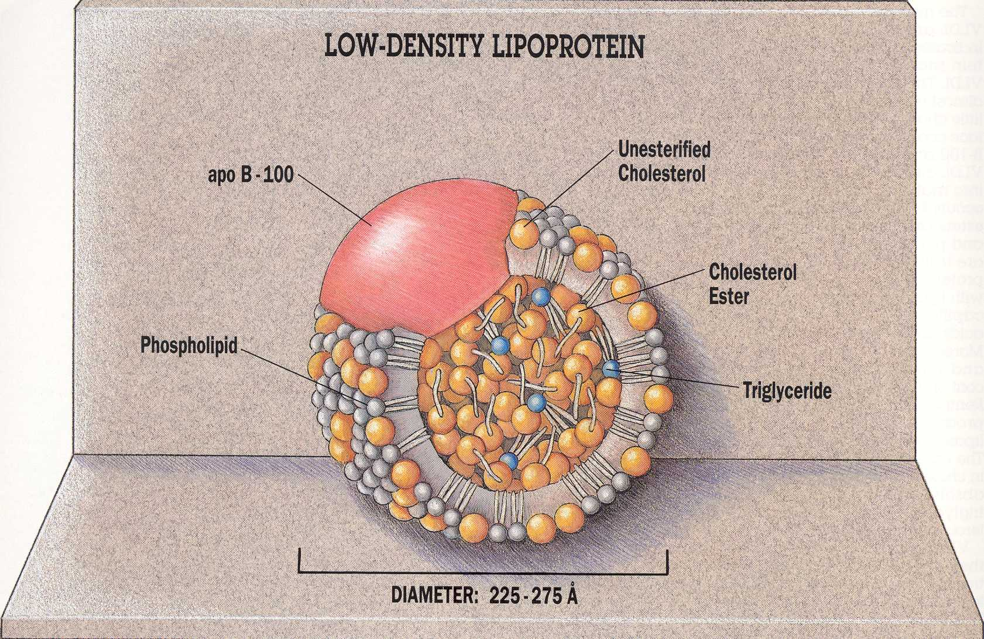
LDL;- cholesterol rich.
Surface Monolayer Phospholipids (25%)
Free Cholesterol (15%)
Protein (22%)
Synthesized from VLDL in blood circulation.
Transports cholesterol from liver and delivers to other tissues.

Slide 35
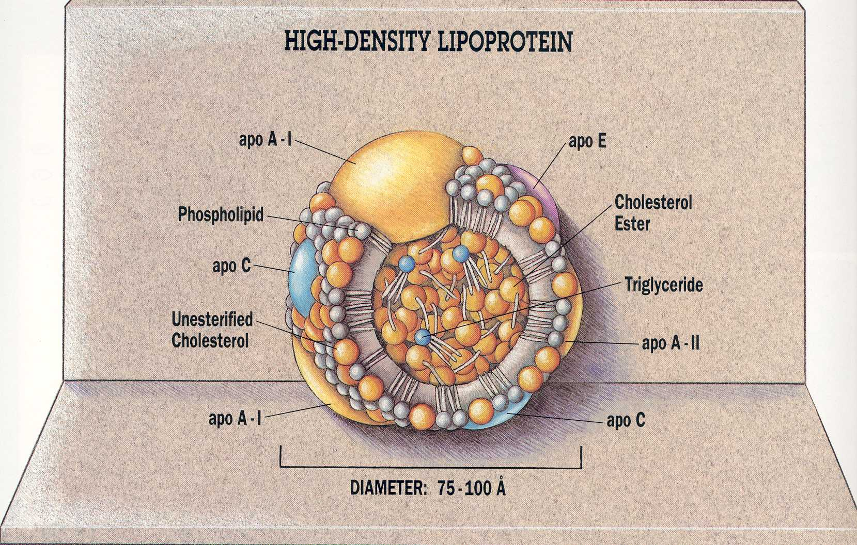
High density lipoprotein-
Surface Monolayer Phospholipids (25%)
Free Cholesterol (7%)
Protein (45%)
Promotes re-esterification process of cholesterol.

Slide 36
HDL Subpopulations
Particle Shape
Apolipoprotein Composition
Discoidal
Spherical
A-I HDL
A-I/A-II HDL
A-II HDL
Particle Size
Lipid Composition
TG, CE, and PL
HDL_{2b}
HDL_{2a}
HDL_{3a}
HDL_{3b}
HDL_{3c}
Rye et al. Atherosclerosis 1999;145:227-238.

Slide 37
The Effects of Various Types of Fat on Blood Lipid Levels
• Saturated Fat
– Increases total cholesterol
– Increases LDL-cholesterol
• Polyunsaturated Fat
– Decreases total cholesterol
– Decreases LDL-cholesterol
– Decreases HDL-cholesterol
• Monounsaturated Fat
– Decreases total cholesterol
– Decreases LDL-cholesterol
– Increases HDL-cholesterol

Slide 38
Omega-3 Fat
– Decreases total cholesterol
– Decreases LDL-cholesterol
– Increases HDL-cholesterol
– Decreases serum triglycerides
• Trans Fat
– Increases total cholesterol
– Increases LDL-cholesterol

Slide 39
Advantages of lipids
Roles in Your Body
Provide Energy
Absorption of Vitamins
Few are Essential Fatty Acids for Body

Slide 40
DisAdvantages Of lipids
Raise Your Susceptibility to Heart Disease
Lead to Weight Gain
Make You Insulin-Resistant
Raise Your Cancer Risk

Slide 41
Applications of Lipids
Studies of fatty acid metabolism using hydrogen isotopes
General synthesis of R1-(CH=CH-CH2)n-R2-COOH (n < 4) Fatty Acids
Metabolism of Unstable Eicosanoids: Role of Prostaglandin E Synthases
7,10,13-Hexadecatrienoic acid and Hexadecanoids – Occurrence & Biosynthesis in Plants
Conjugated Polyenoic Fatty Acids and Metabolites

Slide 42
References
www.google.com
www.wikipedia.com
www.studymafia.org
www.pptplanet.com

Slide 43
Thanks

