Slide 1
Tourism Promotion & Communication
HM 223 Slide 5

Slide 2
Slides Content
1. Public Relation
2. Social Media
3. PR changes due to social media
4. Major activities of public relation
5. Publicity
6.Objectives of PR campaign
7.PR opportunities for the Hospitality industry

Slide 3
What is PR?
The formal practice of what is now commonly referred to as “public relations” dates to the early 20th century. Since that time, public relations has been defined in myriad ways, the definition often evolving alongside public relations’ changing roles and advances in technology.
The earliest definitions emphasized press agentry and publicity, while more modern definitions incorporate the concepts of “engagement” and “relationship building.” In 1982, PRSA adopted the following definition: “Public relations helps an organization and its publics adapt mutually to each other.”

Slide 4
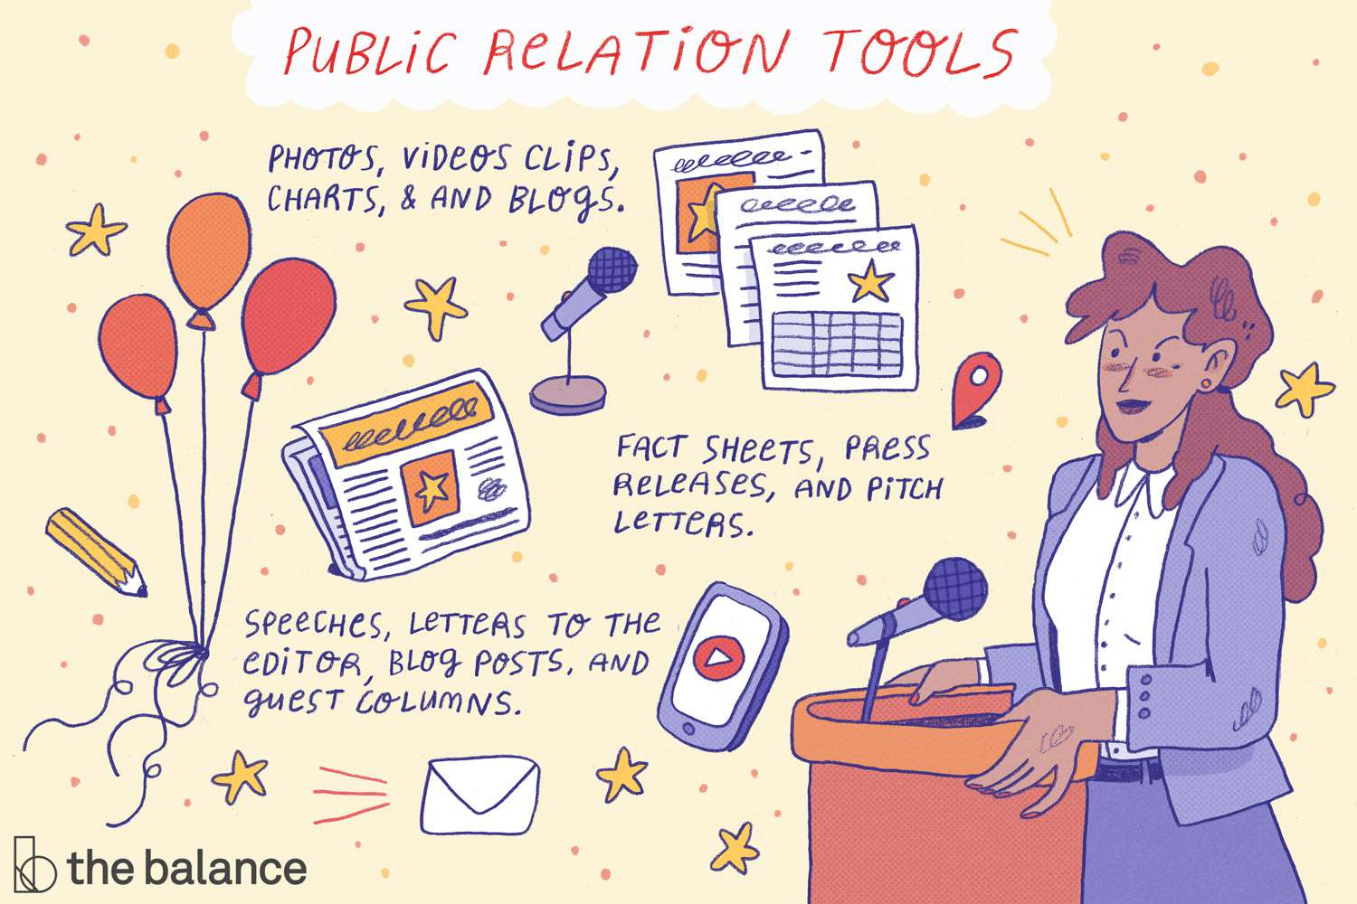
What is PR?
Public relations is a strategic communication process that builds mutually beneficial relationships between organizations and their publics." Public relations can also be defined as the practice of managing communication between an organization and its publics.

Slide 5
Social Media
Social media has proven to be a great way to reach thousands of customers and potential customers. Today most PR campaigns use Internet: websites, blogs, and social networks such as YouTube, Facebook, and Twitter are providing interesting new ways to reach customers.

Slide 6
PR changes due to Social Media
Social media has had a profound effect on public relations, creating new opportunities and challenges for brands. It allows brands and consumers to engage across a variety of channels in real-time, which has led to an increased demand for brands to address consumer inquiries quickly and effectively. Social media has also led to the emergence of powerful digital influencers for brands to reach out to and work with.
1.Two-way Communication: Social media has given brands the opportunity to reach consumers on a variety of channels. Whether it’s through an engaging Facebook post or touching YouTube video, each channel offers a different venue for brands to share its content with consumers. These channels contribute to a brand’s overall personality and help consumers feel a deeper, personal connection with brands. While it gives brands the opportunity to engage with consumers on many channels, it’s a two-way street. Social media also gives consumers the opportunity to engage with brands on a variety of channels. Consumers can “like”, comment on, and share brand content, which can help spread brand awareness and messages. However, it also gives consumers a powerful voice to express criticism and share negative experiences.

Slide 7
PR changes due to Social Media
2. 24/7 Engagement: Social media gives brands the opportunity to engage with consumers on a variety of channels, but with opportunity comes responsibility. The platforms have raised customer service expectations. Gone are the days when consumers could only interact with brands during business hours, Monday through Friday. Consumers can now interact with brands on social media 24/7 and many consumers expect the same from brands. In order to accommodate these customer demands, many brands have extended their social monitoring hours to nights and weekends. Since news and hot issues often break on social media, brands that monitor their social channels closely and address these issues swiftly and tactfully can control the conversations, rather than reacting to them.
3.Citizen Journalism: Social has given ordinary people outlets to share content and voice their opinions. This has broadened the definition of journalism, creating powerful influencers for brands and public relations professionals to collaborate with. In addition to pitching traditional media outlets and reporters, brands now search for these key influencers to promote their products and services to target audiences. Social media has created more contacts for brands to work with, including bloggers, vloggers, contributors, experts, and spokespeople. Brands that have collaborated with these influencers in creative ways have developed meaningful relationships with these contacts and created impactful campaigns.

Slide 8
Publicity
Publicity is also a way of mass communication. It is not a paid form of mass communication that involves getting favorable response of buyers by placing commercially significant news in mass media. Publicity is not paid for by the organization. Publicity comes from reporters, columnists, and journalists. It can be considered as a part of public relations. Publicity involves giving public speeches, giving interviews, conducting seminars, offering charitable donations, inaugurating mega events by film actors, cricketers, politicians, or popular personalities, arranging stage show, etc., that attract mass media to publish the news about them. Publicity is undertaken for a wide range of purposes like promoting new products, increasing sales of existing product, etc. It also aimed at highlighting employees’ achievements, company’s civic activities, pollution control steps, research and development successes, financial performance, its progress, any other missionary activities, or social contribution.

Slide 9
Major Activities of PR
1.Press Relation
2. Product Publicity
3. New Products
4. Corporate Communication
5. Lobbying
6. Counseling.

Slide 10
Publicity
Tourist destinations are particularly influenced by negative publicity.
There are three factors that helps to rebuild tourists destinations positive image after a negative publicity:
The extent of damage by natural or other disaster.
The efficiency with which tourism partners bring their facilities back again.
An effective marketing message that clearly states the destination is once again open.

Slide 11
Objectives for PR campaign
1. Defining the target audience
2. Choosing the PR message and vehicles
a. Publications
b. Events
c. News
d. Bad news/ good news PR
3. Public service activities
4. Implementing the marketing plan
5. Evaluating PR results
Exposures
Awareness or attitude change
Sales and profit contribution
6. Overwhelming negative publicity.

Slide 12
PR opportunities for Hospitality Industry
1. Individual Property
2. Build PR around the owner/operator
3. Build PR around a product or service

