Slide 1
Tourism Promotion And Communication
Slide no 6

Slide 2
Distribution Channels, Delivering Customer Value
Slides Content:
Supply chains and the value delivery network
Nature of distribution Channels
Distribution channel functions
Hospitality distribution channels
Restaurant distribution channels.

Slide 3
Supply Chains and the value delivery network
A supply chain is an entire system of producing and delivering a product or service, from the very beginning stage of sourcing the raw materials to the final delivery of the product or service to end-users. The supply chain lays out all aspects of the production process, including the activities involved at each stage, information that is being communicated, natural resources that are transformed into useful materials, human resources, and other components that go into the finished product or service.
The supply chain consists of upstream and downstream partners. Upstream from the company is the set of firms that supply the raw materials, component parts, information, finances, and expertise needed to create a product or service. Downstream marketing channel partners such as wholesalers and retailers form a vital connection between the firm and its customers.

Slide 4
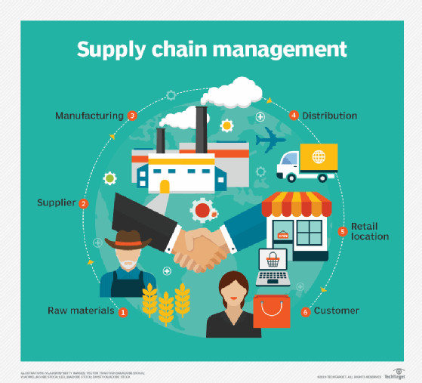
Supply Chains and the value delivery network

Slide 5
Supply Chains and the value delivery network
Value delivery network is a part of the supply chain of a company and includes all its direct participants involved in the production, distribution, marketing, customer service, etc. for a given geographical area. It is a chain of systems where after each system more a more value is added to the product or services thereby increasing its overall value for the customer.”

Slide 6
Nature of Distribution Channels
Distribution channels are the series of marketing entities through which goods and services pass on their way from producers to end users. Distribution systems focus on the physical transfer of goods and services and on their legal ownership at each stage of the distribution process.

Slide 7
Hospitality Distribution Channels
1. Direct Booking
2 Online Travel Agency
3.Global Distribution Systems
4. Travel Agents
5. Travel Wholesalers and Tour Operators
6.Specialists: Tour Brokers, Motivational houses and Junket Reps
7.Hotel Representatives
8. National, State and Local Tourist Agencies
9.Consortia and Reservation Systems
10. Distribution Systems in the Sharing Economy.

Slide 8
Restaurant Distribution Channels
1. Online Reservation: Open Table
2. Delivery, Take out, Drive through window
3. Food trucks
4. Concierges.

Slide 9


