Slide 1
Welcome to the class
Business Communication
Course THM 122

Slide 2
Today’s Content
Meaning of Business Communication
Meaning of Social Communication
Importance of Business Communication
Social and Business Communication
Features of Business Communication
Effective Communication

Slide 3
Meaning of Business Communication
The sharing of information between people within an enterprise that is performed for the commercial benefit of the organization. In addition, business communication can also refer to how a company shares information to promote its product or services to potential consumers.

Slide 4
Meaning of social Communication
Social communication refers to language that is used in social situations.[The American Speech –Language –Hearing Association]
According to Michael D. Brown The importance of social communication in a workplace can be measured to the importance of communication in a relationship. Without it an emotional decay in interaction becomes unavoidable. Basically, you need social communication to spruce the spirit of comradeship in the office. Without this refreshing flavor of social communication, the competition gets too direct between your employees and antagonistically spills into Counter-productivity.”

Slide 5
Importance of Business Communication
The importance of business communication in modern-day scenarios must not be underestimated by any means, since this is the life blood of any company. Embracing new technology for this purpose is also essential, and all successful companies know this. Some importance of business communication is pointed out in below:
Achievement of goal
Preparation of plan
Execution of plan
Making decision
Exchange of news and views
Promotion of employee efficiency
Maintenance of link between central and branch office
Providing jib satisfaction
Market research
Elimination of rumors

Slide 6
Characteristics of Business Communication

Slide 7
Characteristics of Business Communication
Business Communication Characteristic is a specialized form of communication. It basically deals with business related affairs. Business people pass most of their time by directing the workers, prescribing methods and procedures, formulating business policies, selling and obtaining goods and services, reporting to different parties and maintaining liaison with concerned parties. In performing all these activities business executives adopt different form of communication that is totally different from general communication. The main features that have given business communication a distinct identity are mentioned as below:
Specialized branch of communication
Formal elements
Practical information
Clear and condensed information
Formality
The use of language and style
Goals of business communication
Importance of feedback.

Slide 8
Social Media effect on Business

Slide 9
Why Business should worry about social media

Slide 10
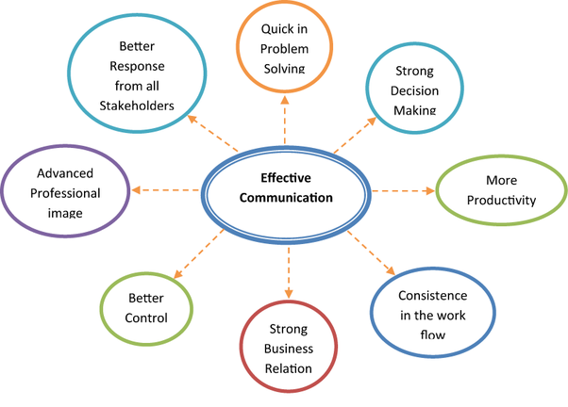
Importance of Effective Communication
Effective communication is not merely about exchanging information between you and your audience. It is about making what you want to say, what you actually say and what your audience interprets. The benefits are showing in the figure below:

Slide 11
End of the Session
Adio`s

