Slide 1
Stresses within soil
Younus Ahmed Khan
Dept. of Geology and Mining
University of Rajshahi

Slide 4
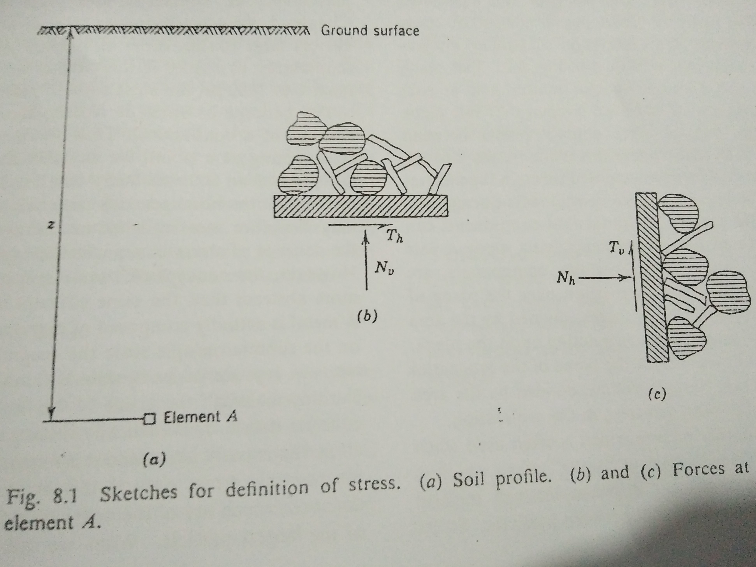
Forces and Stresses:
N_{v}, T_{v}=normal force
T_{h}, N_{h}=shear force
σ_{v} =N_{v}/A
τ_{v}= T_{v} /A
σ_{h} =N_{h}/A
τ_{h}= T_{h} /A
σ_{v} =normal stress
τ_{v}= shear stress
σ_{h} =normal stress
τ_{h}= shear stress
A=area of force action

Slide 5
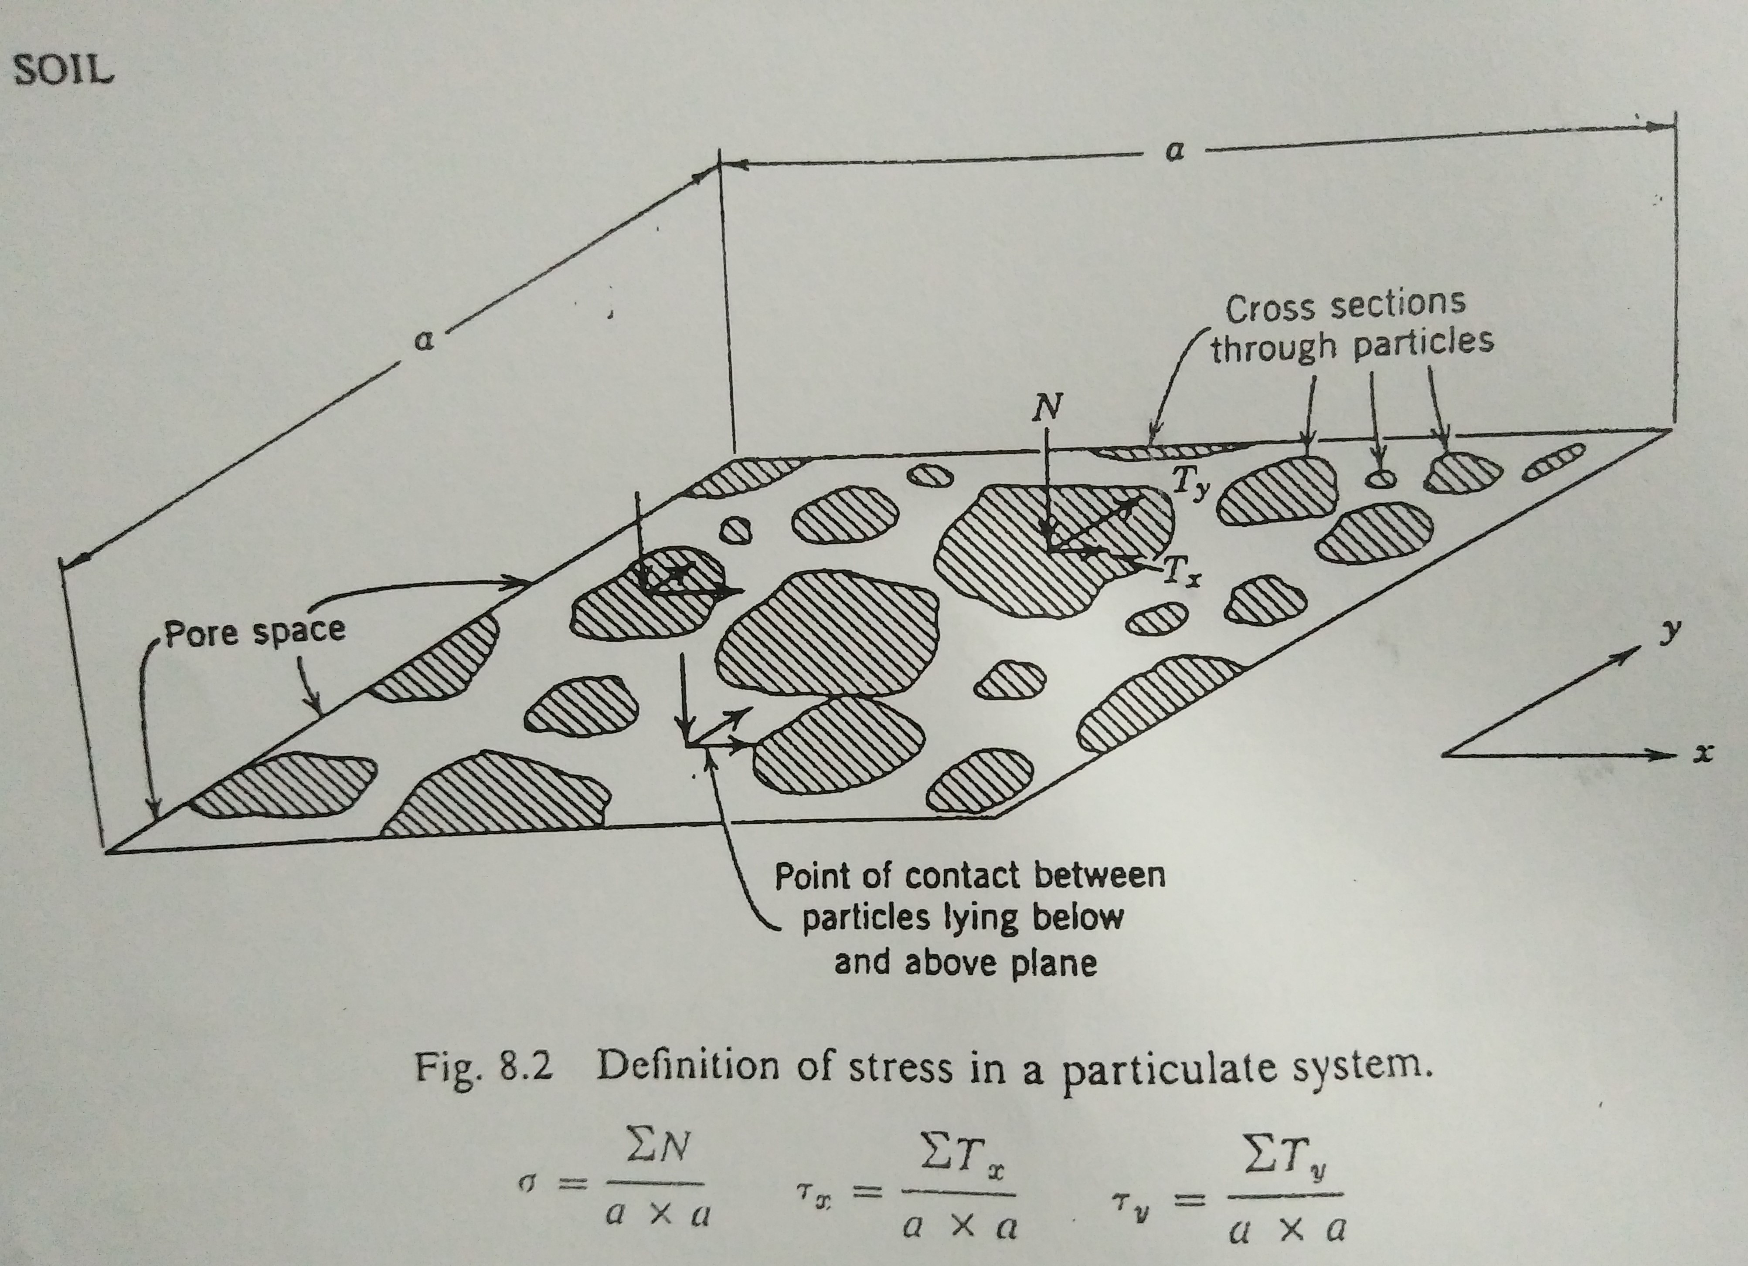
Forces and Stresses

Slide 6
Geostatic Stresses
Stresses inside soil are caused:
1. largely by self weight of soil –simple stress pattern exists if ground surface is horizontal and the soil nature varies little in horizontal directions. Such situation frequently exists in soils, specially sedimentary deposits.(hence called geostatic stresses)
2. by applied loading (surcharge, etc)-stress pattern is rather complicated
Vertical geo-stresses, simply, σ_{v}=zγ, where z is the total depth and γ is the unit weight of soils.
For a typical dry soil, γ=100 pcf (1602 kg/m³ or 15.7 kN/m³ approx.)

Slide 7
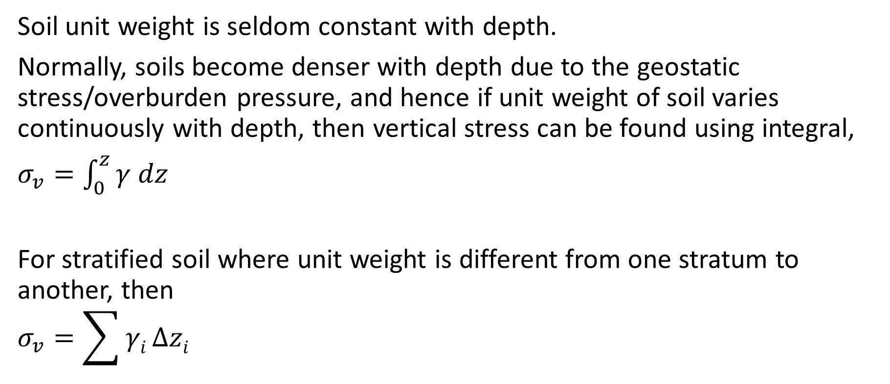
Geostatic Stresses, vertical
Soil unit weight is seldom constant with depth.
Normally, soils become denser with depth due to the geostatic stress/overburden pressure, and hence if unit weight of soil varies continuously with depth, then vertical stress can be found using integral,
$σ_{v}=\int_{0}^{z}{γ dz}$
For stratified soil where unit weight is different from one stratum to another, then
$$σ_{v}=\sum{γi}∆zi$$

Slide 8
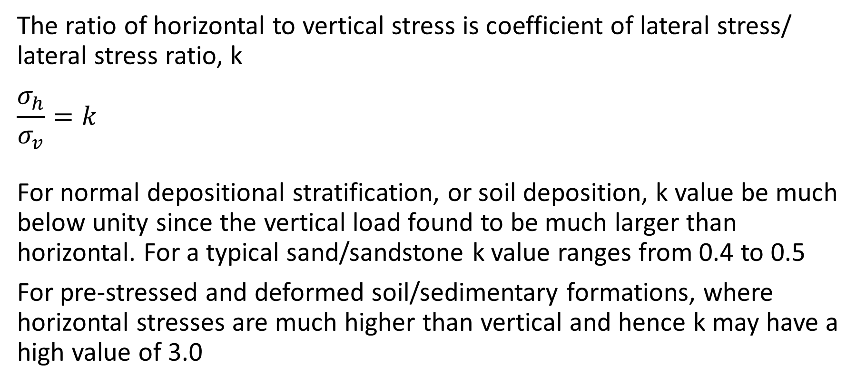
Geostatic Stresses, horizontal
The ratio of horizontal to vertical stress is coefficient of lateral stress/ lateral stress ratio, k
$$\frac{σ_{h}}{σ_{v}}=k$$
For normal depositional stratification, or soil deposition, k value be much below unity since the vertical load found to be much larger than horizontal. For a typical sand/sandstone k value ranges from 0.4 to 0.5
For pre-stressed and deformed soil/sedimentary formations, where horizontal stresses are much higher than vertical and hence k may have a high value of 3.0

Slide 9
Stresses induced by applied load
We often use assumption (theory) of elasticity, which states that the stress is proportional to strain to find the state of stress for an ideal homogenous and isotropic elastic material.
But soil don’t obey this assumption often and we have no other options but choice to use such assumptions. Hence,
Let’s have some cases,
Uniform load over a circular area-use charts 8.4 & 8.5
Uniform load over a rectangular area- chart 8.6
Strip load-use charts 8.7 & 8.8
Accuracy of these charts: Although it is in good agreement with actual calculations with vertical stresses only, one should consider that the error may be up to ± 30%

Slide 14
Principal Stresses
When the components of stresses acting along three orthogonal directions without having any shear stress components, then those stresses are termed as principal stresses.
According to the amount of stresses, they are termed as σ₁ for maximum principal, σ₂ for intermediate principal and σ₃ for minimum principal stresses. i. e.,
σ₁>> σ₂ ≥ σ₃
We know, one vertical and two horizontal stress components as σ_{v,} σ_{h1} and σ_{h2}
If K<1, then σ_{v} = σ₁ ; σ_{h1,2} = σ₂ = σ₃
If K>1, then σ_{h} = σ₁ =σ₂ ; σ_{v} = σ₃
If K=1, then σ_{v} = σ_{h} = σ₁= σ₂ = σ₃ (isotropic state of stress)

Slide 15
Determination of any stresses or Principal Stresses: Mohr Circle (two dimensional analysis, i.e., in the plane)
Let us consider σ₁ and σ₃ for a plane and stresses are positive when compressive
The quantity (σ₁ - σ₃) is called deviator stress or stress difference.
With the given magnitude and directions of σ₁ and σ₃ , normal (σ_{θ}) and shear (τ_{θ}) stresses in any other directions can be calculated as follows:

Slide 17
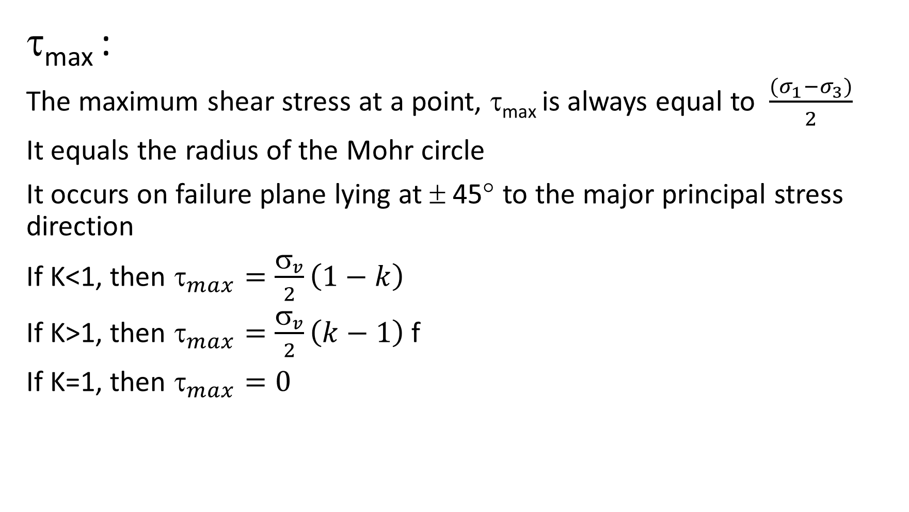
τ_{max} :
The maximum shear stress at a point, τ_{max} is always equal to $\frac{(σ_{1}−σ_{3})}{2}$
It equals the radius of the Mohr circle
It occurs on failure plane lying at ± 45° to the major principal stress direction
If K<1, then $_{max}=\frac{σ_{v}}{2}\left(1−k\right)$
If K>1, then $_{max}=\frac{σ_{v}}{2}\left(k−1\right)$ f
If K=1, then $_{max}=0$

Slide 18
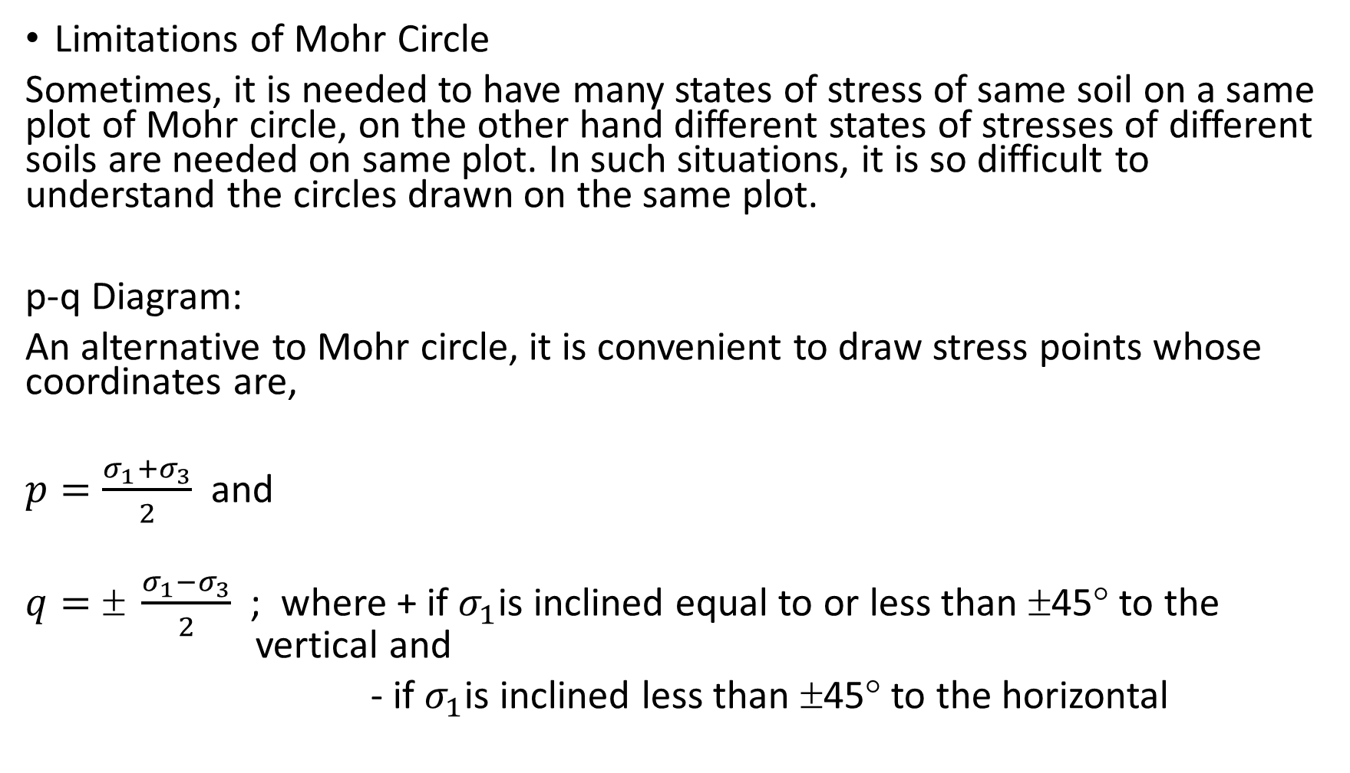
Limitations of Mohr Circle
Sometimes, it is needed to have many states of stress of same soil on a same plot of Mohr circle, on the other hand different states of stresses of different soils are needed on same plot. In such situations, it is so difficult to understand the circles drawn on the same plot.
p-q Diagram:
An alternative to Mohr circle, it is convenient to draw stress points whose coordinates are,
$p=\frac{σ_{1}+σ_{3}}{2}$ and
$q=± \frac{σ_{1}−σ_{3}}{2}$ ; where + if $σ_{1}$is inclined equal to or less than $$45° to the vertical and
- if $σ_{1}$is inclined less than $$45° to the horizontal

Slide 19
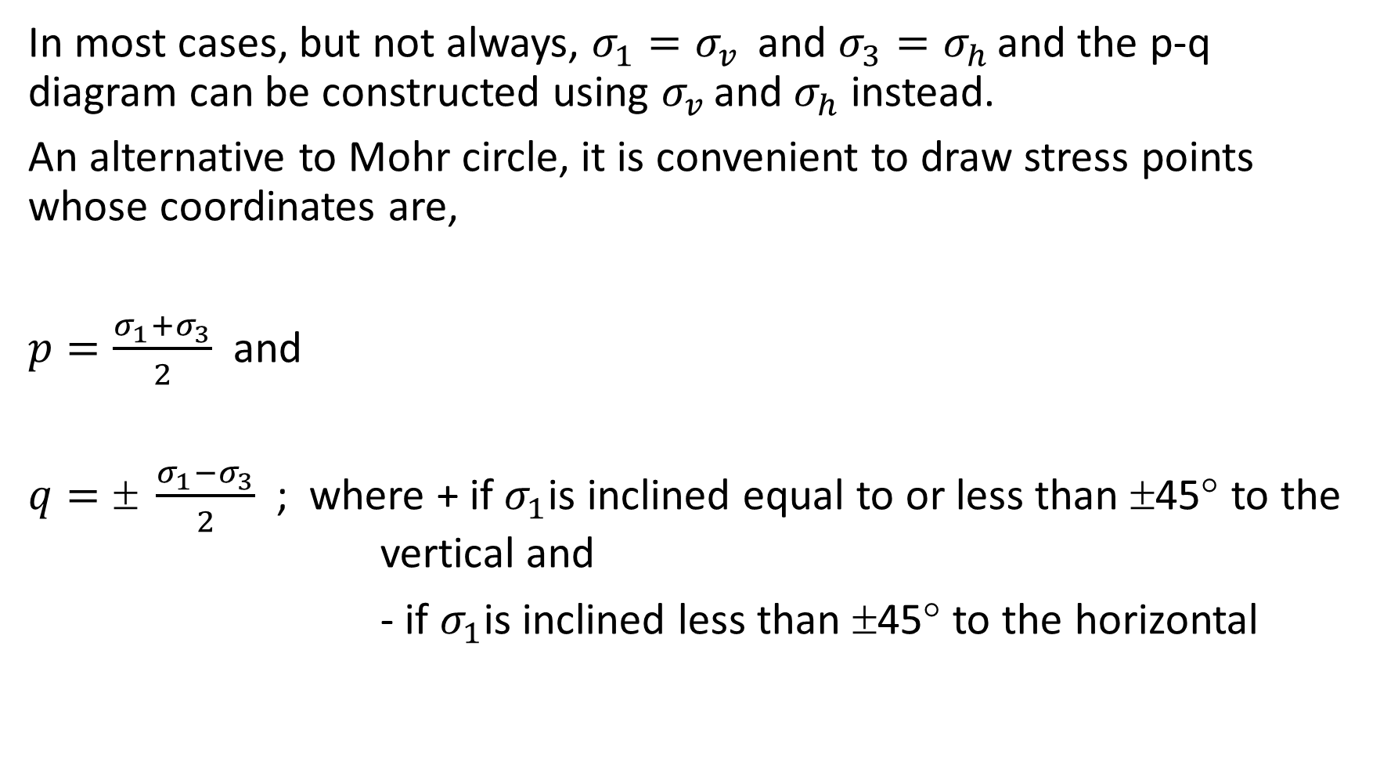
In most cases, but not always, $σ_{1}=σ_{v }$ and $σ_{3}=σ_{h }$and the p-q diagram can be constructed using $σ_{v }$and $σ_{h}$ instead.
An alternative to Mohr circle, it is convenient to draw stress points whose coordinates are,
$p=\frac{σ_{1}+σ_{3}}{2}$ and
$q=± \frac{σ_{1}−σ_{3}}{2}$ ; where + if $σ_{1}$is inclined equal to or less than $$45° to the vertical and
- if $σ_{1}$is inclined less than $$45° to the horizontal

Slide 27
Stress path
To know the successive states of stress in a soil sample loaded, stress path is a perfect way and you need to do a series of successive Mohr circles using principal stresses.
Stress path is a line or curve connecting all the successive points of stresses of a soil sample at test (Fig. 8.10)

