Slide 1
Good Afternoon Everyone
Welcome to the class

Slide 2
Today’s Content
1. Meaning of communication process.
2.Steps of communication process.
3.Components of communication process
4.Systems and communication
5.One way vs. two way communication
6.Contrast between one way and two way communication.

Slide 3
Meaning of communication process
The communication is a dynamic process that begins with the conceptualizing of ideas by the sender who then transmits the message through a channel to the receiver, who in turn gives the feedback in the form of some message or signal within the given time frame.

Slide 4
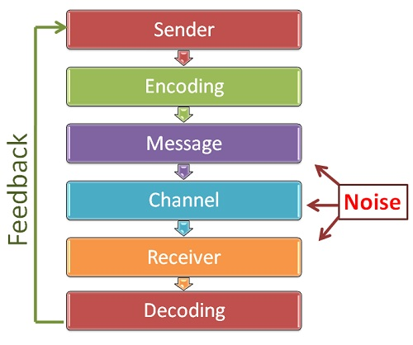
Meaning of communication process
there are Seven major elements of communication process:

Slide 5
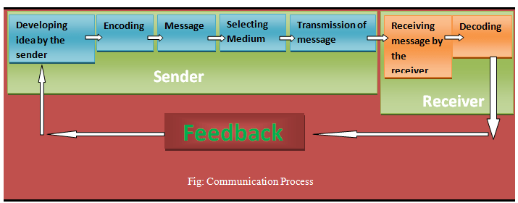
Steps of communication process

Slide 6
Components of Communication process

Slide 7
Systems and Communication
Business communication is called a system because it involves a group of separate but interrelated parts acting together as awhole to achieve desired goal.

Slide 8
One way vs. two way communication
A one-way communication is a communication sent from send to receiver without a feedback.
Basically, we call this type of communication:
1.Top to Bottom
2.Linear Communication
3.Horizontal Communication.

Slide 9
One way vs. two way communication
Two-way communication occurs when the receiver sends response or feedback to sender’s message. In two-way communication process, the sender first transmits the message to the receiver. After receiving a message, the receiver decodes it and then sends back his or her reaction to the sender.

Slide 10
Contrast between one way and two communication

Slide 11
End of this session
Hsia` tse `jien `

