Slide 1
Epigenetics
‘Epi’ means over, above, outer.
Epigenetics is the study of meiotically or mitotically heritable changes that modify chromatin structure without making any alteration of nucleotide sequences, and therefore, contribute to flexible and reversible regulation of gene expression.
Epigenomics is the study of the complete set of epigenetic alterations.
Epigenetic code is the epigenetic features that maintain different phenotypes in different cells.

Slide 2
Cytosine methylation
Adenine methylation
Acetylation
Methylation
Phosphorylation
Sumoylation
Ubiquitination

Slide 4
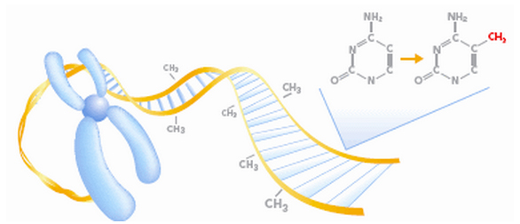
What is DNA methylation?
DNA methylation
DNA methylation is one of the best described, heritable and key epigenetic mechanisms, and is mediated by the addition of a methyl group in the cyclic carbon-5 of cytosine via covalent bonding.
It is involved to modify chromatin structure.
Figure 1: Methylated DNA (Source: https://www.dkfz.de/gpcf/391.html)

Slide 5
DNA methylation
28 million of CpG regions in the genome
60-80% are heavily methylated
CpG islands (100-2,000bp enriched for CpG often found at promoters) are unmethylated across cell types
The frequency of DNA methylation are known to vary widely between organisms, such as 0-3% in insects, 2-7% in vertebrates, 10% in fish and amphibians and with remarkably high levels of DNA methylation of over 30% in some plants.
Modulation of DNA (de-)methylation is still unknown!

Slide 6
In plants, DNA cytosine methylation occurs at CG and the non-CG sequence contexts (CHG and CHH contexts) (where H indicates any nucleotide other than G), in which CG and CHG are symmetric and CHH is an asymmetric sequence.
Unlike in animals, where CG (CG island) methylation predominates, in plants all three types of methylation occur, with the CG sequence context most highly methylated.
CG methylation is concentrated in the gene body of protein coding genes in both dicots (e.g. Arabidopsis: (Watson et al., 2014)) and monocots (e.g. rice: (Hu et al., 2014; Yamauchi et al., 2014).

Slide 7
In plants, the methylation in the symmetrical CG and CHG sequence context is maintained by the enzymes METHYLTRANSFERASE 1 (encoded by MET1) and CHROMOMETHYLASE 3 (encoded by CMT3), respectively, and the methylation in the asymmetric CHH sequence is maintained by CMT3 partially and de novo methylation that is catalyzed by DOMAIN REARRANGED METHYLTRANSFERASE 2 (encoded by DRM2).
DRM2 also mediates de novo methylation at all three contexts. The activity of DRM2 is highly regulated by the RNA-directed DNA methylation (RdDM) pathway.

Slide 8
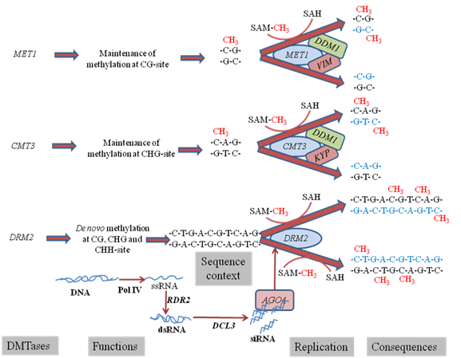

Slide 9
Types of Band | Methylation status | Digestibility of isochizomers and banding patterns
 |  | Hpa II | Msp I | H | M
Class I |  | Active | Active | 1 | 1
Class II |  | Active | Inactive | 1 | 0
Class III |  | Inactive | Active | 0 | 1
Class IV |  | Inactive | Inactive | 0 | 0
CCGG
GGCC
^{m}CCGG
or
CCGG
GGCC
GGC^{m}C
C^{m}CGG
or
C^{m}CGG
GGCC
GG^{m}CC
^{m}C^{m}CG
++++++++++++++++++++++G
^{m}CCGG
GGCC
GG^{m}CC
H and M indicate the enzyme combination of EcoRI/Hpa II and EcoRI/MspI; 1: band present, 0: band absent. ^{m}C denotes methylated cytosine

Slide 10
Class of Bands | Methylation status |  |  | Digestibility of isochizomers and banding patterns
 |  |  |  | HpaII |  | MspI |  | H |  | M
Class I | CCGG GGCC | Non methylation |  | Active |  | Active |  | 1 |  | 1
Class II | CCGG GGCC | Hemi-methylation |  | Inactive |  | Active |  | 0 |  | 1
 | CCGG GGCC | Hemi-methylation |  |  |  |  |  | 0 |  | 1
 | CCGG GGCC | Full methylation
 |  |  |  |  |  |  |  | 0 |  | 1
Class III | CCGG GGCC | Hemi-methylation |  | Active |  | Inactive |  | 1 |  | 0
 | CCGG GGCC | Hemi-methylation |  |  |  |  |  | 1 |  | 0
Class IV | CCGG GGCC | Hemi-methylation |  | Inactive |  | Inactive |  | 0 |  | 0
 | CCGG GGCC | Hemi-methylation |  |  |  |  |  | 0 |  | 0
 | CCGG GGCC | Full methylation |  |  |  |  |  | 0 |  | 0
 | CCGG GGCC | Full methylation |  |  |  |  |  | 0 |  | 0
 | CCGG GGCC | Full methylation |  |  |  |  |  | 0 |  | 0
 | CCGG GGCC | Full methylation |  |  |  |  |  | 0 |  | 0
 | Mutation | Unknown |  | Inactive |  | Inactive |  | 0 |  | 0

Slide 11
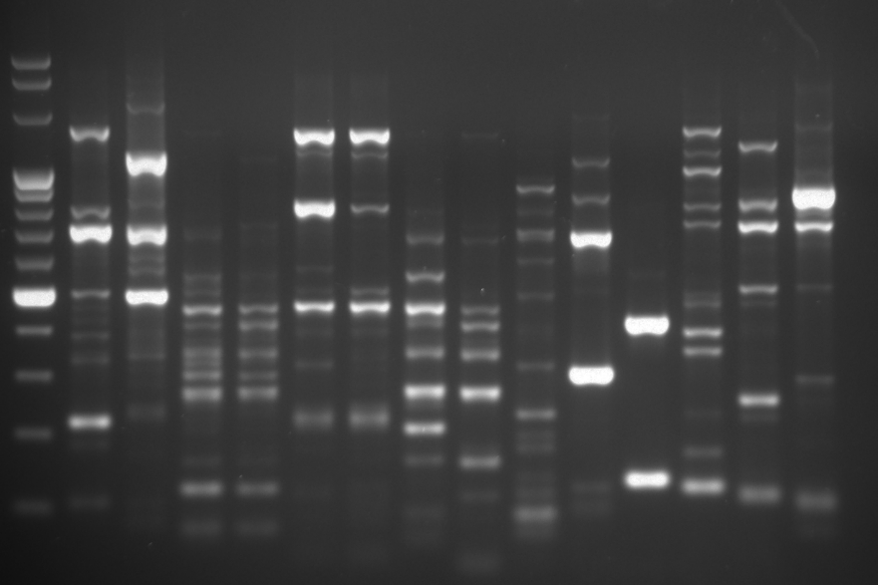
A
E1+HM3
MB
EVL
EC
DC
WC
CS
IVL
Marker
H
M
H
M
H
M
H
M
H
M
H
M
H
M
N
3 kb
1 kb
II
I
IV
500 bp
300 bp
III
100 bp
IV

Slide 12
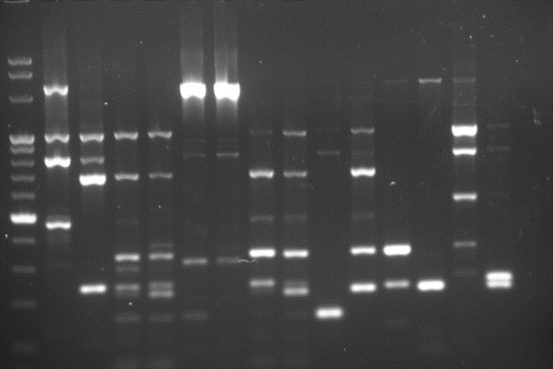
B
E3+HM2
MB
EVL
EC
DC
WC
CS
IVL
Marker
M
M
H
H
M
N
H
H
M
M
H
M
H
M
H
3 kb
III
IV
1 kb
II
500 bp
300 bp
I
100 bp

