Slide 1
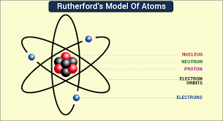

Slide 2
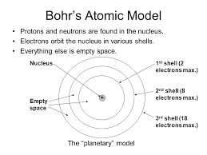

Slide 3
Quantum Number
Principal Quantum Number
Principal quantum numbers are denoted by the symbol ‘n’. They designate the principal electron shell of the atom.
The value of the principal quantum number can be any integer with a positive value that is equal to or greater than one. The value n=1 denotes the innermost electron shell of an atom, which corresponds to the lowest energy state (or the ground state) of an electron.
Azimuthal Quantum Number
The azimuthal (or orbital angular momentum) quantum number describes the shape of a given orbital. It is denoted by the symbol ‘l’.
A value of the azimuthal quantum number can indicate either an s, p, d, or f subshell which vary in shapes.
Magnetic Quantum Number
The total number of orbitals in a subshell and the orientation of these orbitals are determined by the magnetic quantum number. It is denoted by the symbol ‘m’.
Spin Quantum Number
The electron spin quantum number is independent of the values of n, l, and m. The value of this number gives insight into the direction in which the electron is spinning, and is denoted by the symbol ‘s’.

Slide 4
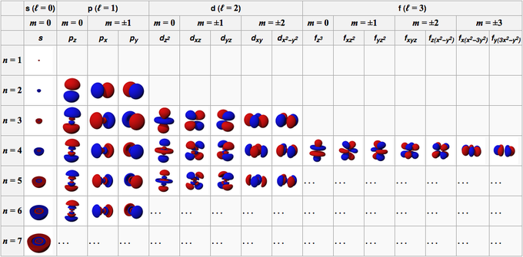

Slide 5
E = hν
E = Energy
h = Plank Constant
ν = Frequency

Slide 6
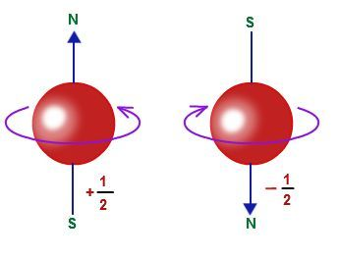
Spin Quantum Number

Slide 7
For spin orientation of protons in nucleus of natural Carbon

Slide 8
For spin orientation of neutrons in nucleus of natural Carbon

Slide 9
For spin orientation of protons in nucleus of natural Nitrogen

Slide 10
For spin orientation of neutrons in nucleus of natural Nitrogen

Slide 11
Explanation of NMR sensitivity based

Slide 12
Explanation of NMR sensitivity based
Explanation of NMR sensitivity based

Slide 13
Mass number, Atomic number and NMR sensitivity of elements
Mass Number | Atomic number | NMR sensitivity | Examples
Odd | Odd | +
Odd | Even | +
Even | Even | -
Even | Odd | +

Slide 14
Basic Principle of NMR
Explanation of NMR Principle based Hydrogen atom
Nascent Hydrogen atom

Slide 15
Proton of natural hydrogen atom
The two allowed spin states for a proton of Hydrogen atom

Slide 16
Aligned and opposed arrangements of bar magnets

Slide 17
The spin states of a proton in the absence and in the presence of an applied magnetic field.

Slide 18
Energy difference (ΔE) depends on the strength of applied magnetic field
The spin states energy separation as a function of
the strength of the applied magnetic field B_{o}
E = h v
according to function theory of calculus
y = f (x)
ΔE = f (B_{o}) ------------------(1)

Slide 19
Energy difference (ΔE) also depends on the type of nucleus involved
Characterization of a nucleus of particular element
Gyromagnetic ratio:
For a nucleus of particular element, the gyromagnetic ratio, often denoted by the symbol γ (gamma) is the ratio of the magnetic momentum in a particle to its angular momentum.
When
µ = Magnetic moment of the spinning bar magnet
Then gyromagnetic ratio
Where h = Planck’s constant and
I = Spin quantum number of the spinning magnet

Slide 20
ΔE = f (B_{o}) ------------------(1)
ΔE = f (γ) = hν --------------------(2)
ΔE = f (γB_{o}) = hν --------------------(3)
According to the Bohr’s postulate , angular momentum of a moving electron is given by:
mvr = n(h/2π)
Since the angular momentum of the nucleus is quantized in units of h/2 π,
the final equation takes the form
Final equation
Bo
v ∝ B_{o}
From final equation, we can write

Slide 21
Resonance
The nuclear magnetic resonance process; absorption occurs when ν = ω
2π
v =
B_{o}
γ
When B_{o} = 14100 gauss [i.e., 1.41 Tesla] and γ = 26750 ( for a hydrogen atom)
then ν = 6000059.7 Hz = 60.0 MHz

Slide 22
Resonance
2π
E₂ – E₁ = ΔE = hv; v ∝ B_{o};
v =
B_{o}
γ
The nuclear magnetic resonance process; absorption occurs
when ν = ω (where ω = resonance frequency)
2π
v =
B_{o}
γ
When B_{o} = 14100 gauss [i.e., 1.41 Tesla] and γ = 26750 ( for a hydrogen atom)
then ν = 6000059.7 Hz = 60.0 MHz

Slide 23
Explanation of NMR Theory based on David Frei Felder
<
<
The energy between two magnetic fields (B_{o} and μ) can be expressed as
E= μB_{o} Sinθ
In case of lower energy state,
E₁ = μB_{o} Sinθ ------------- (i)
In case of higher energy state,
E₂ = μB_{o} Sin (180 – θ) = μB_{o} Sinθ -------------(ii)
Then E₂ ̶ E₁ = ΔE = μB_{o} Sinθ ̶ ( ̶ μB_{o} Sinθ) = 2μB_{o} Sinθ
ΔE = 2μB_{o} Sinθ = νh
Final Equation

Slide 24
Shielding and Deshielding Effect

Slide 25
Shielding and Deshielding Effect
Spinning nucleus
Electrons
Resultant/induced magnetic field
Applied magnetic field B_{o}
B_{eff} = (1 - α)B_{o} ---------- Shielding effect
B_{eff} = (1 + α)B_{o} ---------- Deshielding effect
where α = shielding/deshielding parameter or factor.
α is characteristics of a particular proton environment in a molecule.

Slide 26
Most Shielded Reference Compound
Chemical Shift (δ)
ν_{sample} – ν_{ref}
Chemical shift (δ) =
(at constant B_{o})
Spectrometer frequency in MHz
Δν (in Hz)
Chemical shift (δ) =
(at constant B_{o})
Spectrometer frequency in MHz

Slide 27
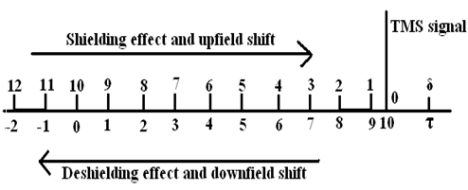
Unit of Chemical shift is ppm (Parts per million)
Relation between
delta (δ) and tau (τ) scale
τ = 10 - δ
b
a
a
a
c
b
c

Slide 28
Equivalent Hydrogen in a organic molecule based on chemical environment
Number of ¹H-NMR signals = Number of equivalent Hydrogen Atom

Slide 29
Most Shielded Reference Compound
Chemical Shift (δ)
ν_{sample} – ν_{ref}
Chemical shift (δ) =
(at constant B_{o})
Spectrometer frequency in MHz
Δν (in Hz)
Chemical shift (δ) =
(at constant B_{o})
Spectrometer frequency in MHz

Slide 30
Unit of Chemical shift is ppm (Parts per million)
Relation between
delta (δ) and tau (τ) scale
τ = 10 - δ
b
a
a
a
c
b
c

Slide 31
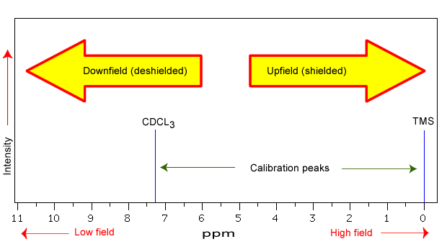

Slide 32
Equivalent Hydrogen in a organic molecule based on chemical environment
Number of ¹H-NMR signals = Number of equivalent Hydrogen Atom

Slide 33
Mathematical Problem
Calculate the chemical shift in ppm (δ) for a proton that has resonance at 126 Hz download from TMS on spectrophotometer that operates at 200 MHz.
Two protons of an organic compound have resonance 50 and 200 Hz downfield from TMS When a 60 MHz NMR instrument is used. What will be their shift in Hz if a NMR instrument of 90 MHz is used? What will the values of these two signals in δ and τ-scales when 90 MHz NMR instrument is used?
Determine the number of Equivalent Hydrogen and number of ¹H-NMR signals

Slide 35
Instrumentation of NMR
c
a = 59999460.7 Hz
b = 60000599.5 Hz
c = 60000896.0 Hz
a
b
a
a
TMS
c
b
¹H-NMR spectrum of propan-2-ol
Two types of NMR Instruments:
The Continuous-Wave (CW) NMR instruments (1 MHz ------- 100 MHZ)
The Pulsed Fourier Transform (FT) NMR instruments (1 MHz -------- 100 MHZ)
4 hrs
1 sec

Slide 36
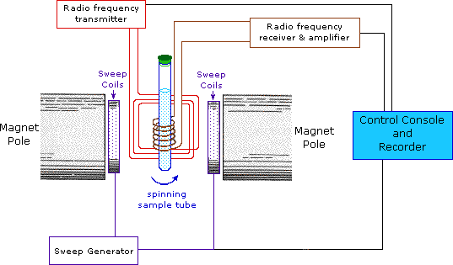
E
C
A
B
D
D
B
A: Sample Holder B: Two powerful electromagnets D: Two additional electromagnets
C: Coil through which radiofrequency transmitter feeds energy to the sample
in the form of radiofrequency
E: Receiving coil receive radio frequency and amplify

Slide 37
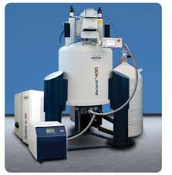
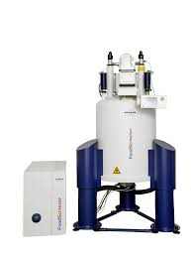

Slide 39
Why is TMS used as internal standard
or reference compound in ¹H-NMR
TMS was proposed as a reference at the time due to the following facts:
It is chemically inert and miscible with a large range of solvents.
Its twelve protons are all magnetically equivalent.
Its resonance position is far away from absorptions due to protons in most organic compounds because it contain most shielded protons.
It is highly volatile and can be easily removed to get back the sample.
It does not take part in intermolecular associations with the sample.
Its chemical shifts are largely temperature and concentration independent

Slide 40
The characteristics required for a solvent
to be used in NMR spectrometer
Example:
CDCl₃ (Chloroform) CD₃-OD (Methanol)
D₂O (Water)
C₆D₆ (Benzene) etc.
It should be chemically inert and magnetically isotropic
It should be devoid of hydrogen atom
It should dissolve the sample to a reasonable extent
Why does NMR use deuterated solvents?
Reason 1: To avoid swamping by the solvent signal.
There is usually much more solvent than sample in an NMR tube.
An ordinary proton-containing solvent would give a huge solvent absorption that would dominate the ¹H-NMR spectrum.
Most ¹H- NMR spectra are therefore recorded in a deuterated solvent, because deuterium atoms absorb at a completely different frequency.
But deuteration is never complete, so in CDCl₃, for example, there is always some residual CHCl₃. You always get a solvent signal from CHCl₃ at 7.26 ppm.
Reason 2: To stabilize the magnetic field strength.
The field strength of superconducting magnets tends to drift slowly.
Modern NMR spectrometers measure the deuterium absorption of the solvent and adjust the field strength to keep the resonance frequency (field strength) constant.
Reason 3: To accurately define 0 ppm.
The difference between the deuterium frequency and 0 ppm (TMS) is well known.
Modern spectrometers can "lock" onto the deuterium signal, so the addition of an internal reference like TMS is not usually required.

Slide 41
Factors influencing chemical Shift (δ)
Inductive effects
Van der Waal’s deshielding effects
Anisotropic effects/Space effect
Hydrogen Bonding effect
Effect of concentration and temperature
Effect of solvent

Slide 42
1. Inductive effects
CH₃-CH₂-CH₂Br
1-Bromopropane
or n-propylbromide
a
b
c
δ = 1.26
δ = 3.30
δ = 1.69
Compound, CH₃X | CH₃F | CH₃OH | CH₃Cl | CH₃Br | CH₃I | CH₄ | (CH₃)₄Si
Electronegativity of X | 4.0 | 3.5 | 3.1 | 2.8 | 2.5 | 2.1 | 1.8
Chemical shift δ (ppm) | 4.26 | 3.4 | 3.05 | 2.68 | 2.16 | 0.23 | 0
Greater electronegativity
Greater is the Deshielding
δ value will be more

Slide 43
2. Van der Waal’s deshielding effects
Electron cloud of a bulky group (hindering group) will tend to repel the electron cloud surrounding the proton.
Thus Such a proton will be deshielded
Proton will resonate at slightly higher value of δ than expected in the absence of this effect
5-Amino-2-(3-amino-2-hydroxy-4-methyl-phenyl)-3-hydroxy-8-(5-methyl-1H-pyrrol-2-yl)-naphthalene-1-carboxylic acid

Slide 44
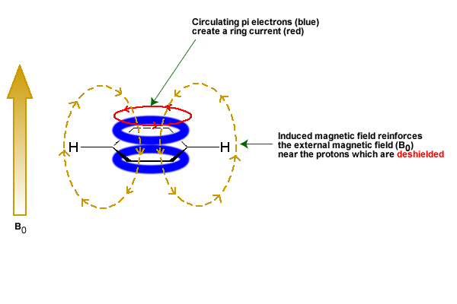
3. Anisotropic effects/ Space effect
Benzene

Slide 45
Proton Type | Effect | Chemical shift (ppm)
C₆H₅-H | highly deshielded | 6.5 - 8
C=C-H | deshielded | 4.5 - 6
C≡C-H | shielded* | ~2.5
O=C-H | very highly deshielded | 9 - 10
* the acetylene H is shielded due to its location relative to the π system
4. Hydrogen Bonding effect

Slide 46
5. Effect of concentration and temperature
Compounds containing the above groups at low concentration
Breakdown of hydrogen bonds
Decrease in δ value
Compound containing the above groups at high temperature
Breakdown of hydrogen bonds
Decrease in δ value
6. Effect of solvent
Few solvents like methanol and DMSO (Dimethyl sulfoxide)
slightly influence the chemical shift value

Slide 47
Spin-Spin interaction /Spin-spin coupling and (n+1) rule
EqHydrogen Chemical Shift
CH₂ 3.90
CH 5.77

Slide 48
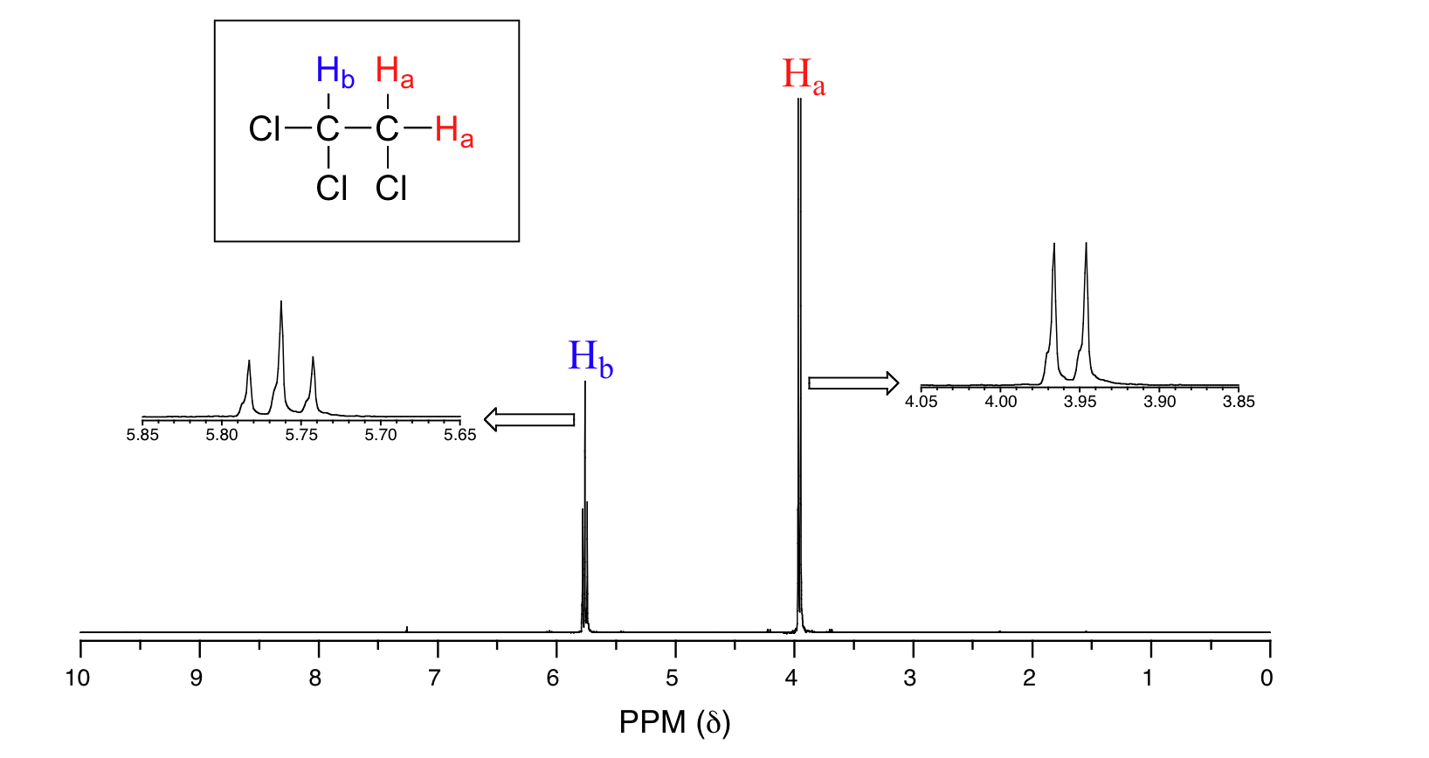
Spin-Spin interaction /Spin-spin coupling and (n+1) rule
1,1,2-trichloroethane
n+1 rule
Splitting pattern reveals the N+1 Rule, which states that a peak’s splitting pattern will be the number of neighboring protons (N) + 1. For example, a triplet peak indicates the hydrogen represented has 2 neighboring hydrogens.
Note: Only protons on adjacent carbons count as “neighbors.” Protons that are on neighboring heteroatoms do not count.

Slide 49
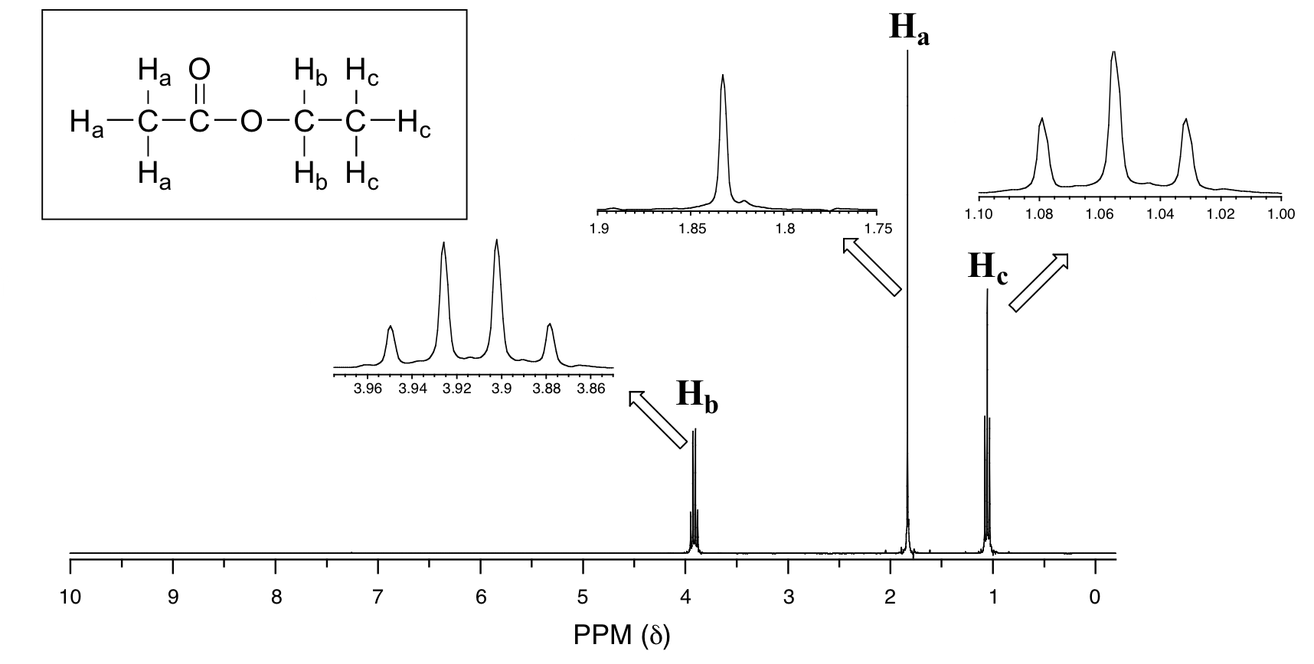
The spectrum for ethyl acetate:

Slide 50
term for peak | # of neighbors
singlet | 0
doublet | 1
triplet | 2
quartet | 3
quintet | 4
sextet | 5
septet | 6
octet | 7
nonet | 8

Slide 52
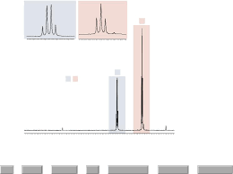
Mechanism of spin-spin interaction in respect to ethyl iodide

Slide 53
Spin orientation of protons of -CH₃ group
against the equivalent protons of -CH₂ group

Slide 54
Spin orientation of protons of –CH₂ group
against the equivalent protons of –CH₃ group

Slide 55
For practice (Determine the number of equivalent hydrogen atom,
number of ¹H-NMR signals and splitting pattern of each compound)

Slide 56
Problems related to structural analysis
The molecular formula of a compound is CH₄O, which gives two singlet peaks in its NMR spectrum. Give name and chemical structure of this compound consistent with NMR data.
The molecular formula of a compound is C₃H₆O, which gives a triplet peak and a quintet peak in its NMR spectrum. Give name and chemical structure of this compound consistent with NMR data.
The molecular formula of a compound is C₃H₅Cl, which gives three singlet peaks in its NMR spectrum. Give name and chemical structure of this compound consistent with NMR data.

Slide 57
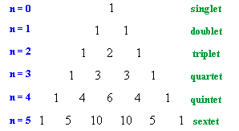
Pascal’s Triangle

Slide 58
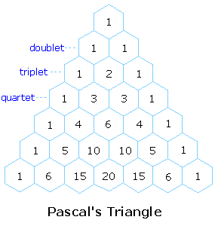

Slide 59
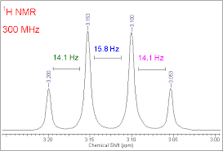
Coupling constant (J)
Definition of Coupling constant (J)
The distance between the peaks in a given multiplet is a measure of the magnitude of splitting effect. , it is referred to as coupling constant and is denoted by the symbol J. Numerical value of J is expressed in Hz
1 1 1 1 2 1 1 3 3 1 1 4 6 4 1 1 5 10 10 5 1 1 6 15 20 15 6 1 1 7 21 35 35 21 7 1
3
3
3 attached nuclei
1
J
1
J
J
Quartet
Pascal’s triangle

Slide 60
Calculation of coupling constant (J)
δ₁
δ₂
ν_{sample} – ν_{ref}
Chemical shift (δ) =
(at constant B_{o})
Spectrometer frequency in MHz
ν_{s1} – ν_{ref}
δ₁ =
--------------------- (i)
Spectrometer frequency in MHz
ν_{s2} – ν_{ref}
δ₂ =
--------------------- (ii)
Spectrometer frequency in MHz

Slide 61
Deduct equation (ii) from equation (i), we find
ν_{s2} – ν_{ref}
ν_{s1} – ν_{ref}
δ₂ - δ₁ =
Spectrometer frequency in MHz
Spectrometer frequency in MHz
ν_{s2} – ν_{ref}
– (ν_{s1} – ν_{ref})
or
δ₂ - δ₁ =
Spectrometer frequency in MHz
ν_{s2} – ν_{ref}
– ν_{s1} + ν_{ref}
or
δ₂ - δ₁ =
Spectrometer frequency in MHz
ν_{s2}– ν_{s1}
or
δ₂ - δ₁ =
Spectrometer frequency in MHz
Finally
Coupling constant (J) =
ν_{s2}– ν_{s1} =
[(δ₂ - δ₁) x
Spectrometer frequency in MHz]
Unit of coupling constant, J is Hz

Slide 62
Problem: The chemical shift (δ) of adjacent peaks of a doublet signal are
2.142 and 2.130 ppm when 500 MHz NMR instrument is used. Calculate the
coupling constant of this doublet peak in Hz.
Types of Coupling:
Geminal Coupling: In ¹H NMR spectroscopy, the coupling of two hydrogen atoms on the same carbon atom is called a geminal coupling. It occurs only when two hydrogen atoms on a methylene group differ stereochemically from each other. The geminal coupling constant is referred to as ²J since the hydrogen atoms couple through two bonds.
B) Vicinal Coupling: In ¹H NMR spectroscopy, the coupling of two hydrogen atoms on adjacent carbon atoms is called vicinal coupling. The vicinal coupling constant is referred to as ³J because the hydrogen atoms couple through three bonds.

Slide 63
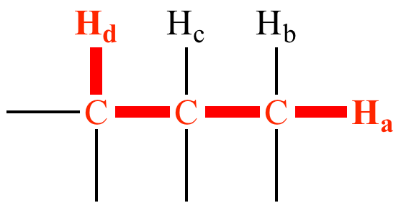
B) Long-range Coupling:
In NMR spectroscopy, coupling between nuclei that are separated by more than three bonds. Coupling of H_{a} with H_{d} (if present) is long range coupling, because these protons are separated by four sigma bonds.
But-2-ene

Slide 64
Factors affecting coupling constant (J)
Number of intervening bonds:
The magnitude of coupling constant (J) depends on the number of bonds intervening between two atoms or groups of atoms that interact. The magnitude of coupling constant (J) decreases with increasing the number of intervening bond.
But-2-ene
J₁
J₂
J₃
J₁ > J₂ > J₃

Slide 65
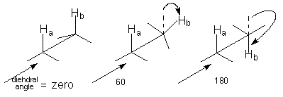
2. Hybridization of carbon atom:
With increasing the s-character of the carbon atom the value of coupling constant (J) increases.
1S², 2S², 2P²
1S², 2S¹, 2P_{x}¹, 2P_{y}¹, 2P_{z}¹
sp3
J increases as the amount of s character in the C-H bond increases.
Typical values are
125 Hz for sp3, 167 Hz for sp2, and 250 Hz for sp hybridization.
3. Bond angle:
Coupling constant (J_{H-H}) is greatest (7 to 15 Hz) when the dihedral angle is 0 ° (syn) or 180 °(anti), less (2 to 5 Hz) for a gauche conformation and 0 for a 90 ° angle
90

Slide 66
4. Geometry of the molecule:
The magnitude of coupling constant (J) differs for cis and trans hydrogen. For a pair of isomeric cis-trans, the value of J_{trans} is greater than the J_{cis}
5. Neighboring substituents:
The increasing in electronegativity of the neighboring substituents decrease the value of coupling constant (J_{H-H}).
For example,
J_{H-H} = 8.9 Hz for CH₃CH₂-Li and 4.7 Hz for CH₃CH₂-OR₂.
Also, J_{H-H} = 23.9 Hz for trans-CH₂=CH-Li and 12.8 Hz for trans-CH₂=CH-F.

Slide 67
6. Ring Strain
Strained rings show unusually large C-H couplings.
This is consistent with the idea that the C-H bonds in strained rings have a high degree of s character.
Typical values are 127 Hz for cyclohexane, 140 Hz for cyclobutane, 161 Hz for cyclopropane, and 228 Hz for the alkene C-H bond of cyclopropene.

Slide 68
Peak Area and Proton counting
H_{b}
H_{c}
H_{a}
H_{a}
H_{b}
H_{c}
A(H_{b}) = 1.99
A(H_{a}) = 3.04
A(H_{c}) = 2.96
A(H_{a}) : A(H_{b}) : A(H_{c}) = 3 : 2 : 3

Slide 69
How to determine the peak area
4
3
r
1
2
Area: πr²
Circumference: 2πr
∫
r
2πr dr
= πr²
0

Slide 70
Information in a ¹H-NMR Spectra
Observable | Name of parameter | Information
Peak position | Chemical shifts (d) | chemical (electronic) environment of nucleus
Peak Splitting | (n + 1) rule | Number Neighboring hydrogen atoms attached to the adjacent carbons
Distance between Splitted peaks | Coupling Constant (J) Hz | Structural variation
Peak Intensity | Integral value | Nuclear/proton count (ratio); Number of equivalent hydrogen atoms in involved in the formation of the corresponding peak.

Slide 71
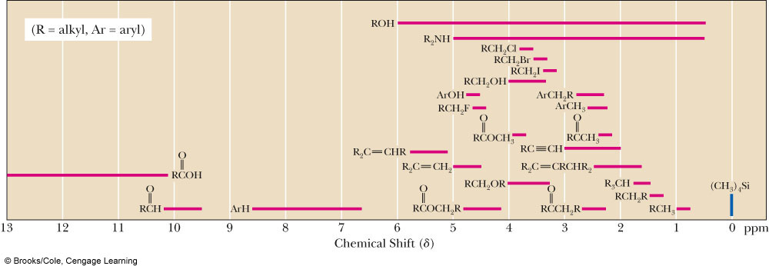
Average values of chemical shifts of representative types of hydrogens

Slide 72
Applications of ¹H-NMR Spectroscopy (Non biological)
Identification of structural isomers:
2. Detection of hydrogen bonding:

Slide 73
3. Detection of aromaticity:
Deshielded; δ = 7.0 – 9.0 ppm
H
4. Detection of electronegative atom or group:
Compound, CH₃X | CH₃F | CH₃OH | CH₃Cl | CH₃Br | CH₃I | CH₄ | (CH₃)₄Si
Electronegativity of X | 4.0 | 3.5 | 3.1 | 2.8 | 2.5 | 2.1 | 1.8
Chemical shift δ (ppm) | 4.26 | 3.4 | 3.05 | 2.68 | 2.16 | 0.23 | 0
Greater electronegativity
Greater is the Deshielding
δ value will be more

Slide 74
5. Distinction between cis- and trans- isomers:
6. Detection of some double bond character due to resonance:

