Slide 1
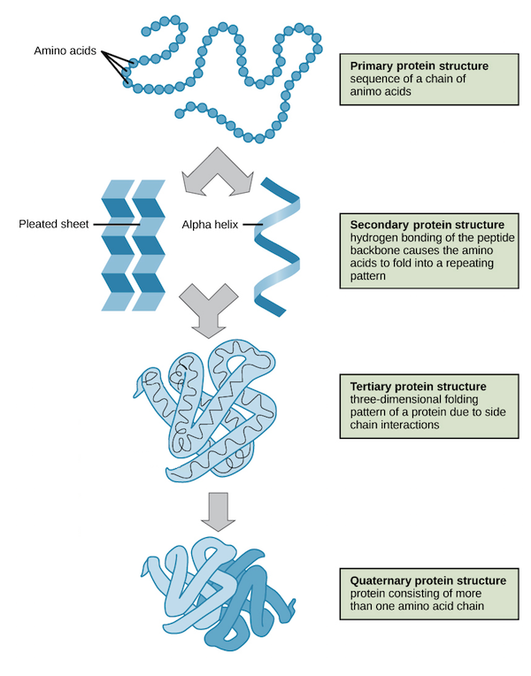

Slide 2
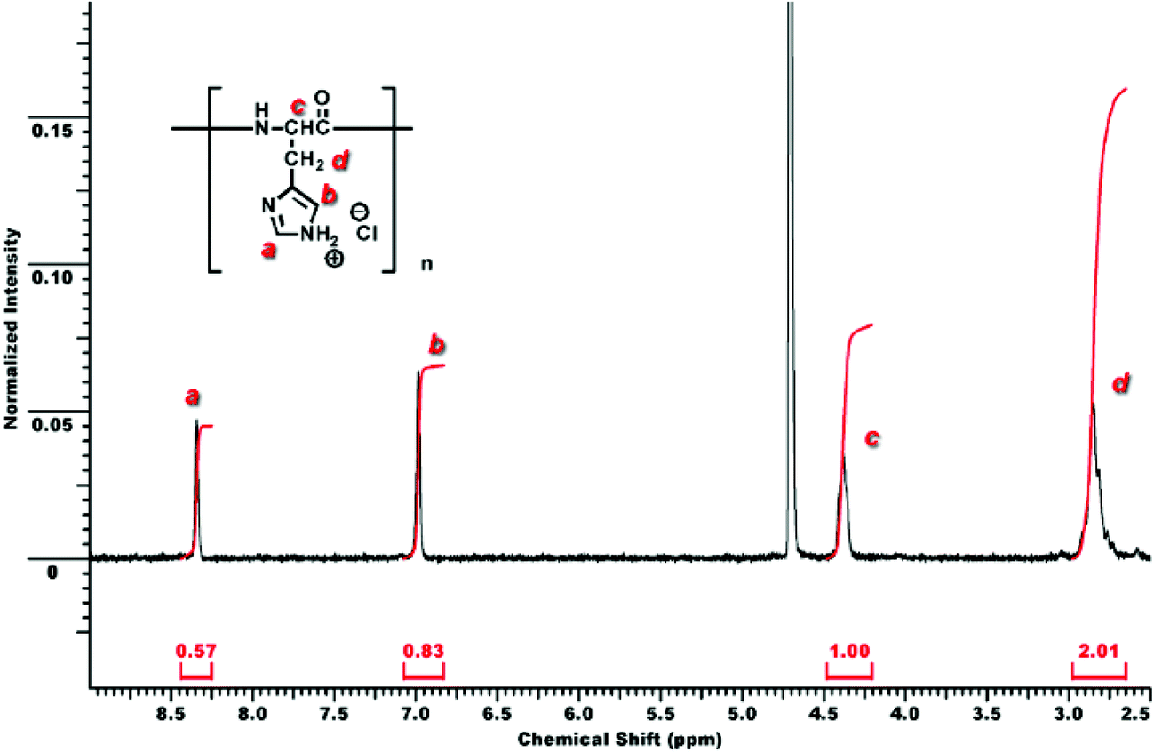
Assignment of line for Proteins and polypeptides in ¹H-NMR spectrum
Characteristics sets of lines at particular positions that can be recognized in
complex spectra by simple inspection:

Slide 3
2. Comparison between the spectra of a protein with known sequence and its fragments
Carboxypeptidase
O
O
O
+
–
H₃NCHC
protein
C
NHCHCO
R
R
Trypsin
O
O
O
NHCHC
NHCHC
NHCHC
C
C
R
R'
R"

Slide 4
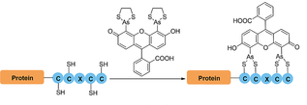
3. Chemical Reaction with a particular residue and binding of a ligand to
the residue of a protein
bi-Arsenic complex
4. Use of deuterated amino acid residue

Slide 5
5. Comparison of the spectrum of a protein with that of a mutant in which there is a single amino acid substitution

Slide 6
6. Comparison between ¹H-NMR spectra of a protein with their X-ray diffraction analysis data
Ways to study proteins by NMR
1. To determine the fraction of amino acids in the α-helical configuration
2. To monitor helix-coil transitions and especially to observe local changes during the transition
3. To determine the conformation of selected regions of the protein (e.g. around a particular amino acid)
4. To observe the binding of small molecules and metal ions to selected regions of the protein (by observing either the ligand or the protein spectra)
5. To study paramagnetic active sites in electron- transfer proteins.

Slide 7
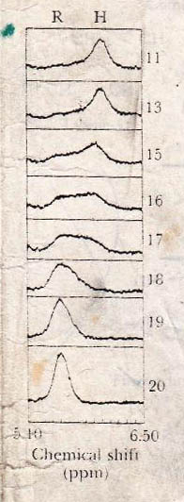
Fraction of residues of poly-(γ-benzyl-L-glutamate) in the α-helical configuration
poly-(γ-benzyl-L-glutamate)

Slide 8
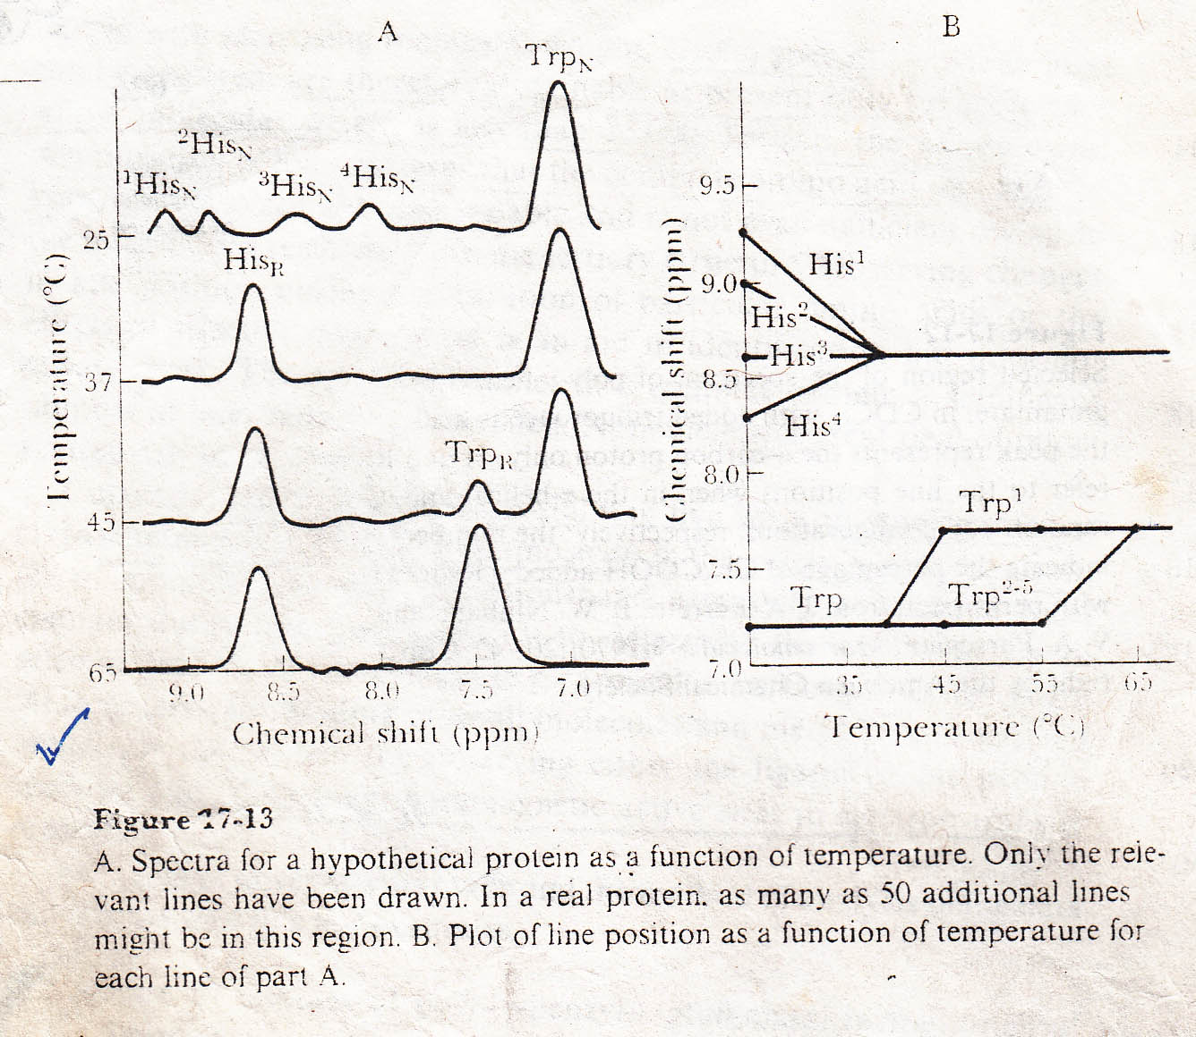
Unfolding of a protein / Denaturation of a protein

Slide 9
Properties of the active site of Ribonuclease-A
Ribonuclease-A
Ribonuclease-A is an enzyme secreted by the pancreas into the small intestine, where it catalyzes the hydrolysis of certain bonds in the ribonucleic acids present in ingested food.
Ribonuclease-A
Total residues: 124; α-helical (%): 26; β-conformation: 35
3'-CMP / 2'-CMP / 5'-CMP (All are competitive inhibitors of ribonuclease-A)

Slide 10
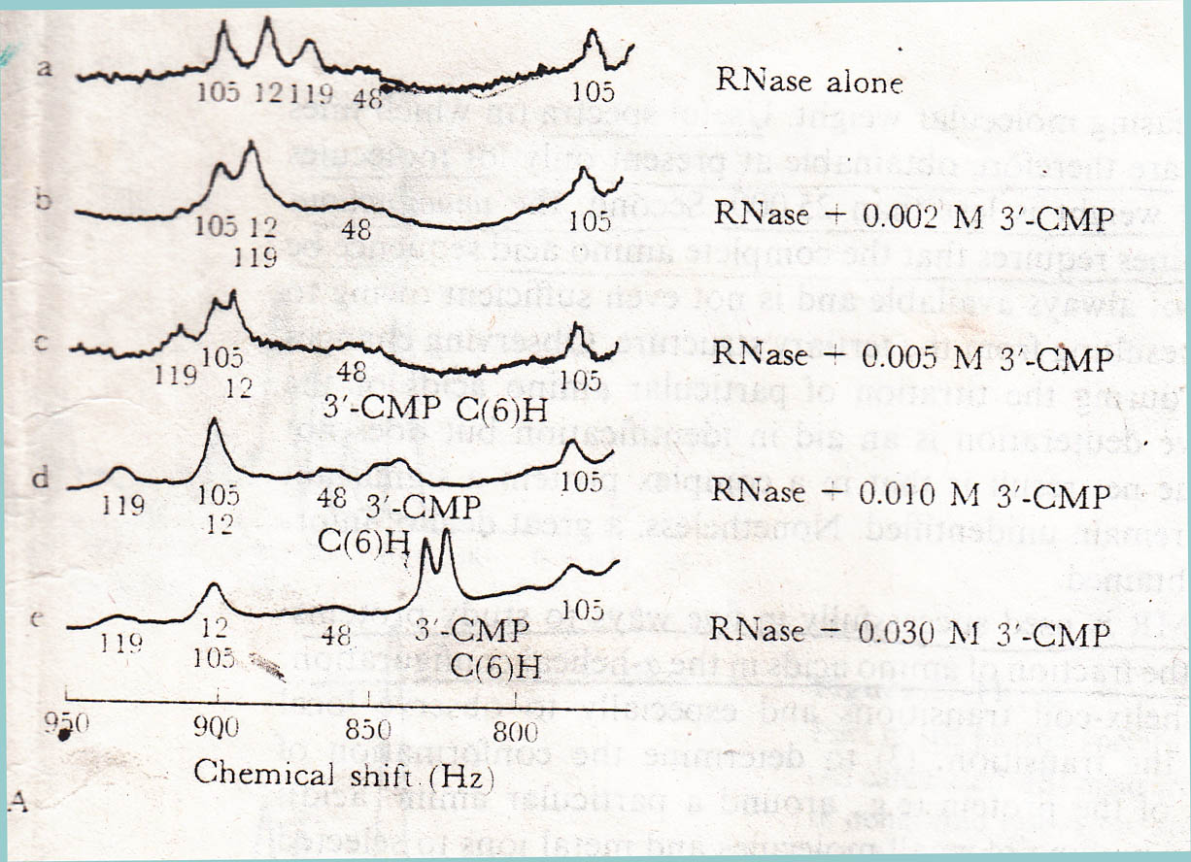
H-C2 of three histidine residues (His-12, 48, 119) of RN-A (Ribonuclase-A)
+
3'-CMP
Chemical shift change

Slide 11
H-C2 (Proton of C-2) of imidazole ring (instead of Histidine residue)
+
Different concentration of Phosphate Group (Instead of 3'-CMP)
Same change in chemical shift like His-119
H-C2 of three histidine residues (His-12, 48) of RN-A (Ribonuclase-A)
+
3'-CMP / 2'-CMP/ 5'-CMP (competitive inhibitors of Ribonuclase-A)
whose binding constant different
Using different pH of medium
Chemical shift change is same for three inhibitors (3'-CMP / 2'-CMP/ 5'-CMP)

Slide 12
Proton of phenyl ring of phenylalanine residue (Phe-120) of Ribonuclase-A
+
3’-CMP
Big change in chemical shift
Proton of phenyl ring of phenylalanine residue (Phe-120) of Ribonuclase-A
Proton of phenyl ring of phenylalanine residue (Phe-120) of Ribonuclase-A
+
Phosphate Group
+
Cytosine / (3'-CMP / 2'-CMP/ 5'-CMP)
No change in chemical shift
Same big change in chemical shift

Slide 13
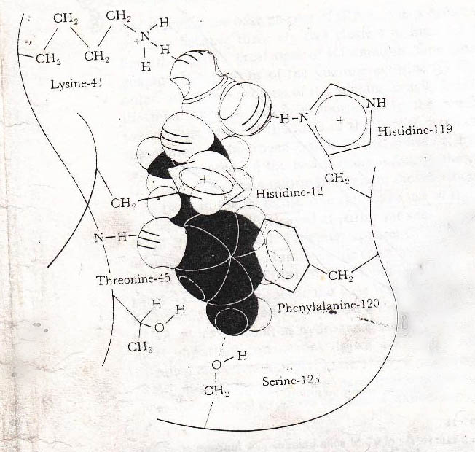

Slide 14
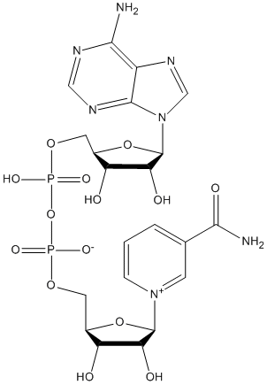
Effect of a cofactor on enzyme-substrate binding
E + NAD
Nicotinamide proton
Broadened
other E + NAD
Nicotinamide proton
Not Broadened
Methyl proton of Et-OH
and acetaldehyde
E + NAD
Broadened
Methyl proton of Et-OH
and acetaldehyde
E
Not Broadened
Methyl proton of Et-OH
and acetaldehyde
NAD
Not Broadened

Slide 15
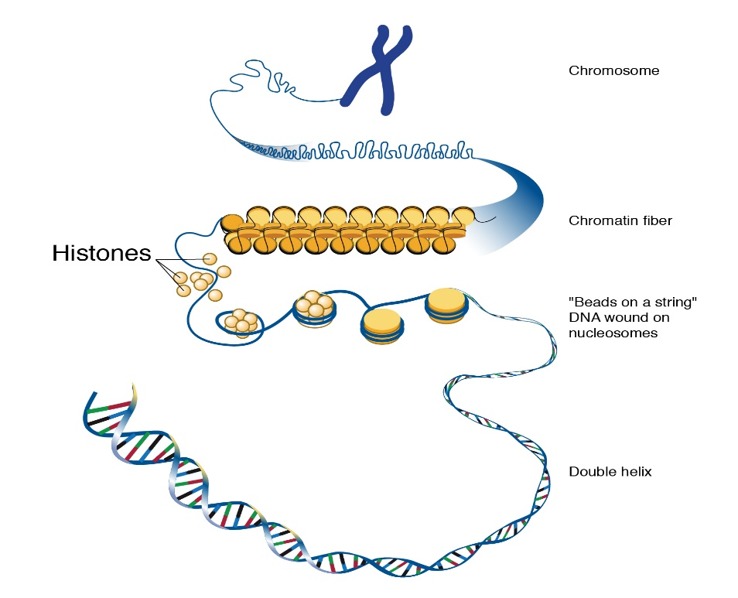
Binding of a polymer to a protein (DNA-histone complex)
Histone
Basic region
Nonpolar region
Acidic region
DNA + Histone
DNA-histone complex
DNA strands wrap around proteins called histones
There are four types of histones, named: H2A, H2B, H3, and H4.

Slide 16
Spin Labeling

Slide 17
The amount of broadening line decreases α
1
Distance between the unpaired electrons
and the nucleus of interest increases
≤ 40 Aº

Slide 18
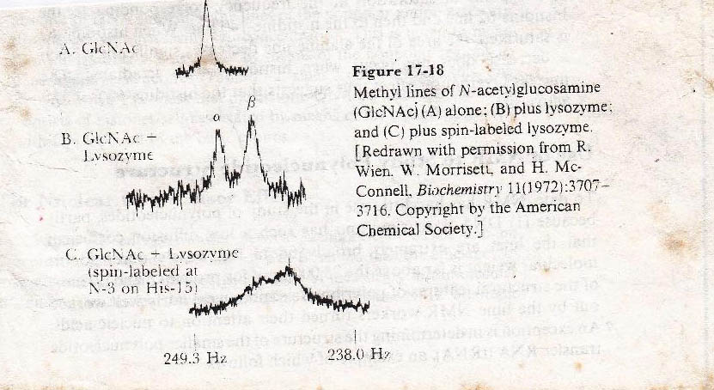
Amino acids
Labeled Histidine-15 residue

Slide 19
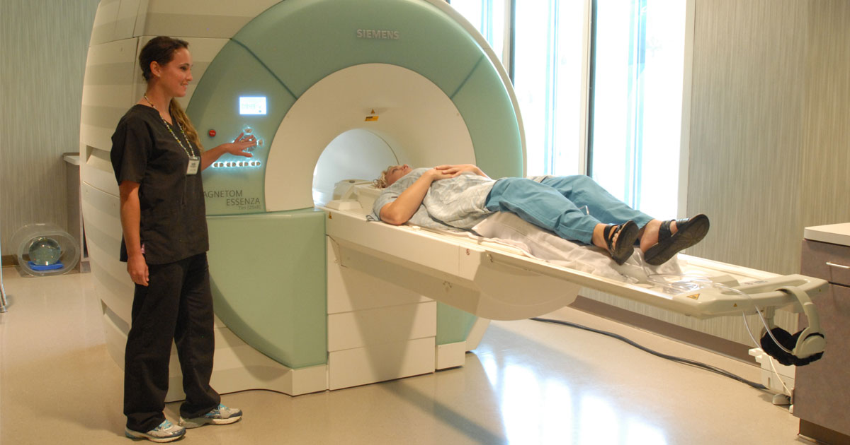
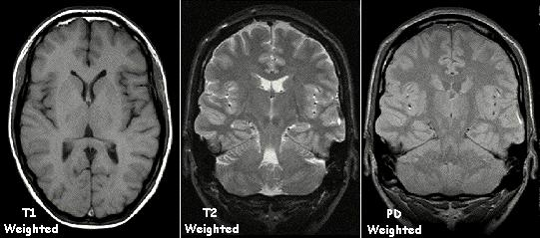
MRI (Magnetic Resonance Imaging)

Slide 20
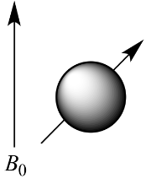
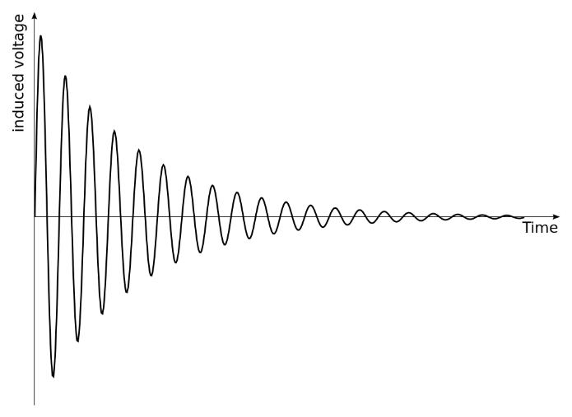
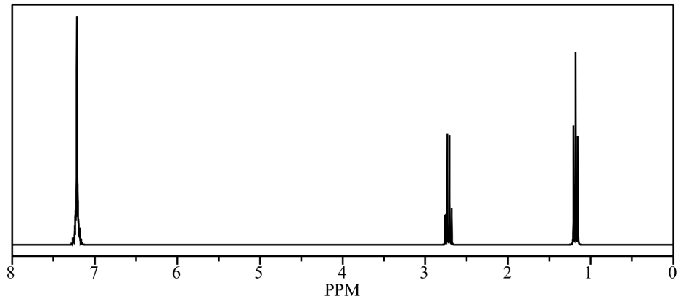
Fourier Transform NMR
 | Absorb photon (excitation)
 | Emit photon (relaxation)
Fourier transform
Free induction decay

