Slide 1
Parts of a computer system
What Does Computer System Mean?
A computer system is a basic, complete and functional hardware and software setup with everything needed to implement computing performance.
1) Hardware:
i) Input devices ii) Output devices
2) Software:
i) System software ii) Application software
3) Data
4) User or operator

Slide 2
3) Data
In computing, data is information that has been translated into a form that is efficient for movement or processing
or Computer data is information processed or stored by a computer.
This information may be in the form of characters, symbol, text documents, images, audio clips, software programs, or other types of data.
Data is the plural form of the Latin datum, although data is used conversationally to represent both singular and plural.
4) User:
People are the computer users, also known as operators. It can be argued that some computer systems are complete without a person’s involvement; however no computer is totally autonomous. Even if a computer can do its job without a person sitting in front of it, people still design, build, program and repair computer systems. This autonomy is especially true of personal computer systems.
The User’s role
Setting up the system
Installing software
Running programs
Managing files
Introduction to computers by peter Norton; Page no: 43-44

Slide 3
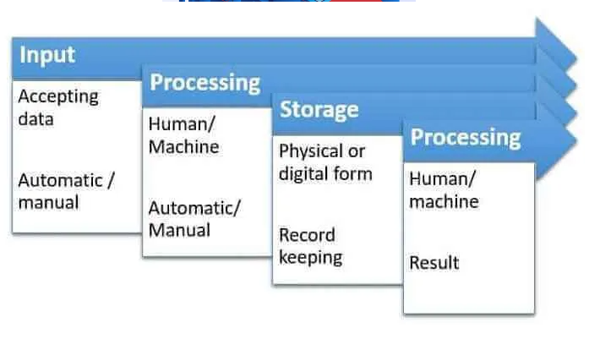
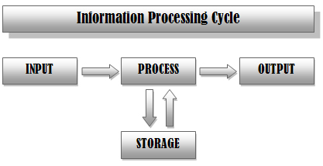

Slide 4
input – Entering data into the computer
Feeding the collected raw data in the cycle for processing. This is the raw data which is supplied for processing & obtaining information.
Input can be done by utilizing various devices such as keyboards, mouse, flatbed scanners, barcode readers, joysticks, digital data tablets (for graphics drawing), electronic cash registers, etc
Processing – Performing operations on the data
Once the input is provided the raw data is processed by a suitable or selected processing method. This is the most crucial step as it allows for the processed data in the form of output which will be used further.
Processing is usually done by CPU (Central Processing Unit) in a computer. CPU is the crucial component for getting the operations done.
Storage – Saving data in a soft/physical form
Storage can be done on external hard disk, inbuilt hard disk, pen drives, micro SD cards, compact disks or even in registers.
Output – Results obtained, i.e., information
This is the outcome, and the raw data provided in the first stage is now “processed,” and the data is useful and provides information and no longer called data. This might be further used for data visualisation.
This can be used as it is or used for further processing along with more data.

Slide 5
Software
Definition: A set of instruction or code which is designed to solve problems or perform specific tasks within computer system, is called a software or a program.
Classification of software:
Software
System software
Application software
Operating system
Network Operating system
Utility
Operating system (OS)
Definition: The master control software that provides an interface for a user to communicate with the computer; manages hardware devices; manages and maintain disk file systems and supports application softwares. An OS tells the computer how to use its own components.
Examples: Windows Xp; Windows 7,8, 9 & 10; Linux; Macintosh; etc

Slide 6
Function of Operating Systems (OS)
Displays the on screen elements with which we interact the user interface
Loads software into the computer’s memory so that you can use them
Coordinates how software work with the computer’s hardware and other software
Manages the way information is stored on and retrieved from disks
Types of Operating Systems (OS)
Real-Time Operating Systems : OS in life support systems, Air traffic control systems
Single-User/Single-Tasking Operating Systems: Examples-MS-DOS
Single-User/Multitasking Operating Systems: Examples- Windows Xp, Windows -7,8,9,10, Linux, Macintosh, etc.
Multiuser/Multitasking Operating Systems: Examples: UNIX, VMS
Real-Time Operating Systems : Example: VRTX, RT-Linux, Lynx, PSOS, etc

Slide 7
2. Single-User/Single-Tasking Operating Systems
Example: DOS (Disk operating systems):
What is meant by disk operating system?
A disk operating system (abbreviated DOS) is a computer operating system that resides on and can use a disk storage device, such as a floppy disk, hard disk drive, or optical disc. A disk operating system must provide a file system for organizing, reading, and writing files on the storage disk.
Examples:
There are various versions of DOS like MS-DOS(Microsoft), PC-DOS(IBM), Apple DOS,
Dr-DOS etc. WINDOWS was similar to APPLE Mach operating system interface on IBM-PC.
Function of Disk Operating System (DOS)
It takes commands from the keyboard and interprets them.
It shows all the files in the system.
It creates new files and allots space for programme.
It changes the name of a file in place of old name.
It copies information in a floppy.
It helps in locating a file.
It searchers where the file is located in the disk.
If we want the information in the file to be printed, it gives printout of the information.
It hides the files and directories so as not to be seen by others.
It permanently removes the file.

Slide 8
Weaknesses:
It supports one user and can run only one program at a time
It has no built-in support for networking
For this OS, user has to install drivers any time they added a new hardware component to their PC
It is also limited in the amount of RAM and storage space that it can support
It supports only 16-bit programs
It does not take full advantage of the power of modern 32-bit or 64-bit processors
It use command-line interface
Why is DOS still in use:
DOS is still in because of its size and simplicity.
It does not require much memory or storage space for the system and
it does not require powerful computer

Slide 9
Single-User/Multitasking Operating Systems
Windows NT (New Technology):
A 32-bit OS; Released in 1993
Windows NT Workstation (Used in architectural firms; audio and video production studios, graphics studios
Windows NT Server (Used on network server)
Windows 9x
Windows 95 Windows 98 Windows Me (Millennium)
Windows 95:
First OS that can exchange information with printers, networks and files in 32-bit pieces instead of 16-bit pieces.
It was designed to support integrated networking and improve graphical user interface (GUI)
It is the first version to support the Plug and Play standard for connecting new hardware
Windows 98:
Inclusion of the Internet Web browser with a new feature, the Active Desktop, that lets user browse the Internet
Windows Me:
It is a consumer-grade operating systems that was released in 2000.
Improved multimedia capabilities
Built –in support for digital video editing
Enhanced Internet features
But all the three version of Windows 9x (i.e., Windows 95, Windows 98 and Windows Me) contains a lot of 16-bit code that supports old DOS -OS

Slide 10
Windows 2000 Professional
Released in 2000 as four version
One for desktop and other three for network server
It is designed for offices and business purposes
It includes support for symmetric multiprocessing (SMP) with up to two processor
Windows Xp
Released in 2001 as Windows Xp professional, Windows Xp Home, Windows Xp Media center edition, etc
It supports 32- and 64-bit programs
Here some of the features have been upgraded in Windows Xp:
Digital Media Support
Advanced Networking and Communication
Advanced Mobile Computing

Slide 11
Windows Vista
It is an OS from Microsoft and it is a part of the windows series of operating system. It was released in late 2006 and offers enhancement of reliability, security, easy development and performance over its previous version, Windows Xp
The main features of windows vista include:
Simplified and centralized desktop configuration management
Detection of hardware problems before they occur
Enhanced security features offering protection against the latest generation of threats, such worms, viruses and spyware
New sleep state consuming less power and having a faster start-up time
The different version of Windows vista:
Windows Vista Home Basic: Explore websites; browse the Internet; view files and photographs, send and retrieve e-mail and set parental controls.
Windows Vista Home Premium: All features of Windows Vista Home Plus Tablet PC support, Windows Sideshow, Windows media center, Windows Mobility Center, etc
Windows Vista Business: Designed for small businesses and include features like simplicity in usage and mechanism which protects all the stored information from unauthorized viewers.
Windows Ultimate: This version covers all the features of Windows Vista Business and Windows Vista Home Premium with certain extra features like Language Packs, BitLocker Drive Encryption and DreamScence
Windows Vista Enterprise: This version is mainly used in large global organizations having desktops protected by Software Assurance Agreements or organizations with a Microsoft Enterprise Agreement that comprises the Windows desktop component.

Slide 12
Windows 7
Windows 7 is a personal computer operating system that was produced by Microsoft as part of the Windows NT family of operating systems. It was released to manufacturing on July 22, 2009 and became generally available on October 22, 2009, less than three years after the release of its predecessor, Windows Vista
Primary Features:
The primary features of Windows 7 are:
Start Menu – The Start Menu provides the primary access point for programs and applications on your ThinkPad.
Taskbar and Notification Area – The Taskbar contains 3 main components, the Start button, the Task/Quicklaunch bar and the System Notification Area.
Windows 8
Windows 8 is a personal computer operating system that was produced by Microsoft as part of the Windows NT family of operating systems. The operating system was released to manufacturing on August 1, 2012.
The transition from Windows 7 to Windows 8 introduced a number of new features across various aspects of the operating system. These include:
It bring a greater focus on optimizing the operating system for touchscreen-based devices (such as tablets) and cloud computing.
It provides innovative & dynamic Desktop.
It Improves search function. The search capability of windows 8 for all apps and files is even stronger than previous one.
Windows 8 allows users to make a copy of their OS complete with their settings, wallpapers, files and even apps, into a USB thumb drive
,

Slide 13
Windows 10
Windows 10 is a series of personal computer operating systems produced by Microsoft as part of its Windows NT family of operating systems. It is the successor to Windows 8.1, and was released to manufacturing on July 15, 2015.
Windows 10 offers user some new and advanced features.
1. New Start Menu
Microsoft has brought back the start menu in windows 10. Now, when user click on the Start button at the bottom left of the screen, user get two panels side by side, with the left column showing pinned, recently and most-used apps.
2. Cortana Integration
Windows 10 will bring Microsoft’s voice-controlled digital assistant Cortana to desktop computers, to make it easier for you to interact with your device without lifting a finger.
3. Microsoft Edge Web Browser:
Internet Explorer was replaced by Microsoft Edge, which features a new rendering engine called EdgeHTML. Edge also integrates with the Cortana Digital Assistant to provide voice control, search, and personalized info to users.
4. Virtual Desktops
Unless you have a multi-monitor setup it can be easy to run out of screen space. For that reason, Windows 10 provides multiple desktops that you can work in and quickly switch between.

Slide 14
Macintosh Operating System:
Macintosh Operating system (Mac OS ) works only Macintosh computers and it is the biggest drawback of this operating system.
Although it has a small market share, the Mac remains the first choice of many publishers, multimedia developers, graphic artists and schools.
The current version of Mac OS is called Mac OS sytem X (ten)
Multi-User/Multitasking Operating Systems
UNIX:
Its interface is command-line and it requires many commands to do even simple tasks.
In the UNIX OS, everything is either a process or a file.
A file can be considered as a collection of data which are created by the users.
A process can be considered as a program which is under execution and is identified by a unique process identifier (PID).
UNIX OS is composed of three parts:
1) Kernel:
The main function of the kernel is to allocate memory and time to the programs.
It also handles system calls in response to the storage of files and communications.
2) Shell:
The main function of the shell is to act as interface between the user and kernel.
How does shell work:
This is done through small process which takes place when a user logs in, and the program which has a control over the login checks for the correct user name and password of every user who tries to log in. This starts another program called shell which Command Line Interpreter (CLI). The command typed by the user interpreted by shell and arranged for the processes to be carried out.
3) Programs: These perform specific tasks

Slide 15
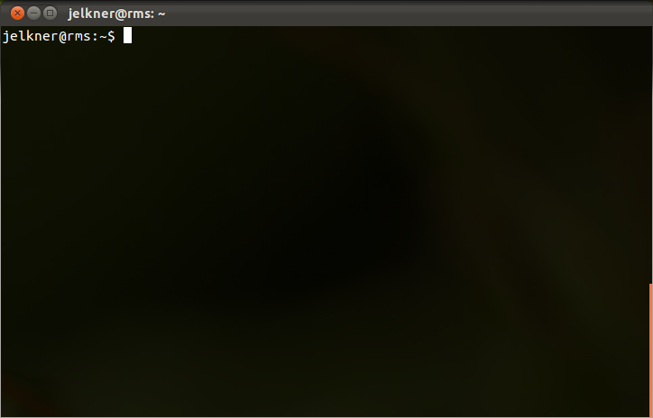

Slide 16
Linux:
Linux is considered a “Freeware” operating system and it a full 32-bit, multitasking operating system that supports multiple users and multiple processors. Linux uses command-line but windows-based GUI environments, called shells, are also available.
The biggest nontechnical difference between UNIX and Linux is price. Anyone can get a free copy of Linux OS on the internet.
Network Operating Systems (NOS)
Definition: A network operating system (NOS) is an OS that is designed to run on a network server dedicated to providing various services to other computers on the network. The “other” computers are called client computers, and each computer that connects to a network server must be running client software designed to request a specific service.
Examples:
Windows NT Server (designed for Windows NT workstation)
Windows 2000 Server
Server Standard Edition : This version is fine-tuned for using as network server. This version with symmetric multiprocessing (SMP) feature supports for up to two processors.
Advanced Server: This NOS version for SMP with up to four processors and enhance balancing of network and component loads with more RAM.
Data Center Server: This version is the most powerful of the server editions and optimized for use as large-scale application server, such as database server. It includes the advanced server features, plus support for SMP with up to 32 processors.

Slide 17
Examples:
3. Windows Server 2003
Windows server 2003 Windows Xp-style interface GUI.
Its two version are as follows:
Windows server 2003 Standard Edition : This version with symmetric multiprocessing (SMP) feature supports for up to two processors.
Data Center Server: It support for SMP with up to 32 processors.
4. Windows 2008 Server
Windows 2008 server offers increased reliability and flexibility in the server environment.
Windows 2008 server has four versions which are different in 32-bit and 64-bit systems.
Windows 2008 server standards: (4 GB RAM in 32-bit version/32 GB RAM in 64-bit versions; supports up to 4 processors and a maximum of 12 server roles)
Windows 2008 server Enterprise: (64 GB RAM in 32-bit version/2 TB RAM in 64-bit versions; supports up to 8 processors and a maximum of several server roles)
Windows 2008 server Datacenter: (64 GB RAM in 32-bit version/2 TB RAM in 64-bit versions; supports up to 64 processors and a maximum of several server roles)
Windows web server 2008: (4 GB RAM in 32-bit version/32 GB RAM in 64-bit versions; supports up to 2 processors and It can support only the Web Server role)
5. Novell NetWare
6. UNIX for Servers

Slide 18
Embedded Operating Systems
An embedded operating system is an operating system for embedded computer systems. These operating systems are designed to be compact, efficient at resource usage, and reliable, forsaking many functions that standard desktop operating systems provide
Types of embedded OSes
Embedded OS are designed for the task they will perform. The various types of operating systems include the following:
Multitasking operating system. A multitasking OS can perform several tasks at once. It uses job scheduling to perform basic tasks. For example, a cellphone OS divides up CPU resources among multiple tasks.
Real-time operating system. A real time OS is designed to be reactive. It processes inputs when they are received and responds within a specific timeframe. If the response time falls outside of the specified time period, the system could fail. Real-time OSes sometimes use rate monotonic scheduling, which assigns priorities to tasks.
Single loop control system. This type of embedded OS exercises control over a single variable. An example would be temperature control in a smart home. A smart thermostat measures the temperature in the house and if it exceeds the limit set by the user, turns off the heat.

Slide 19
An embedded operating system is one that is built into the circuitry of an electronic device, which resides on a magnetic disk. Embedded operating system are now find in wide verity of devices such as Cell phones, Medical equipment, bar-code scanners, etc.
Examples:
Windows XP Embedded
Windows CE.NET (Used for medical instruments)
Android OS (Google Inc.)
iPhone OS/iOS (Apple)
Bada (Samsung Electronics)
Symbian OS (Nokia & Sony Ericssion)
MeeGo OS (Nokia and Intel)

Slide 20
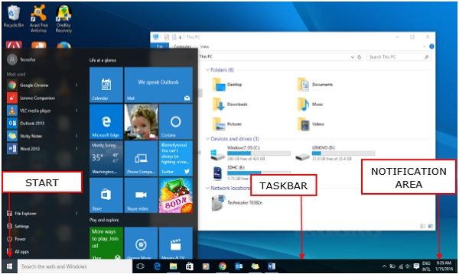
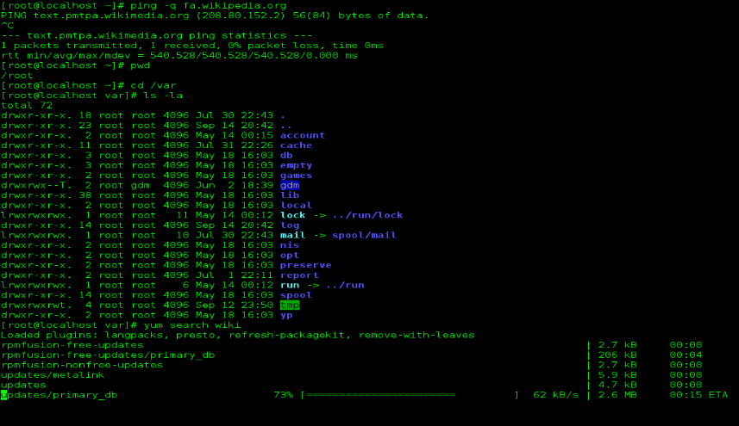
User Interface
The user interface is the on-screen elements that enable the user to interact with the software
Types of user interface
Graphical user interface (GUI)
Command-line interface (CLI)
Graphical User Interface (GUI): A user interface in which actions are initiated when the user selects an icon, a toolbar button, or an option from a pull-down menu with the mouse or other pointing device. GUI also represent documents, programs and devices on screen as graphical elements that the user can use by clicking or dragging.
Command-line interface: A user interface that enables the user to interact with the software by typing strings of characters at a prompt.
In a command-line interface, prompt is the on-screen location where the user type commands
Graphical user interface (GUI)
Command-line interface (CLI)

Slide 21
Why is GUI better than CLI?
Most people can learn and use GUI much faster and easier than CLI which requires a higher degree of memorization and familiarity. For example, GUIs provide the user with immediate visual feedback in most cases, whereas there is often no obvious feedback in the case of CLIs

Slide 22
Utility
Enhancing an OS with Utility software
Utility software is software designed to help analyze, configure, optimize or maintain a computer.
It is used to support the computer infrastructure - in contrast to application software, which is aimed at directly performing tasks that benefit ordinary users. However, utilities often form part of the application systems.
Utilities enhance or extend the operating system’s capabilities or that simply offer new features not provided by the operating system itself.
Backup utilities
Software designed to duplicate important data in the event of a hard drive failure, user error, disaster or accident. Software applications that handle the process of backing up and restoring files, folders, databases, hard drives, or entire network servers are also sometimes referred to as disaster recovery tools.

Slide 23
Popular backup software tools include
Norton Ghost,
Symantec Backup Exec,
Acronis True Image
Total Recovery Pro.
An alternative to standard backup software tools are online backup and recovery services that save your important data to a remote location in the cloud. Examples of cloud backup services include Carbonite, Mozy and IDrive.
For safekeeping, a backup utility can help you copy large groups of files from your hard disk to another storage medium such as pendrive or a CD-R disc. This utility of new version, also help to organize the files, update backups and restore backups to disk in case of data loss.
Function:
Backup software makes copies of all information stored on a disk and restores either the entire disk (Disk cloning) in an event of disk failure or selected files that are accidentally deleted or corrupted.

Slide 24
Antivirus
What is virus of computer system?
A virus is a parasitic program that can delete or scramble or replicate itself until the host disk is full.
What is antivirus software?
Antivirus software is a program or set of programs that are designed to search, detect, and remove software viruses and other malicious software like worms, trojans, adware, and more. Examples: Nortan, McAfee, Bitdefender, etc
Function:
An antivirus utility can examine the contents of a disk or RAM for hidden viruses and files that may act as hosts for virus code.
In a word, anti-virus utilities scan for computer viruses and block or remove them.
3. Firewall
A Firewall is a network security device that monitors and filters incoming and outgoing network traffic based on an organization's previously established security policies. At its most basic, a firewall is essentially the barrier that sits between a private internal network and the public Internet.
Firewall are specialized computers used by ISP (Internet Service Provider) and most corporations, that are dedicated to examining and blocking traffic coming from and going to the Internet.

Slide 25
According to their structure, there are three types of firewalls – software firewalls, hardware firewalls, or both.
At home, a smaller and less expensive hardware firewall or a software firewall is used as firewall utility.
Examples:
ZoneAlarm Free Firewall 2017
Tinywall
Anti NetCut3
Comodo Free Firewall
PeerBlock
Little Snitch [Mac]
Private Eye [Mac]
Function:
A firewall is a network security device that monitors incoming and outgoing network traffic and decides whether to allow or block specific traffic based on a defined set of security rules.

Slide 26
4. Screen Savers:
Screen savers display a moving image on the screen and prevent the previous displayed images from “burning” into the monitors.
Function: It prevent phosphor burn-in on CRT and plasma computer monitors
5. File manager:
A file manager is a computer program that provides a user interface to manage files and folders. Examples: Windows 10 Manager, jDownloader, iFunBox, etc.
Function:
Functions of a file management system are as follows:
Store, arrange, or accessing files on a disk or other storage locations.
Creating new files.
Displaying the old files.
Adding and editing the data in files.
Moving files from one location to another.
Sorting files according to the given criteria. For example, file size, file location, modified date, creation date, etc.
6. Disk cleaner:
Disk cleaner is a computer maintenance utility that is included in Microsoft Windows and it is designed to free up disk space on a computer's hard drive.
Function: The utility scans your computer’s hard drive for files that you no longer need such as temporary files, cached webpages, and rejected items that end up in your system’s Recycle Bin

Slide 27
Acquiring Application Software
Application software
Any computer program used to create or process data such as text documents, spreadsheet programs, presentation programs, etc.
Commercial
Non-commercial
Personal creation
1. Commercial software:
Stand-Alone Programs : MS-Word
Software Suites: Microsoft office
Shareware: Shareware is software that is available free of cost but only up to a certain time limit. Furthermore, after the time limit, the user has to pay the money to use the full-featured version of the software. Since, after the time limit, the software deactivates itself.
Types of Shareware
There are several types of shareware software. They are as follows:
1. Adware
Adware stands for “advertising-supported software”. This software basically displays advertisements to earn revenue for the developer.
Examples are Adblock Plus, Skype, Fireball, Appearch, DeskAd, Gator, etc.

Slide 28
2. Demoware
It is a trial version of the software that provides a demo or trial of the software. It further divides into two categories. They are as follows:
a) Crippleware
This software provides only a certain number of features until the user does not purchase the full version of the software. Example: Facebook Lite
b) Trialware
In this software, the user can use all the features of the software within the time limit. Hence, it provides full usage and the right to know the software fully.
Example: Adobe Software
3. Donationware
It is the type of software that provides the full-featured version to the user and requests the user to pay an optional amount. Example: Cyberduck, Adium and Handbrake
4. Nagware
This software continuously reminds the user to pay for the software. They continuously display alert messages or dialogue boxes either on starting the software or while using the application. Besides some software also applies watermarks on files clearly stating that the files are of an unlicensed copy of the software.
Examples are WinZip, WinRAR

Slide 29
5. Freemium
This software provides the full-featured version of the software. But, at the same time, the user has to pay an amount for the premium version. The premium version of the software contains some advanced features of the software. Examples: Dropbox
Advantages of Shareware
Advantages of shareware are as follows:
It is initially free for the customers.
The user can fully understand the capabilities and flaws of the software.
One will not have to pay money for software he doesn’t like.
A lot of overhead expenses of printing and packaging of software are saved for the author.
Disadvantages of Shareware
There are many threats to using shareware. They are as follows:
Malware: Hackers can fool users using adware and make them download malicious software.
Security Vulnerabilities: The shareware is usually more at risk. Since there is no license in the beginning and there are no updates therefore if the software is left unused on the system it may pose risk to the system.
Sponsored Software: Some shareware may download a secondary program which can cause a threat to the system.
Data Leaks: Some software is such which can send the data of the system to the author which can be a great threat.

Slide 30
2. Non-commercial software:
Freeware: Adobe Reader
Public domain: Public domain software is any software that has no legal, copyright or editing restrictions associated with it. It is free and open-source software that can be publicly modified, Public-domain software is software that has been placed in the public domain: in other words, software for which there is absolutely no ownership such as copyright, trademark, or patent. Example- I2P software
3. Personal creation :
Open-Source software: Sometimes software is designed for users who need to customize the programs they use. Open source software (OSS) is software that is distributed with its source code, making it available for use, modification, and distribution with its original rights. Example-

Slide 31
Difference between Freeware and Shareware
Freeware | Shareware
Software is free of cost. | Free of cost but only for a certain time duration.
It is usually fully functional and all the features are available. | Only certain features are available for the trial period.
Distribution is free of cost. | Free distribution may require the author’s permission.
There is no time limit for usage. | There is a certain trial period usually 30 days.
Examples are MSN Messenger, Adobe PDF, Yahoo Messenger, etc. | Examples are WinZip, Getright, etc.

Slide 32
Examples of Application software
Word Processing Programs
A word processing program (also called a word processor) provides tools for creating all kinds of text-based documents
MS (Microsoft)-Word
Its interface:
Menu bars
Toolbars
Rulers
Scroll bars
A status bar
Formatting text:
Character formatting
Paragraph formatting
Document formatting

Slide 33
Examples of Application software
Spreadsheet Programs
A Spreadsheet program is a software tool for entering, caculating, manipulating and analyzing sets of numbers
MS (Microsoft)-Excel
Its interface:
Menu bars
Toolbars
Formula bar
Document area
Cell
Row and Column
Status bars
Scroll bars
Four type of data entered into cell:
Labels
Values
Dates
Formulas

Slide 34
Examples of Application software
Presentation: Presentation is a collection of slides that can be shown to an audience. Presentations are created using special software called a Presentation Program.
Presentation Programs
A Presentation is a program that allow the user to design slides or single screen images containing a combination of text, numbers, and graphics (such as charts, clip art, or pictures) often on a colorful background.
MS (Microsoft)-PowerPoint
Its interface:
Menu bars
Toolbars
Rulers
Document area
Slide
Drawing tools
Status bars
Scroll bars
Views in PowerPoint: There are four main views in a PowerPoint presentation
Normal View
Slide Sorter View
Slide Show View
Notes Page View

Slide 35
List of ways for displaying the slides to an audience
On the PC’s Screen
On a Large-Format Monitor
On a Television
From a Data Projector
Examples of Application software
Personal information manager
Personal Information Managers (PIM):
The explosion of contact information has given rise to a special type of software, called the personal information manager, or PIM.
A personal information manager software is designed to keep track of many different kinds of contact information, for many different people. PIM software is sometimes referred to as contact manager or contact management software.
You also can use a PIM to manage your schedule, create reminders, and set up to-do lists.
Contact lists are often called address books in e-mail programs and PIMs
Examples: Microsoft Outlook and Entourage

Slide 36
Graphics and Multimedia
Graphics are categorized into two forms:
Graphics
Bitmap graphics
Vector graphics
Bitmap graphic is a binary representation of an image in which each part of the image, such as a pixel, is represented by one or more bits in a coordinate systems
Vector graphic is a representation by a set of vectors, which are mathematical equations describing the size, shape, thickness, position, color, and fill of lines or closed graphical shapes.

Slide 37
Uses of Bitmap graphics and Vector graphics for graphics software:
Some types of graphics programs work with bitmaps images and some work with vector images and some work with both.
Whether you use a bitmap- or vector- based program depends on what you are trying to do.
If you want to be able to retouch a photo, create seamless tiling textures for the Web or for 3-D surfaces, or create an image that looks like a painting, you will choose bitmap-based software.
Vector-based software is your best choice if you want flexibility of resizing an image without degrading its sharpness, the ability to reposition elements easily in an image, or the ability to achieve an illustrative look as when drawing with a pen or pencil.

Slide 38
File formats suitable for all Bitmap-based graphics programs:
All Bitmap-based graphics programs can use any of the following file formats:
BMP (BitMaP): A graphics format is native to Microsoft Windows and is widely used on PCs for icons and wallpaper. The BMP file format supports up to 24-bit depth coloror over 16 million different colors.
PICT (PICTure): It is designed by Apple for use in Macintosh computer only.
TIFF (Tagged Image File Format): It is widely used in PCs. This format is usually the best to use when exchanging bitmap files that will be printed or edited further
JPEG (Joint Photographic Experts Group): This format is common on the world wide web (www) pages and is often used for photos and other high-resolution (24-bit or millions of colors) images that will be viewed on screen.
GIF (Graphic Interchange Format): It is often found in world wide web (www) pages. Unlike JPEG images, GIF images can contain only 256 or fewer colors.
EMF (Windows Enhanced MetaFile): This format was originally developed for Microsoft Office suite of applications.

Slide 39
Getting Images into computer
There are several ways to load images into a computer for editing, but the most common methods are :
Scanners: An image scanner is like a photocopy machine, but instead of copying an image onto paper, it transfers the image directly into the computer.
Digital Cameras: This type of camera stores digitalized images for transfer into a computer.
Digital Video Cameras:
Clip Art: The term clip art originated with large books filled with professionally created drawings and graphics that could be clipped from the pages and glued to a paper layout. Today many software features built-in collections of clip art.
Graphics software
Five major categories of graphics software:
Paint programs (Microsoft paint)
Photo-editing programs (Adobe Photoshop, Corel PaintShop , etc.)
Draw programs (Artweaver, Krita, My paint, etc)
Computer-aided design (CAD) programs: Computer-aided design (CAD) is a combination of computer programs and systems that allow engineers and architects to design detailed two- or three-dimensional models of physical objects, such as mechanical parts, buildings, and molecules.(Archimedes, Mesh LAB, Misfit Model 3D, etc.)
3-D modeling and animation programs: (Autodesk 3ds Max, Cinema 4D, Modo, etc)

