Slide 1
What is network:
A network is a set of technologies-including hardware, software and media that can be used to connect computers together, enabling them to communicate, exchange information, and share resources in real time.
The following three components are required to build a network:
Hardware
Software
Media
Four benefits that networks provide to their users:
1) Simultaneous Access:
Network server: A network server is a central computer with a large storage device and other resources that all users can share.
If the server stores data files for users to access, it is commonly called a file server.
2) Shared Peripheral Devices:
The ability to share peripheral devices is one of the best reasons for small businesses to set up network
3) Personal communications:
Example of personal communications are electronic mailing system (e-mail) and teleconferencing.
Subcategories of teleconferencing are videoconferencing, Audio-conferencing and Data-conferencing
4) Easier Data Backup:
Data backup is achieved in business by keeping it on a shared storage device that employees can access through a network. Often the network manager makes regular backups of the data on the shared storage device

Slide 2
Common Types of Networks
Local Area Network (LAN)
Wide Area Network (WAN)
Hybrid Networks
Examples:
Campus Area Networks (CAN)
Metropolitan Area Network (MAN)
Others: Home Area Networks (HAN)
Server
A server is a computer or system that provides resources, data, services, or programs to other computers, known as clients, over a network. In theory, whenever computers share resources with client machines they are considered servers. There are many types of servers, including file servers, Application servers, virtual servers.
File servers
File servers store and distribute files. Multiple clients or users may share files stored on a server. In addition, centrally storing files offers easier backup or fault tolerance solutions than attempting to provide security and integrity for files on every device in an organization. File server hardware can be designed to maximize read and write speeds to improve performance.

Slide 3
Application servers
Application servers run applications in lieu of client computers running applications locally. Application servers often run resource-intensive applications that are shared by a large number of users. Doing so removes the need for each client to have sufficient resources to run the applications. It also removes the need to install and maintain software on many machines as opposed to only one.
i) DNS servers
Domain Name System (DNS) servers are application servers that provide name resolution to client computers by converting names easily understood by humans into machine-readable IP addresses. When a client needs the address of a system, it sends a DNS request with the name of the desired resource to a DNS server. The DNS server responds with the necessary IP address from its table of names.
ii) Mail servers
Mail servers are a very common type of application server. Mail servers receive emails sent to a user and store them until requested by a client on behalf of said user. Having an email server allows for a single machine to be properly configured and attached to the network at all times. It is then ready to send and receive messages rather than requiring every client machine to have its own email subsystem continuously running.

Slide 4
Web servers
One of the most abundant types of servers in today’s market is a web server. A web server is a special kind of application server that hosts programs and data requested by users across the Internet or an intranet. Web servers respond to requests from browsers running on client computers for web pages, or other web-based services. Common web servers include Apache web servers, Microsoft Internet Information Services (IIS) servers and Nginx servers.
Database servers
The amount of data used by companies, users, and other services is stored in databases. Databases need to be accessible to multiple clients at any given time and can require extraordinary amounts of disk space. Both of these needs lend themselves well to locating such databases on servers. Database servers run database applications and respond to numerous requests from clients. Common database server applications include Oracle, Microsoft SQL Server, DB2, and Informix.
Proxy servers
A proxy server acts as an intermediary between a client and a server. Often used to isolate either the clients or servers for security purposes, a proxy server takes the request from the client. Instead of responding to the client, it passes the request on to another server or process. The proxy server receives the response from the second server and then replies to the original client as if it were replying on its own. In this way, neither the client nor the responding server needs to directly connect to each other.

Slide 5
What is Node?
A node is a processing location that can be a PC or some other device such as networked printer.
A network node is a connection point in a communications network. Each node is an endpoint for data transmissions or redistribution.
How network are structured
Sever-based networks:
A Server-based network is a network in which network security and storage are managed centrally by one or more servers. A Server-Based network can also be termed as a Client-Server network. A server is a node that acts as a service provider for clients.
Client/Server Networks: A client-server network is the medium through which clients access resources and services from a central computer, via either a local area network (LAN) or a wide-area network (WAN), such as the Internet.
Peer-to-Peer Networks:
A peer-to-peer (P2P) network in which interconnected nodes share resources amongst each other without the use of a centralized administrative system

Slide 6
Data movement through network
Packets: Data moves through the network in a structure called packets. Packets are pieces of a message broken down into small units by the sending PC and reassembled by the receiving PC
Most packets have two parts:
The Header (First part)
The Payload (Second Part)
The information contained within Header:
The header identifies the node that sent the packet (The source) and provides the address of the node that will receive the packet (The destination)
The header also contain the information for network to determine the best way to get it to its destination.
The header also holds control data that helps the receiving node reassemble a message’s packets in the right order.
Payload is the actual data that is being transmitted between two nodes.
Network Topology
Definition: The logical layout of the cables and devices that connect the nodes of the network, is called network topology.
Network designers consider the following factors when deciding which topology of combination of topologies to use:
The distance between computers
The speed at which data must travel around the network
The cost of setting up the network
Hence, network topologies can be either logical or physical.
In the logical topology, there is actual transfer of the data in the network as per its design plan whereas in case of a physical topology, the physical design of a network which consists of location, devices and the cable installation is referred.

Slide 7
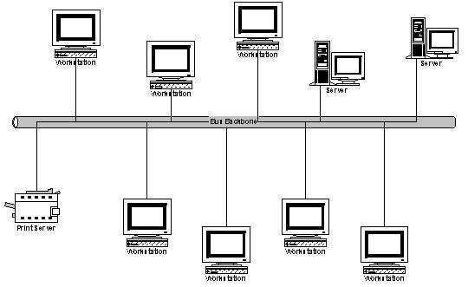
Types of Network Topology
Bus Topology:
Advantages of bus topology
It works well when you have a small network.
It's the easiest network topology for connecting computers or peripherals in a linear fashion.
It requires less cable length than a star topology.
Disadvantages of bus topology
It can be difficult to identify the problems if the whole network goes down.
It can be hard to troubleshoot individual device issues.
Bus topology is not great for large networks.
Terminators are required for both ends of the main cable.
If a main cable is damaged, the network fails or splits into two.
Terminator

Slide 8
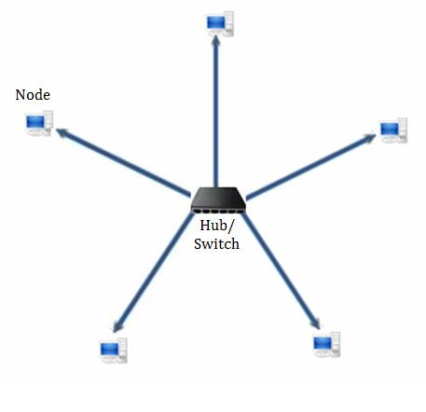
Star Topology:
Advantages of Star Topology
1) As compared to Bus topology it gives far much better performance. A sent signal reaches the intended destination after passing through central device called hub. Performance of the network is dependent on the capacity of central hub. 2) Easy to connect new nodes or devices. In star topology new nodes can be added easily without affecting rest of the network. Similarly components can also be removed easily. 3) Centralized management. It helps in monitoring the network. 4) Failure of one node or link doesn’t affect the rest of network. At the same time its easy to detect the failure and troubleshoot it.
Disadvantages of Star Topology
1) Too much dependency on central device has its own drawbacks. If it fails whole network goes down. 2) The use of hub, a router or a switch as central device increases the overall cost of the network. 3) Performance and as well number of nodes which can be added in such topology is depended on capacity of central device.

Slide 9
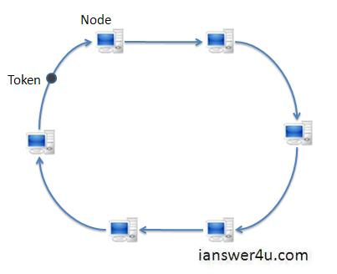
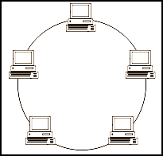
Ring Topology:
Advantages of Ring Topology
1) This type of topology is very organized. Each node gets to send the data when it receives an empty token. This helps to reduces chances of collision. Also in ring topology all the traffic flows in only one direction at very high speed. 2) Even when the load on the network increases, its performance is better than that of bus topology 3) Additional components do not affect the performance of network. 4) Each computer has equal access to resources. Disadvantages of Ring Topology
1) Each packet of data must pass through all the computers between source and destination. This makes it slower than star topology.
2) If one workstation or port goes down, the entire network gets affected. 3) Network is highly dependent on the wire which connects different components.

Slide 10
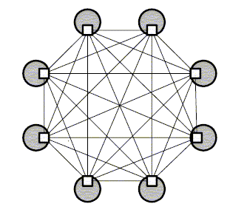
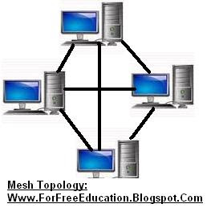
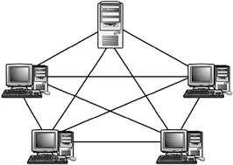
Mesh Topology:
Advantages
Since, there are many links to transfer data, Mesh topology gets rid of the traffic problem. Data may be transferred through different links.
If one link becomes unusable, it does not disturb the whole system. Other links can be used for communication.
Since each node has physical connection with other nodes, therefore, one node can transfer data to many nodes at the same time
Disadvantages
1. It is very expensive due to implementation of multiple links for each node. 2. It is difficult to install and reconfigure. 3. Adding or removing a node is difficult.

Slide 11
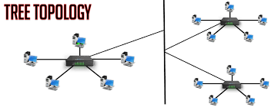
Tree Topology:
Tree topology is a combination of bus and star topology. It is a hybrid topology
Advantages:
Easy to expend and implementation the network.
Easy to identify the faulty device.
Well suited for temporary networks.
Point-to-point connection for each device.
If one device is damaged then the other devices are not affected.
disadvantages:
Difficult to troubleshoot the problem.
If there is a problem with the main cable, the entire network goes down.
This network is not secure, anyone can see transmitted data.
The maintenance becomes difficult as more and more nodes and segments are added.

Slide 12
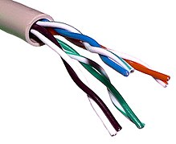
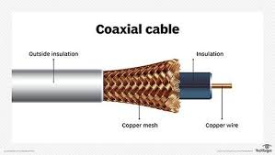
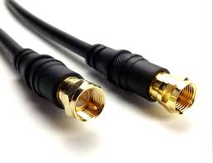
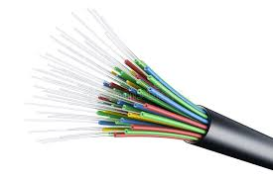
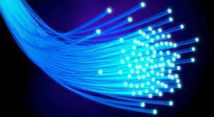
Network media:
Media refers to the means used to link a network’s nodes together.
Media are two types:
Ware-based media
Wireless media
Wire-based media: There are different type of ware used as ware-based media
a) Twisted-pair cable (1 Gbps)
b) Coaxial cable (10 Mbps)
c) Optic fiber cable (100 Gbps)
2. Wireless media: Here different data are transferred through air (called ether)

Slide 13
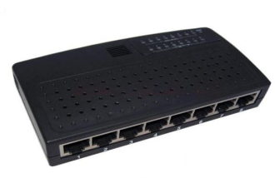
Network Interface Cards (NICs):
Regardless of wiring and topology used, each computer on the network needs a hardware component to control the flow of data. The device that performs this function is the network interface cards (NICs)
It is also known as a network adapter or network card
This printed circuit board fits into one of the computer’s expansion slots and provides a port where the network cable is attached.
In the case of wireless NICs, there will not be port, an antenna will be showing or a light or indicator will indicate that an internal antenna is activated.
Network Linking Devices
Hub:
The function of a hub is to allow communications between devices so that data can be transmitted from one computer to another.
When a Hub receives data from one of the connected devices, it passes data to all the other ports without checking for the destination device except the port through which it receives the data.
Hub can monitor traffic and help to prevent collision

Slide 14
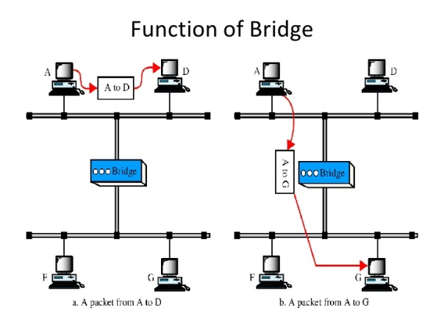
2. Bridge:
Function:
A bridge is a device that connects and passes packets between two LANS or two segments of the same LANs that use the same communications protocol.
A bridge looks at the information in each packet header and forwards data that is traveling from one LAN to another, to appropriate destination.
3. Switches:
Function:
A switch is a high-speed device that receives incoming data packets and redirects them to their destination on a LAN.
A switch prevents collisions by providing a circuit between the source and destination ports.

Slide 15
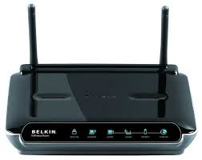
4. Router
A router is a complicated device that stores the routing information for networks.
Function:
Router looks at each packet’s header to determine where the packet should go and then determines the best route for the packet to take toward its destination. A data packet is typically forwarded from one router to another router through the networks that constitute an internetwork until it reaches its destination node.

Slide 16
Network Technology
Definition:
Network Technology is the technology that helps us networking with other people via a network of computer and connected electric devices . The major stuff that network technology covers are following:
Communication devices: From Cable to Wireless technology, all are discussed in network technology such as router, modem, adapter, etc.
Intranet and Extranet: Private networks and public networks which are the two core area of studies in network technology.
Tools to communication: From texting to video conference, all are the part of network technology. Virtual reality communication that are being told as the next big thing is also part of network technology.
The most common type of network technologies include:
Ethernet:
Ethernet is a family of computer networking technologies commonly used in local area network (LAN), metropolitan are network (MAN) and wide area network (WAN). The original implementation of ethernet used coaxial cable were called 10Base-5 and 10Base-2. The most popular implementation of ethernet called 10 Base-T, uses a star topology and twisted-pair wires and can achive transmission speeds up to 10 Mbps. Most new network installations ethernet use an star topology with either twisted-pair cable or an optic fiber cables as the medium.
Other types of network technology include Fast ethernet, Gigabit ethernet, Token Ring

Slide 17
Network protocol
Definition: A set of standards used for network communications, is called network protocol. Network protocol take the form of software or hardware that must be installed on every computer on the network
How the network protocol works
Protocols, using their own methods, break data down into small packets in preparation for transportation. Linking devices pass these packets to the various pieces of equipment, including other computers and printers that are attached to the network. The receiving computer reconstructs the packets into their original structure.
For ethernet network , usually the OS software tells the computer exactly how to break up, format, send, receive and reassemble data using the following network protocol
TCP/IP: It is the protocol of internet and it is required on any computer that must communicate across the internet.
IPX/SPX: A proprietary protocol of Novell, IPX/SPX has been used in the most version of the NetWare network operating system for networking offices throughout the world.
NetBIOS/NetBEUI: It is an excellent protocol for networking in small business or home.
OSI Model (Open System Interconnection)
OSI (Open Systems Interconnection) is a standard ISO model for how applications communicate over a network. The model defines a framework networking used for the implementation of protocols present in seven layers.

Slide 18
Layer 1. Physical Layer
The first layer of the seven layers of Open Systems Interconnection (OSI) network model is called the Physical layer. Physical circuits are created on the physical layer of Open Systems Interconnection (OSI) model.
Function: Physical layers describe the electrical or optical signals used for communication. Physical layer of the Open Systems Interconnection (OSI) model is only concerned with the physical characteristics of electrical or optical signaling techniques which includes the voltage of the electrical current used to transport the signal, the media type, impedance characteristics, physical shape of the connector, Synchronization etc.
Layer 2. Data link Layer
The second layer of the seven layers of Open Systems Interconnection (OSI) network model is called the Data link layer. The Data Link layer resides above the Physical layer and below the Network layer.
Function: Data link layer is responsible for providing end-to-end validity of the data being transmitted. Here frames of data are transmitted from the same network segment between computers.
Layer 3. Network Layer
The third layer of the seven layers of Open Systems Interconnection (OSI) network model is the Network layer.
Function: The Network layer of the OSI model is responsible for managing logical addressing information in the packets and the delivery of those packets to the correct destination.

Slide 19
Layer 4. Transport Layer
The fourth layer of the seven layers of Open Systems Interconnection (OSI) network mode is the Transport layer.
Function: The Transport layer handles transport functions such as reliable or unreliable delivery of the data to the destination. On the sending computer, the transport layer is responsible for breaking the data into smaller packets. At the receiving system, the transport layer will be responsible for opening all of the packets and reconstructing or reassembling the original message.
Layer 5. Session Layer
Session layer is the fifth layer of seven layered Open Systems Interconnection (OSI) Model.
Function: The session layer is responsible for establishing, managing, and terminating connections between applications at each end of the communication.
Layer 6. Presentation Layer
The position of Presentation Layer in seven layered Open Systems Interconnection (OSI) model is just below the Application Layer.
Function: When the presentation layer receives data from the application layer, to be sent over the network, it makes sure that the data is in the proper format. If it is not, the presentation layer converts the data to the proper format. On the other side of communication, when the presentation layer receives network data from the session layer, it makes sure that the data is in the proper format and once again converts it if it is not.

Slide 20
Layer 7. Application Layer
The Application Layer the seventh layer in OSI network model. Application Layer is the top-most layer of the seven layered Open Systems Interconnection (OSI) network model.
Function: The main function of the application layers is to provide the end-user services. It end user processes and support application
The main benefits of the OSI model include the following:
• Helps users understand the big picture of networking
• Helps users understand how hardware
are and software elements function together
• Makes troubleshooting easier by separating networks into manageable pieces
• Defines terms that networking professionals can use to compare basic functional relationships on differ-
ent networks
• Helps users understand new technologies as they are developed

Slide 22
Modem
MOdulator/DEModulator:
A modem converts digital signals generated by the computer into analog signals which can be transmitted over a telephone or cable line and transforms incoming analog signals into their digital equivalents.
Types of Modems Modems can be of several types and they can be categorized in a number of ways.
Categorization is usually based on the following basic modem features:
Directional capacity:
half duplex modem and full duplex modem.
2. Connection to the line:
2-wire modem and 4-wire modem.

Slide 23
Internet
Definition:
Internet is a global computer network providing a variety of information and communication facilities, consisting of interconnected networks using standardized communication protocols.
In a word, internet is a network of networks.
The Internet’s History
The Beginning: A “Network of Networks
The seeds of the internet were planted in 1969, when the Advanced Research Projects Agency (ARPA) of the U.S. Department of Defense began connecting computers at different universities and defense contractors. The resulting network was called ARPANET.
Goal of this network:
The goal of this early project was to create a large computer network with multiple paths in the form of telephone lines that could survive a nuclear attack or a natural disaster such as an earthquake. If one part of the network were destroyed, other parts of network would remain functional and data could continue to flow through the surviving lines.
ARPA had a second important reason for creating such a network. That is, it would allow people in remote locations to share scarce computing resources.

Slide 24
The network (ARPANET) jumped across the Atlantic to Europe in 1973 and in the mid-1980s, an other federal agency, the National Science Foundation (NSF) joined to the ARPANET project. The NSF created a new, higher-capacity network called NSFnet to complement the older and by then overloaded APRANET. The link between ARPANET, NSFnet and other networks was called the Internet
The Internet’s Major Services
World Wide Web (www)
Electronic mail; E-mail (Yahoo, G-mail, etc)
News (News Rover, Xnews, NewsPro)
File Transfer Protocol
Chat
Instant messaging
Online services
Peer-to-peer services

Slide 25
World Wide Web (www)
The World Wide Web (also know as web/www) was created in 1989 at the European Particle Physics Laboratory in Geneva, Switzerland, as a method for incorporating footnotes, figure, and cross references into online documents (called web documents)
Hypertext:
Hypertext is text displayed on a computer display or other electronic devices with references (hyperlink) to other text that the reader can immediately access.
Web documents can be linked together because they are created in a format know as hypertext.
Hyperlink/hypertext link:
Hyperlink or hypertext link is a word or icon or other objects that when clicked jumps to another location on the document or another web page.
Hypertext Transfer Protocol (HTTP):
Hypertext Transfer Protocol is a set of file transfer rules used on the world wide web that controls the way of information sharing.
Hypertext Markup Language (HTML):
Hypertext Markup Language is a page-description language used on the world wide web that defines the hypertext links between documents.
Web page:
Web page is a document developed using HTML and found on the world wide web. Web page contain information about a particular subject with links to related web pages and other resources.
Web site:
Website is a collection of related Webpages.
Web browser:
A web browser (commonly referred to as a browser) is a software application for accessing information on the World Wide Web. The most popular web browsers are Chrome, Firefox, Safari, Internet Explorer, and Edge.

Slide 26
URL (Uniform Resource Locator): The Hypertext transfer protocol uses internet addresses in a special format, called Uniform Resource Locator or URL.
URL stands for Uniform Resource Locator, and is used to specify addresses on the World Wide Web. A URL is the fundamental network identification for any resource connected to the web (e.g., hypertext pages, images, and sound files).
URLs have the following format:
type://address/path
Or
protocol://hostname/other_information
http://www.loc.gov/exhibits/treasure
The address is for an
internet server that
uses http
To find specific webpages about ongoing exhibits at the library of congress (LOC)
This site is on the part of internet known as the world wide web
This site is run by the government agency-the library of congress (LOC)

Slide 27
Search engine: Google
Boolean Operators are used to connect and define the relationship between your search terms. When searching electronic databases, you can use Boolean operators to either narrow or broaden your record sets.
The three Boolean operators are AND, OR and NOT.
Operator | Search criteria | Effect
AND | Printer AND color | The search engine looks only for pages that include both terms and ignores pages that include only one of them
OR | Printer OR color | The search engine looks for pages that include either or both of the terms
NOT | Printer NOT color | The search engine looks for pages that include the term printer, but do not also include the term color. The engines ignores any pages that include both terms.

Slide 28
E-commerce
Electronic commerce or ecommerce is a term for any type of business, or commercial transaction, that involves the transfer of information across the Internet. Ecommerce allows consumers to electronically exchange goods and services with no barriers of time or distance.
There are 6 basic types of e-commerce:
1. Business-to-Business (B2B) 2. Business-to-Consumer (B2C) 3. Consumer-to-Consumer (C2C) | 4. Consumer-to-Business (C2B). 5. Business-to-Administration (B2A) 6. Consumer-to-Administration (C2A)
1. Business-to-Business (B2B)
Business-to-Business (B2B) e-commerce encompasses all electronic transactions of goods or services conducted ​​between companies.
2. Business-to-Consumer (B2C)
The Business-to-Consumer type of e-commerce is distinguished by the establishment of electronic business relationships between businesses and final consumers.
3. Consumer-to-Consumer (C2C)
Consumer-to-Consumer (C2C) type e-commerce encompasses all electronic transactions of goods or services conducted ​​between consumers.
4. Consumer-to-Business (C2B)
In C2B there is a complete reversal of the traditional sense of exchanging goods. This type of e-commerce is very common in crowdsourcing based projects. A large number of individuals make their services or products available for purchase for companies seeking precisely these types of services or products.
5. Business-to-Administration (B2A)
This part of e-commerce encompasses all transactions conducted online between companies and public administration. This is an area that involves a large amount and a variety of services, particularly in areas such as fiscal, social security, employment, legal documents and registers, etc. These types of services have increased considerably in recent years with investments made in e-government.
6. Consumer-to-Administration (C2A)
The Consumer-to-Administration model encompasses all electronic transactions conducted between individuals and public administration.

Slide 29
Business-to-Consumer (B2C)
Online shopping
The following essential features should be shared by effective online shopping sites:
A catalog where you can search for information about products services
A “checkout” section where you can securely pay for the items you want to purchase.
A customer-service page, where you can contact the merchant for assistance
The ways of paying during online shopping:
One time credit card
Set Up an online account
During online shopping, one should check the following information of customer service resources before purchasing:
Contact information
Return policies
Shopping policies
Charges and fees

