Slide 1
Protein : structure & function
Lecture 4
Dr Md. Rezaul Karim
Professor, Dept of Biochemistry and Molecular Biology, University of Rajshahi

Slide 2
WOW!!! Facts
Proteins are major components of all cellular systems
Proteins consist of one or more linear polymers called polypeptides
Proteins are linear and never branched
Different AA’s are linked together via PEPTIDE bonds
The individual amino acids within a protein are known as RESIDUES
The smallest known P’ is just nine residues long - oxytocin
The largest is over 25,000 residues - the structural protein titin
Proteins are generally between 100 and 1000 residues in length.
In the absence of stabilizing forces a minimum of 40 residues is needed to adopt a stable 3D structure in water.

Slide 3
Typical bonds in protein molecules
Peptide bond
Covalent bonds
Disulfide bond
Hydrogen bond
Non-covalent bonds
Ionic bond
Hydrophobic interactions

Slide 4
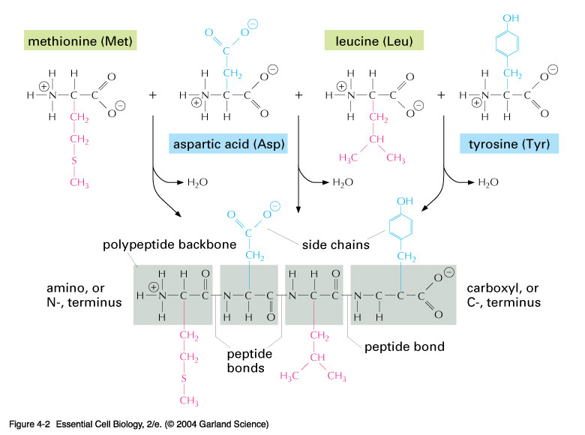
Each AA’ contributes three atoms to the polypeptide backbone. The side groups of adjacent AA’s protrude in an alternating manner
Notes:
04_02_polypeptide back.jpg

Slide 5
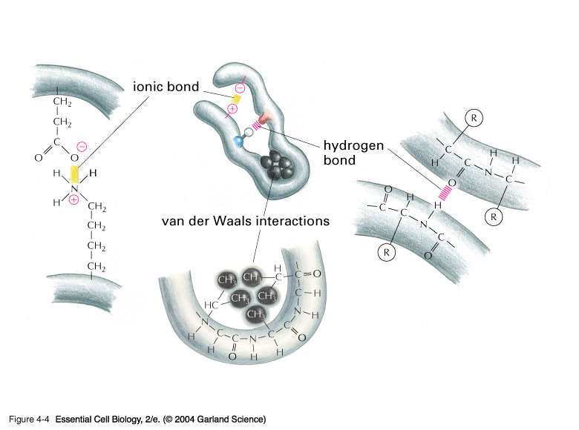
04_04_noncovalent.jpg
Non-covalent bonds within and between P’ chains are as important in their overall conformation and function
Ionic bonds
Hydrogen bonds
Van der Waals forces
Notes:
04_04_noncovalent.jpg

Slide 6
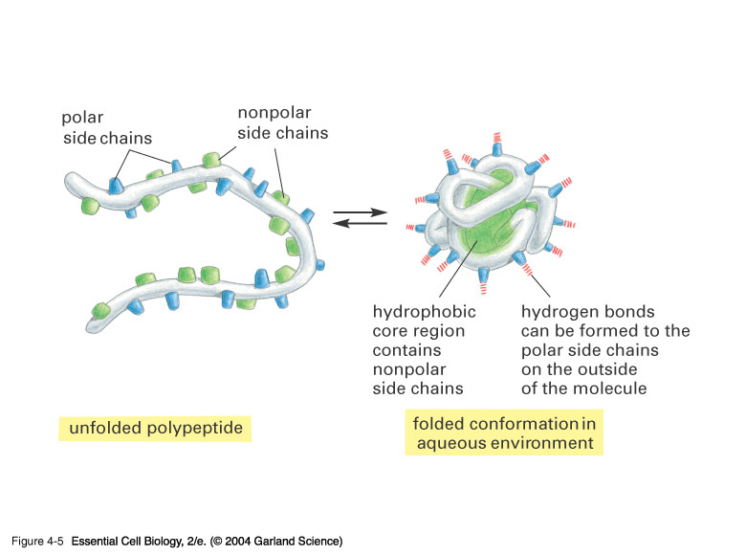
04_05_Hydrophobic.jpg
The side groups of the linear unfolded polypeptide are intermingled. Only when correctly folded do we see the wonder of Nature!
Notes:
04_05_Hydrophobic.jpg

Slide 7
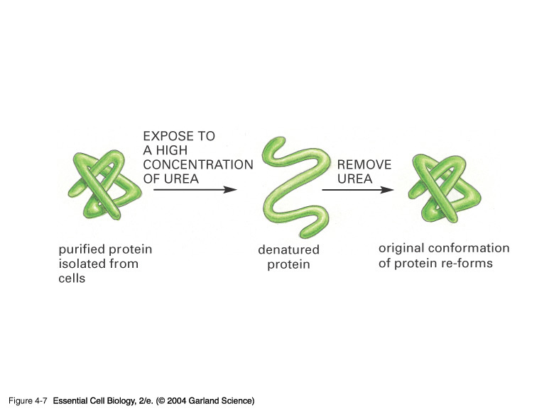
04_07_Denatured prot.jpg
The 3D folding of a P’ is governed solely by the sequence of the AA’s. Under some physiological conditions & in vitro many P’s can reversibly unfold and refold
Notes:
04_07_Denatured prot.jpg

Slide 8
Shapes & Sizes
There are more varieties of P’s in a cell than any other macromolecule
Filamentous & Globular
Large & Small

Slide 9
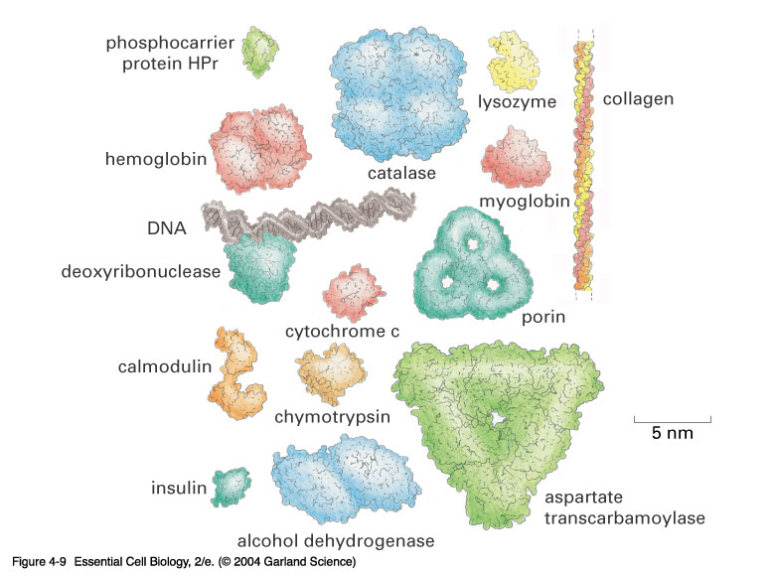
04_09_Proteins.jpg
Notes:
04_09_Proteins.jpg

Slide 10
Structural organization of proteins
Primary structure
Secondary structure
Tertiary structure
Quaternary structure
Native protein structure is essential for the biological function of a protein.
Loss of structure results in loss of biological function.

Slide 11
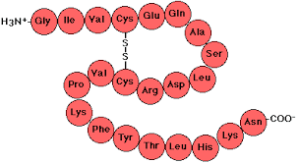
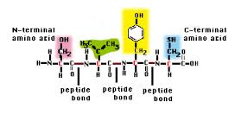
Primary structure
Definition:
The linear sequence of amino acids forming the backbone of a protein.
Peptides: di-, three-, tetra- peptides
Oligopeptides: up to 20 amino acids
Polypeptides: from 20 to 50 amino acids
Proteins: > 50 amino acids

Slide 12
2^{O} Structure
The 2^{O} Structure of P’s is defined as the localized folding of domains of the polypeptide chain
α-helices
β-sheets
β-barrels
coiled-coils

Slide 13
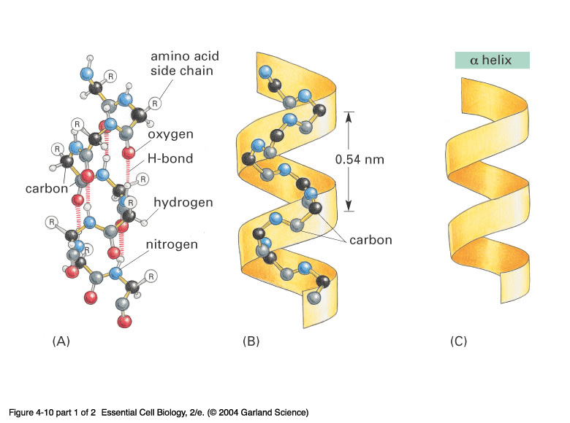
04_10_1_alpha h. beta s.jpg
Right-handed α-sheets
Notes:
04_10_1_alpha h. beta s.jpg

Slide 14
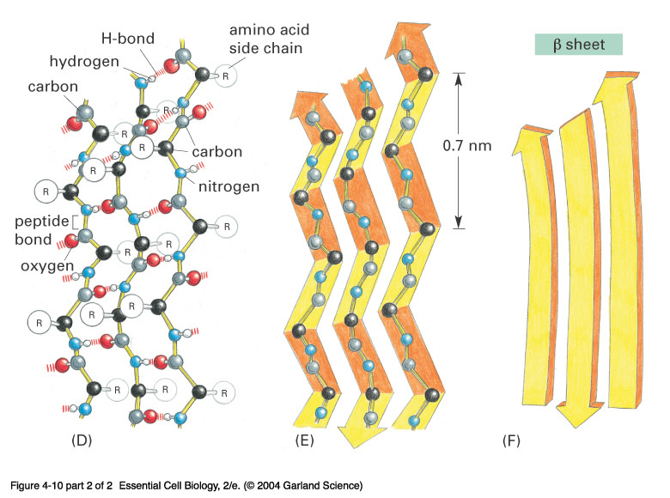
04_10_2_alpha h. beta s.jpg
Anti-parallel β-sheets
Notes:
04_10_2_alpha h. beta s.jpg

Slide 15
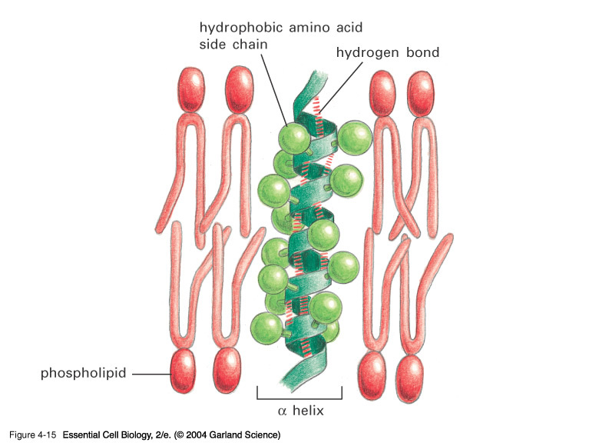
04_15_ahelix_lip_bilayer.jpg
The helix is fundamental in allowing P’s to sit within the plasma membrane
it is the foundation of many many very important P’s
Visual Pigments
Immune cell receptors
Notes:
04_15_ahelix_lip_bilayer.jpg

Slide 16
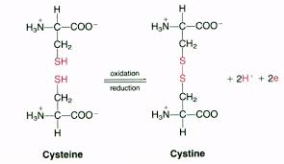
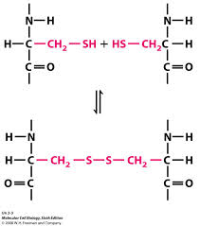
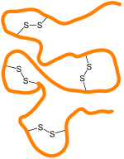
Covalent bond: Disulfide bond
Between two cysteine molecules
Between two cysteine R-groups of polypeptide chains

Slide 17
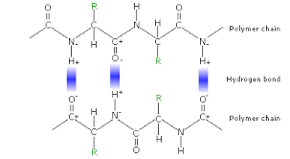
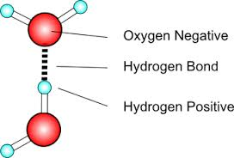
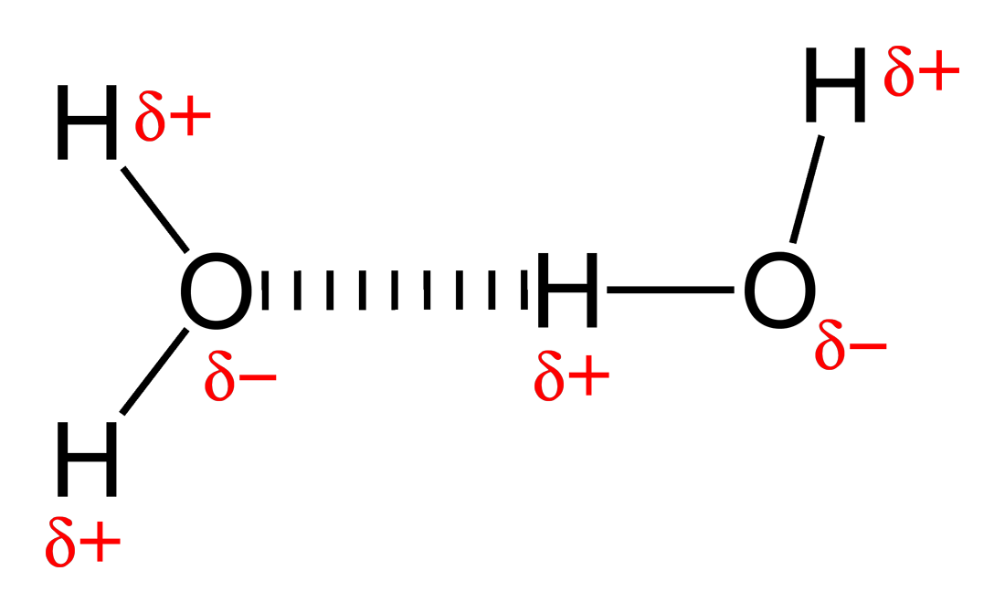
Non-covalent bonds: Hydrogen bond
Hydrogen bond
Hydrogen bond formation
А) between peptide bonds

Slide 18
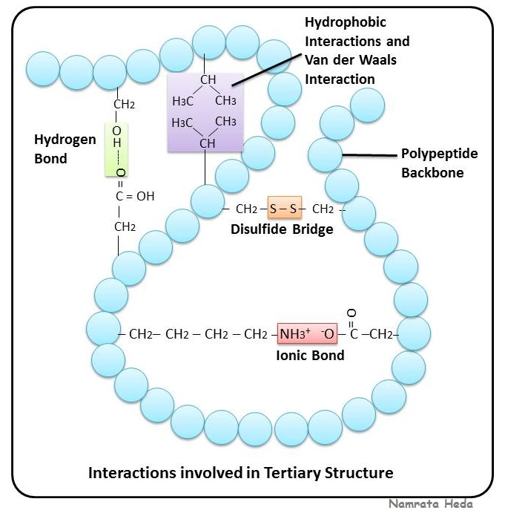
Protein bonds: Summary

Slide 19
Remember
Every polypeptide chain has a unique amino acid sequence determined by genes.
A single amino acid change in polypeptide chain may change or completely abolish protein function.
Primary structure determines the higher levels of protein organization.
Bonds in primary structure: Peptide bonds.

Slide 20
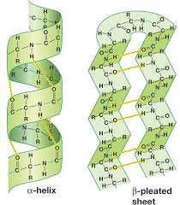
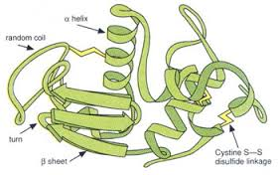
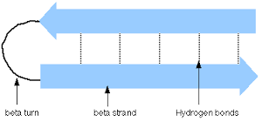
Secondary structures: Summary

Slide 21

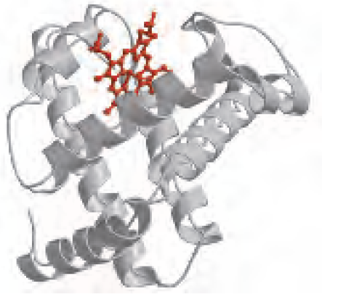
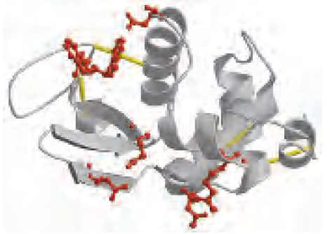
Spatial relationship of the different secondary structures
α – amylase inhibitor
myoglobin
lysozyme
Only β – sheets.
No α – spirals.
40% α – helix.
12% β – sheets.
75% α – helix.
No β – sheets.

Slide 22
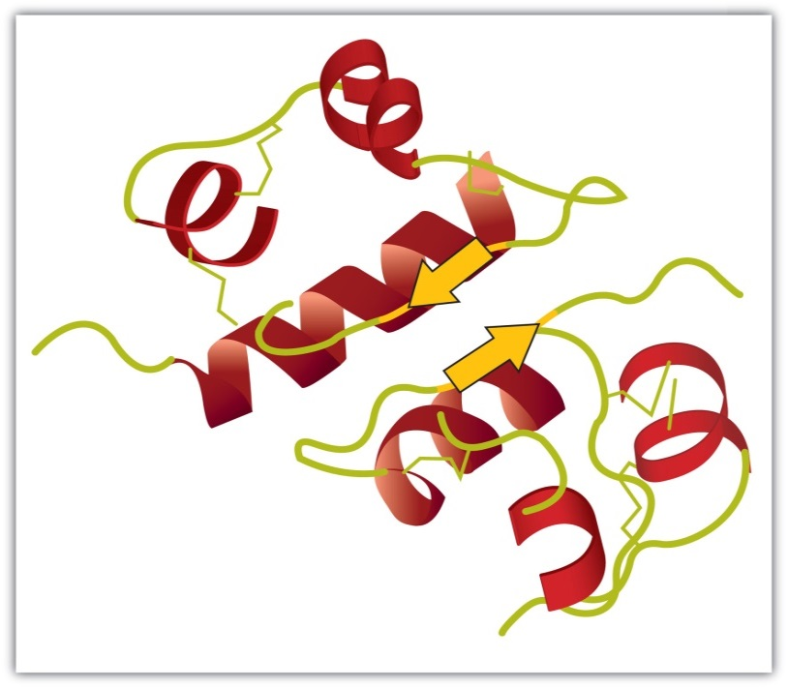
Tertiary structure
Complete three-dimensional shape of a given protein. Conformation.
Represent the spatial relationship of the different secondary structures to one another within a polypeptide chain and how these secondary structures themselves fold into the three-dimensional form of the protein.
The spiral regions represent sections of the polypeptide chain that have an α-helical structure, while the broad arrows represent β-pleated sheet structures.

Slide 23
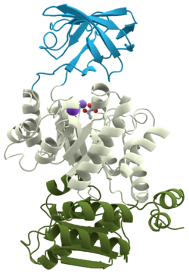
Tertiary structure: Describes the relationship of different domains to one another within a protein.
Protein domain
A domain is a basic structural unit within a protein molecule.
Part of protein that can fold into a stable structure independently.
Different domains can possess different functions.
Proteins can have one to many domains depending on protein size.
A polypeptide with 200 amino acids consists of two or more domains.
Domains are usually connected with relatively flexible areas of protein.
Pyruvate kinase (a monomeric protein):
three domains

Slide 24
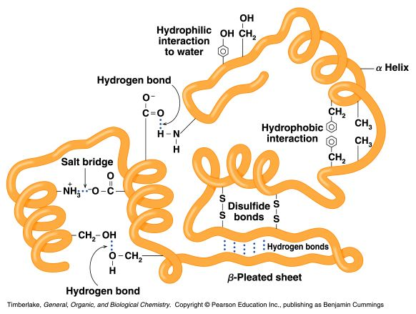
Tertiary structure is based on various types of interactions between the side-chains of the peptide chain.

Slide 25
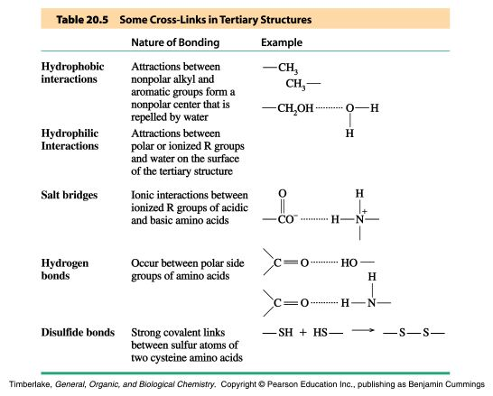
Stabilizing Interactions of Tertiary Structures

Slide 26
Globular Proteins
Globular proteins fold up into compact, spherical shapes.
Their functions are related to cell metabolism: biosynthesis and biodegradation, transport, catalytic function.
Hydrophobic R-groups are oriented into inner part of the protein molecule, while hydrophilic R-groups are pointed towards molecule edges.
Globular proteins are water soluble.

Slide 27
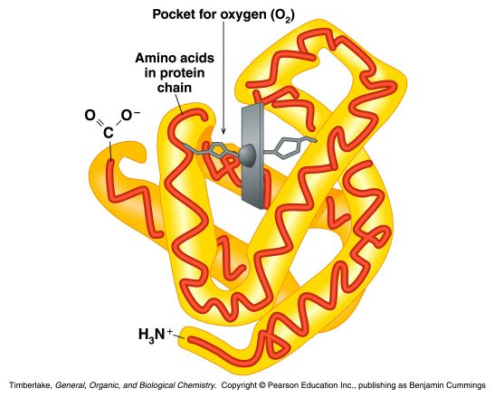
Example: myoglobin
Globular protein that stores oxygen in muscles
A single peptide chain that is mostly α-helix
O₂ binding pocket is formed by a heme group and specific amino acid side-chains that are brought into position by the tertiary structure

Slide 28
Fibrous proteins
Much or most of the polypeptide chain is parallel to a single axis
Fibrous proteins are often mechanically strong and highly cross-linked
Fibrous proteins are usually insoluble
Usually play a structural role

Slide 29
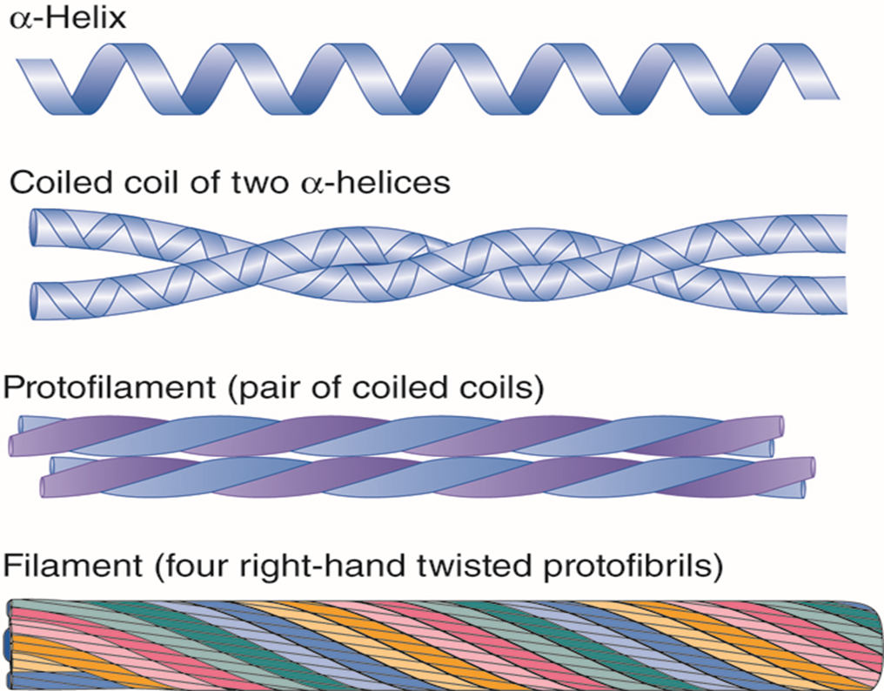
Fibrous Proteins: Keratins
For example, α-keratins are fibrous proteins that make hair, fur, nails and skin
- hair is made of twined fibrils
- the α-helices are held together by disulfide bonds

Slide 30
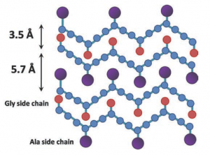
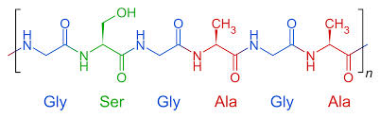
Fibrous proteins: Fibroin
Fibroin
Fibroins are the silk proteins. They also form the spider webs
Made with a β-sheet structures with Gly on one face and Ala/Ser on the other
Fibroins contain repeats of [Gly-Ala-Gly-Ala-Gly-Ser-Gly-Ala-Ala-Gly-(Ser-Gly-Ala-Gly-Ala-Gly)8]
The β-sheet structures stack on top of each other
Bulky regions with valine and tyrosine interrupt the β-sheet and allow the stretchiness

Slide 31
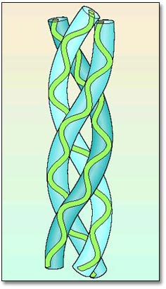
Fibrous proteins: Collagen is a Triple Helix
Collagen is formed from tropocollagen subunits. The triple helix in tropocollagen is highly extended and strong.
Features:
Three separate polypeptide chains arranged as a left-handed helix (note that an a-helix is right-handed).
3.3 residues per turn
Each chain forms hydrogen bonds with the other two: STRENGTH!
Nearly one residue out of three is Gly
Proline content is unusually high
Many modified amino acids present:
  4-hydroxyproline
  3-hydroxyproline
  5-hydroxylysine
Pro and HydroxyPro together make 30% of amino acids.
Collagen amino
acid composition:

Slide 32
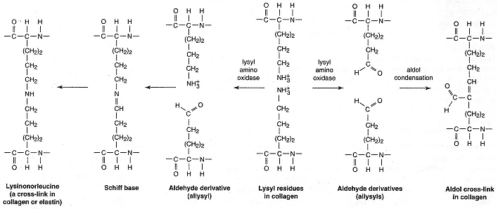
Covalent cross-links in collagen: alteration of mechanical properties of collagen
Catalyzed by lysyl amino oxidase

Slide 33
Globular proteins vs Fibrous proteins
1. Compact protein structure Extended protein structure
2. Soluble in water (or in lipid Insoluble in water (or in lipid bilayers) bilayers)
3. Secondary structure is а complex Secondary structure is simple
with a mixture of a-helix, b-sheet with predominant one type only
and loop structures
4. Quaternary structure is held Quaternary structure is usually together by noncovalent forces held together by covalent
bridges
5. Functions in all aspects of Structural function
metabolism (enzymes, transport, (tendons, bones, muscle, immune protection, hormones, etc). ligaments, hair, skin)

Slide 34
Quaternary structure of proteins
Monomeric proteins:
– built of a single polypeptide chain.
Oligomeric proteins:
– built of more than one polypeptide chains called subunits or monomers.

Slide 35
Quaternary structure describes the joining of two or more polypeptide subunits.
The subunits each have their own tertiary structure.
Bonds – non-covalent interactions.
Subunits can either function independently or work co-operatively.
Dissociation of a subunit results in loss of function.

Slide 36
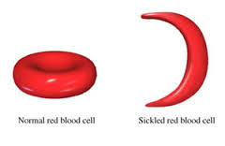
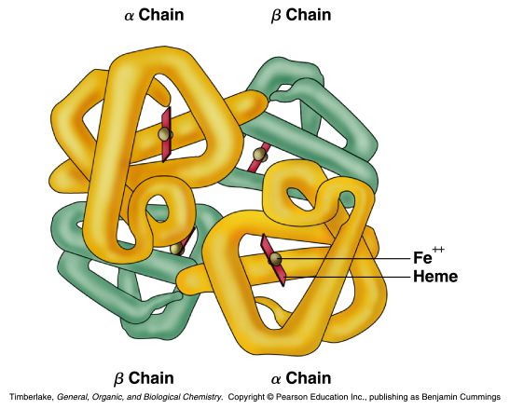
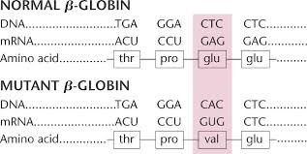
For example: Hemoglobin
A globular protein that consists of four subunits (2α and 2β, of two different types (α and β)
Each subunit contains a heme group for O₂ binding
Binding O₂ to one heme facilitates O₂ binding by other subunits
Replacement of even one amino acid in primary structure with another amino acid is critical for the function of the protein.

Slide 37
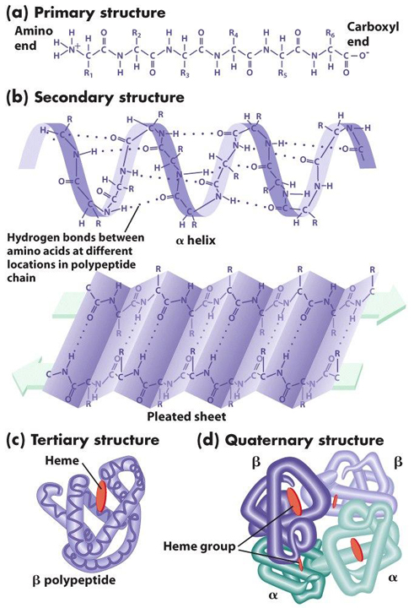
Structural organization of proteins: Summary

Slide 38
Functions of Protein
It is an integral part of the body. For example, it is present in skin, muscle, hair, blood, eyes, fingernails and bone. It is an essential part of each cell membrane (lipoprotein bilayer)
Protein act as an essential nutrient. Next to carbohydrate and fat, protein is the third source of energy.
Protein acts as hormone and regulates many body function. For example, Insulin, Oxytocin, Vasopressin etc.
Protein act as enzyme or biocatalyst to enhance biochemical reactions. Examples are Amylase, lipase and protease.
Protein functions as transporters to carry something from one place to another place of the body. Examples are, Hemoglobin, myoglobin.
Protein take part in defense system of the body. Examples are immunoglobulins (IGE, IGM, IGG etc.).
Protein plays a role as receptor or gate keeper on the cell membrane. Examples are rhodopsin and prostaglandin E2 receptor.

Slide 39


